Slide 1
UE22CS320A – Capstone Project Approval
PROJECT TITLE : AVIOS – Adaptive Vigilant Intelligent Operating System
PROJECT ID : Team 144
PROJECT GUIDE : Prof. Swetha Patil
PROJECT TEAM
Kurumeti Prajval ( PES2UG22CS274 )
Manoj Kumar KS ( PES2UG22CS302 )
Dhanushree K ( PES2UG22CS176 )
Nagaratna ( PES2UG22CS331 )

Slide 2
Outline
Problem Statement
Scope and Feasibility study
Applications/Use cases
Expected Deliverables
Capstone ( Phase - I ) Project Timeline
Any other information

Slide 3
Problem Statement
Artificial Intelligence Integrated with Operating System.
Our project aims to elevate user experience by leveraging intelligent automation, delivering personalized recommendations, and advancing system management for seamless and efficient performance.Automate routine tasks.
Adaptive Resource Management
Self Learning Environment
Self-Healing System ( Automated Fault detection and Recovery )
Assisted Security System

Slide 4
Why AI Integrated OS ?
FEATURE | EXISTING OS | AVIOS
Resource Management | Static Allocation | Dynamic Allocation
Assisted Security System | Have Fixed Rules and Virus Definitions. | Keeps it’s security up to date using system logs
Fault Detection and Recovery | Reactive Approach | Automated
Self Learning Environment | Require User to Optimize setting | Learns based on User Usage Pattern

Slide 5
Scope
Expected Outcome:
Develop an AI-driven OS with:
Enhanced user experience through intelligent automation.
Improved system management using predictive capabilities.
Personalized interface adjustments leveraging machine learning.
Core features to be included:
Smart Resource Management for efficient allocation.
Predictive Maintenance to prevent system failures.
Personalized Interface Adjustments based on user behavior.
Potential Expansion:
Post-Linux kernel stabilization:
Develop a custom kernel with deeper AI integration.
Aim for improved performance and better security.
Future capabilities may include:
Advanced Natural Language Processing for better user interaction.
Real-time Threat Detection for enhanced cybersecurity.
Integration with IoT devices for smart environments, targeting homes or enterprises.
Competitive Advantage:
Offers intelligent and adaptive interactions compared to traditional OSs.
Optimizes user tasks based on observed usage patterns .
Reduces resource waste and boosts user productivity.
Early adoption could provide a first-mover advantage in the growing market of AI-focused personalization and automation.

Slide 6
Feasibility study
Technical Feasibility: The Linux kernel provides a reliable, open-source base with strong community support and AI integration potential. Challenges include optimizing AI for various hardware and ensuring compatibility with different applications and devices. Open-source AI frameworks like TensorFlow or PyTorch could simplify development.
Data Availability: Pre-Existing Large Datasets ( by Google ) and User data for Real-Time Training ( system logs ).
Economic Feasibility: Initial costs cover development, data acquisition, and testing. Open-source tools reduce expenses.
Operational Feasibility: Familiar with Linux System, Machine Learning, Deep Learning, C Programming, Python Programming.
Risk Assessment:
Technical risks: Ensuring compatibility with diverse hardware and applications will be challenging, especially for deep learning.
Privacy concerns: Data usage must be transparent and GDPR-compliant to avoid legal issues and maintain trust.
Market acceptance: Users may hesitate to switch OSs, so focus on intuitive design and user education is essential.
Market Potential: Rising AI adoption offers strong potential in personal computing, IoT, and enterprise markets. Early adopters and tech enthusiasts could build advocacy, expanding reach as AI features become more normalized.

Slide 7
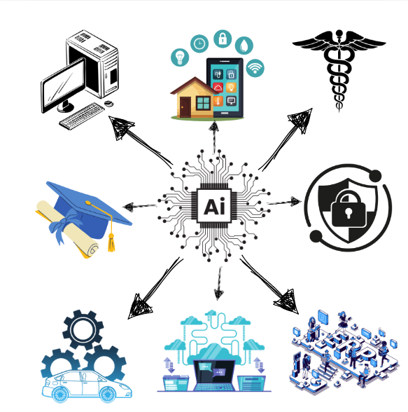
Applications/Use cases
Personal Computers: Learns user habits and automates task based on that.
Education: Customizes learning materials and offers intelligent tutoring based on student progress.
Healthcare: Monitors patient data in real-time to detect health issues and recommend personalized treatments.
Smart Home Applications: Automates lighting, heating, and security by learning user preferences and behaviors.
Cloud Computing: Optimizes resource allocation and performance through AI-driven load balancing and cost management.
Security Services: Continuously monitors system behavior to detect anomalies and enhance cybersecurity.
Enterprise Systems: Predicts hardware failures and automates data analysis for decision-making support.
( “Design created with Canva” )

Slide 8
Expected Deliverables
Capstone Phase-1 ( Semester 5 ): Deliverables: Background Study, Formulation the problem statement, Literature Survey
Capstone Phase-2 ( Semester 6 ): Deliverables: High Level Design, Part of Implementation.
Capstone Phase-3 ( Semester 7 ): Deliverables: Low level Design and Complete Implementation, Draft version of the paper for publishing.
Capstone Phase-4 ( Semester 8 ): Deliverables: Paper Publication in Scopus indexed journals/ Web of Science/ UGC Journal etc..

Slide 9
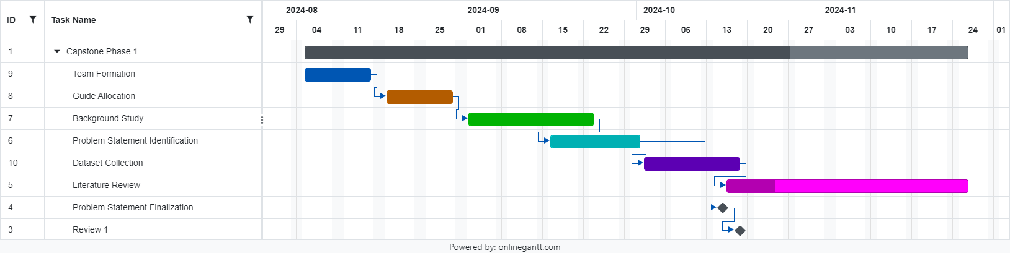
Capstone ( Phase – I ) Project Timeline
Gantt Chart for Phase 1

Slide 10
Capstone ( Phase - I ) Project Timeline
Timeline ( August 2024 to December 2024 )
Background Study (3 weeks )
Effort : All Team members conduct their respective research, find relevant tools to be used, Expertise of each member, Feasibility Study, Scope and Future market Launch Analysis
Team Involvement : All members are involved
Problem Statement Formation ( 1 week )
Effort : Form the Problem Statement and review with guide
Team Involvement : Everyone comes up with Problem Statement and go for a Poll to Choose a good one.
Literature Survey ( 4 week )
Effort : Analyse papers based on AI, ML, Security, Operating System
Team Involvement : Split the content between 4 people and come up with there survey
Dataset and Finalization of Phase 1 ( 2 week )
Effort : Prepare Deliverables ( Kaggle Datasets, Literature review ) for Submission.
Team Involvement : All members collective contribution

Slide 11
References
“Design of High-Confidence Embedded Operating System based on Artificial Intelligence and Smart Chips”, 2022, Qinmin Ma – LINK
“Design of Equipment Automation Control and Remote Supervision System Based on Artificial Intelligence Algorithm”, 2024, Xiaoge Li - LINK
“Artificial Intelligence Techniques for Power System Stabilization”, 2022, Ndukwe Okpo Kalu ;Oluseun Oyeleke ; Sadiq Thomas ; Omotayo O ; Oshiga – LINK
“Research on Vulnerability Detection System of Instant Communication Network Based on Artificial Intelligence”, 2024, Haiming Zhang – LINK
“Artificially Intelligent Operating System with Sapi5 Voice Recognition Engine”, 2023, S .Sumathi, N.Nivetha ,J Princy Jovita - LINK
“Artificial immune system for Android OS”, 2015, Sergei Bezobrazov , Anatoly Sachenko , M yroslav Komar ,Vladimir Rubanau – LINK
“Dynamic analysis of malware using artificial neural networks: Applying machine learning to identify malicious behavior based on parent process hierarchy.”, 2017, Cristian Pascariu ,Ionut – Daniel Barbu - LINK
“Investigation on Power System Dynamic Monitoring System Using Artificial Neural Networks”, 2023, ShiJie;Zhang yanxia ; Yu Linin ; Zhuo Zhao – LINK
“Cyber-Attacks Risk Mitigation on Power System via Artificial Intelligence Technique”, 2022, Saraa Ismaeel Khalel ;Shaker M ; Khudher - LINK

Slide 12
Thank You

