Slide 1

ASSIGNMENT 1
AUTOMATIC LENS SMEAR DETECTION
Gandhali Khedlekar (A20435493)
Rohit Lakde (A20434998)
Kalpana Pratapaneni (A20448916)

Slide 2
INPUT A sequence of Street View Images
OUTPUT A mask of the smear on the lens

Slide 3
INTRODUCTION
Dirt on camera lenses and occlusions from objects are the artifacts in digital imaging systems
Finding out which image has smear is difficult. Following are the examples of such images
Image taken from street view when camera has dust
Thin occluders while capturing images
Preprocessing images is necessary in order to remove the smear on the images

Slide 4
APPROACH
GRAY-SCALING
Colors of the image are converted from BGR to Grayscale
Noise in the image is removed using Gaussian filter
IMAGE AVERAGING
Image color is normalized
The average value of images is stored
If the image contains smear, it is detected

Slide 5
ADAPTIVE THRESHOLDING
Normalized image obtained in the previous step is
used as an input to this process
Adaptive threshold is calculated by combining the
individual thresholds of different parts of the image
MASKING
Mask is created by calculating threshold and smear
is depicted with black color

Slide 6
FLOWCHART
Following are the steps involved in the approach
GRAY - SCALING
IMAGE - AVERAGING
ADAPTIVE THRESHOLDING
MASKING

Slide 7
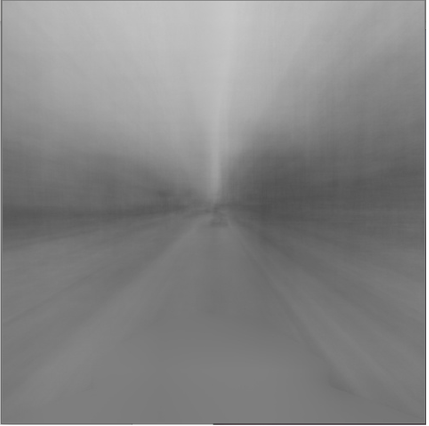
GRAY - SCALING
Fig 1. Image obtained after gray - scaling

Slide 8
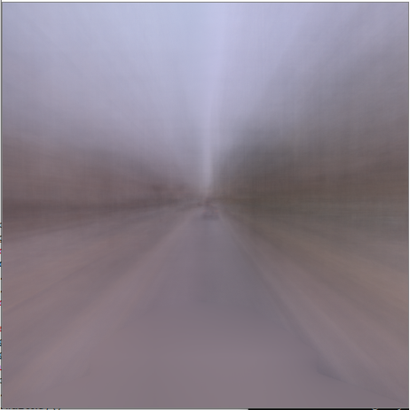
IMAGE - AVERAGING
Fig 2. Image obtained after image - averaging

Slide 9
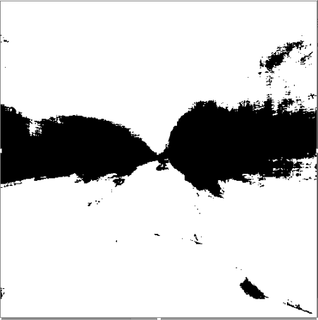
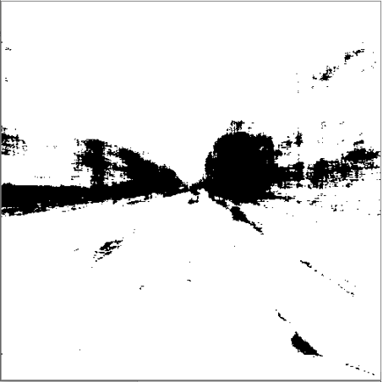
ADAPTIVE THRESHOLDING
Fig 3. Image obtained after adaptive threshold average
Fig 4. Image obtained after adaptive threshold Gaussian

Slide 10
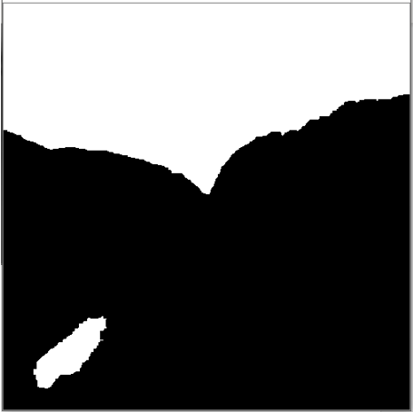
MASKING
Fig 5. Image obtained after masking

Slide 11
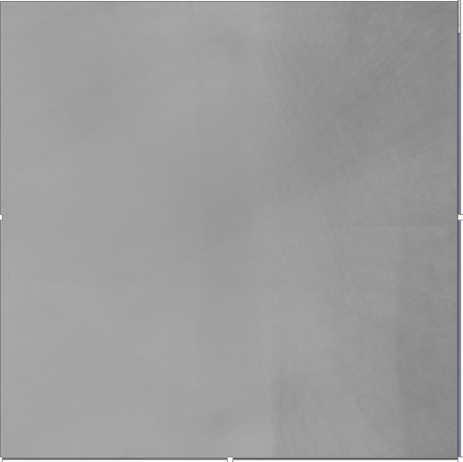
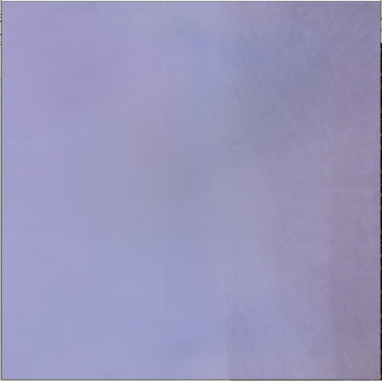
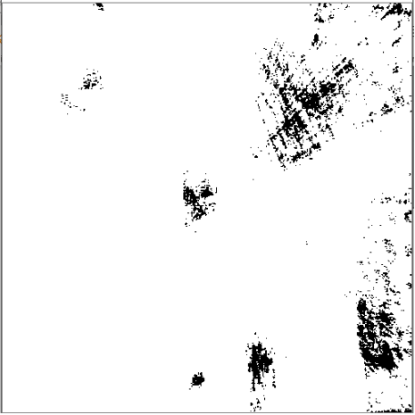
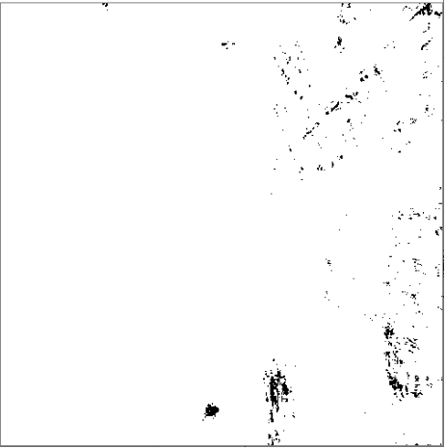
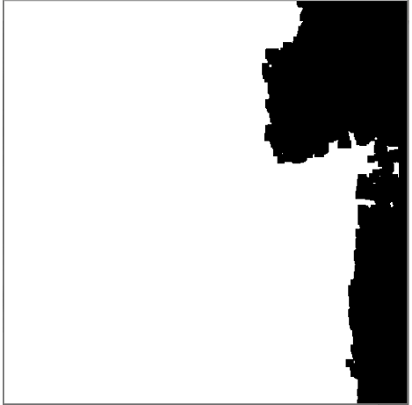
Output for images from camera 5
Gray Scaling
Image Averaging
Adaptive Threshold Average
Adaptive Threshold Gaussian
Masking

Slide 12
CONCLUSION
In special cases like thin and transparent smears, algorithm may not detect the smears
Detected smears that are visible on images
Capable of detecting a smear that was acquired in the middle of the ride

Slide 13
THANK YOU!

