Slide 1

OBJECT DETECTION IN POINT
CLOUD - POLE
Gandhali Khedlekar (A20435493)
Rohit Lakde (A20434998)
Kalpana Pratapaneni (A20448916)

Slide 2
INPUT final_project_point_cloud.fuse
OUTPUT Poles detected as straight
line segments

Slide 3
INTRODUCTION
Point Cloud - Also represented as set of data points in space is used to measure points on external surfaces of objects
Point clouds are used for various purposes such as creation of 3D CAD models, visualization, animation, metrology and related applications
Four types of objects are : road surface, support facility, uncorrelated object and moving object

Slide 4
Object detection is popular in HD map and sensor - based autonomous driving
Pole detection algorithm is used for better understanding of roads, to improve accident-avoidance strategies, to manage natural and man-made disasters effectively, to develop mishap detection applications and many more
By detection of poles, maps can be created with improved accuracy and be beneficial to mankind

Slide 5
FLOWCHART
Following are the steps involved in the approach
CONVERSION
ISOLATION
FILTERING
DETECTION
SEGMENTATION

Slide 6
APPROACH
CONVERSION
Input file is read and each point is converted into as x,y,z coordinates which represent latitude, longitude and altitude respectively using cartesian method and stored in Original Point Cloud.obj

Slide 7
ISOLATION
In this sub process, the outliers in the Original Point Cloud.obj are removed and noise is reduced
K-nearest neighbor method is used and average distance, mean and standard deviation is calculated
Points which deviate from mean distance with a distance greater than 5 standard deviations are removed

Slide 8
FILTERING
After noise removal, kD-Tree is built on the data
Closest distance and squared distances are found for each point
A particular distance is considered as a threshold value and points whose distance is less than the threshold value are removed
Thus, large components such as buildings are filtered

Slide 9
SEGMENTATION
In this sub process, small objects are detected
Connected components with an area less than the threshold value are extracted
Points excluding the cylindrical objects are extracted and removed

Slide 10
DETECTION
This is the final sub process of the approach
Points which are near to ground are detected and removed
Segments which are isolated are detected and rest of the points are filtered out
Thus, poles are detected which are represented as line segments

Slide 11
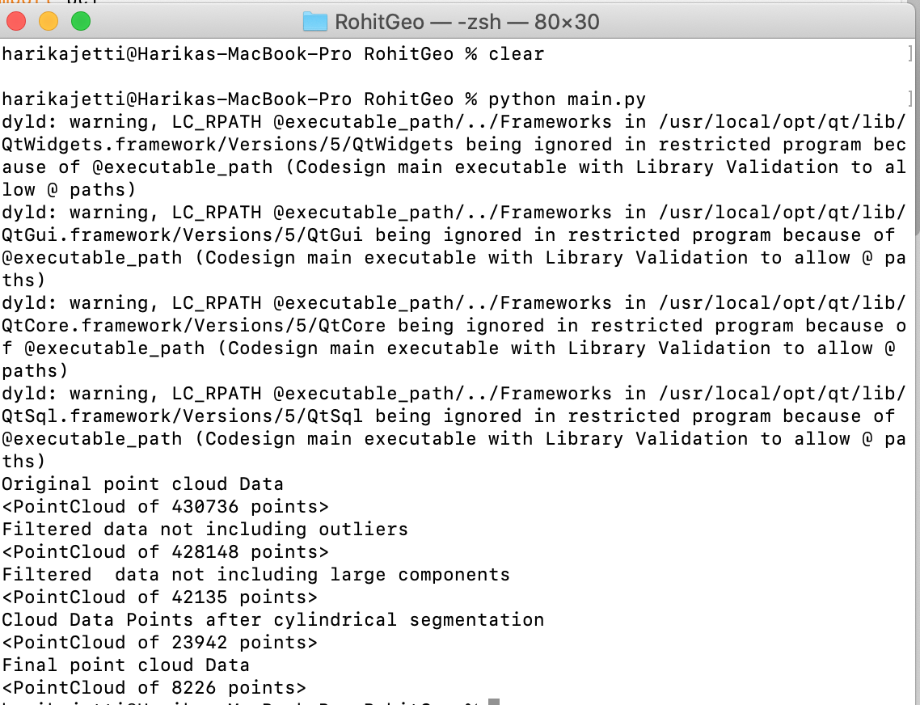
OUTPUT
Image 1. Code Run

Slide 12
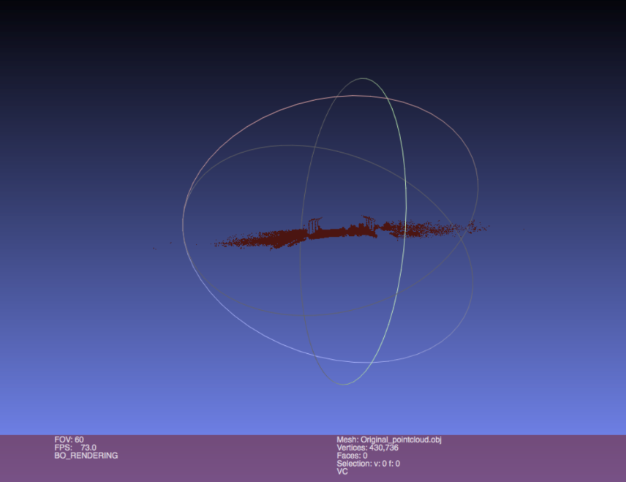
Image 2. Original Image

Slide 13
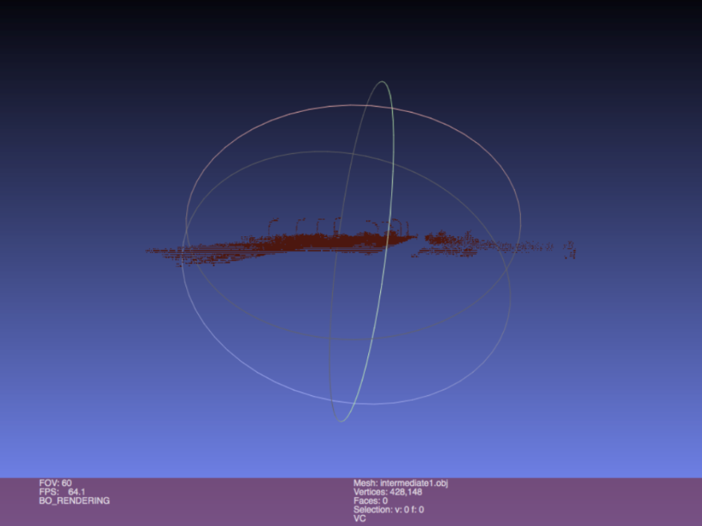
Image 3. Intermediate output

Slide 14
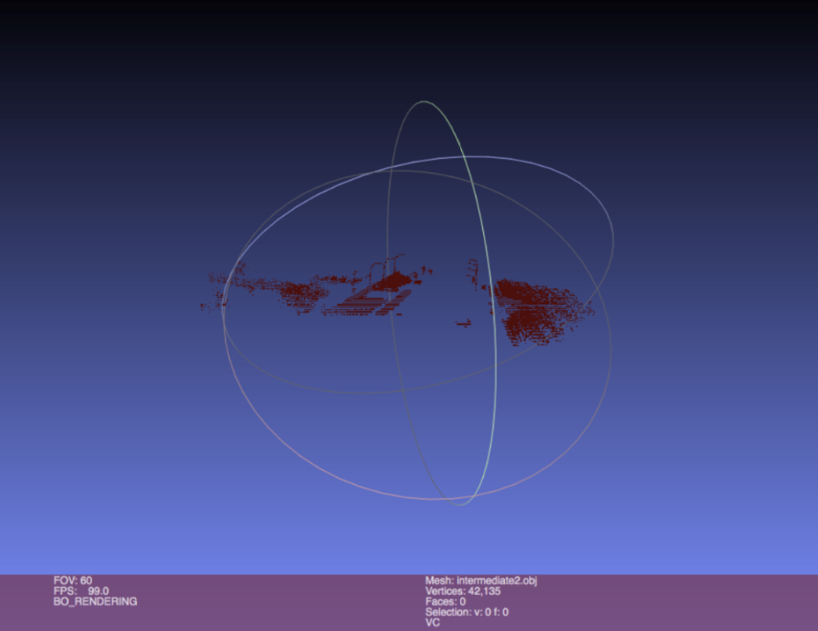
Image 4. Intermediate Output

Slide 15
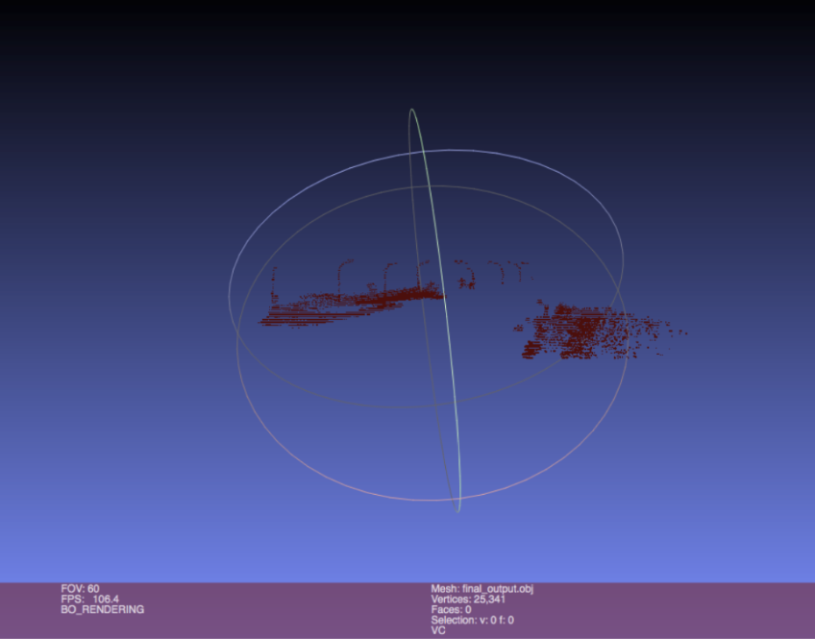
Image 5. Final Output

Slide 16
CONCLUSION
Data file is read and each point is converted into coordinates as x,y,z which represent latitude, longitude and altitude respectively using cartesian logic
Poles detected are represented through line segments
The primary objective to develop a pole detection algorithm is achieved

Slide 17
THANK YOU!

