Slide 1
Satellite/Aerial Image Retrieval
Done by:
1) Abhishek Krishna Vandadi (A20426749)
2) Nital Milind Bansode (A20427196)
3) Karthik Mahesh (A20383027)
4) Amitdeb Prasad Bhattacharya (A20402789)

Slide 2
Aim:
Write a program using Bing maps tile system to automatically download aerial imagery (maximum resolution available) given a lat/lon bounding box
Input: lat1, lon1, lat2, lon2
Output: An aerial imagery as an output for the given lat/lon points.

Slide 3
Understanding of the problem:
Our aim is to design a program which gives us an aerial image as output with best possible resolution when given latitude and longitude of two images as input.

Slide 4
Approach
The latitude/longitude points are converted into pixels.
Pixels are used to get tile1 and tile2 for given Geo Points.
Values of tiles for given geo points used as starting and ending tile. Using those tile tuples intermediate tile1 and tile2 values are calculated.
Quadkeys are calculated from tile1 and tile2.
Using the quadkeys, the tile images are downloaded.
All tiles are joined to get the final output image.

Slide 5
Output
Points covering Illinois Institute of Technology
Lat1: 41.834734
Lon1: -87.623386
Lat2: 41.839363
Lon2: -87.629659

Slide 6
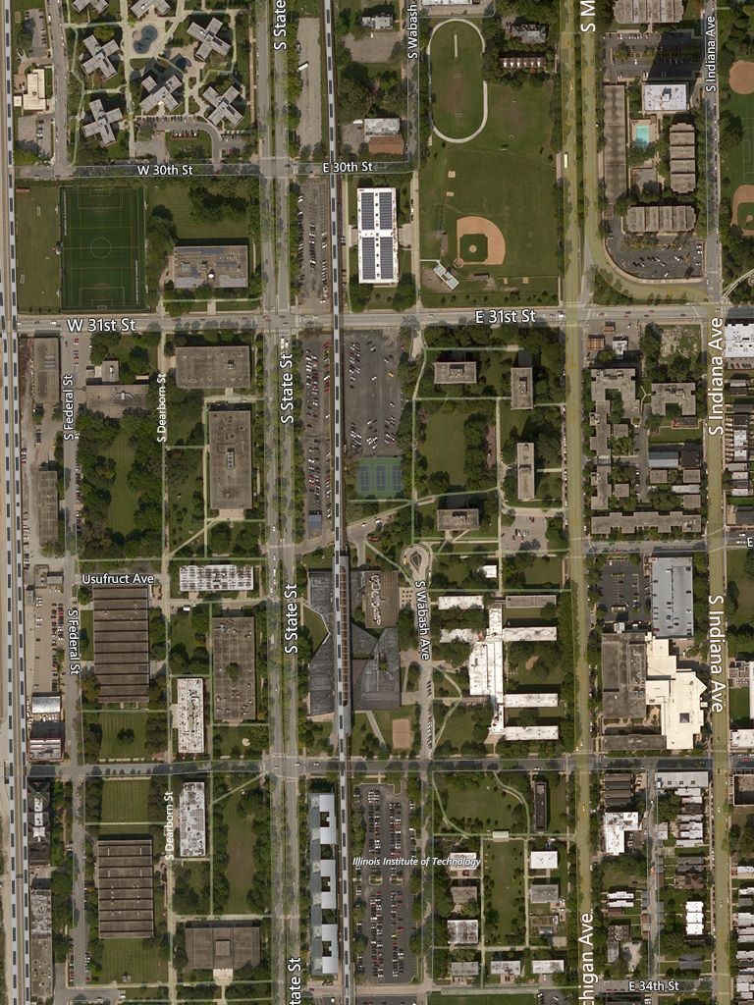
Final Output

Slide 7
Thank you!

