Slide 1
Open Items

Slide 2
Discussion Topics
Right Click Options: (Kelsey’s opinion) Should be avoided on webpages. This capability is unusual and not expected in web applications and therefore not obvious to the user.

Slide 3
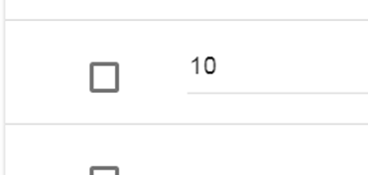




Insert Below Options

