Slide 1
Open Issues Doc

Slide 2
Discussion Topics
Right Click Options: Should avoid on webpages. This capability is unusual and not expected and therefore not obvious to the user.

Slide 3
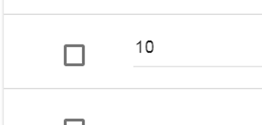




Insert Below Options

