Slide 1

Hybrid Neural Networks
Comparison quantum and classical NN on classification task
https://github.com/kprokofi/Quantum-Machine-Learning

Slide 2
Task Description
Binary classification: Autism recognition
  The task is to recognized autism by the given photo of a child
Convolution NN as a baseline including few ResNet blocks and fully connected layers
Hybrid NN will include classical one + quantum decision head (last layer)

Slide 3
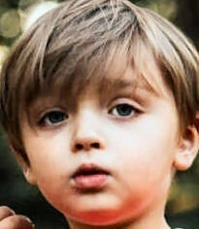
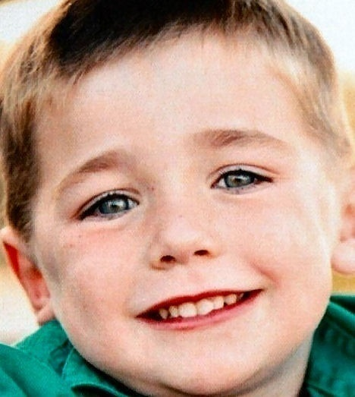
Dataset description
Train: 2538 images
Test: 200 images
2 classes

Slide 4
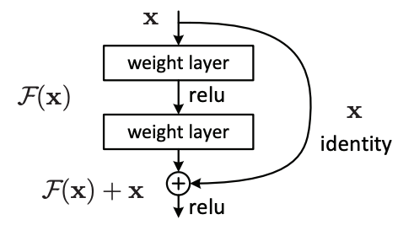
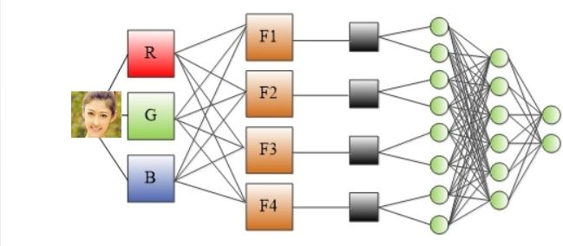
Classical Convolution Network Architecture
Resize to 224x224
Basic augmentations
2 ResNet blocks with stride = 2
MLP Network

Slide 5
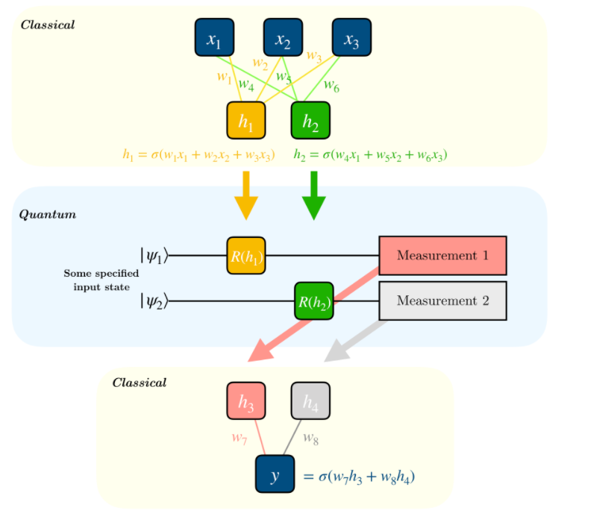
Quantum Layer

Slide 6
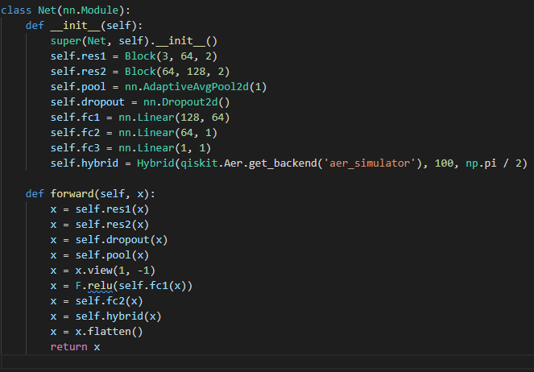
Hybrid Neural Network

Slide 7
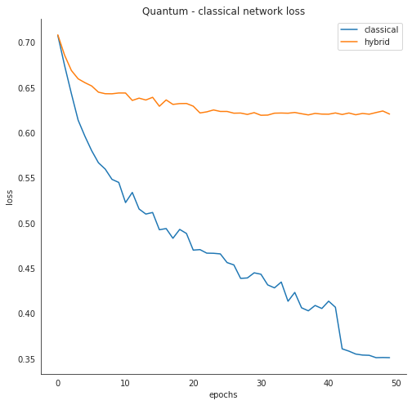
Experiments
Best recipe:
  Optimizer: SGD
  LR Scheduler: Reduce on plateau
  BCE loss
  50 epochs
Accuracy:
  Classical NN: 71.78 %
  Hybrid: 54.53 %

Slide 8
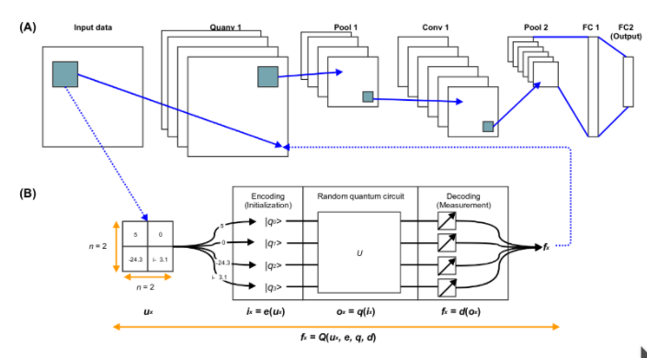
Quanvolutional Neural Networks [Henderson M. et.al., 2019]

Slide 9
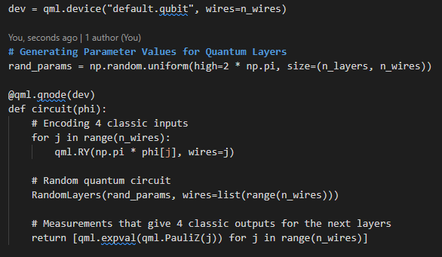
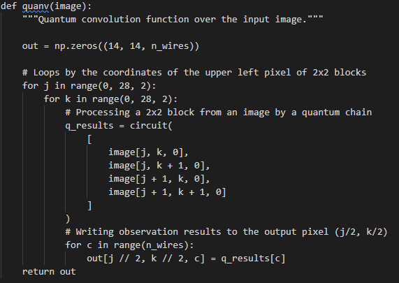
Implementing Quantum Convolution

Slide 10
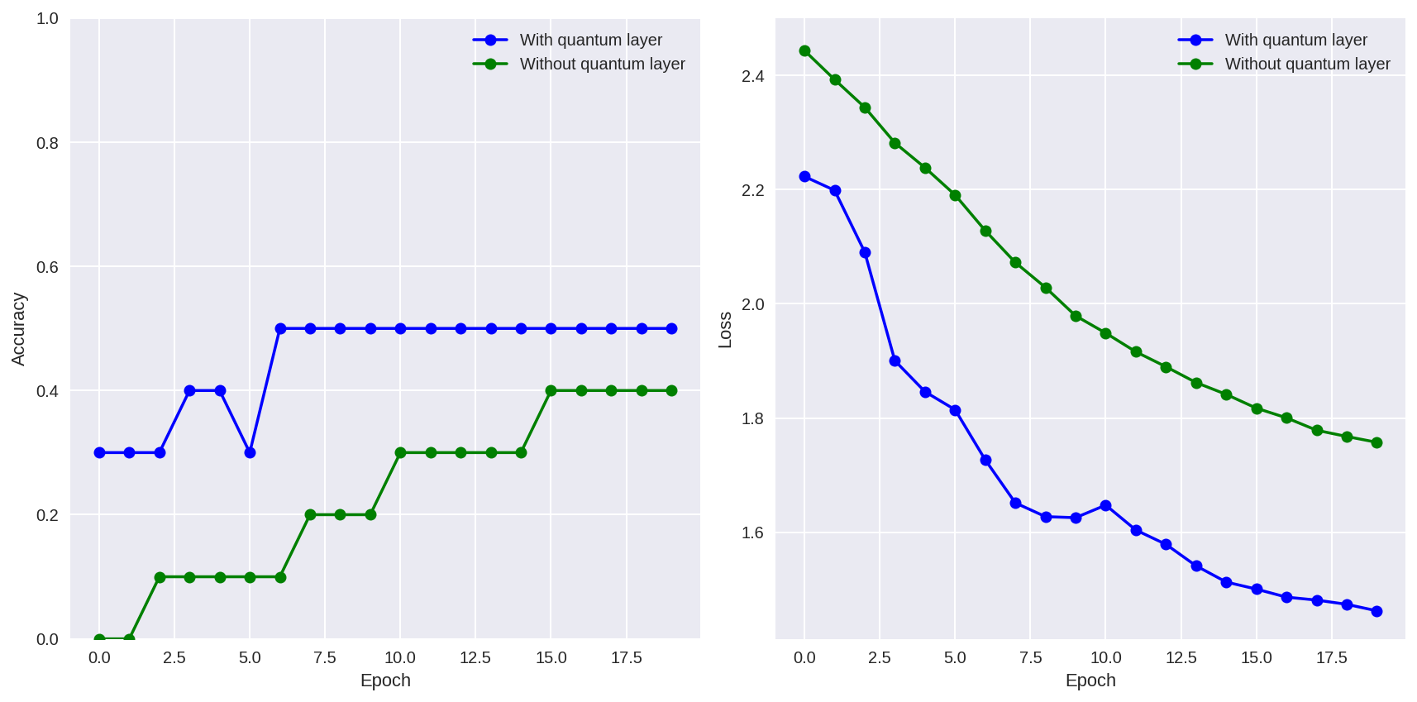
Experiments. Results

