Slide 1
Microsoft Fabric Cross-Tenant Access
Architecture assessment for Epic/Cogito as resource-tenant provider
Fabric
Cross-Tenant
Epic/Cogito
Entra B2B
1

Slide 2
Executive Conclusion
EXECUTIVE SUMMARY
Technically Feasible
Operationally Unverified
Resource-tenant model fully documented by Microsoft
Works for lakehouses, warehouses, notebooks
B2B invitation and cross-tenant access policies supported
Confirmed by official docs and community guidance
Epic has not published tenant-level Fabric settings
No public confirmation of B2B guest access enablement
Cogito described as managed analytics service
Identity requirements and CTAP status unknown
Recommendation: Engage Epic account management to confirm Fabric workspace access, B2B settings, and identity requirements
Architecture Assessment | Cross-Tenant Fabric Access | Epic/Cogito
2
Notes:
The cross-tenant resource-tenant model is fully documented by Microsoft and works for lakehouses, warehouses, notebooks, and other Fabric items. However, Epic has not publicly confirmed whether Cogito exposes a Fabric workspace or whether B2B guest access is enabled in their tenant. Next step: engage Epic account management with the six questions listed in slide 9.
Sources:
- [1] Microsoft Learn, Collaborate with external users in Fabric (preview) https://learn.microsoft.com/en-us/fabric/security/security-external-data-sharing-overview
- [2] Microsoft Fabric Community, Cross-Tenant Access in Microsoft Fabric https://community.fabric.microsoft.com/t5/Service/Cross-Tenant-Access-in-Microsoft-Fabric/m-p/3546108

Slide 3
Microsoft Fabric Cross-Tenant Architecture
MICROSOFT ARCHITECTURE
Resource Tenant
Home Tenant
Provider tenant owns Fabric capacity, workspace, and data items
Consumer tenant holds user identity; user travels to provider
B2B Invitation
Cross-Tenant Policies
Entra B2B bridges identities across tenants via guest objects
CTAP controls inbound/outbound access per tenant or as default
Architecture Assessment | Cross-Tenant Fabric Access | Epic/Cogito
3
Notes:
Microsoft Fabric uses a resource-tenant model where the provider tenant owns the Fabric capacity and grants access to external identities from a consumer (home) tenant. Both sides have independent admin controls. The provider controls which external identities may access Fabric items; the consumer controls whether its users may accept invitations.
Sources:
- [1] Microsoft Learn, Collaborate with external users in Fabric (preview) https://learn.microsoft.com/en-us/fabric/security/security-external-data-sharing-overview
- [2] Microsoft Fabric Community, Cross-Tenant Access in Microsoft Fabric https://community.fabric.microsoft.com/t5/Service/Cross-Tenant-Access-in-Microsoft-Fabric/m-p/3546108

Slide 4
Resource-Tenant Model in Detail
Resource Tenant (Provider)
Home Tenant (Consumer)
Owns Fabric capacity and compute
Holds user primary identity
Hosts workspace and data items
User travels to provider tenant
VS
Controls external identity access
Controls outbound invitation acceptance
Issues B2B invitations
Configures cross-tenant access policies
Absorbs compute cost and licensing
Appears as guest in provider Entra ID
Architecture Assessment | Cross-Tenant Fabric Access | Epic/Cogito
4
Notes:
The resource-tenant model creates a bilateral administrative structure. The provider tenant administrator decides which external identities can access Fabric items. The consumer tenant administrator decides whether its users can accept external invitations. Both sides must enable access for cross-tenant collaboration to work.
Sources:
- [1] Microsoft Learn, Collaborate with external users in Fabric (preview) https://learn.microsoft.com/en-us/fabric/security/security-external-data-sharing-overview

Slide 5
Tenant Terminology
MICROSOFT ARCHITECTURE
Term | Also Known As | Role
Resource Tenant | Provider Tenant | Owns Fabric capacity, workspace, and data assets; grants access to external identities
Home Tenant | Consumer Tenant | Tenant where user's primary identity is registered; user travels to resource tenant
Key Distinction
The resource tenant controls the data and compute. The home tenant controls the identity.
Both administrators must independently enable cross-tenant access for collaboration to function.
Architecture Assessment | Cross-Tenant Fabric Access | Epic/Cogito
5
Notes:
Consistent terminology is critical for cross-team communication. The resource tenant (also called the provider tenant) owns all Fabric assets. The home tenant (also called the consumer tenant) is where the user's identity is registered. The user 'travels' to the resource tenant to access shared items.
Sources:
- [1] Microsoft Learn, Collaborate with external users in Fabric (preview) https://learn.microsoft.com/en-us/fabric/security/security-external-data-sharing-overview

Slide 6
Supported Identity Model
IDENTITY MODEL
Entra ID (Work)
Microsoft Account
Email OTP
Most common enterprise path
Work/school accounts backed by Entra ID
Full organizational identity governance
Recommended for B2B scenarios
Personal Microsoft accounts
Consumer-grade identity
Less common in enterprise
Suitable for individual access
One-time passcode via email
No Microsoft account required
Fallback for external users
Lowest friction onboarding
Guest users appear in the provider tenant's Entra ID directory with Fabric RBAC and item-level permissions applied
Architecture Assessment | Cross-Tenant Fabric Access | Epic/Cogito
6
Notes:
Cross-tenant access relies on Microsoft Entra B2B (business-to-business). Three identity types are supported. The consumer-side user appears as a guest in the provider tenant's Entra ID directory. Fabric then applies its own role-based and item-level permissions on top of the Entra identity.
Sources:
- [1] Microsoft Learn, Collaborate with external users in Fabric (preview) https://learn.microsoft.com/en-us/fabric/security/security-external-data-sharing-overview
- [3] Microsoft Learn, Entra B2B overview https://learn.microsoft.com/en-us/entra/external-id/what-is-b2b

Slide 7
Required Fabric Settings & Licensing
CONFIGURATION
Setting | Location | Purpose
Guest invitation | Entra ID > External Identities | Allows provider to issue B2B invitations
Guest access to Fabric | Fabric Admin Portal > Tenant Settings | Enables guest interaction with Fabric items
Guest edit/manage | Fabric Admin Portal > Tenant Settings | Grants guests create/modify permissions
Cross-Tenant Access Policies | Entra ID > Cross-tenant settings | Defines allowed tenants and applications
Licensing Rule
Guest users need a Fabric licence in the resource tenant, not the home tenant.
The provider tenant's Fabric capacity absorbs all compute cost.
Architecture Assessment | Cross-Tenant Fabric Access | Epic/Cogito
7
Notes:
Four settings in the provider tenant must be correctly configured for cross-tenant access to work. Additionally, guest users need a Fabric licence allocated in the resource (provider) tenant, not the home tenant. The provider tenant's Fabric capacity absorbs the compute cost.
Sources:
- [1] Microsoft Learn, Collaborate with external users in Fabric (preview) https://learn.microsoft.com/en-us/fabric/security/security-external-data-sharing-overview
- [2] Microsoft Fabric Community, Cross-Tenant Access in Microsoft Fabric https://community.fabric.microsoft.com/t5/Service/Cross-Tenant-Access-in-Microsoft-Fabric/m-p/3546108

Slide 8
What Is Confirmed
EPIC/COGITO VALIDATION
Epic/Cogito Validation Findings
Fabric Workspace Exposure
Guest Access Settings
Unknown if Epic exposes workspace/lakehouse directly to customers
No confirmation of Fabric guest-access tenant settings in Epic's Entra ID
Epic partnership with Microsoft confirmed. Fabric adoption for Cogito analytics workloads validated via public announcements.
Identity Model
CTAP Configuration
Which identity type Epic supports for external access is not published
Unknown if customer must configure cross-tenant access policies independently
8
Notes:
Epic Cogito is Epic's analytics and reporting platform. Recent partnership announcements with Microsoft confirm Epic is adopting Fabric as an underlying technology. If Epic provisions a Fabric workspace inside their Entra ID tenant, they become the resource (provider) tenant. However, four critical operational details remain publicly unconfirmed.

Slide 9
Required Epic Confirmation Questions
EPIC/COGITO VALIDATION
Direct these questions to Epic account management
1
Fabric Workspace Access
Does Cogito include direct access to a Fabric workspace, lakehouse, or warehouse in Epic's tenant?
2
Guest Access Enabled
Has Epic enabled 'Allow Azure AD guest users to access Microsoft Fabric' in their admin portal?
3
Identity Requirements
What identity type is required? Entra ID B2B guest, Microsoft Account, or email OTP?
4
Invitation Mechanism
Does Epic issue B2B invitations, or must the customer configure CTAP independently?
5
Permission Level
What Fabric item-level permissions are granted to guest users? Viewer, Contributor, Member, or Admin?
6
Licensing Allocation
Is a Fabric licence allocated to guest users in Epic's tenant, or must the customer supply licensing?
Architecture Assessment | Cross-Tenant Fabric Access | Epic/Cogito
9
Notes:
These six questions should be directed to Epic account management to resolve the operational gaps identified in the validation findings. Answers will determine whether the cross-tenant architecture path is viable or whether the fallback self-hosted approach is needed.

Slide 10
Architecture Process Flows
ARCHITECTURE FLOWS
A: Cross-Tenant
B: Permission Stack
C: Fallback Path
Customer User (Home Tenant)
B2B / Cross-Tenant Policy
Epic Tenant (Resource)
Fabric Capacity > Workspace
Lakehouse / Warehouse / Reports
Entra ID (Home Tenant)
B2B Guest Object (Epic)
Workspace Role assignment
Item-level ACLs per asset
RLS / CLS data restrictions
Epic Cogito API / Export
Customer Azure Subscription
Customer Fabric Capacity
Customer Lakehouse / Warehouse
Customer Reports & Notebooks
Diagrams A and B apply if Epic confirms cross-tenant access; Diagram C is the fallback self-hosted path
Architecture Assessment | Cross-Tenant Fabric Access | Epic/Cogito
10
Notes:
Three architecture scenarios described as process flows. Diagram A shows the standard cross-tenant path with B2B identity bridging. Diagram B shows the layered identity and permission stack from Entra ID through to row/column-level security. Diagram C shows the fallback when Epic does not expose Fabric — customer ingests data into their own Fabric instance.

Slide 11
Implementation Checklist
IMPLEMENTATION
# | Step | Owner
1 | Confirm Epic Fabric workspace access | PM / Epic AM
2 | Verify consumer Entra ID configuration | IT / Identity
3 | Accept B2B invitations or configure CTAP | IT / Identity
4 | Confirm Fabric licence in Epic's tenant | Epic AM
5 | Validate Fabric item access | Analytics
6 | Apply data governance controls | Security
7 | Document network / CA requirements | IT / Network
Key Dependencies
Steps 1 and 4 require Epic account management confirmation
Steps 2-3 are customer-side Entra ID configuration
Steps 6-7 ensure security and compliance posture
Architecture Assessment | Cross-Tenant Fabric Access | Epic/Cogito
11
Notes:
Seven-step implementation checklist with clear ownership. Steps are sequential: start with Epic confirmation, then configure consumer-side identity, accept invitations, confirm licensing, validate access, apply governance, and document network requirements. Each step has a designated owner team.

Slide 12
Security & Governance Considerations
SECURITY
Conditional Access
Data Loss Prevention
Epic's CA policies apply to guest sessions: MFA, device compliance, location restrictions
Sensitivity labels and DLP policies in Epic's tenant govern classification and export controls
Audit Logging
Lifecycle Management
Fabric audit logs record guest activity; request periodic access-review reports from Epic
B2B guest accounts require expiry and access-review policies to prevent stale accounts
Architecture Assessment | Cross-Tenant Fabric Access | Epic/Cogito
12
Notes:
Four governance areas require attention when enabling cross-tenant guest access. The resource (Epic) tenant's conditional access policies apply to guest sessions, including MFA, device compliance, and location requirements. Sensitivity labels and DLP policies govern data classification. Fabric audit logs record guest activity. B2B guest accounts should have expiry and access-review policies.

Slide 13
Fallback Architecture
CONTINGENCY
01
02
03
04
Provision Capacity
Build Ingestion
Land Data
Build Reports
Deploy own Fabric capacity in customer Azure subscription
Data Factory, notebooks, or REST API to pull from Cogito
Store in customer-owned lakehouse or warehouse
Create reports and notebooks in customer Fabric workspace
Avoids cross-tenant access but requires customer-funded Fabric capacity and ETL development
Architecture Assessment | Cross-Tenant Fabric Access | Epic/Cogito
13
Notes:
If Epic provides data only via API or export (not a shared Fabric workspace), the customer must provision their own Fabric capacity and build an ingestion pipeline. This avoids cross-tenant access entirely but requires the customer to own and fund Fabric capacity and ETL development.

Slide 14
Evidence Quality Assessment
EVIDENCE QUALITY
Source | Type | Confidence
MS Learn: Fabric cross-tenant | Primary documentation | High
Fabric Community: Cross-Tenant | Community / semi-official | Medium-High
MS Learn: Entra B2B overview | Primary documentation | High
Epic/Cogito announcements | Vendor marketing | Low-Medium
Epic tenant settings / B2B | Not publicly available | Not confirmed
Assessment Summary
Microsoft-side architecture is well-documented with high-confidence primary sources.
Epic-side operational details are the sole evidence gap — public materials confirm intent but not implementation.
Architecture Assessment | Cross-Tenant Fabric Access | Epic/Cogito
14
Notes:
Source confidence ranges from High (Microsoft primary documentation) to Not Confirmed (Epic tenant settings). Microsoft Learn documentation provides the strongest evidence for the cross-tenant architecture. Epic-specific operational details remain the key gap.
Sources:
- [1] Microsoft Learn, Collaborate with external users in Fabric https://learn.microsoft.com/en-us/fabric/security/security-external-data-sharing-overview
- [2] Microsoft Fabric Community, Cross-Tenant Access https://community.fabric.microsoft.com/t5/Service/Cross-Tenant-Access-in-Microsoft-Fabric/m-p/3546108
- [3] Microsoft Learn, Entra B2B overview https://learn.microsoft.com/en-us/entra/external-id/what-is-b2b

Slide 15
Final Recommendation
RECOMMENDATION
Primary Path
Fallback Path
Cross-tenant Fabric access via Entra B2B
Epic as resource tenant, customer as home tenant
Requires Epic confirmation of settings and licensing
Lowest TCO if Epic enables guest access
Self-hosted Fabric with data ingestion from Cogito
Customer owns and funds capacity and ETL
No dependency on Epic tenant configuration
Higher cost but fully customer-controlled
Plan for both paths until Epic confirms. All technical prerequisites are documented — the sole gap is operational confirmation.
Architecture Assessment | Cross-Tenant Fabric Access | Epic/Cogito
15
Notes:
The cross-tenant model is the correct Microsoft-supported architecture for accessing Fabric resources in an external tenant. All technical prerequisites are documented. The sole gap is operational confirmation from Epic. Until Epic confirms, plan for both paths: the cross-tenant primary path and the self-hosted fallback ingestion path.

Slide 16
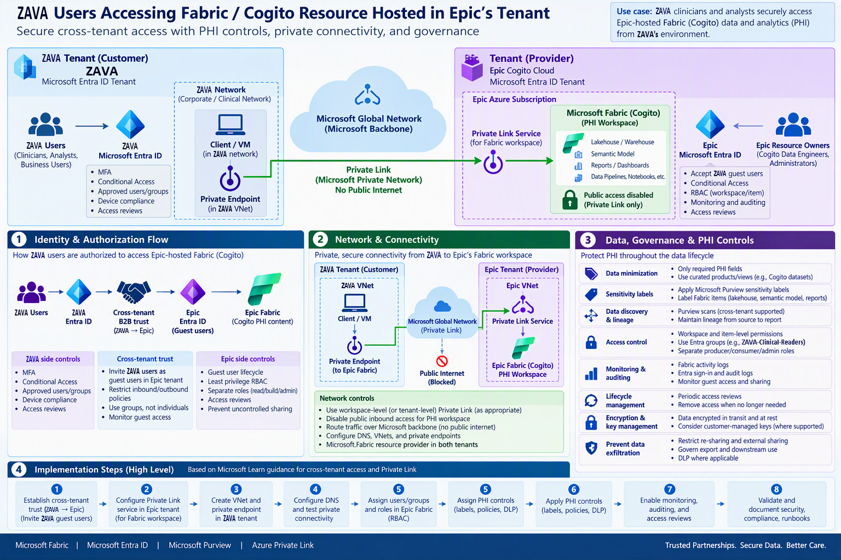
Fabric in Epic Tenant with ZAVA access

Slide 17
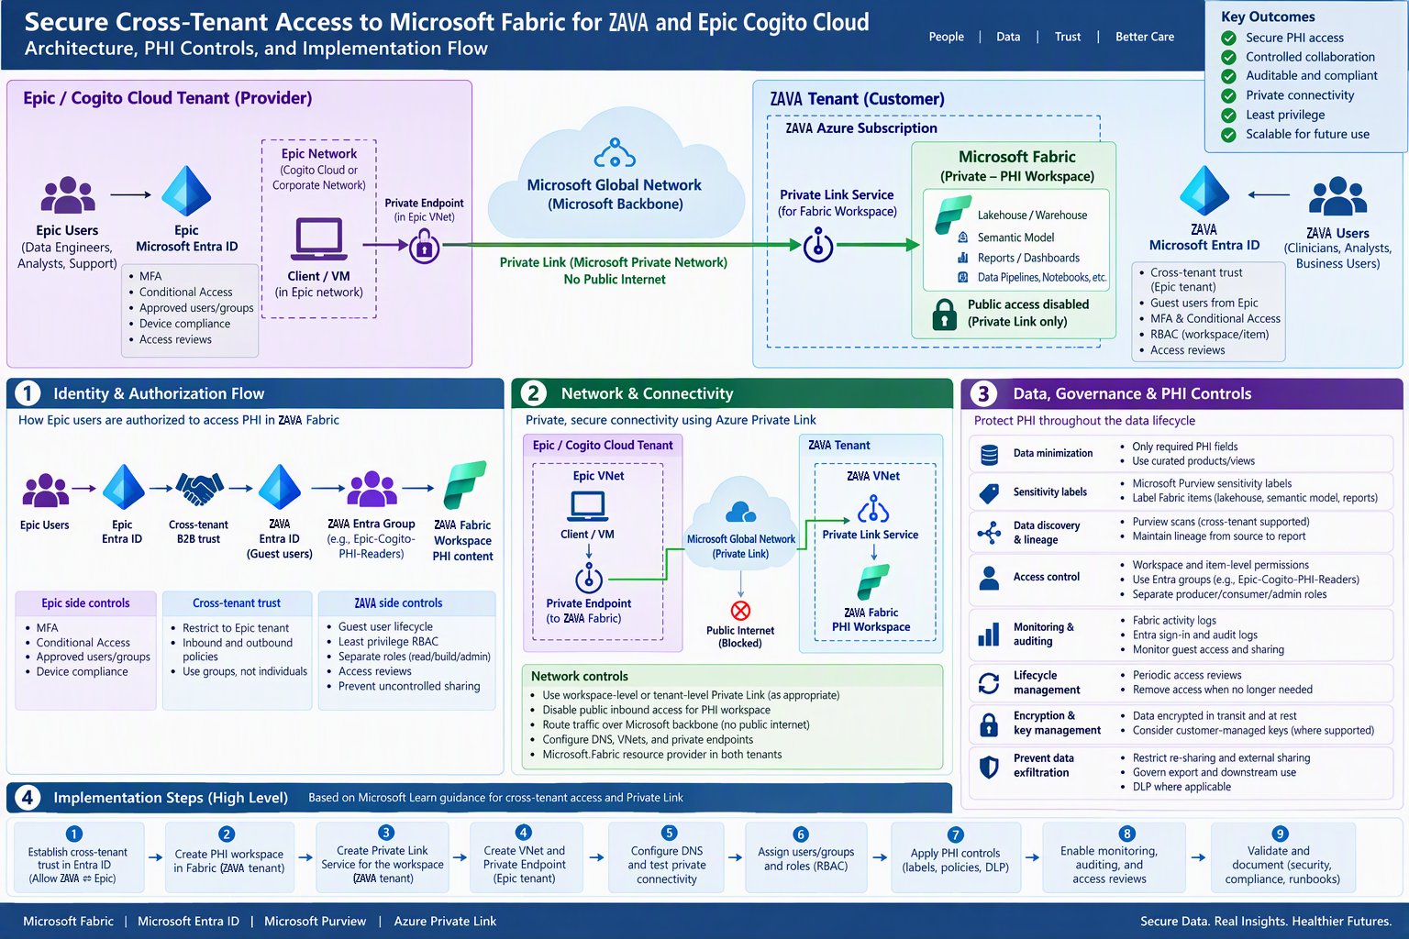
Fabric in Customer(ZAVA) Tenant

