Slide 2
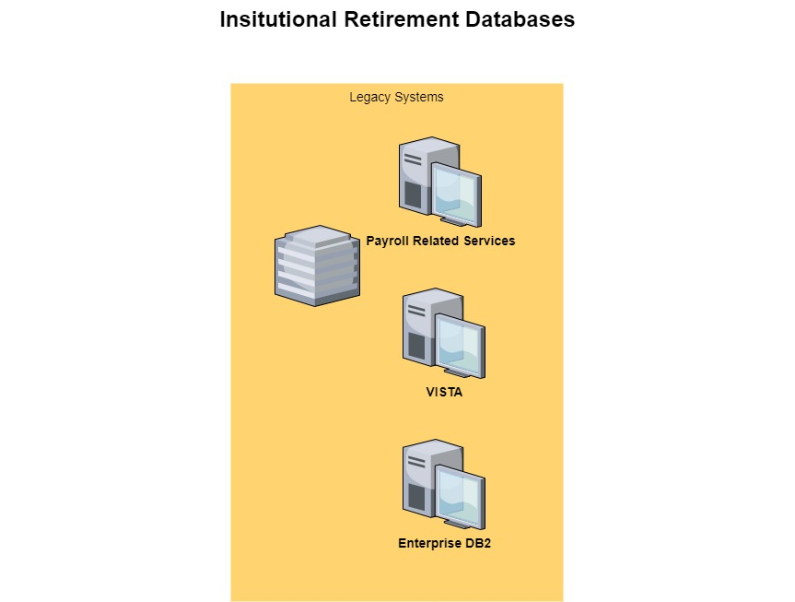
Payroll Related Services (PRS):
Rule based system for managing participant payroll functions
Core Functions: Payroll Deferrals, Employee Contributions
Tech Stack: DB2 Database from IBM
VISTA (Core Record Keeping):
Main System of records
Core Functions: Retirement plans, participants fund balances e.t.c
Tech Stack : VSAM (Virtual Storage Access Method) is a file storage access method.
Enterprise:
Record Keeping data from VISTA/VSM is replicated into DB2 for ease of access of data to other systems.
Tech Stack : DB2 Database from IBM

Slide 3
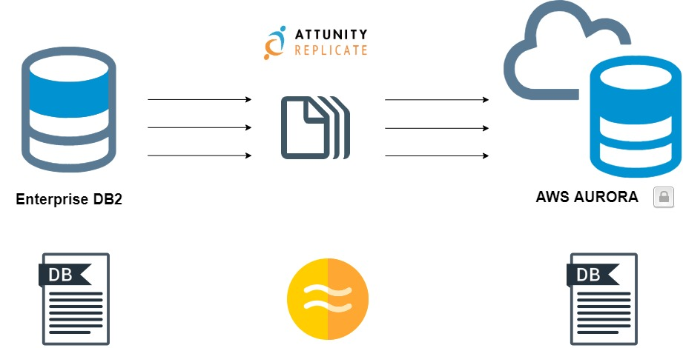
Data is Asynchronously Synched from Enterprise DB2 to AWS Aurora.
AWS Aurora data is read only.
AWS Aurora Data structures mimic DB2 database (Tables, Views, Columns)

Slide 4
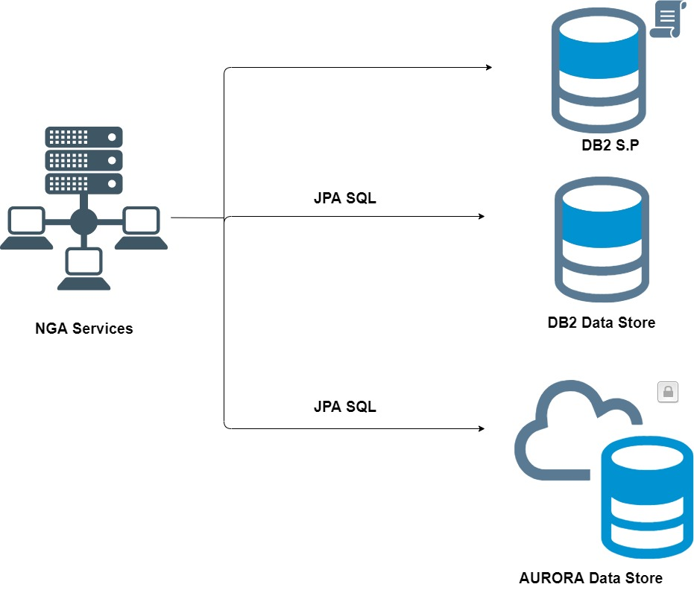
Data is Asynchronously Synched from Enterprise DB2 to AWS Aurora.
AWS Aurora data is read only.
AWS Aurora Data structures mimic DB2 database (Tables, Views, Columns)

Slide 5
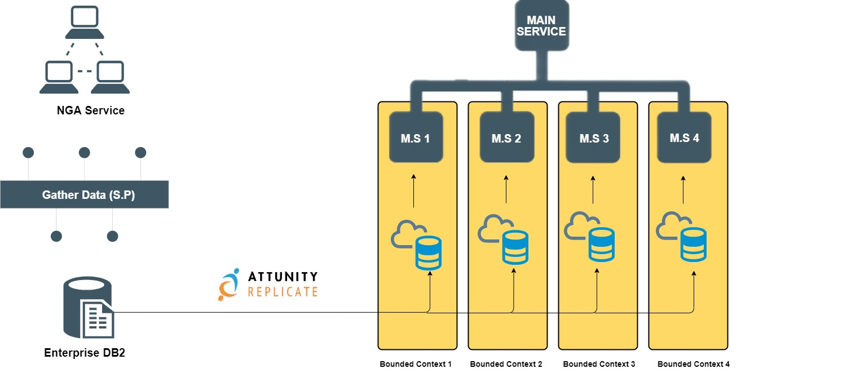
Data is Asynchronously Synched from Enterprise DB2 to AWS Aurora.
AWS Aurora data is read only.
AWS Aurora Data structures mimic DB2 database (Tables, Views, Columns)

Slide 6
DB2 Tools
RUMBA
Access mainframe DB2 to execute and write S.P
Microfocus Enterprise Developer(Eclipse)
Query Capability
Build/Execute S.P
IBM Data Studio
Query Capability
Build/Execute S.P

