Slide 1

EARTHFORCE TRACK · 1 OF 16 SALESFORCE EQUALITY GROUPS
Team-DreamSync
Where systems meet sustainability
Ivy- An AI agent that tracks, reduces, and reports your carbon footprint in real time.
AGENTFORCE FOR GOOD HACKATHON · DREAMFORCE 2026

Slide 2
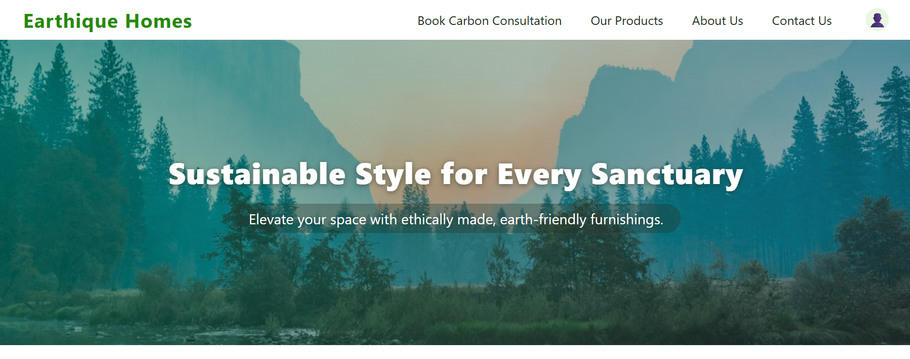
PROJECT INTRO
“We are Earthique Homes — deliver high-quality furniture with a measurably lower carbon footprint across its lifecycle—from responsible material sourcing and efficient manufacturing to durable design, repair, reuse, and end-of-life recovery. The goal is to reduce embodied carbon while creating products that perform, endure, and support a more circular future.
Sourcing — responsibly sourced, low-embodied-carbon materials (certified wood, recycled/bio-based inputs, low-impact finishes), with supplier-level carbon data where available.
Manufacturing — energy-efficient production (renewable energy use, waste reduction, optimized cut yields) tracked against a per-unit carbon baseline.
Durability & Design — products engineered for long service life, modularity, and ease of repair, reducing replacement-driven emissions over time.
AGENTFORCE FOR GOOD HACKATHON · DREAMFORCE 2026

Slide 3
Use Case Theme:
Accelerating Sustainability: Conscious Choices. Elevated by Design. Enduring Value.
PROBLEM STATEMENT Many home-furnishings companies struggle to effectively track and reduce their product and supply-chain carbon emissions:
Emissions data is siloed across BOMs, suppliers, and shipments, making it hard to get a full picture.
Design and logistics teams often lack immediate visibility into product-level and shipment-level carbon hotspots.
Business needs automated, auditable sustainability reporting to track performance and meet stakeholder expectations.
PROPOSED SOLUTION
Unified Emissions Platform: Integrate all SKU, supplier, and shipment data within Salesforce Data Cloud for a holistic carbon view.
Agent-Driven Insights:
Product Emissions Agent calculates and compares CO₂e for each SKU, offering “what-if” changes for greener design.
Supply-Chain Emissions Agent monitors and flags high-emission shipments, recommending more sustainable logistics alternatives.
Predictive Agent auto-generates real-time executive dashboards, KPI tiles, and audit logs for transparent, actionable reporting.
Helps in Carbon Consultation by setting up calendar invites for B2C.
OUTCOME
Helps business to confidently measure, reduce, and report on their carbon performance—product by product, shipment by shipment—strengthening their sustainability leadership.
TOOL(S) NEEDED TO BRING IDEA TO LIFE: Salesforce Data Cloud, CRM, Agentforce, Agentforce Voice, Meta

Slide 4

















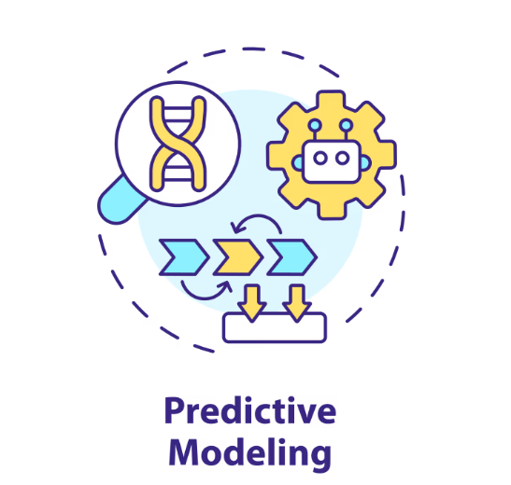





Solution Architecture:
Jacob is happy as he got the much-needed help in one click!!
Elly-Sales Representative
Jacob, a Manufacturer who is sad seeking help from multiple people, websites to gather the info on the Co2e emission on the products/materials/transport he plans to use in building a Sofa
He goes to Agent- Ivy requests on the Co2e emission by providing the details of his product say Sofa/factors causing, prediction on the products turning from RED to GREEN PRODUCTS
Human Agent (Service Agent) resolved the customer issue
Ivy, collects the details and provides the detailed info on the emission guiding the user with alternatives, highlighting on the Max and Min emission factors, prediction of GREEN products etc.
Conversations route to Human Agent for extended support
Apex + Prompts
Web
Enquiry Data
Ivy: Provides Co2e emission factors, details on Website and Meta, altering departments on increase on carbon emission during a product design
Material & Transport Emission
Stream
Ingestion
Salesforce Data 360
CRM –
BOM, Emission Factors, Products
Predictive Model
SFTP
Products, Manufacturing, Transport
Data transformation
Data modeling
Predictive Modelling on certain params like Product/Material/Costs/Emission
Ivy: Predicts patterns and trends and provide details Co2e emission factors, details on Website and Meta, Generate Reports
Batch
Ingestion
Search Indexes on Unstructured Data, used by the Agent
RAG
Materials and Manufacturing Details pdf
Consultation Booking
Ivy: Helps in consultation booking via emails on Website and Meta

Slide 5
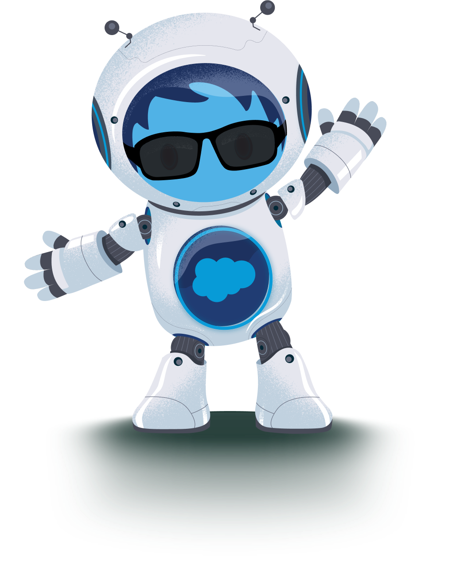
Impact Expected:
Business, Environment, Market & Cost Impact
💼 Business Impact
Statement: Enhances customer empowerment, brand trust, and operational excellence.
Key Points:
Empowers customers to make sustainable choices
Differentiates brand as a sustainability leader
Streamlines customer support through automation
🌍 Market Impact
Statement: Strengthens market position and attracts eco-conscious consumers.
Key Points:
Creates a competitive edge in a sustainability-focused market
Supports regulatory and reporting requirements
Attracts new audience segments (green shoppers, partners)
💰 Cost Impact
Statement: Drives cost savings and operational efficiency.
Key Points:
Recommends lower-cost, lower-emission materials
Reduces manual customer support workload
Optimizes supply chain through smart insights
Environment Impact
Statement: Reduces environmental footprint across the product lifecycle.
Key Points:
Lowers embodied carbon through smarter material recommendations
Cuts waste by flagging inefficient design and production choices
Extends product lifespan through durability and repair guidance
AGENTFORCE FOR GOOD HACKATHON · DREAMFORCE 2026

Slide 6
AI Expert Suite - Accessibility Expert Skill and RAI Self Check Skill
Agentforce voice unlocks accessibility while Einstein Trust Layer enforces responsible AI—together, ensures inclusive access and intrinsically responsible AI, ensuring all users are served safely and equally
Accessibility Expert Skill
RAI Self Check Skill
Agentforce voice enables hands-free, conversational interactions so users with visual, motor, or cognitive impairments can fully access Salesforce services.
This expands usability across all customer segments, reducing barriers to digital engagement.
The Einstein Trust Layer delivers responsible AI by handling grounding, privacy, toxicity filtering, bias detection, and robust auditability.
RAI Self Check controls are built in, mitigating risk across each sub agents/ topics

Slide 7
Thank you!
AGENTFORCE FOR GOOD HACKATHON · DREAMFORCE 2026

