Slide 1
KIET Group of Institutions, Ghaziabad
To develop the Machine Learning Model for Crop Safety
Group ID: PCSE25-29
Team Leader: Kapil Singh Semester :4th Department: CSE
Group Member: Rani Asmit Semester :4th Department: CSE
Group Member: Prateek Kumar Semester :4th Department: CSE
Name of Guide : Ms. Bharti
Date of Presentation :14/06/2023
1

Slide 2
KIET Group of Institutions, Ghaziabad
Project Objectives
Our 4 Major Objectives of our project are:-
Design and development of Website
Improving Food Quality
Selective Breeding
Disease Detection

Slide 3
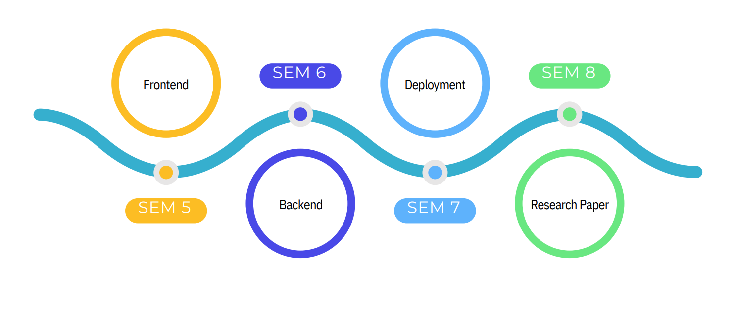
KIET Group of Institutions, Ghaziabad
Timeline
3

Slide 4
KIET Group of Institutions, Ghaziabad
Literature Review
Sr.No. | Journals | Year | Techniques | Findings | Shortcomings
1 | Disease Prediction in Plants: An Application of Machine Learning in Agriculture Sector | 2020 | It was a review paper. | Questions asked were- Why? What? How? Where? When?
2 | Smart classification method to detect irregular nozzle spray patterns inside carbon black reactor using ensemble transfer learning | 2022 | It was a article. | Questions asked were- Why? What? How? Where? When?
4

Slide 5
Sr.No. | Journals | Year | Techniques | Findings | Shortcomings
3 | Agricultural commodity price prediction model: a machine learning framework | 2023 | It was a review article | Questions asked were- Why? What? How? Where? When?
4 | A lightweight convolutional neural network for disease detection of fruit leaves | 2023 | It was a article. | Questions asked were- Why? What? How? Where? When?

Slide 6
KIET Group of Institutions, Ghaziabad
Thank You

