Slide 1
SQL
Phani

Slide 2
Introduction of SQL
Structured Query Language(SQL) as we all know is the database language by the use of which we can perform certain operations on the existing database and also we can use this language to create a database. SQL uses certain commands like Create, Drop, Insert etc. to carry out the required tasks.

Slide 3
These SQL commands are mainly categorized into four categories as discussed below:
DDL(Data Definition Language)
DML(Data Manipulation Language)
DCL(Data Control Language)
TCL(transaction Control Language)

Slide 4
DDL(Data Definition Language)
DDL or Data Definition Language actually consists of the SQL commands that can be used to define the database schema. It simply deals with descriptions of the database schema and is used to create and modify the structure of database objects in database.
CREATE – is used to create the database or its objects (like table, index, function, views, store procedure and triggers).
DROP – is used to delete objects from the database.
ALTER-is used to alter the structure of the database.
TRUNCATE–is used to remove all records from a table, including all spaces allocated for the records are removed.
COMMENT –is used to add comments to the data dictionary.
RENAME –is used to rename an object existing in the database.

Slide 5
SQL | CREATE
There are two CREATE statements available in SQL:
CREATE DATABASE
CREATE TABLE

Slide 6
CREATE DATABASE
A Database is defined as a structured set of data. So, in SQL the very first step to store the data in a well structured manner is to create a database. The CREATE DATABASE statement is used to create a new database in SQL.
Syntax:
CREATE DATABASE database_name; database_name: name of the database.
Example Query:
This query will create a new database in SQL and name the database as my_database.
CREATE DATABASE my_database;

Slide 7
CREATE TABLE
The CREATE TABLE statement is used to create a table in SQL. We know that a table comprises of rows and columns. So while creating tables we have to provide all the information to SQL about the names of the columns, type of data to be stored in columns, size of the data etc.
CREATE TABLE table_name ( column1 data_type(size), column2 data_type(size), column3 data_type(size), .... );
table_name: name of the table.;column1 name of the first column.;data_type: Type of data we want to store in the particular column. size: Size of the data we can store in a particular column.
Example Query: This query will create a table named Students with three columns, ROLL_NO, NAME and SUBJECT.
CREATE TABLE Students ( ROLL_NO int(3), NAME varchar(20), SUBJECT varchar(20), );

Slide 8
SQL | DROP
DROP is used to delete a whole database or just a table.The DROP statement destroys the objects like an existing database, table, index, or view.
A DROP statement in SQL removes a component from a relational database management system (RDBMS).
Syntax:DROP object object_name
Examples: DROP TABLE table_name;
table_name: Name of the table to be deleted.
DROP DATABASE database_name;
database_name: Name of the database to be deleted.

Slide 9
SQL | ALTER (ADD, DROP, MODIFY)
ALTER TABLE is used to add, delete/drop or modify columns in the existing table. It is also used to add and drop various constraints on the existing table.
Sample Table:
ROLL_NO | NAME
1 | Ram
2 | Abhi
3 | Rahul
4 | Tanu

Slide 10
ALTER TABLE – ADD
ADD is used to add columns into the existing table. Sometimes we may require to add additional information, in that case we do not require to create the whole database again, ADD comes to our rescue.
Syntax:
ALTER TABLE table_name ADD (Columnname_1 datatype, Columnname_2 datatype, … Columnname_n datatype);
Example:To ADD 2 columns AGE and COURSE to table Student.
ALTER TABLE Student ADD (AGE number(3),COURSE varchar(40));
ROLL_NO | NAME | AGE | COURSE
1 | Ram
2 | Abhi
3 | Rahul
4 | Tanu

Slide 11
ALTER TABLE-MODIFY
It is used to modify the existing columns in a table. Multiple columns can also be modified at once.
Syntax:
ALTER TABLE table_name MODIFY column_name column_type;
ALTER TABLE Student MODIFY COURSE varchar(20);
After running the above query maximum size of Course Column is reduced to 20 from 40.

Slide 12
ALTER TABLE – DROP
DROP COLUMN is used to drop column in a table. Deleting the unwanted columns from the table.
Syntax:
ALTER TABLE table_name DROP COLUMN column_name;
ALTER TABLE Student DROP COLUMN COURSE;
ROLL_NO | NAME | AGE
1 | Ram
2 | Abhi
3 | Rahul
4 | Tanu

Slide 13
SQL | ALTER (RENAME)
Sometimes we may want to rename our table to give it a more relevant name. For this purpose we can use ALTER TABLE to rename the name of table.
Syntax:
ALTER TABLE table_name RENAME TO new_table_name; (Oracle,MySQL,MariaDB)
ALTER TABLE table_name RENAME COLUMN old_name TO new_name; (Oracle)
ALTER TABLE table_name CHANGE COLUMN old_name TO new_name; (MySQL,MariaDB)
Change the name of column NAME to FIRST_NAME in table Student.
ALTER TABLE Student RENAME COLUMN NAME TO FIRST_NAME;

Slide 14
SQL | TRUNCATE
TRUNCATE statement is a Data Definition Language (DDL) operation that is used to mark the extents of a table for deallocation (empty for reuse). The result of this operation quickly removes all data from a table, typically bypassing a number of integrity enforcing mechanisms. It was officially introduced in the SQL:2008 standard.
Syntax:
TRUNCATE TABLE table_name; table_name: Name of the table to be truncated. DATABASE name - student_data
TRUNCATE TABLE Student_details;

Slide 15
DROP vs TRUNCATE
Truncate is normally ultra-fast and its ideal for deleting data from a temporary table.
Truncate preserves the structure of the table for future use, unlike drop table where the table is deleted with its full structure.
Table or Database deletion using DROP statement cannot be rolled back, so it must be used wisely.
To delete the whole databaseDROP DATABASE student_data;
DROP DATABASE student_data;
After running the above query whole database will be deleted.
To truncate Student_details table from student_data database.TRUNCATE TABLE Student_details;
TRUNCATE TABLE Student_details;
After running the above query Student_details table will be truncated, i.e, the data will be deleted but the structure will remain in the memory for further operations.

Slide 16
DML(Data Manipulation Language)
The SQL commands that deals with the manipulation of data present in database belong to DML or Data Manipulation Language and this includes most of the SQL statements.
Examples of DML:
SELECT – is used to retrieve data from the a database.
INSERT – is used to insert data into a table.
UPDATE – is used to update existing data within a table.
DELETE – is used to delete records from a database table.

Slide 17
SQL | SELECT Query
Select is the most commonly used statement in SQL. The SELECT Statement in SQL is used to retrieve or fetch data from a database. We can fetch either the entire table or according to some specified rules. The data returned is stored in a result table. This result table is also called result-set.
With the SELECT clause of a SELECT command statement, we specify the columns that we want to be displayed in the query result and, optionally, which column headings we prefer to see above the result table.
The select clause is the first clause and is one of the last clauses of the select statement that the database server evaluates. The reason for this is that before we can determine what to include in the final result set, we need to know all of the possible columns that could be included in the final result set.

Slide 18
Basic Syntax:
SELECT column1,column2 FROM table_name column1 , column2: names of the fields of the table table_name: from where we want to fetch
This query will return all the rows in the table with fields column1 , column2.
To fetch the entire table or all the fields in the table:
SELECT * FROM table_name;
Query to fetch the fields ROLL_NO, NAME, AGE from the table Student:
SELECT ROLL_NO, NAME, AGE FROM Student;

Slide 19
SQL | INSERT INTO Statement
The INSERT INTO statement of SQL is used to insert a new row in a table. There are two ways of using INSERT INTO statement for inserting rows:
Only values: First method is to specify only the value of data to be inserted without the column names.
Syntax: INSERT INTO table_name VALUES (value1, value2, value3,...);
table_name: name of the table.
value1, value2,.. : value of first column, second column,... for the new record
Example:
INSERT INTO Student VALUES ('5','HARSH','WEST BENGAL','8759770477','19');

Slide 20
Column names and values both: In the second method we will specify both the columns which we want to fill and their corresponding values as shown below:
Syntax:INSERT INTO table_name (column1, column2, column3,..) VALUES ( value1, value2, value3,..); table_name: name of the table. column1: name of first column, second column ... value1, value2, value3 : value of first column, second column,... for the new record
INSERT INTO Student (ROLL_NO, NAME, Age) VALUES ('5','PRATIK','19');

Slide 21
SQL | UPDATE Statement
The UPDATE statement in SQL is used to update the data of an existing table in database. We can update single columns as well as multiple columns using UPDATE statement as per our requirement.
Basic Syntax
UPDATE table_name SET column1 = value1, column2 = value2,... WHERE condition; table_name: name of the table column1: name of first , second, third column.... value1: new value for first, second, third column.... condition: condition to select the rows for which the values of columns needs to be updated.
NOTE: In the above query the SET statement is used to set new values to the particular column and the WHERE clause is used to select the rows for which the columns are needed to be updated. If we have not used the WHERE clause then the columns in all the rows will be updated. So the WHERE clause is used to choose the particular rows.

Slide 22
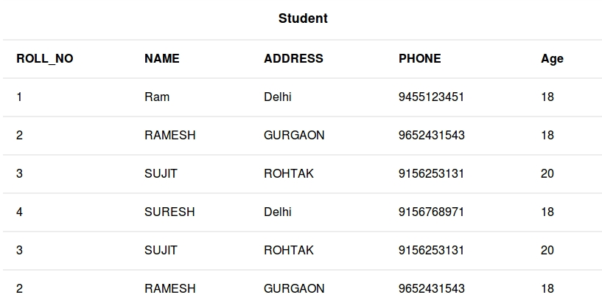
SQL | UPDATE Statement

Slide 23
Example Queries
Updating single column: Update the column NAME and set the value to ‘PRATIK’ in all the rows where Age is 20.
UPDATE Student SET NAME = 'PRATIK' WHERE Age = 20;
Output:
This query will update two rows(third row and fifth row) and the table Student will now look like,
ROLL_NO | NAME | ADDRESS | PHONE | Age
1 | Ram | Delhi | 9455123451 | 18
2 | RAMESH | GURGAON | 9562431543 | 18
3 | PRATIK | ROHTAK | 9156253131 | 20
4 | SURESH | Delhi | 9156768971 | 18
3 | PRATIK | ROHTAK | 9156253131 | 20
2 | RAMESH | GURGAON | 9562431543 | 18

Slide 24
Updating multiple columns: Update the columns NAME to ‘PRATIK’ and ADDRESS to ‘SIKKIM’ where ROLL_NO is 1.
UPDATE Student SET NAME = 'PRATIK', ADDRESS = 'SIKKIM' WHERE ROLL_NO = 1;
Note: For updating multiple columns we have used comma(,) to separate the names and values of two columns.
ROLL_NO | NAME | ADDRESS | PHONE | Age
1 | PRATIK | SIKKIM | 9455123451 | 18
2 | RAMESH | GURGAON | 9562431543 | 18
3 | PRATIK | ROHTAK | 9156253131 | 20
4 | SURESH | Delhi | 9156768971 | 18
3 | PRATIK | ROHTAK | 9156253131 | 20
2 | RAMESH | GURGAON | 9562431543 | 18

Slide 25
Omitting WHERE clause: If we omit the WHERE clause from the update query then all of the rows will get updated.
UPDATE Student SET NAME = 'PRATIK';
Output:
ROLL_NO | NAME | ADDRESS | PHONE | Age
1 | PRATIK | Delhi | 9455123451 | 18
2 | PRATIK | GURGAON | 9562431543 | 18
3 | PRATIK | ROHTAK | 9156253131 | 20
4 | PRATIK | Delhi | 9156768971 | 18
3 | PRATIK | ROHTAK | 9156253131 | 20
2 | PRATIK | GURGAON | 9562431543 | 18

Slide 26
SQL | DELETE Statement
The DELETE Statement in SQL is used to delete existing records from a table. We can delete a single record or multiple records depending on the condition we specify in the WHERE clause.
Basic Syntax:
DELETE FROM table_name WHERE some_condition; table_name: name of the table some_condition: condition to choose particular record.
Note: We can delete single as well as multiple records depending on the condition we provide in WHERE clause. If we omit the WHERE clause then all of the records will be deleted and the table will be empty.

Slide 27
Deleting single record: Delete the rows where NAME = ‘Ram’. This will delete only the first row.
DELETE FROM Student WHERE NAME = 'Ram’;
Output:
ROLL_NO | NAME | ADDRESS | PHONE | Age
2 | RAMESH | GURGAON | 9562431543 | 18
3 | SUJIT | ROHTAK | 9156253131 | 20
4 | SURESH | Delhi | 9156768971 | 18
3 | SUJIT | ROHTAK | 9156253131 | 20
2 | RAMESH | GURGAON | 9562431543 | 18

Slide 28
Deleting multiple records: Delete the rows from the table Student where Age is 20. This will delete 2 rows(third row and fifth row).
DELETE FROM Student WHERE Age = 20;
Output:
ROLL_NO | NAME | ADDRESS | PHONE | Age
1 | Ram | Delhi | 9455123451 | 18
2 | RAMESH | GURGAON | 9562431543 | 18
4 | SURESH | Delhi | 9156768971 | 18
2 | RAMESH | GURGAON | 9562431543 | 18

Slide 29
Delete all of the records: There are two queries to do this as shown below,
query1: "DELETE FROM Student";
query2: "DELETE * FROM Student";
Output:
All of the records in the table will be deleted, there are no records left to display. The table Student will become empty!

Slide 30
DCL(Data Control Language)
DCL includes commands such as GRANT and REVOKE which mainly deals with the rights, permissions and other controls of the database system.Examples of DCL commands:
GRANT-gives user’s access privileges to database.
REVOKE-withdraw user’s access privileges given by using the GRANT command.

Slide 31
TCL(transaction Control Language)
TCL commands deals with the transaction within the database.
Examples of TCL commands:
COMMIT– commits a Transaction.
ROLLBACK– rollbacks a transaction in case of any error occurs.
SAVEPOINT–sets a savepoint within a transaction.
SET TRANSACTION–specify characteristics for the transaction.

Slide 32
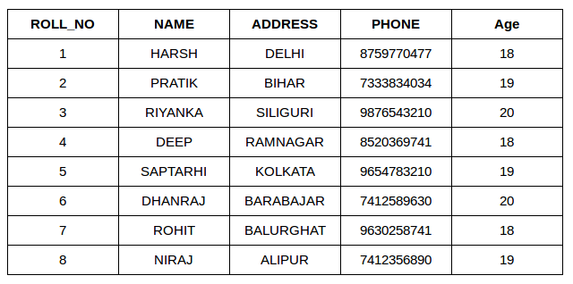
Join
Student

Slide 33
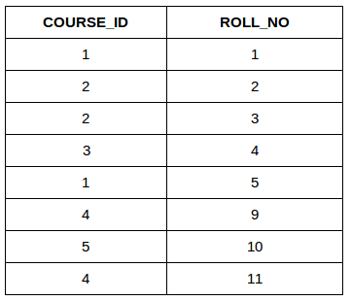
StudentCourse

Slide 34
SQL | Join (Inner, Left, Right and Full Joins)
A SQL Join statement is used to combine data or rows from two or more tables based on a common field between them. Different types of Joins are:
INNER JOIN
LEFT JOIN
RIGHT JOIN
FULL JOIN

Slide 35
INNER JOIN:
The INNER JOIN keyword selects all rows from both the tables as long as the condition satisfies. This keyword will create the result-set by combining all rows from both the tables where the condition satisfies i.e value of the common field will be same.
Syntax:
SELECT table1.column1,table1.column2,table2.column1,.... FROM table1 INNER JOIN table2 ON table1.matching_column = table2.matching_column;
table1: First table.
table2: Second table
matching_column: Column common to both the tables.
Note: We can also write JOIN instead of INNER JOIN. JOIN is same as INNER JOIN.

Slide 36
This query will show the names and age of students enrolled in different courses.
SELECT StudentCourse.COURSE_ID, Student.NAME, Student.AGE FROM Student INNER JOIN StudentCourse ON Student.ROLL_NO = StudentCourse.ROLL_NO;

Slide 37
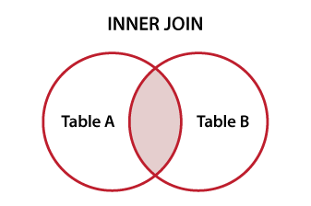
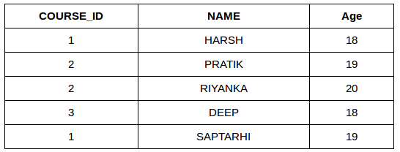

Slide 38
LEFT JOIN
This join returns all the rows of the table on the left side of the join and matching rows for the table on the right side of join. The rows for which there is no matching row on right side, the result-set will contain null. LEFT JOIN is also known as LEFT OUTER JOIN.
SELECT table1.column1,table1.column2,table2.column1,.... FROM table1 LEFT JOIN table2 ON table1.matching_column = table2.matching_column;
table1: First table.
table2: Second table
matching_column: Column common to both the tables.
Note: We can also use LEFT OUTER JOIN instead of LEFT JOIN, both are same.

Slide 39
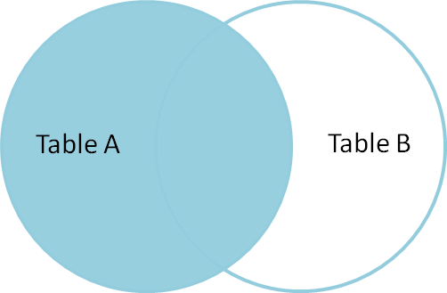
SELECT Student.NAME,StudentCourse.COURSE_ID FROM Student LEFT JOIN StudentCourse ON StudentCourse.ROLL_NO = Student.ROLL_NO

Slide 40
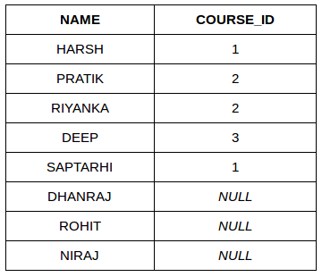

Slide 41
RIGHT JOIN
RIGHT JOIN is similar to LEFT JOIN. This join returns all the rows of the table on the right side of the join and matching rows for the table on the left side of join. The rows for which there is no matching row on left side, the result-set will contain null. RIGHT JOIN is also known as RIGHT OUTER JOIN.
Syntax:
SELECT table1.column1,table1.column2,table2.column1,.... FROM table1 RIGHT JOIN table2 ON table1.matching_column = table2.matching_column;
table1: First table.
table2: Second table
matching_column: Column common to both the tables.
Note: We can also use RIGHT OUTER JOIN instead of RIGHT JOIN, both are same.

Slide 42
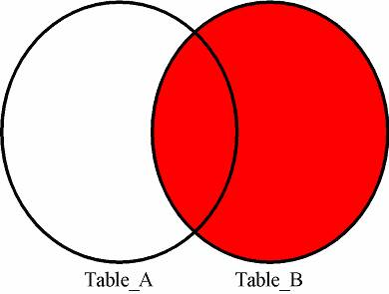
SELECT Student.NAME,StudentCourse.COURSE_ID FROM Student RIGHT JOIN StudentCourse ON StudentCourse.ROLL_NO = Student.ROLL_NO;

Slide 43
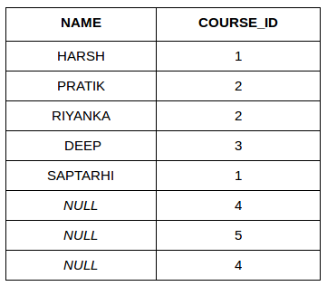

Slide 44
FULL JOIN:
FULL JOIN creates the result-set by combining result of both LEFT JOIN and RIGHT JOIN. The result-set will contain all the rows from both the tables. The rows for which there is no matching, the result-set will contain NULLvalues.
Syntax:
SELECT table1.column1,table1.column2,table2.column1,.... FROM table1 FULL JOIN table2 ON table1.matching_column = table2.matching_column;
table1: First table.
table2: Second table
matching_column: Column common to both the tables.

Slide 45
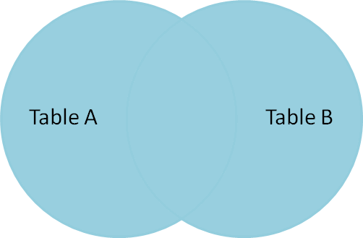
SELECT Student.NAME,StudentCourse.COURSE_ID FROM Student FULL JOIN StudentCourse ON StudentCourse.ROLL_NO = Student.ROLL_NO;

Slide 46
