Slide 1
IST687 Final Project Hotel Booking Cancellation Prediction
Kangsheng Pu

Slide 2
Objective & Agenda:
Objective: to discover the significant factors for customers to cancel their reservations.
Final data Description
Candidate Variable Selection
EDA
Logistic Regression Model
SVM Model
Tree Model
Model Selection

Slide 3
Final Data Description
Added & adjusted variables for prediction:
Meal, Deposit Type adjusted to ordinal factor value.
Meal : 0[SC] – 1[BB] – 2[HB] – 3[FB]
Deposit Type: No deposit : 0, refundable: 1, nonrefundable: 2
AssignedReservedRoom: A TRUE/FALSE checking whether the user acquired the room the user requested.
CancellationRate: the percentage of users previously cancelled the hotel booking.
StayedDays: The number of days stayed in the hotel
Contains 35689 units of observation After data cleaning. The data cleaning process includes:
Z-score checking removing outliers
Manually remove serval unreasonable values for columns.
Removing undefined Meal plans.
Removed Country for primary analysis.

Slide 4
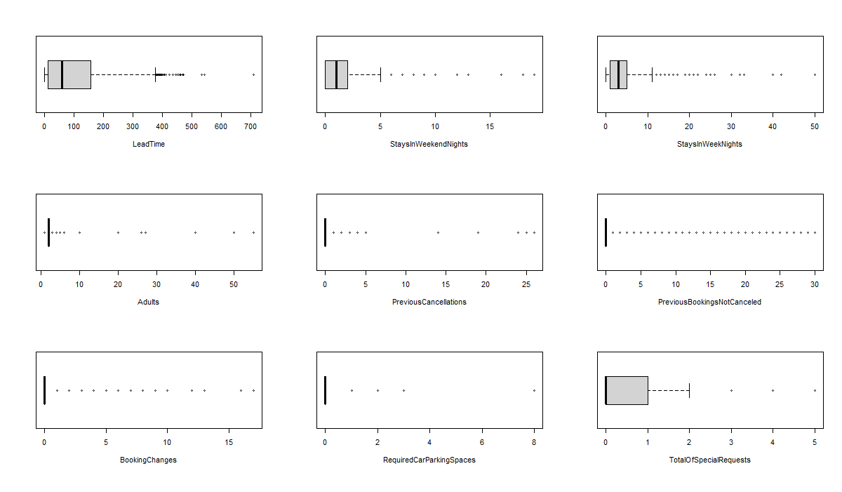
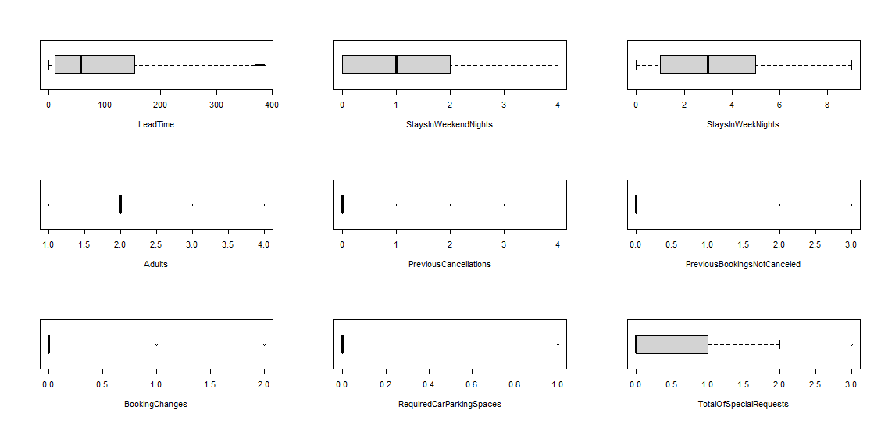
Final Data Description
Before Data Cleanup
After Data Cleanup

Slide 5
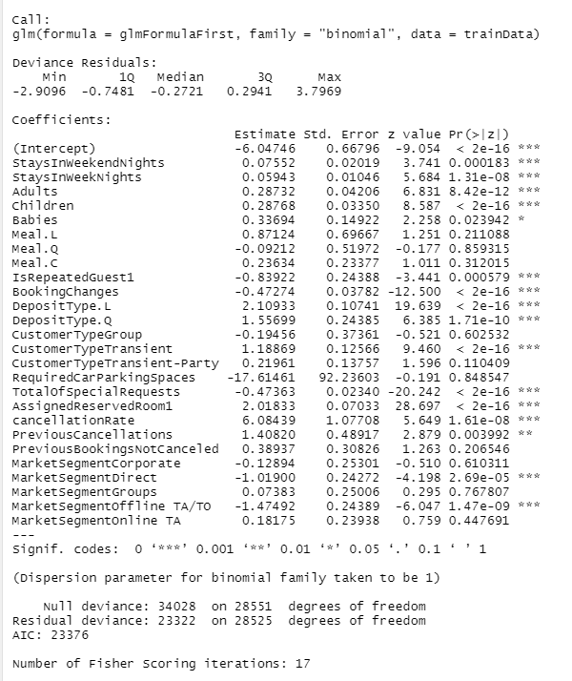
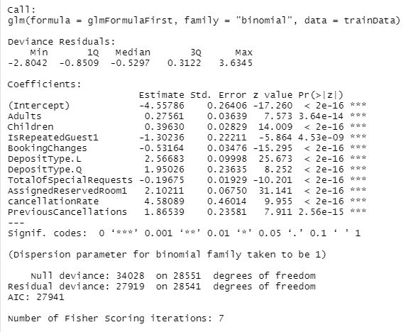
Logistic Regression
Insignificant predictors removal

Slide 6
Logistic Regression Interpretation
The number increase of adults, children, cancellation rate of previous bookings and number of cancellations will positively influence the cancellation of this booking.
Repeated guest is less likely to cancel compared to first time guest
The deposit type have an increasing and accelerating trend of cancellation as the deposit type becomes stricter (High deposit requirements leads to )
Customers with same assigned and reserved room types is more likely than customers with different reserved and assigned room types.
The number of special requests will negatively influence the possibility of cancelling the hotel booking.
Accuracy: 72.87%

Slide 7
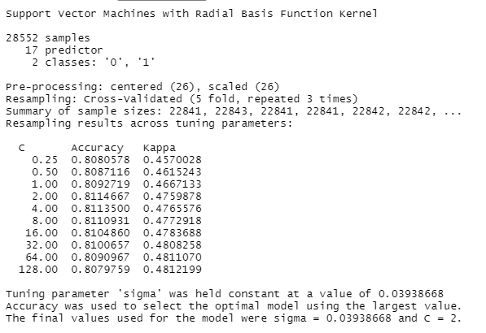
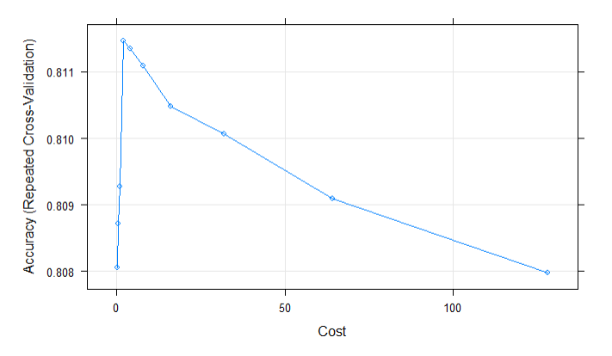
SVM Model
Used 5-fold cross-validation and 3 repeats to avoid overfit.
The accuracy peaked at 81.15% with cost = 2.

Slide 8
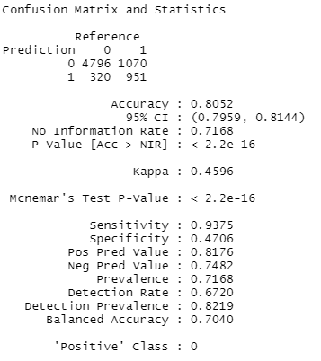
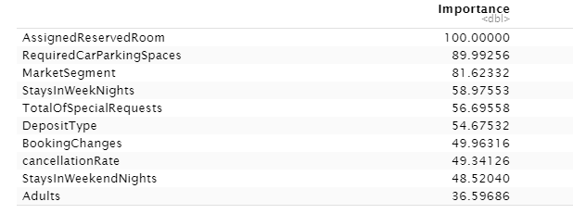
SVM Model
← According to p-value, we deduce that this is a statistically significant model.
↓ The most important variables for predicting the cancellation rate

Slide 9
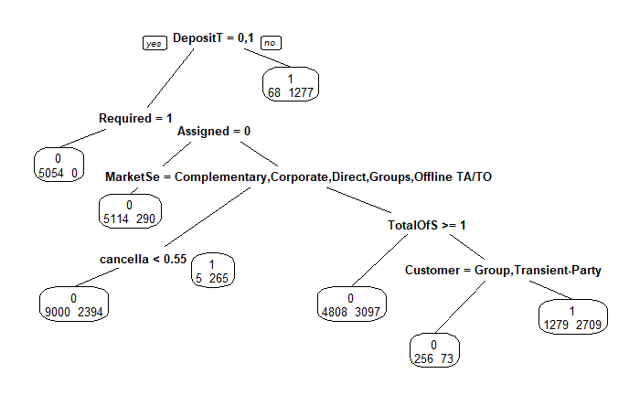
Treebag Model
Variables that are significant in the model:
Deposit Type
Required
Whether user get the request room
Market Segment
Previous Cancellation rate
Number of special requests
Customer Group

Slide 10
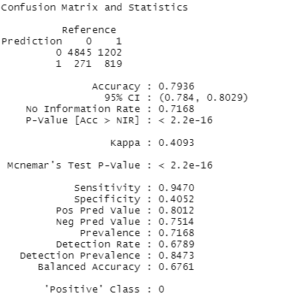
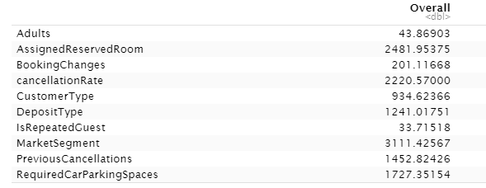
Treebag Model
Accuracy 79.4%
P-value is small enough to consider this model as significant.

Slide 11
Model Selection
Logistic Regression:
Manually selected predictors
Lowest accuracy
SVM Model:
System processed all the variables
Applied cross validation to avoid overfitting
Highest accuracy
Treebag Model:
Middle accuracy
No special outfit control methods

Slide 12
Recommendations & Work In progress
Whether the customer get the request room Previous cancellation rate, Market Segment, and deposit Type are the key predictors that the hotel need to pay special attention.
Work in progress:
Countries: classifying The countries into Continents might be better to predict Data.

