Slide 1
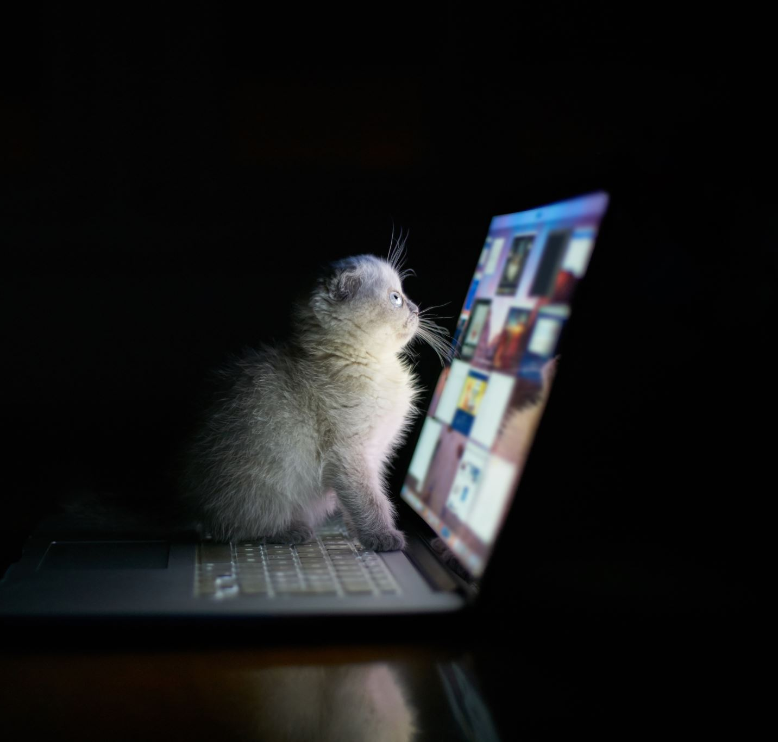
Animal Image Recognition
Kangsheng Pu
IST 707 Applied Machine Learning

Slide 2
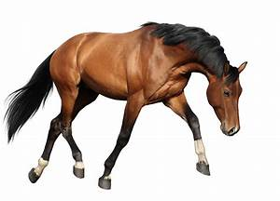
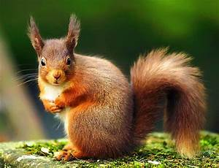

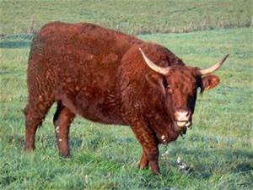
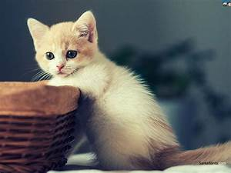
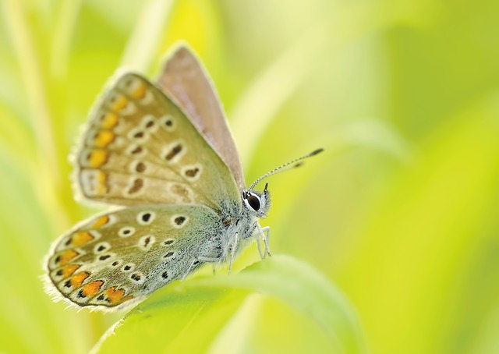
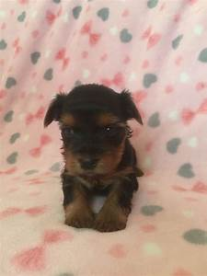
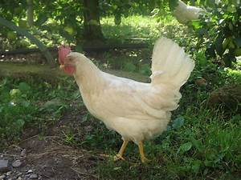
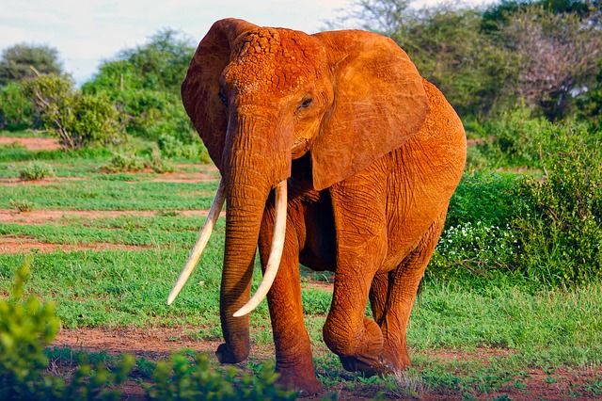
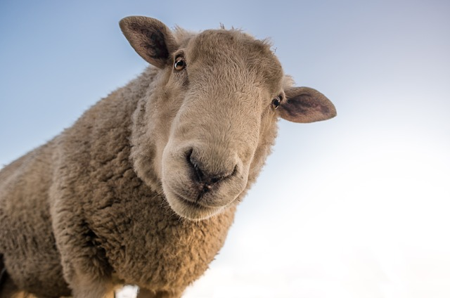
Project Objective:
Kaggle: https://www.kaggle.com/datasets/alessiocorrado99/animals10/code
Raw image data for ten categories of animals:
Cow, cat, butterfly, dog, roster, elephant, sheep, spider, squirrel, horse
26179 Images.

Slide 3
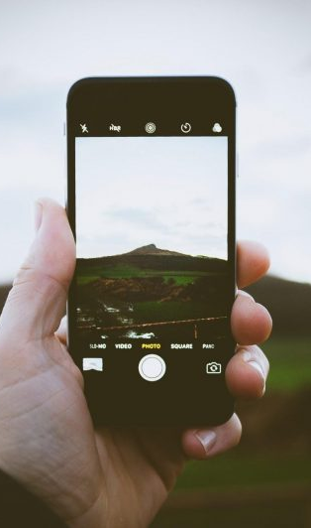
Future Usage
Visual search engine
Camera Auto focusing
Automated Image Organization

Slide 4
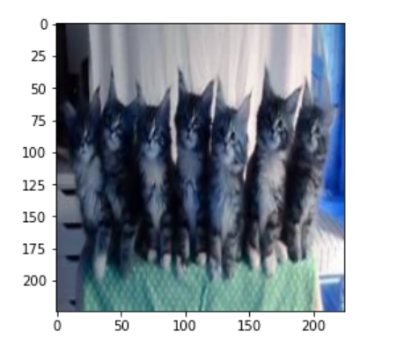
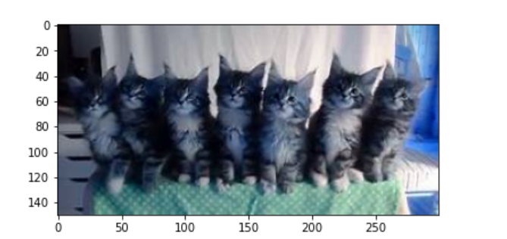
Possible Approach
Naïve Bayes Classifier
Support Vector Machine
Convoluted Neural Network
Random Forest

Slide 5
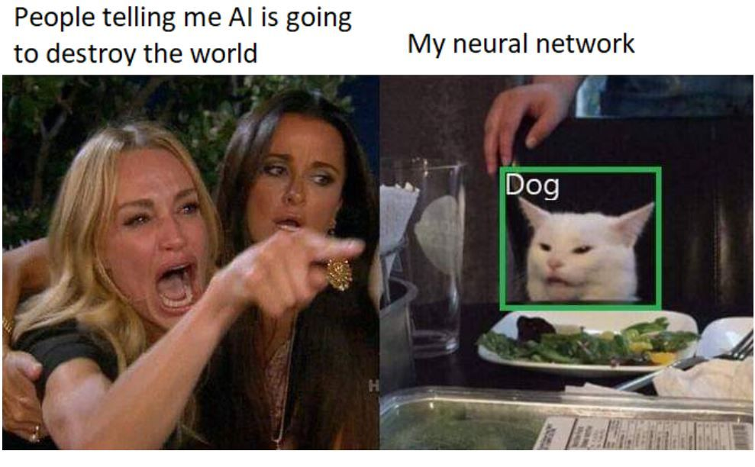
Challenges
Raw Image data
Every image has different resolution
Long processing time
Parameters processing
CNN
Hyperparameter Tuning
Model Building
Time issue
Other Machine learning algorithms
Color VS Grey

