Slide 1
Media bazaar system
Developed by team kreem

Slide 2

The team With mentor
Michael Bahchevanov ANDRè POSTMA
Mihail bondarenco
Michael Groenewegen van der weijden
Kristiyan strahilov

Slide 3
Outline
Two sprints overview
How did we approach the problems
System demo
Next steps

Slide 4
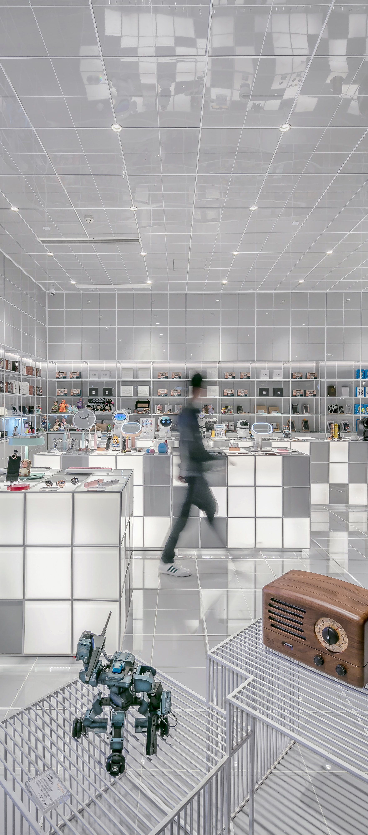
Iteration 1 and 2
The Media Bazaar website
Stock management implementation

Slide 5
Our approach
Website | Stock management system | Department management system
Schedule preview | CRUD | TBA
Shift preference | Statistics review
Create, Read and Update personal information

Slide 6

System demo

Slide 7

Next steps
Implementation of a department management system
Finalization and deployment

