Slide 1

taskberry
The smart planner
Team Leader: Michael Bahchevanov (3806596)
Team members:
Aleksandar Todorov (3787842)
Kristiyan Strahilov (3807487)
Michael Groenewegen van der Weijden (3842401)

Slide 2
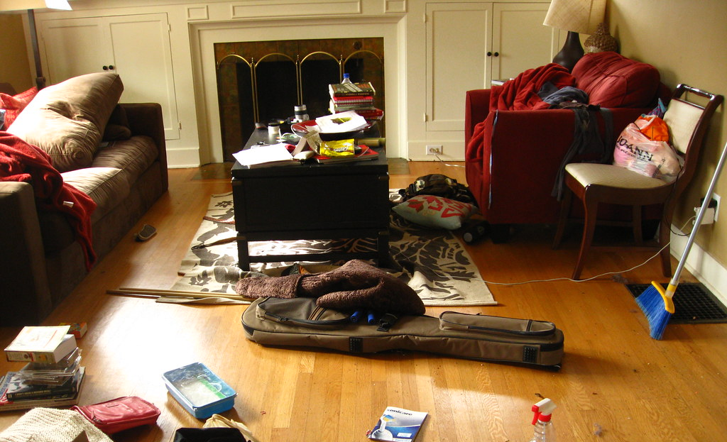
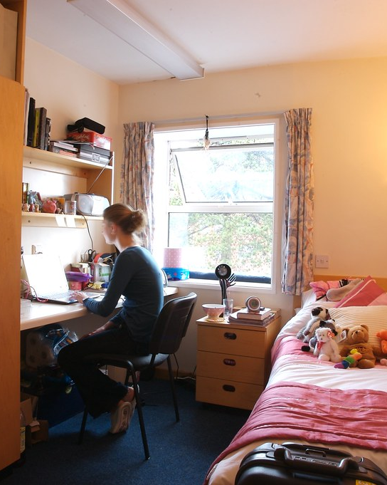
What was the problem

Slide 3
Our work
Roles
Accounts
Reward
Points system
Duties
Calendar system
Communication
Chat room
Announcements
Announcement system

Slide 4
Used technologies
C#
MS Server
Cisco (VPN)
Visual Studio (IDE)
SSMS
Photoshop

Slide 5

Roles
Tenant
Communication
Landlord
Account management
Calendar
Calendar manipulation
Points
Communication
DEMO
DEMO

Slide 6

Reward system
Less points
More points
$
$
DEMO

Slide 7

Duties
Accept chore
Do chore
Get points
Lower rent
DEMO

Slide 8

Communication
DEMO
DEMO

Slide 9


Announcements
Landlord
Tenant

Slide 10

Deep dive
DEMO

Slide 11

Thank you for your attention

Slide 12
References
C#, Link: https://docs.microsoft.com/en-us/dotnet/csharp/language-reference/
SSMS, Link: https://docs.microsoft.com/en-us/sql/ssms/sql-server-management-studio-ssms?view=sql-server-ver15
Cisco VPN, Link: https://www.cisco.com/c/en_ca/products/security/anyconnect-secure-mobility-client/index.html?dtid=osscdc000284
Visual Studio, Link: https://visualstudio.microsoft.com/vs/
Photoshop, Link:https://www.adobe.com/products/photoshop.html?promoid=KFOIE&s_cid=70114000002CfGJAA0&s_iid=70114000002ChdJAAS
MS Server, Link: https://docs.microsoft.com/en-us/windows-server/get-started-19/get-started-19

