Slide 1

taskberry
The smart planner

Slide 2
Our work
Roles
Accounts
Reward
Points system
Duties
Calendar system
Communication
Chat room
Announcements
Announcement system

Slide 3
Used technologies
C#
MS Server
Cisco (VPN)
Visual Studio (IDE)
SSMS
Photoshop

Slide 4
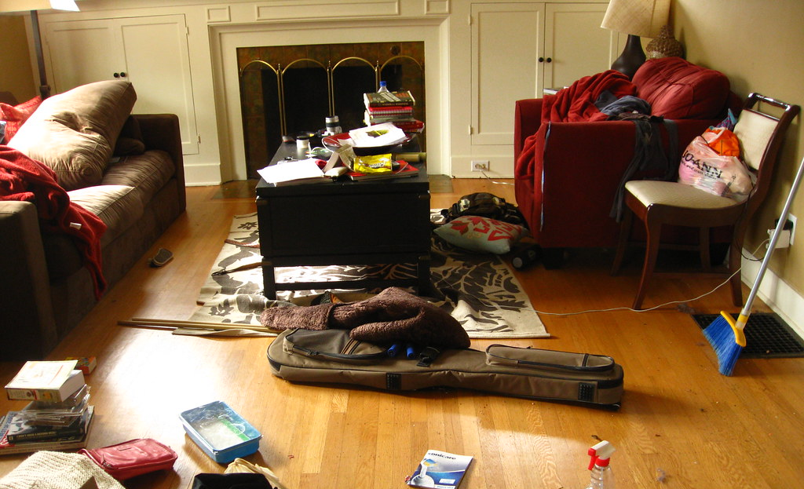
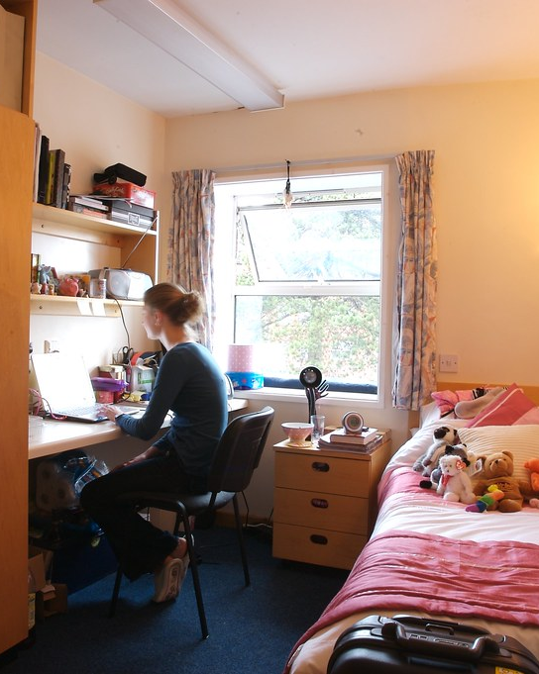
What was wrong

Slide 5

Roles
Tenant
Communication
Landlord
Account management
Calendar
Calendar manipulation
Points
Communication
DEMO
DEMO

Slide 6

Reward system
Less points
More points
$
$
DEMO

Slide 7
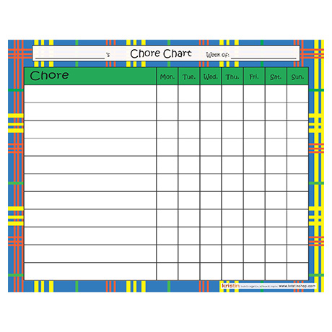
Duties
Accept chore
Do chore
Get points
Lower rent
DEMO

Slide 8

Communication
DEMO
DEMO

Slide 9


Announcements
Landlord
Tenant

Slide 10

Deep dive
DEMO

Slide 11

Thank you for your attention

