Slide 1
Proposed Chlorothalonil Plant Location
Presented by Kyle Clapper, FDE WET inc.

Slide 2
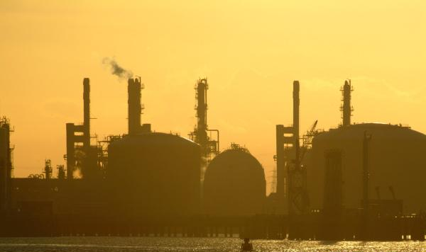
Overview
Criteria
State
Site
Questions / Comments
Notes:
In this presentation we are going to go over our criteria for site selection, which state we narrowed it down to and a description of the proposed site. There should be time for questions and comments at the end.

Slide 3
Selection Criteria
Transportation
Political
Proximity to raw material suppliers
Proximity to customers
Proximity to major shipping lanes
Proximity to rail lines
Proximity to major roadways
Low corporate tax rate
No preventative regulatory concerns
Safety
Low major storm risk
Proximity to population centers
Proximity to large bodies of water
Notes:
Be sure to mention secondary suppliers and customers

Slide 4
State – North Carolina

Slide 5
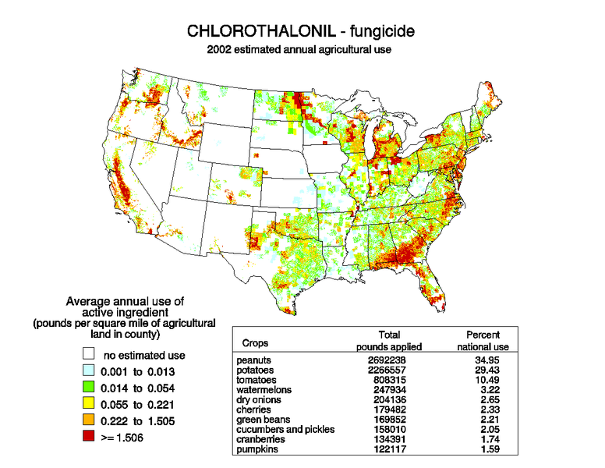
USGS 2002

Slide 6
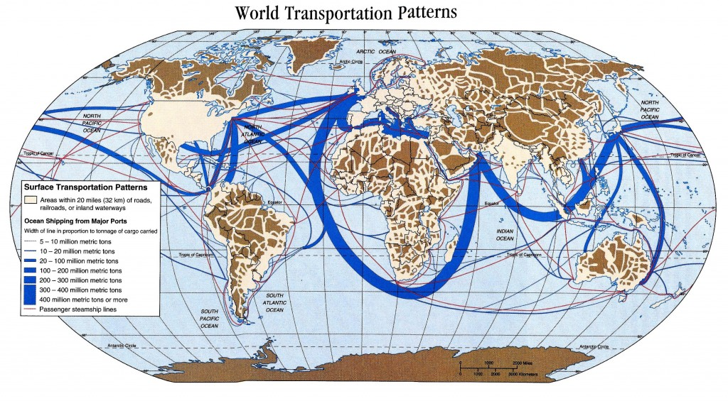
marine-knowledge.com

Slide 7
State – North Carolina
Close proximity to customers
Close proximity to shipping lanes
Access to International suppliers/consumers
Low corporate income tax
Similar tornado risk as MA
Some hurricane risk
Alternatives Investigated:
Arizona
Texas
New York
Mississippi

Slide 8
1906 Old Creak Road, Greenville NC

Slide 9
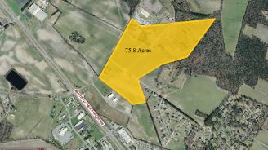
Landandfarm.com

Slide 10
Old Creek Industrial Facility
Pros:
Cons:
Low cost - $2.274 M
Relatively sparse surrounding population
Rail access nearby
No nearby large bodies of water
Partially zoned for industrial use
Small neighborhood nearby
Rezoning will be necessary
Closest Starbucks is more than 3 miles away

Slide 11

Moving Forward
Determine cost for rail line
Determine cost to hook up utilities
Determine transportation costs
Begin facility design and layout
Determine average wind speed/direction

Slide 12
For more information visit:
www.worsteadengineering.com/Greenville

