Slide 1
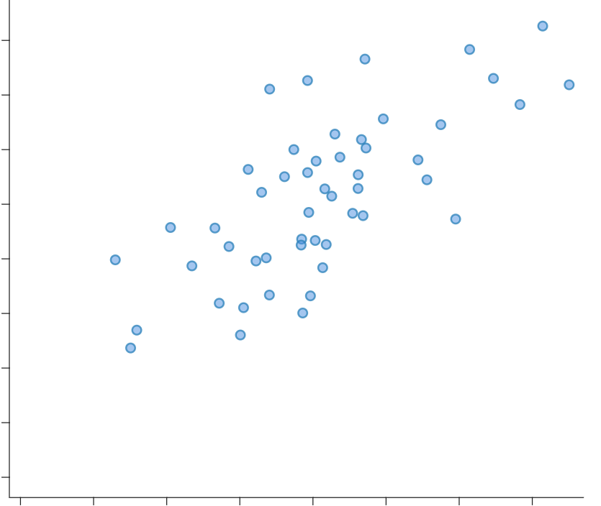
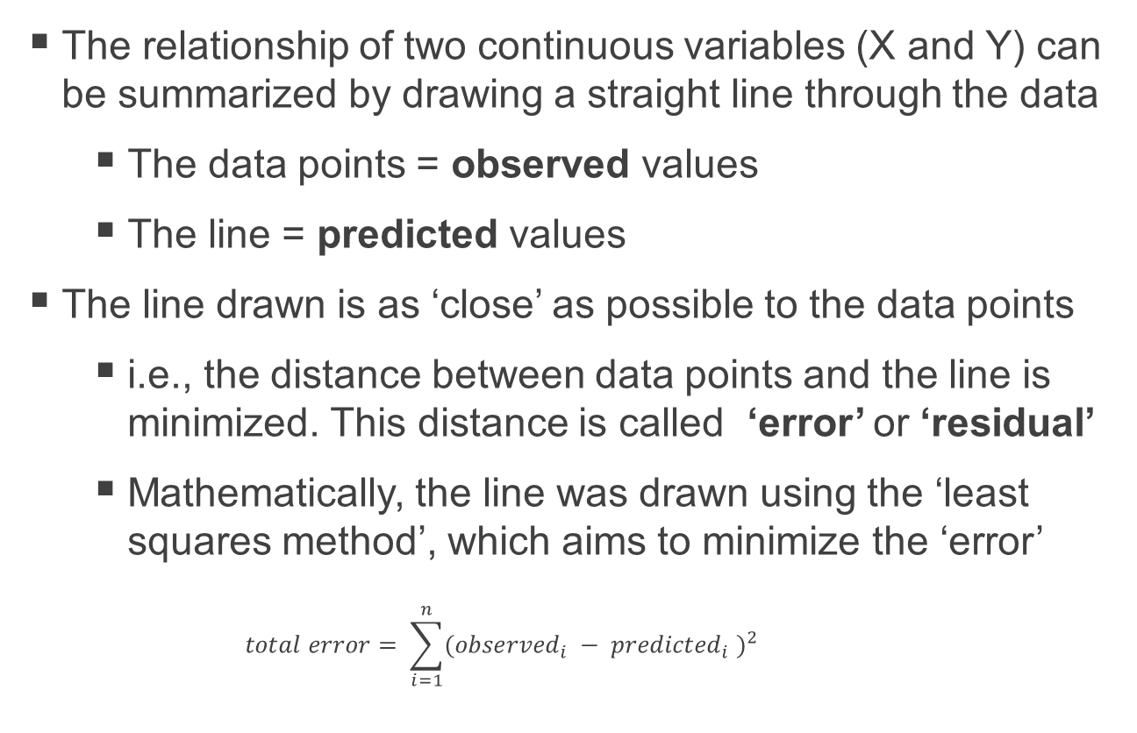
Linear Regression
The relationship of two continuous variables (X and Y) can be summarized by drawing a straight line through the data
The data points = observed values
The line = predicted values
The line drawn is as ‘close’ as possible to the data points
i.e., the distance between data points and the line is minimized. This distance is called ‘error’ or ‘residual’
Mathematically, the line was drawn using the ‘least squares method’, which aims to minimize the ‘error’
$$total error= \sum_{i=1}^{n}{{({observed}_{i} − {predicted}_{i} )}^{2}}$$
Y
Residual
(observed value minus predicted value)
X
Notes:
To calculate the total error in a model we square the difference between the observed value of the outcome and the predicted value that come from the model
We square because sometime the residuals are positive and other times they are negative, and if we summed without squaring they would cancel each other out

Slide 2
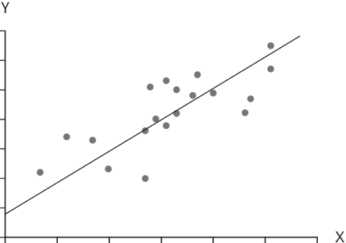
Linear Regression
The line may be described by the equation: Y = (intercept) + (slope)(X)
Y = β₀ + (β₁)(X)
The intercept (β₀) is the the estimated Y when X = 0
The slope (β₁) is the the estimated change in Y for a one-unit increase in X
With this equation, we can estimate the value of Y for any given value of X
The value of β₀ and β₁ are calculated and of main interest when conducting a regression
The null-hypothesis is that the regression coefficients (i.e., β₀ and β₁) equal to 0
i.e., the p-values associated with β₀ and β₁ indicate whether they are different from 0
If the line has a slope of zero (i.e., a flat horizontal line; β₁ = 0), X and Y are not associated; the expected value of Y will be the same regardless of the value of X
β₁
1
β₀
0

Slide 3
Linear Regression
The line may be described by the equation: Y = (intercept) + (slope)(X)
Y = β₀ + (β₁)(X)
The intercept (β₀) is the the estimated Y when X = 0
The slope (β₁) is the the estimated change in Y for a one-unit increase in X
With this equation, we can estimate the value of Y for any given value of X
The value of β₀ and β₁ are calculated and of main interest when conducting a regression
The null-hypothesis is that the regression coefficients (i.e., β₀ and β₁) equal to 0
i.e., the p-values associated with β₀ and β₁ indicate whether they are different from 0
If the line has a slope of zero (i.e., a flat horizontal line; β₁ = 0), X and Y are not associated; the expected value of Y will be the same regardless of the value of X

Slide 4
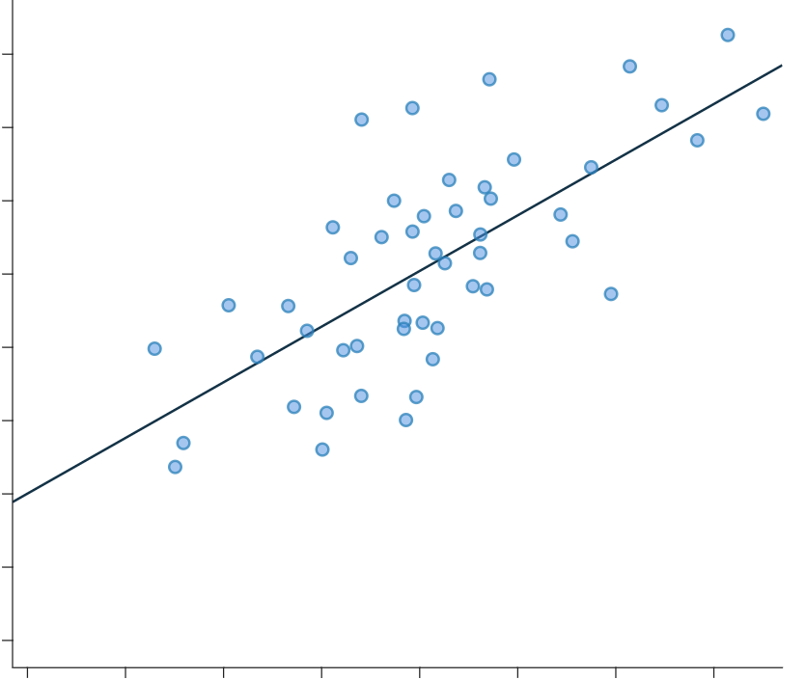
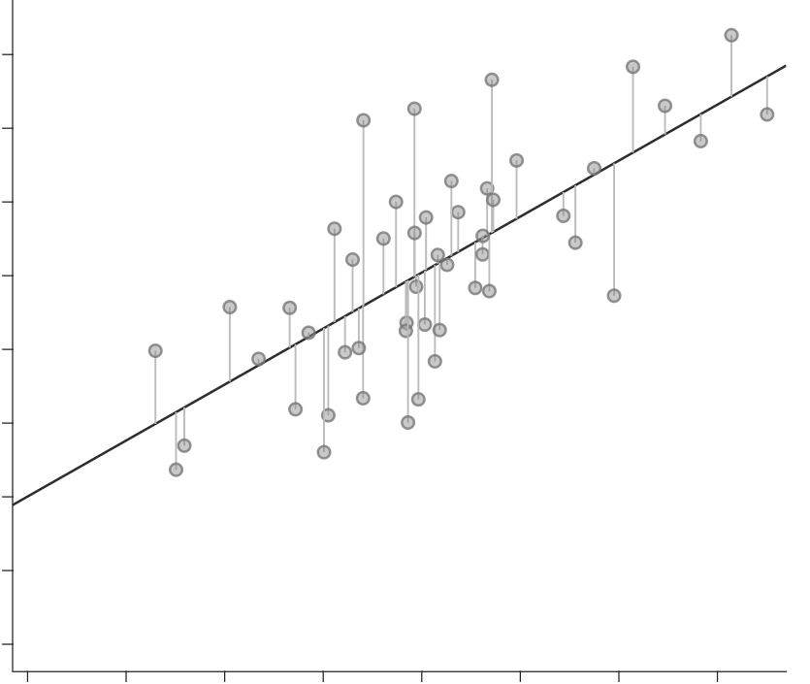
Residual
(observed value minus predicted value)
β₁
1
β₀
0

