Slide 1
Section #1: Tax Schedules and Progressivity
API 102A
Kelsey Pukelis
2022-01-28

Slide 2
Intro to the course
It’s (always) a great time to study economic and social policy!
Goals:
get comfortable using models, applying them, picking them apart
recognize, think critically about trade-offs
Note of the limitations of economic thinking

Slide 3
My goals for this class
Present technical and conceptual materials clearly
Engage in discussions about critical, timely policies
Highlight what we know and what we don’t about these topics (the research frontier)
Connect topics to popular culture, popular debate and discourse

Slide 4
Agenda
Review of tax rates, progressivity
Practice problems
Extras (if time)
Tax prep volunteering
Schmeduling

Slide 5

If you think taxes aren’t easy, you’re not alone
“The hardest thing in the world to understand is the income tax.”
--Albert Einstein
From Stefanie Stantcheva

Slide 6
Extras
Not included in exam material

Slide 7
Want to learn more about the tax system?
Learn by doing!
Volunteer to help low-income households file their taxes for free with HLS TaxHelp https://orgs.law.harvard.edu/taxhelp/
Training and passing exams required – likely self-study
Volunteer at Cambridge Public Library as much as you are able
Thursdays from 2 pm to 7 pm
Saturdays from 11 am to 4 pm
Initial questions, can email me
For more info, email hls.taxhelp@gmail.com

Slide 8
“Schmeduling”
To schmedule = to misperceive a (tax) schedule; to interpret (tax) rates incorrectly (Liebman and Zeckhauser 2004)
Common behavioral error
can also occur in non-tax settings
“when people have limited understanding of the actual schedules that they face, they are likely to perceive them in a crude fashion” (Liebman and Zeckhauser 2004)
These misinterpretations lead to mistakes in decision-making, and therefore welfare losses
(Note: the idea of a “mistake” is not uncontroversial in behavioral welfare economics)
Two types of schmeduling in theory: ironing and spotlighting

Slide 9
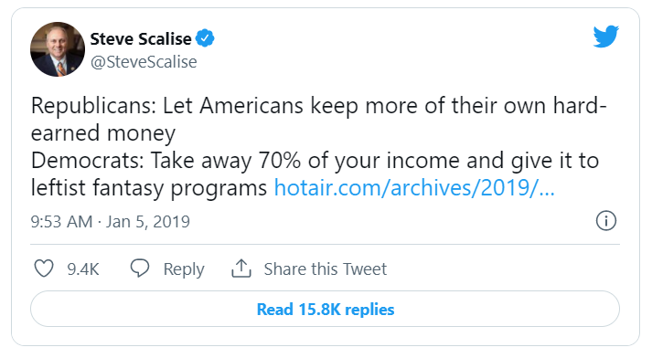
Example of schmeduling?

Slide 10
Ironing
“Ironing arises when an individual facing a multipart schedule perceives and responds to the average price at the point where he consumes” rather than the marginal price (Liebman and Zeckhauser 2004)
In other words, ironing is mistakenly behaving as though average tax rates are marginal tax rates.
Estimate: 43 percent of population irons in the context of U.S. taxes (Rees-Jones and Taubinsky 2020)

Slide 11
Ironing example (Liebman and Zeckhauser 2004)
An single individual earns $80,000 in 2021
Therefore she is in the 22 percent marginal tax bracket
But she observes her total tax liability (total taxes due): $10,575.50 [check my math for practice]
So she faces an average tax rate of 13.2 percent
≈ 10,575.5/80,000 * 100
BUT she makes decisions as if she faced a 13.2 percent marginal tax rate
This is a mistake! Why?

Slide 12
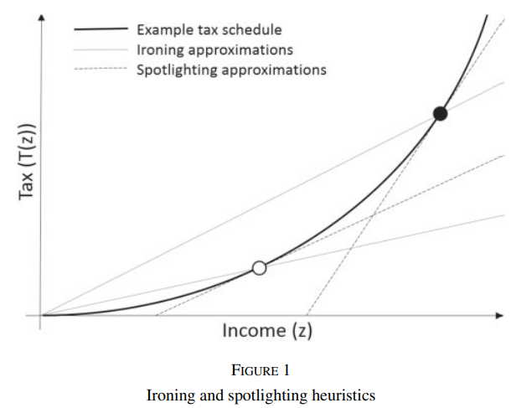
(Rees-Jones & Taubinsky 2020)

Slide 13
Spotlighting
“Spotlighting occurs when consumers identify and respond to immediate or local prices, and ignore the full schedule, even though future prices [tax rates] will be affected by current consumption [behavior].” (Liebman and Zeckhauser 2004)
In other words, “linearizing the tax schedule using one’s marginal tax rate” (Rees-Jones & Taubinsky 2020)
Basically, a problem of ignoring (tax) bracket cutoffs, a.k.a. changes in marginal tax rates
No evidence of spotlighting in the context of U.S. taxes (Rees-Jones and Taubinsky 2020)

Slide 14
Spotlighting example
A food stamp receipt consumes more food early in the month, when, because she has not exhausted her monthly food stamp allotment, food “seems” cheaper
She does not account for the fact that consuming her benefits now means the marginal price of food will be higher later in the month
The consequences of this are large. At the end of the month:
Hospitalizations increase (Basu et al. 2017)
Crime increases (Carr & Packham 2019)
Students perform worse on high-stakes tests, are less likely to attend college (Bond et al. 2022)
(Benefit amounts may also be inadequate)

Slide 15
Suggested extra reading
Schmeduling:
J. Liebman and R. Zeckhauser, 2004. “Schmeduling,” Harvard KSG Working Paper. Link
A. Rees-Jones and D. Taubinsky (2020). “Measuring ‘Schmeduling’”. The Review of Economic Studies 87.5, pp. 2399–2438 Link
Reich, R. (2018). Just giving: Why philanthropy is failing democracy and how it can do better. Princeton, New Jersey: Princeton University Press. Link
Arguments against the generous way philanthropy, foundations are treated in the U.S. tax system

