Slide 1
Section #2: Excess Burden (EB) and Behavioral Responses to Taxes
API 102A
Kelsey Pukelis
2022-02-04

Slide 2

The Beatles wrote about taxes: Taxman
Example from Stefanie Stantcheva

Slide 3
The Beatles wrote about taxes: Taxman
One, two, three, four
Let me tell you how it will be
There’s one for you, nineteen for me
’Cause I’m the taxman
Yeah, I’m the taxman
Should five per cent appear too small?
Be thankful I don’t take it all
’Cause I’m the taxman
Yeah, I’m the taxman
I’ll tax the street (If you try to sit, sit)
I’ll tax your seat
(If you get too cold, cold)
I’ll tax the heat (If you take a walk, walk)
I’ll tax your feet Taxman!
’Cause I’m the taxman
Yeah, I’m the taxman
Don’t ask me what I want it for
(Ha, ha, Mr. Wilson)
If you don’t want to pay some more
(Ha, ha, Mr. Heath)
’Cause I’m the taxman
Yeah, I’m the taxman
Now my advice for those who die
Declare the pennies on your eyes
Yeah, I’m the taxman (yeah, I’m the taxman)
And you’re working for no one but me (taxman!)

Slide 4
Outline
Review
Elasticity
Excess burden
Taxable income and behavioral responses to taxes
Extras (if time)
Equity
Efficiency
Clarifying externalities & internalities

Slide 5
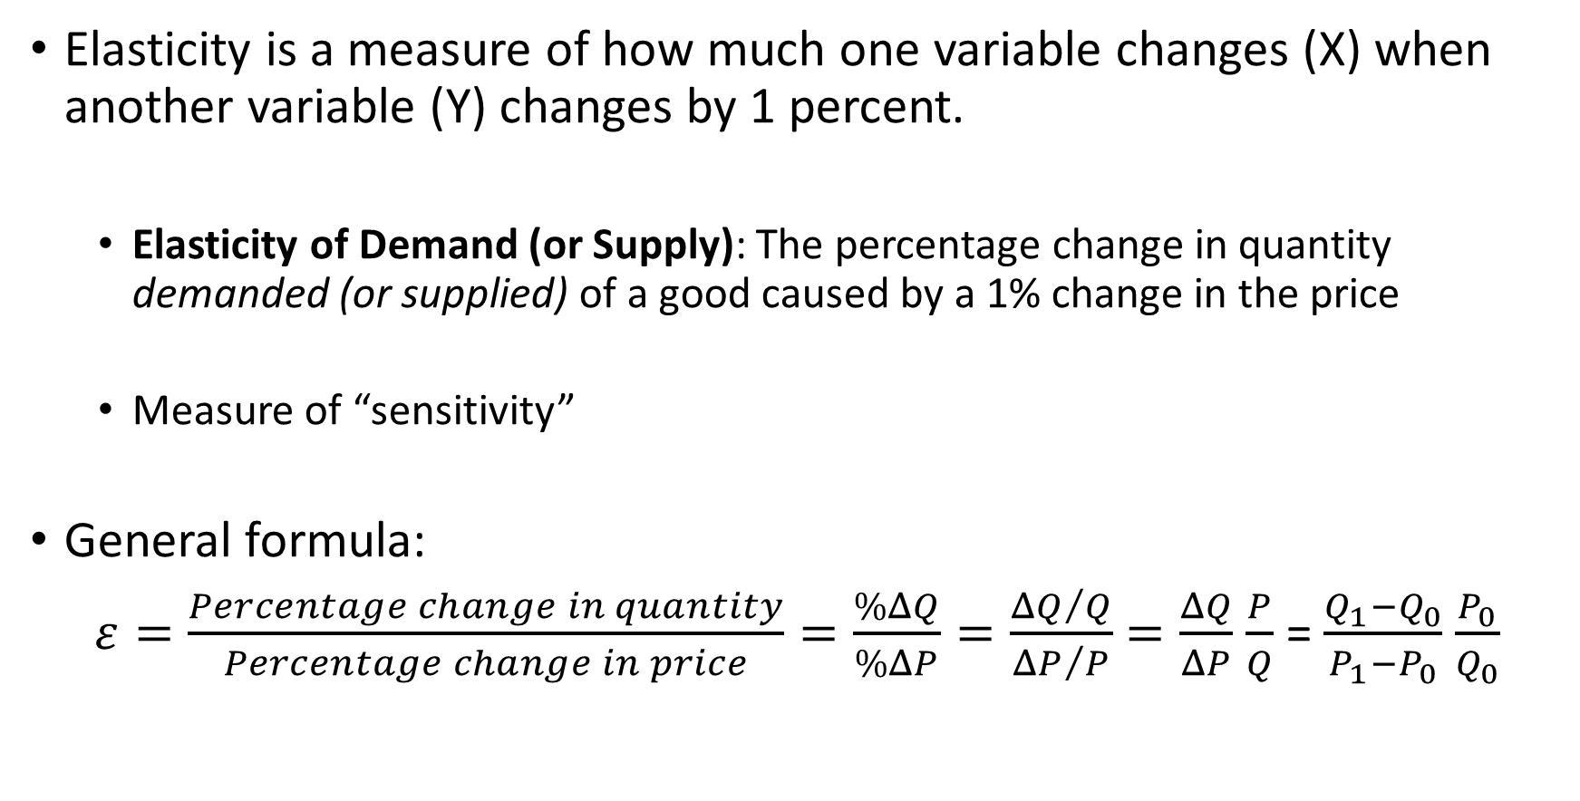
Quick Review: Elasticity
Elasticity is a measure of how much one variable changes (X) when another variable (Y) changes by 1 percent.
Elasticity of Demand (or Supply): The percentage change in quantity demanded (or supplied) of a good caused by a 1% change in the price
Measure of “sensitivity”
General formula:
$ε=\frac{Percentage change in quantity}{Percentage change in price}=\frac{\%ΔQ}{\%ΔP}=\frac{{ΔQ}/Q}{{ΔP}/P}$ $=\frac{ΔQ}{ΔP}$ $\frac{P}{Q}$ = $\frac{Q_{1}−Q_{0}}{P_{1}−P_{0}}$ $\frac{P_{0}}{Q_{0}}$

Slide 6
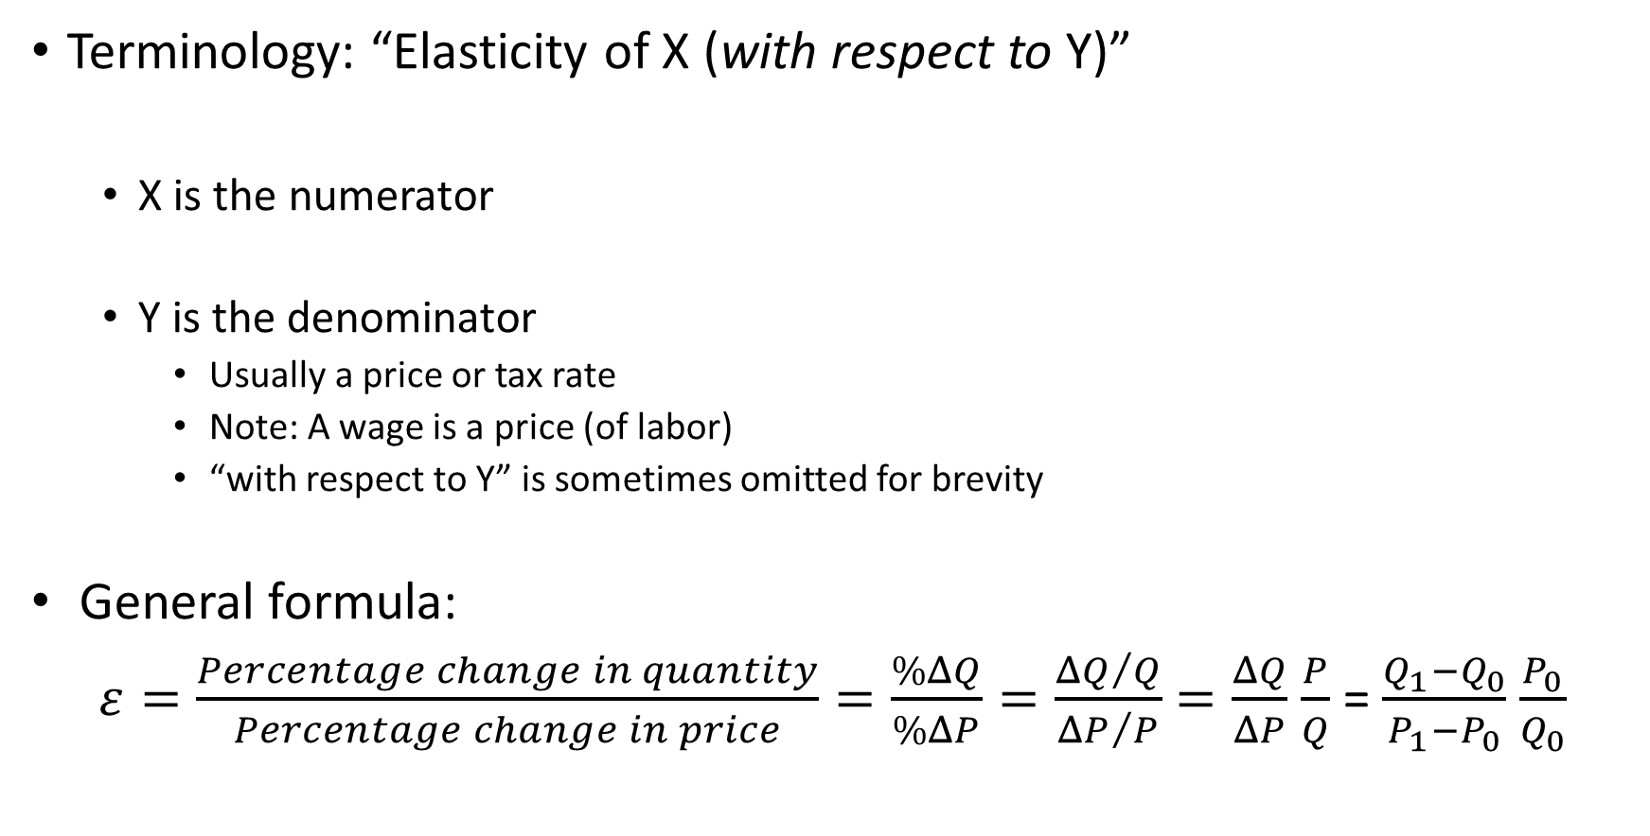
Quick Review: Elasticity
Terminology: “Elasticity of X (with respect to Y)”
X is the numerator
Y is the denominator
Usually a price or tax rate
Note: A wage is a price (of labor)
“with respect to Y” is sometimes omitted for brevity
General formula:
$ε=\frac{Percentage change in quantity}{Percentage change in price}=\frac{\%ΔQ}{\%ΔP}=\frac{{ΔQ}/Q}{{ΔP}/P}$ $=\frac{ΔQ}{ΔP}$ $\frac{P}{Q}$ = $\frac{Q_{1}−Q_{0}}{P_{1}−P_{0}}$ $\frac{P_{0}}{Q_{0}}$

Slide 7
Excess Burden (EB)
Note: synonymous with “Deadweight Loss” (DWL)

Slide 8
EB: Motivating Question
We need to raise $3.5 trillion.
What’s the efficiency cost of different approaches?
Note that we’re ignoring how we spend the $3.5 trillion!
We might spend on effective programs or ineffective programs
We might redistribute money to the poor or bailout large financial institutions
But regardless of how we spend the money, raising money via taxes has economic costs (economic activity that did not occur). EB quantifies these changes.

Slide 9

Okun’s leaky bucket analogy
analogy of taxes and transfers as a “leaky bucket”
“leakage” often used to describe the efficiency costs of taxation
Revenue leakage is a measure of this efficiency cost.
“The money must be carried from the rich to the poor in a leaky bucket. Some of it will simply disappear in transit, so the poor will not receive all the money that is taken from the rich” (Arthur Okun Equality and Efficiency, the Big Tradeoff, p. 91).

Slide 10
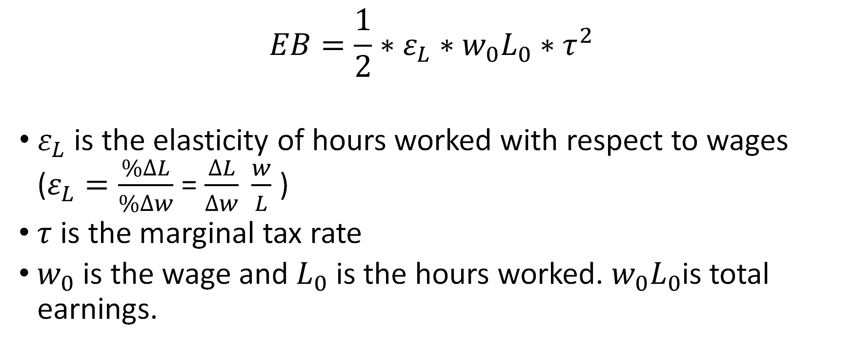
EB Equation from Class
$$EB=\frac{1}{2}∗ε_{L}{∗w_{0}L_{0}∗τ}^{2}$$
$ε_{L}$is the elasticity of hours worked with respect to wages ($ε_{L}=\frac{\%∆L}{\%∆w}$ = $\frac{∆L}{∆w} \frac{w}{L}$ )
$τ$ is the marginal tax rate
$w_{0}$ is the wage and $L_{0}$ is the hours worked. $w_{0}L_{0}$is total earnings.

Slide 11

Aside: Where did this formula come from?
Area of the Triangle = A:
$$EB= \frac{1}{2}∗∆L∗\left(w∗MTR\right)$$
$$EB= \frac{1}{2}∗∆L∗∆w$$
Labor Supply
Labor Demand
w⁰
A
w⁰(1-MTR)
EB(T) = A
L⁰
Quantity (Q)

Slide 12
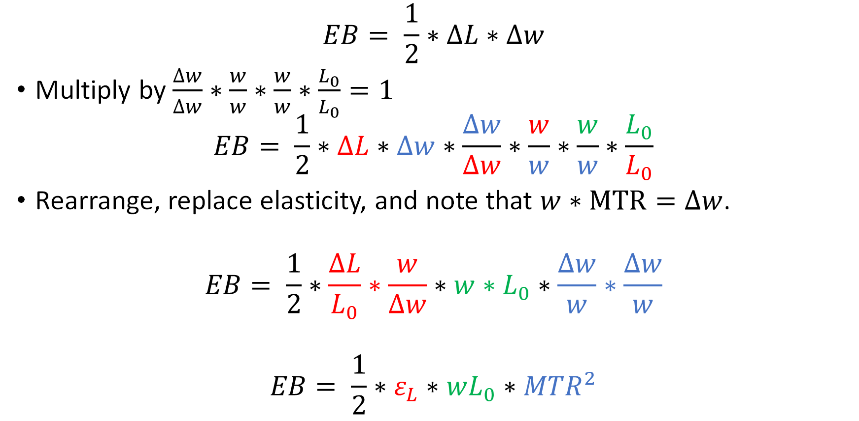
Aside: Where did this formula come from?
$$EB= \frac{1}{2}∗∆L∗∆w$$
Multiply by $\frac{∆w}{∆w}∗\frac{w}{w}∗\frac{w}{w}∗\frac{L_{0}}{L_{0}}=1$
$$EB= \frac{1}{2}∗∆L∗∆w∗\frac{∆w}{∆w}∗\frac{w}{w}∗\frac{w}{w}∗\frac{L_{0}}{L_{0}}$$
Rearrange, replace elasticity, and note that $w∗MTR=∆w$.
$$EB= \frac{1}{2}∗\frac{∆L}{L_{0}}∗\frac{w}{∆w}∗w∗L_{0}∗\frac{∆w}{w}∗\frac{∆w}{w}$$
$$EB= \frac{1}{2}∗ε_{L}∗wL_{0}∗{MTR}^{2}$$

Slide 13
Two key rules for EB
Higher elasticity → higher EB
Low elasticity: we can have progressive tax schedules and do lots of redistribution with small efficiency costs ☺
High elasticity: big efficiency costs to redistribution ☹
The EB rises with the square of marginal tax rate
Marginal EB of a tax is higher at higher tax rates
More efficient to have lower rates and a broader base, i.e. more sources of tax revenue

Slide 14
Taxable Income & Behavioral Responses to Taxation

Slide 15
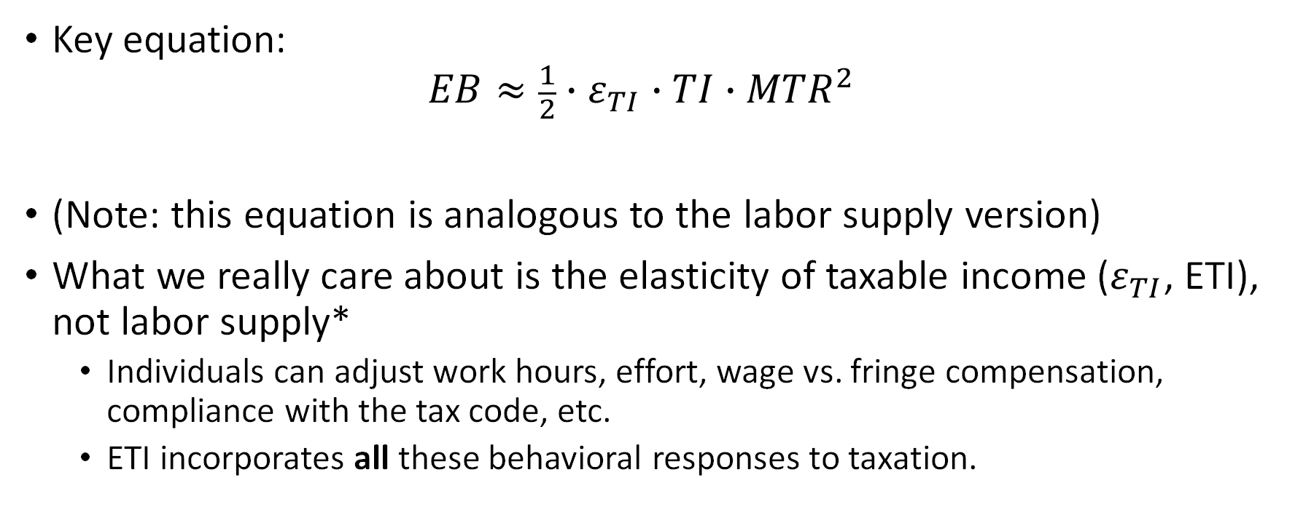
Taxable Income
Key equation:
$$EB≈\frac{1}{2}∙ε_{TI}∙TI∙{MTR}^{2}$$
(Note: this equation is analogous to the labor supply version)
What we really care about is the elasticity of taxable income ($ε_{TI}$, ETI), not labor supply*
Individuals can adjust work hours, effort, wage vs. fringe compensation, compliance with the tax code, etc.
ETI incorporates all these behavioral responses to taxation.
*This was a key result in Public Economics (Feldstein 1999)

Slide 16
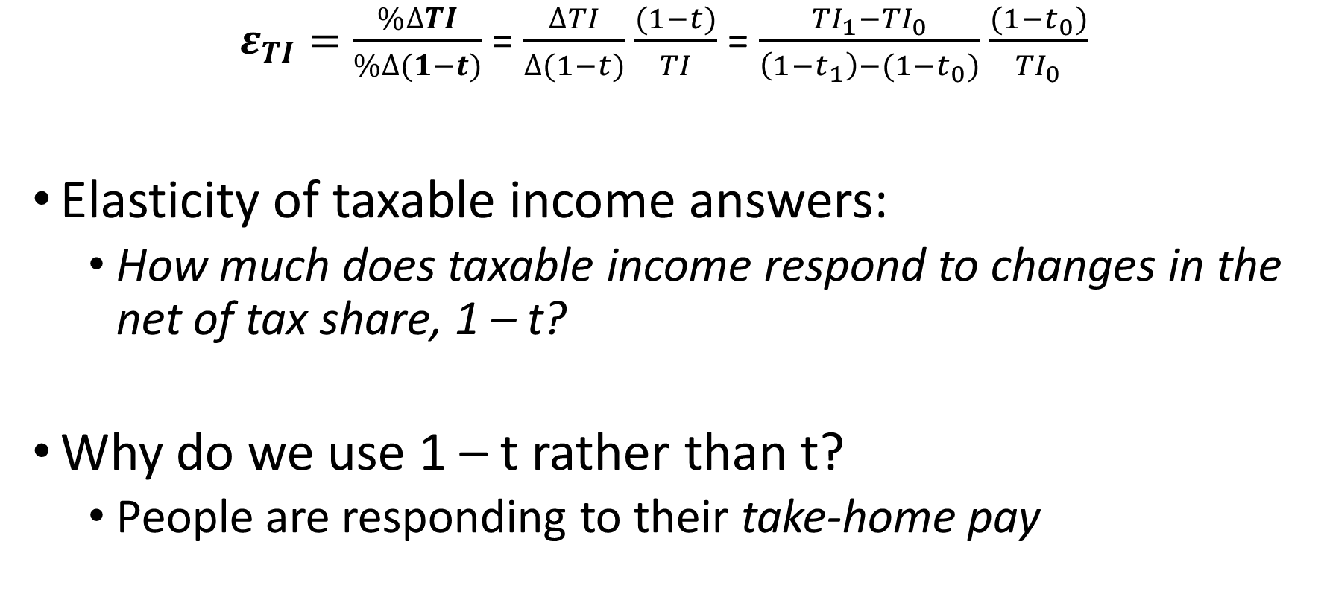
Elasticity of Taxable Income Explained
$ε_{TI}=\frac{\%∆TI}{\%∆(1−t)}$ = $\frac{∆TI}{∆(1−t)}$ $\frac{(1−t)}{TI}$ = $\frac{{TI}_{1}−{TI}_{0}}{\left(1−t_{1}\right)−(1−t_{0})}$ $\frac{(1−t_{0})}{{TI}_{0}}$
Elasticity of taxable income answers:
How much does taxable income respond to changes in the net of tax share, 1 – t?
Why do we use 1 – t rather than t?
People are responding to their take-home pay

Slide 17
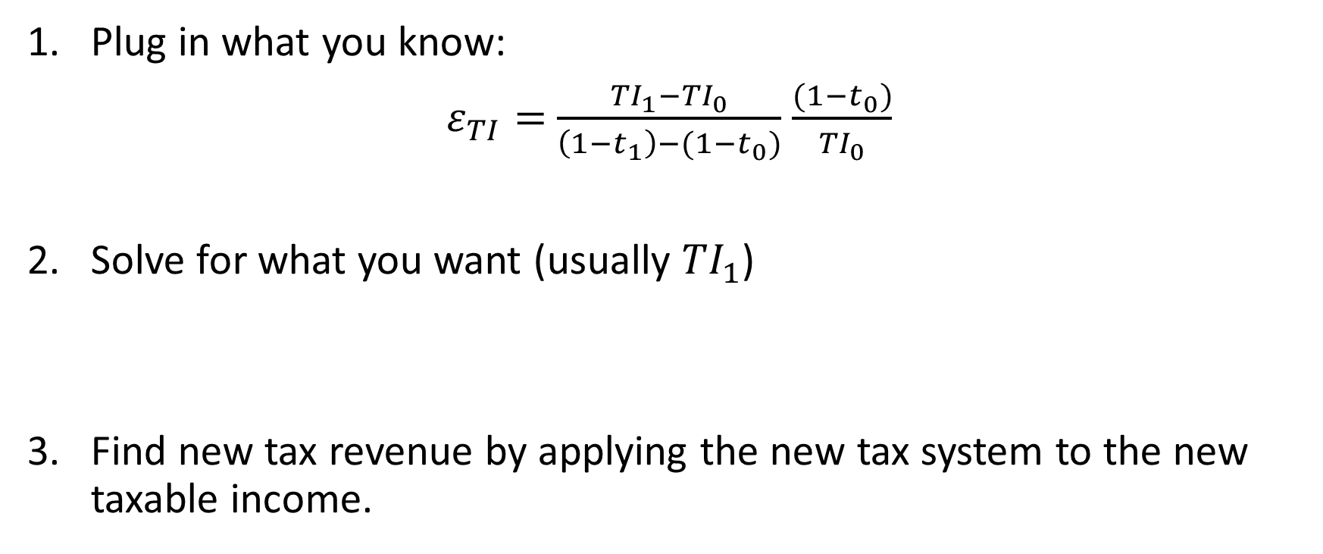
Practical advice
Plug in what you know:
$ε_{TI}=$ $\frac{{TI}_{1}−{TI}_{0}}{\left(1−t_{1}\right)−(1−t_{0})}$ $\frac{(1−t_{0})}{{TI}_{0}}$
Solve for what you want (usually ${TI}_{1}$)
Find new tax revenue by applying the new tax system to the new taxable income.

Slide 18
Extra: Equity

Slide 19
Quantifying equity
Social Marginal Welfare Weights = way to quantify how much society should care about different (income) groups
a concept used in optimal tax theory
There is no “ideal” notion of equity, and so no “ideal” social welfare weights
Which weights society should be used are determined by moral values, philosophy
Every tax system sets these weights implicitly

Slide 20
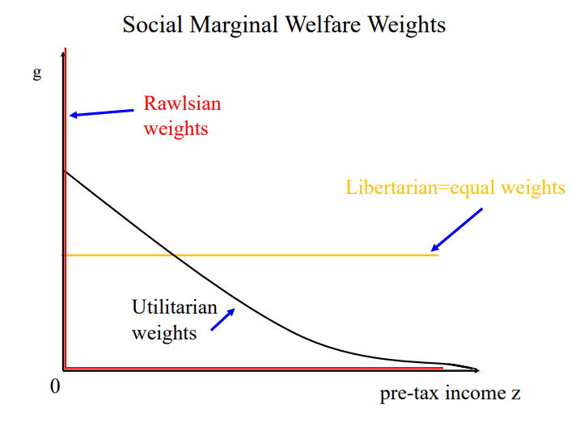
Quantifying equity: 3 (extreme) kinds of weights
Libertarian: equal weights on every individual, regardless of income
Rawlsian: all weight on the lowest income person
“difference principle”
Utilitarian: weights decrease with income because marginal utility decreases with income
think: Oreos or Peeps
Weights could theoretically be any line you can draw

Slide 21
How to think about equity principles?
Importance of political philosophy
Political philosophy has something to say about moral questions surrounding tax policy, redistribution, etc.

Slide 22
Extra: Efficiency
Largely based off of slides from Stefanie Stantcheva

Slide 23
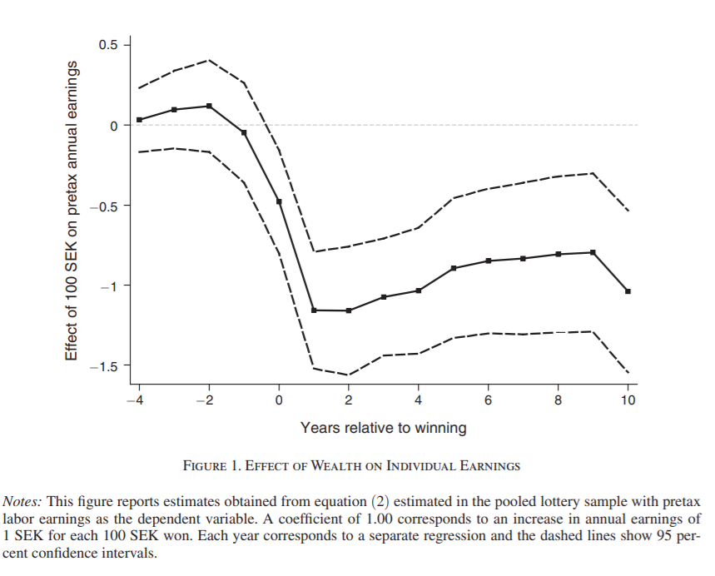
Labor supply and lotteries in Sweden
Q: How does people’s work behavior change when they win the lottery?
A: People work less, effect is immediate, small & quite stable
(Cesarini et al. 2017)

Slide 24
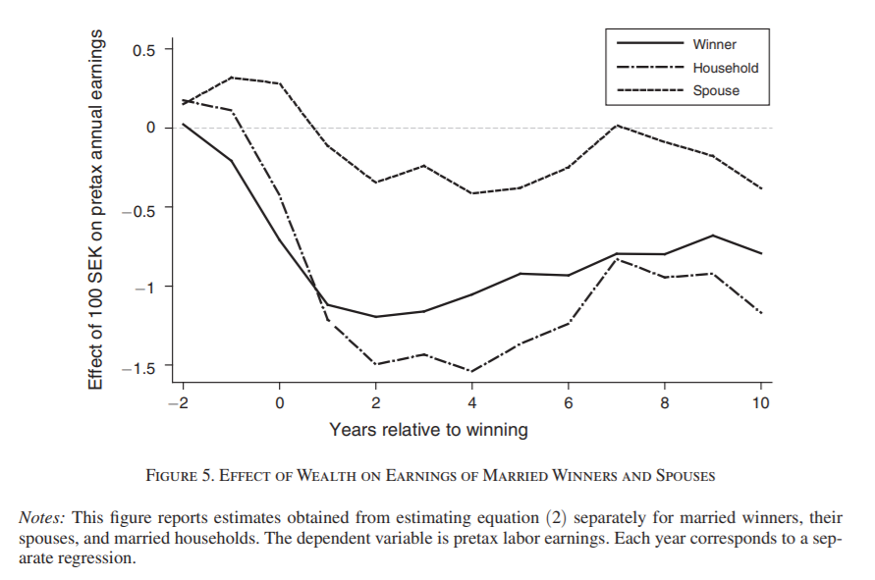
Effects on spouse, but not as large as winner

Slide 25
Long-term behavioral responses
Kibbutz are egalitarian and socialist communities in Israel, thrived for almost a century within a more capitalist society
Exactly equal sharing within Kibbutz
How to incentivize effort: social sanctions on shirkers
Shirkers are observable in these small communities with limited privacy
What might be the long-term effects of removing the equal sharing policy?
Hint: on high school students’ performance

Slide 26
Long-term behavioral responses
High school students study (a bit) harder once their kibbutz shifts away from equal sharing
Small effects on high school student performance:
3 pp (percentage points) more likely to graduate
6 pp more likely to achieve a matriculation certificate that meets university entrance requirements
3.6 more points on their exams, on average
Sources: Abramitzky-Lavy ECMA 2014; Abramitzky 2018 book

Slide 27
Intensive vs. extensive behavioral responses
Intensive (continuous):
Hours of work, work effort, training
Extensive (discrete):
Whether to work or not
E.g. retirement decisions
move away or stay (migration)
What does this imply about how tax rates should be set across place?

Slide 28

Behavioral responses of soccer players
European professional football players
(Top) tax rates differ across countries
How might soccer / football players respond to tax rates?

Slide 29
Behavioral responses of soccer players
Football players migrate in responses to tax rates – extensive margin response
After market deregulation in 1995
elasticity of the number of foreign players with respect to the net-of-tax rate ≈ 1
Can someone interpret this elasticity?
Domestic players: ≈ 0.15 – why do you think the domestic player elasticity is smaller than the foreign player one?
Sorting: low taxes attract high “ability” players who displace low-ability players
Displacement: low taxes on foreigners displace domestic players
Source: Kleven-Landais-Saez AER 2013

Slide 30
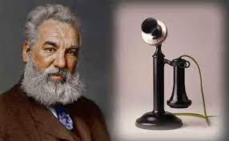
How might star inventors respond to taxes?

Slide 31
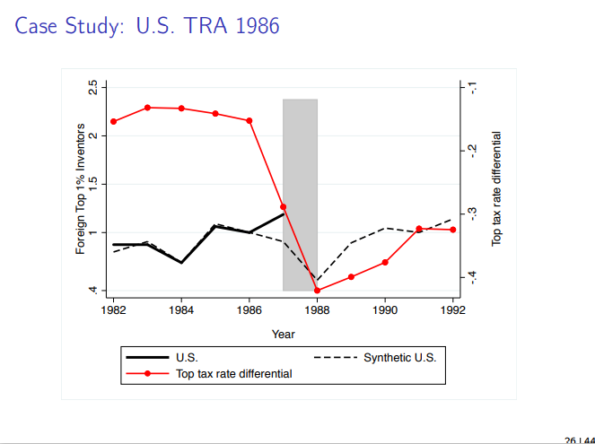
Source: Akcigit-Baslandze-Stantcheva AER 2016, using patent data

Slide 32
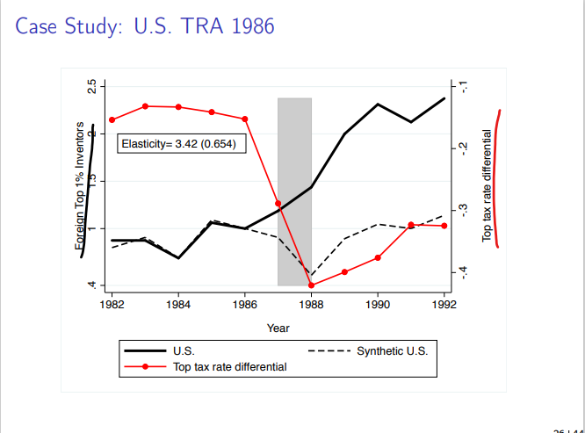
Source: Akcigit-Baslandze-Stantcheva AER 2016, using patent data

Slide 33
“Top of the Laffer curve” is not a point fixed in nature
Recall: top of the Laffer curve is the tax rate which maximizes government revenue, accounting for behavioral responses
It’s a theoretical concept: we don’t know exactly where it is
But, empirical studies tell us which side of the peak we are on
Key: the top of the Laffer curve is not fixed by Nature
Amount of leakage is a result of the design and implementation of our tax system
how much the system allows people to avoid or evade taxes can be changed

Slide 34
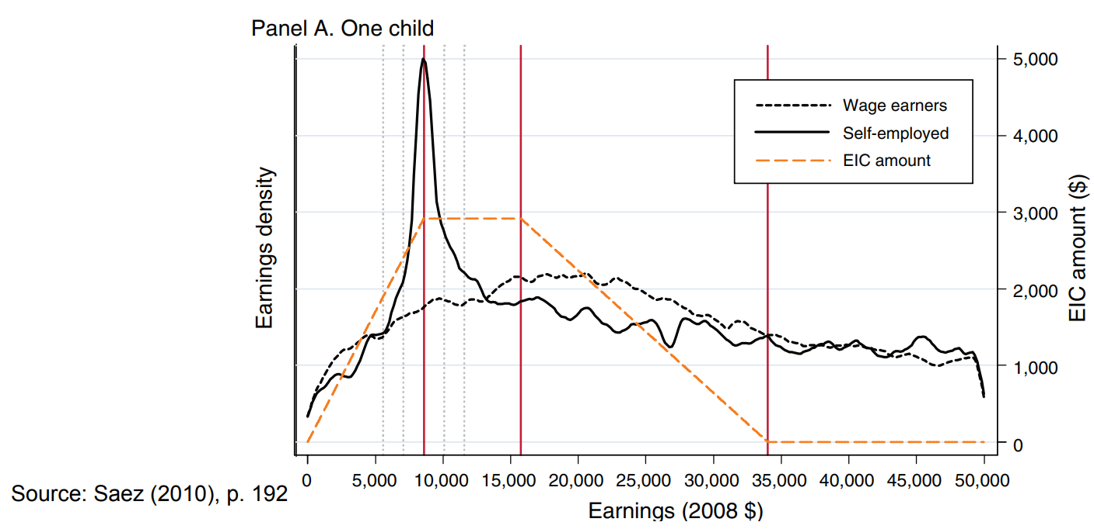
Self-employed manipulate reported earnings to maximize tax credit

Slide 35
Behavioral responses - shifting
Shifting: “moving money” to take advantage of lower tax rates
Type: shifting between types e.g. labor to capital income, in the same time period
What does this imply about how tax rates should be set across types?
Type: shifting between time periods a.k.a. intertemporal substitution
E.g. waiting to realize capital gains in a period with low capital gains taxes
Shifting usually does not reflect changes in real economic activity
A kind of “fiscal externality”

Slide 36
Key elements to avoid tax evasion and avoidance
Third-party reporting → lessen opportunities for tax avoidance
Broad tax base
Equalize tax rates across income types
To remove shifting
Tax coordination: equalize tax rates across geography
To remove avoidance by migration to tax havens
Equalize tax rates across time, to some extent
To remove avoidance by “hoarding” assets, for example

Slide 37
Extra: clarifying externalities & internalities

Slide 38
Externalities
Externality: when an individual’s action affects others; “spillovers”
E.g. smoking, mask-wearing
Justifies gov intervention. Why?
One their own, individuals would choose something that is not socially optimal--because of effects of others
E.g. smokers would like to smoke anywhere
Gov intervention encourages socially optimal behavior
E.g. government regulations now largely prohibit smoking in restaurants

Slide 39

Internalities
Internality: when an individual does not optimize
E.g. lack of information, misperception
Justifies government intervention. Why?
One their own, individuals would choose something that is not socially optimal *same as before* --this time because of effects on herself
E.g. people might smoke because they don’t know the negative effects of smoking on health
Gov intervention can encourage socially optimal behavior
E.g. requiring warning labels to be printed on cigarette boxes

Slide 40
Citations, extra readings
Feldstein, Martin. 1999. “Tax Avoidance and the Deadweight Loss of the Income Tax.” Review of Economics and Statistics 81 (4): 674–80.
Cesarini, David, Erik Lindqvist, Matthew J. Notowidigdo, and Robert Östling. 2017. "The Effect of Wealth on Individual and Household Labor Supply: Evidence from Swedish Lotteries." American Economic Review, 107 (12): 3917-46.
Kleven, Henrik Jacobsen, Camille Landais, and Emmanuel Saez. 2013. "Taxation and International Migration of Superstars: Evidence from the European Football Market." American Economic Review, 103 (5): 1892-1924.
Akcigit, U., Baslandze, S., & Stantcheva, S. (2016). Taxation and the international mobility of inventors. American Economic Review, 106(10), 2930-81.
Saez, E. (2010). Do taxpayers bunch at kink points?. American Economic Journal: Economic Policy, 2(3), 180-212.
Saez, E., & Stantcheva, S. (2016). Generalized social marginal welfare weights for optimal tax theory. American Economic Review, 106(1), 24-45.
John Rawls A Theory of Justice (political philosophy)

