Slide 1
Section #3: Inequality
API 102A
Kelsey Pukelis
2022-02-11

Slide 2
Outline
Gini practice
Supply and demand framework
Extras:
Human capital vs. signaling models of the returns to education
Supply-Demand-Institutions framework
Unions and inequality
Minimum wage and inequality

Slide 3
Measures of Inequality and Gini Index

Slide 4
Quick review: Measures of Inequality
Top X% shares (X = 1%, 10%, 0.1%, etc.)
= (Total income earned by top X%) / (Total income earned by everyone)
Captures inequality driven by the very top
Pros: only need data on top earners, total income
Cons: miss what’s going on in the rest of the distribution
Percentile ratios
E.g., 90/50 ratio: Ratio of income at 90th% to income at 50th% (median)
Cons: Misses inequality from the very top (and bottom)
Gini index (or Gini coefficient)
Summarizes inequality across entire distribution (Pro)
Basic idea: Measure “how far” the distribution is from perfect equality
Cons: A lot of data needed

Slide 5
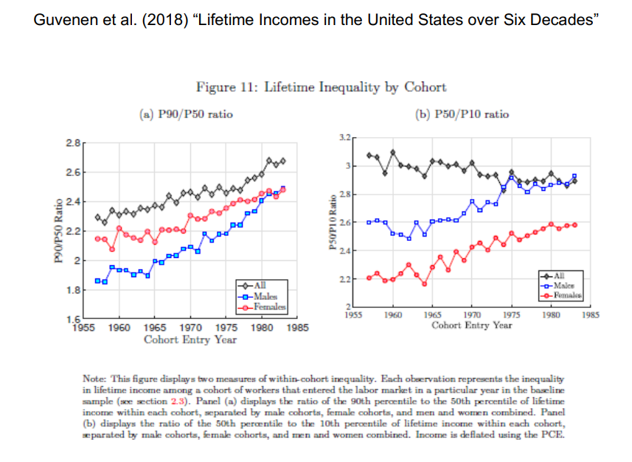

Slide 6
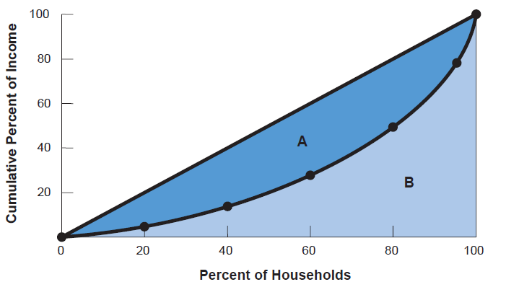
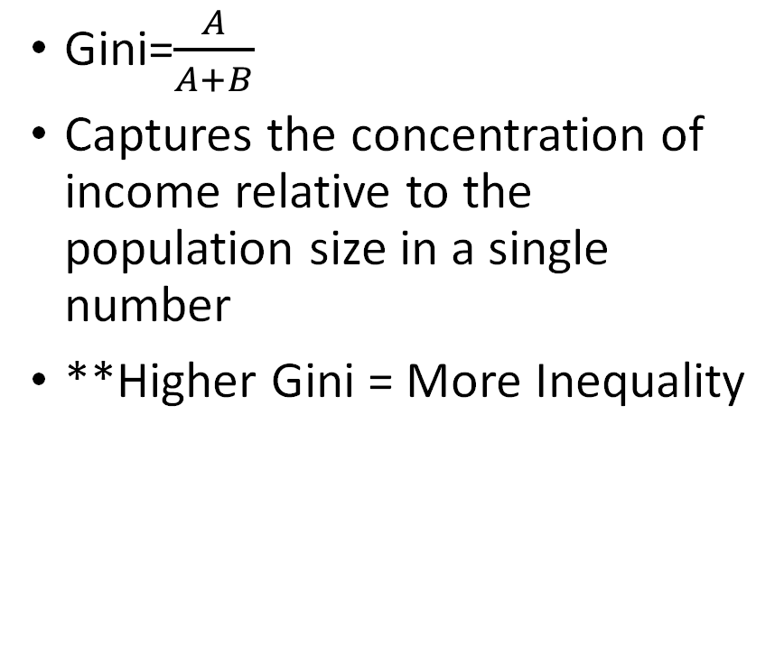
Calculating the Gini Coefficient: A/(A+B)
Gini=$\frac{A}{A+B}$
Captures the concentration of income relative to the population size in a single number
**Higher Gini = More Inequality
Source: U.S. Census Bureau, Historical Income Tables, Households, Table H-2.

Slide 7
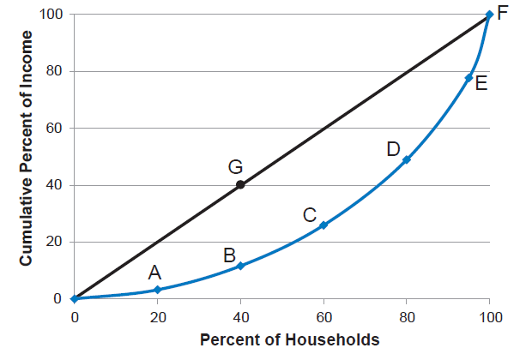
How to make a Lorenz Curve
Table column 1: Order households from lowest to highest income
Col 2: Cumulative income
E.g. third line in table is income totaled across 3 poorest individuals
Col 3: Total income in economy
Col 4: cumulative inc as % of total inc
= col 2 / col 3 * 100%
Col 5: Cumulative % of population
E.g. if 20 people, increment by 5%
Plot: cumulative % of income (y-axis, col 4) against cumulative % of population (x-axis, col 5)
45-degree line represents absolute equality
Source: U.S. Census Bureau, Historical Income Tables, Households, Table H-2.

Slide 8
Extra Practice Problem - Gini
Suppose that there are 5 individuals in the economy and no taxes or transfers. Everyone’s annual income is given in the following table.
Plot the Lorenz curve for this economy.
Suppose all incomes rise by 10,000. How does the Gini Index change?
Suppose all incomes rise by 25%. How does the Gini Index change?
Ann | $10,000
Bryan | $20,000
Catelyn | $40,000
Yasmin | $55,000
Ellen | $75,000

Slide 9
Practice Problem a
 | (1) | (2) | (3) | (4) | (5)
Ann | $10,000
Bryan | $20,000
Catelyn | $40,000
Yasmin | $55,000
Ellen | $75,000

Slide 10
Practice Problem a
a) First, cumulative income percentiles.
Quintile | Percent of Income | Cumulative Percent of Income
Lowest fifth | $10,000 /$200,000=5% | 5%
Second fifth | 10% | 15%
Middle fifth | 20% | 35%
Fourth fifth | 27.5% | 62.5%
Highest fifth | 37.5% | 100%

Slide 11
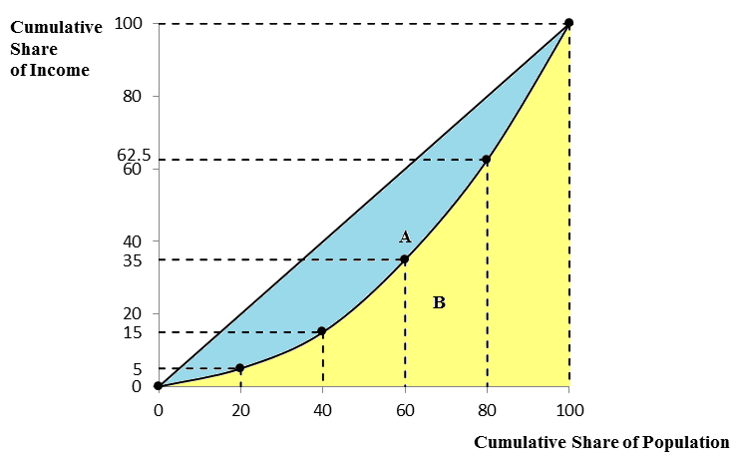
Practice Problem a
Note: The Gini coefficient would be calculated as the ratio of the area between the Lorenz curve and the 45-degree line and the total area below the 45-degree line; in other words, A/(A+B) as shown in the graph. (Note: this is too tedious of a calculation to include in Pset or exam, but important conceptually.)
Line of Equality
(45⁰)
Lorenz Curve

Slide 12
Practice Problem b
Suppose all incomes rise by 10,000. How does the Gini Index change?
b) Intuition:
 | (1) | (2) | (3) | (4) | (5)
Ann | $20,000
Bryan | $30,000
Catelyn | $50,000
Yasmin | $65,000
Ellen | $85,000

Slide 13
Practice Problem
b) The $10,000 increase the share of income held by low earners, so the Gini index decreases.
I’ve done out the math on the next slide in case it helps with intuition, but you can answer this question intuitively without doing new calculations
However, if you were asked to plot and label the new Lorenz curve (like you will be on the next problem set), you’ll have to do the math in order to properly plot and label the new points .

Slide 14
Practice Problem
 | Income after 10,000 increase
Ann | $20,000
Bryan | $30,000
Catelyn | $50,000
Yasmin | $65,000
Ellen | $85,000
Quintile | Percent of Income | Cumulative Percent of Income
Lowest fifth | $20,000/$250,000=8% | 8%
Second fifth | 12% | 20%
Middle fifth | 20% | 40%
Fourth fifth | 26% | 66%
Highest fifth | 34% | 100%

Slide 15
Practice Problem c
Suppose all incomes rise by 25%. How does the Gini Index change?
c) Intuition:
 | (1) | (2) | (3) | (4) | (5)
Ann | $10,000*0.25
Bryan | $20,000*0.25
Catelyn | $30,000*0.25
Yasmin | $55,000*0.25
Ellen | $75,000*0.25

Slide 16
Practice Problem
c) The proportional increase doesn’t change the share of total income received by each person, so the Gini index remains the same.
I’ve done out the math on the next slide in case it helps with intuition, but you can answer this question intuitively without doing new calculations.

Slide 17
Practice Problem
 | Income after 25% increase
Ann | $12,500
Bryan | $25,000
Catelyn | $50,000
Yasmin | $68,750
Ellen | $93,750
Quintile | Percent of Income | Cumulative Percent of Income
Lowest fifth | $12,500/$250,000=5% | 5%
Second fifth | 10% | 15%
Middle fifth | 20% | 35%
Fourth fifth | 27.5% | 62.5%
Highest fifth | 37.5% | 100%

Slide 18
Extra Practice Problem - Gini
Consider the same economy as before. But now, we have taxes and transfers: suppose there is a $65,000 deduction, with an MTR of 50% on any remaining taxable income. All taxes collected are redistributed equally to the 2 poorest people in the economy. Assume the rich have a behavioral response, with a taxable income elasticity that is quite small: 0.1. Everyone’s initial annual income is given in the following table.
What is Ellen’s taxable income after accounting for her behavioral response to taxes?
What is the total tax revenue collected?
What is the total size of transfers given? What is the size of each individual transfer?
Ann | $10,000
Bryan | $20,000
Catelyn | $40,000
Yasmin | $55,000
Ellen | $75,000

Slide 19
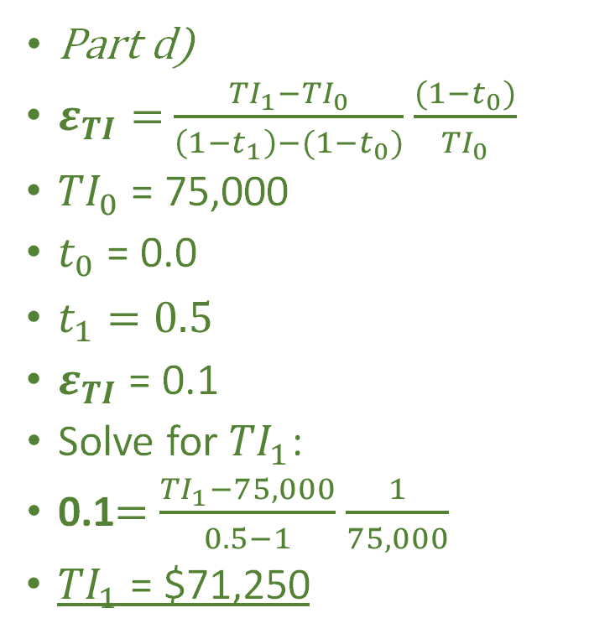
Extra Practice Problem – Gini
Part d)
$ε_{TI}=$ $\frac{{TI}_{1}−{TI}_{0}}{\left(1−t_{1}\right)−(1−t_{0})}$ $\frac{(1−t_{0})}{{TI}_{0}}$
${TI}_{0}$ = 75,000
$t_{0}$ = 0.0
$t_{1}=0.5$
$ε_{TI}$ = 0.1
Solve for ${TI}_{1}$:
0.1$=$ $\frac{{TI}_{1}−75,000}{0.5−1}$ $\frac{1}{75,000}$
${TI}_{1}$ = $71,250
Part e)
Taxable income = total income – deduction = 71,250 – 65,000 = $6,250
50% MTR applies to the taxable income, so
Total tax revenue collected (from Ellen) = 6250*0.5 = $3,125
Part f)
Total transfers given must equal total tax revenue collected = $3,125
Size of indiv transfer, since given to two people:
2T = 3125
So T = 3125/2 = $1,562.50

Slide 20
Extra Practice Problem - Gini
On your own: fill in the following table
On your own: Plot the Lorenz curve for this economy before and after taxes and transfers.
 | Income before tax change | Income before taxes and transfers | Income after taxes and transfers
Ann | $10,000
Bryan | $20,000
Catelyn | $40,000
Yasmin | $55,000
Ellen | $75,000

Slide 21
Extra Practice Problem - Gini
 | Income before tax change | Income before taxes and transfers | Income after taxes and transfers | Cumulative income, after taxes and transfers | Cumulative % income (y-axis of Lorentz curve, after) | Cumulative % of households (x-axis of Lorentz curve)
Ann | $10,000 | $10,000 | 10,000+1562.50= $11,562.50 | $11,562.50 | 5.89 | 20
Bryan | $20,000 | $20,000 | 20,000+1562.50= $21,562.50 | $33,125 | 16.88 | 40
Catelyn | $40,000 | $40,000 | $40,000 | $73,125 | 37.26 | 60
Yasmin | $55,000 | $55,000 | $55,000 | $128,125 | 65.29 | 80
Ellen | $75,000 | $71,250 | 71250-3125 = $68,125 | $196,250 | 100 | 100

Slide 22
Supply-demand framework
Race between education and technology (Katz & Goldin)

Slide 23
“Education-Technology Race” Model
Changes in broad inequality are mostly accounted for by rising returns to education.
Review: What do we mean by the “returns to education”?
But why have returns to education increased?
Key economic model and evidence presented by Claudia Goldin and Larry Katz in The Race Between Education and Technology (2008)
Known as the “Education-Technology Race” model
Or Supply-Demand(-Institutions) framework

Slide 24
Supply and demand framework: big picture
Framework introduced in class to understand wage inequality dynamics over time
Supply and demand of what? _______
Supply in this context is _______
Demand in this context is driven primarily by _______

Slide 25
Supply and demand framework: big picture
Framework introduced in class to understand wage inequality dynamics over time
Supply and demand of what? Skill
Supply in this context is education, i.e. the supply of skill in the economy
Demand in this context is driven primarily by technology, or technological change
Key insight: Returns to education determined by supply & demand of skill, or equivalently skilled workers, in the economy

Slide 26
Aside on “skill” terminology
“High-skill” typically refers to college grads (vs. lower skilled HS grads), but the term could also be applied to other, often finer dimensions of skill.
Skill and education are roughly interchangeable in these discussions
The use of the word “skill” has been discussed / criticized recently in economics and related circles.
I will use these terms freely, as they are in the literature

Slide 27
Two Key Trends
Demand for high-skilled has increased steadily over time
Key story: “Skill-biased technical change”
Computers and automation have made high-skilled workers more productive, but have replaced middle-skilled jobs (e.g., clerical work, manufacturing)
Supply growth of high-skilled has fluctuated over time
1900s-1970s: Growth of number of college grads
Early 1970s-onwards: Slowdown in growth of college grads
Punchline: steady increase in demand for college workers + slowdown in the growth of college grads → rising wage inequality
in particular, the college/non-college wage gap

Slide 28
Skill-biased technological changes: examples
Industrial robots
Broadband internet
Computers, information technology
“automation”

Slide 29
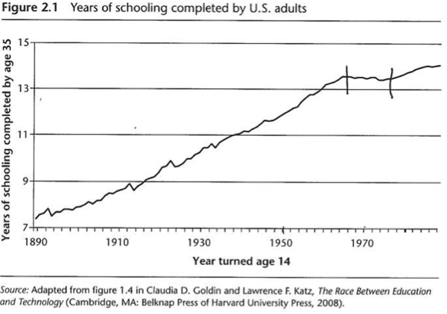
Supply: Decelerating Supply of Education
…but technology marches forward.

Slide 30
Race between Education and Technology
Low-Education
High-Education
Wage
Wage
S₀
S₀
W_{High}
D₀
Education wage gap
(= returns to education)
D₀
W_{Low}
Q of Workers
Q of Workers

Slide 31
Take-Aways
Pay gap between high and low-skill workers are driven by a “race” between supply and demand of educated workers or skill
Changes in technology increase demand for educated workers. Can supply keep up?
Policy implications:
Increasing pay gaps between high- and low-skill workers are not inevitable
Investments in education can play a key role in offsetting rising inequality

Slide 32
Extras

Slide 33
Human capital vs. signaling models of returns to education
Pure human capital: education provides real skills valuable in the labor market
Prediction: Increasing education for some would:
increase their earnings
not affect earnings of other groups
Pure signaling: education provides no skills; level of education as just a signal of innate “ability”
The only reason college-goers earn more than HS grads is because they have signaled they are smarter
Predictions: Increasing education for some would:
Short-term: Increase their earnings BUT also effect wage level of other groups
Long-term: “rat race” – others would like to increase their education to keep up same wages
Real world: some combination of both, but mostly human capital

Slide 34
Evidence: Human capital
Compulsory schooling laws increase earnings for affected cohorts
Students who just cross FIU GPA admissions threshold see earnings increase – 8.7 percent (Zimmerman 2014)
Individuals who win lottery to attend nursing schools see increased earnings – 44 percent (Grosz 2020)
Qualification: education needs to be good quality
4-year colleges vs. 2-year colleges’ graduation rates
For-profit vs. public/private non-profit

Slide 35
Example: signaling model setup
3 possible education levels: HS dropout, HS grad, college
Each with corresponding wage
Individuals’ personal cost of schooling increases with “ability”
Higher ability → easier to attend more school
Employers don’t observe individual ability
Only observe schooling level
→ one wage for each schooling level, which reflects the avg ability of the group (“pooling”)
Imagine sudden increase in college access

Slide 36
Example: signaling model prediction
Imagine sudden increase in college access
→ highest ability individuals who would have been HS grads now go to college
→ employers know average ability among HS grads has fallen, so wages for HS grads fall
→ among those who would have been HS grads, lowest ability individuals now drop out of HS
because finishing HS has a lower reward, or wage
→ key prediction: increase in college access → increase in HS dropout rates
Some, but weak evidence of this (Bedard 2001)

Slide 37
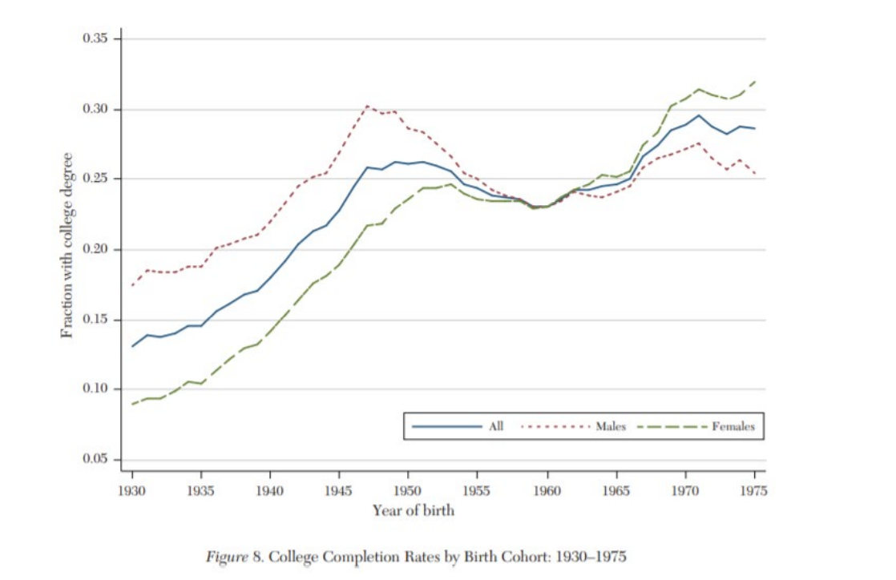
College-going trends differ for women
Why do I bring this up? (1) it’s important! and (2) labor economists have studied men much more than women

Slide 38
Labor force participation rates by gender
Source: https://www.bls.gov/opub/reports/womens-databook/2020/home.htm#:~:text=Women's%20labor%20force%20participation%20was%2057.4%20percent%20in%202019%2C%20up,previous%20year%20(69.1%20percent) Table 2

Slide 39
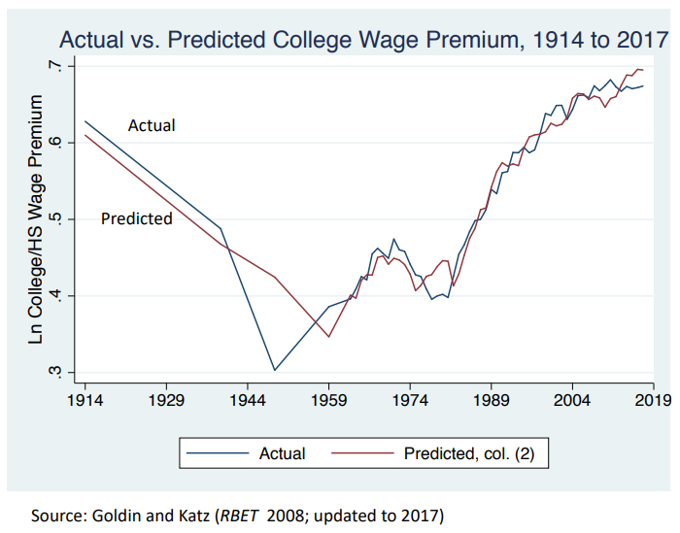
When do SD predictions deviate from reality?

Slide 40
Supply-demand-institutions (SDI) framework
Katz-Goldin: supply and demand of skilled workers explains much of the variation in wage gaps between education groups over time
Any gaps or “anomalies” can be explained by outsized influence of institutions
There is some disagreement among economists about how much institutions matter for wage inequality
Key concern: are the timing of institutional changes truly random/exogenous?

Slide 41
Which “institutions” might influence wage inequality?
Unions
Minimum wage
Works councils (Europe)
Shift to “performance” pay
commission
Fissuring of the workplace, i.e. contracting, outsourcing
e.g. food service workers at Harvard no longer work for Harvard directly
Monopsony?
i.e. rising monopoly power in labor market
Changes in pay setting norms, decline in worker power (Stansbury & Summers)
Trade policy (China shock), globalization, immigration
Child care..?
Based on slide from Larry Katz

Slide 42
With all of these factors, things are quite complex!
Wage structure changes likely are a result of all three:
Supply and Demand Shocks
what the problem set focuses on
Interactions of Market Forces and Institutions
Institutional Changes

Slide 43
How might unions reduce wage inequality?
Institutionally, through rules governing labor markets:
Union membership wage premium (selection problem?)
Non-members can still enjoy increased wages if covered by a union contract
Culturally
Union threat effect: firms increase wages to prevent union formation; can affect entire industries or segments of the economy
Unions could influence pay setting norms, job security, etc.
Politically
Unions are one of the few kinds of political interest groups which represent the working class
Thus, can also advocate for more generous social policy (not wage inequality, but transfer policy)
(Western & Rosenfeld 2011, Brady et al 2013)

Slide 44
Unions and inequality: evidence
1936-present
mid-20th century: union households were much less educated and more nonwhite
pre-World War II and today: union and nonunion hh’s are similar
Union wage premium steady throughout entire period (10-20%)
“consistent evidence that unions reduce inequality, explaining a significant share of the dramatic fall in inequality between the mid-1930s and late 1940s”
Source: Farber et al 2021: “Unions and Inequality over the Twentieth Century: New Evidence from Survey Data”

Slide 45
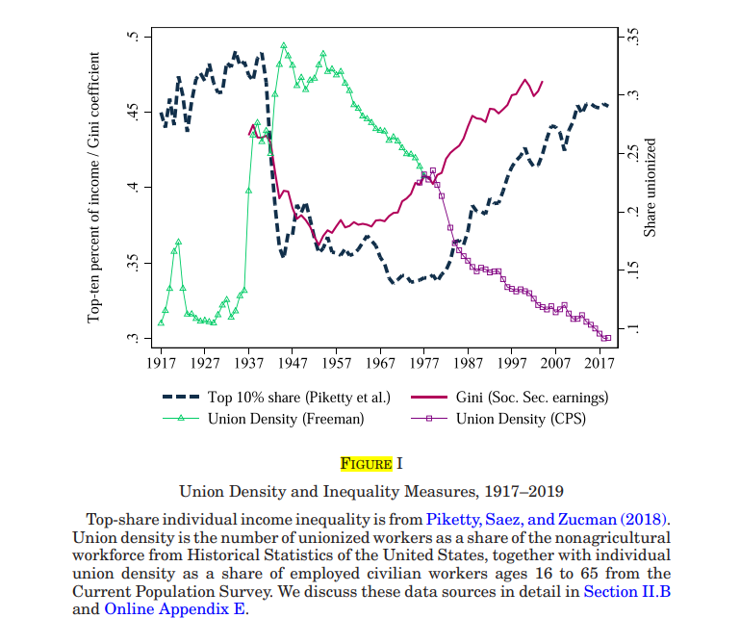

Slide 46
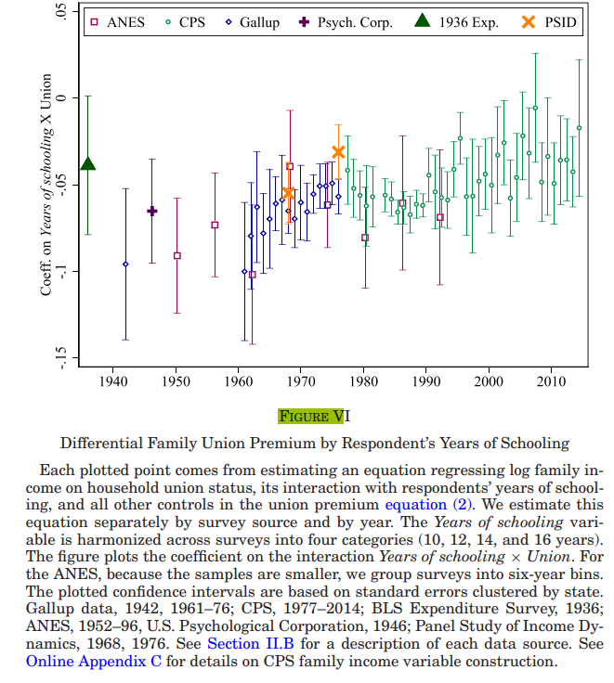
Unions membership more beneficial for lower-education individuals

Slide 47
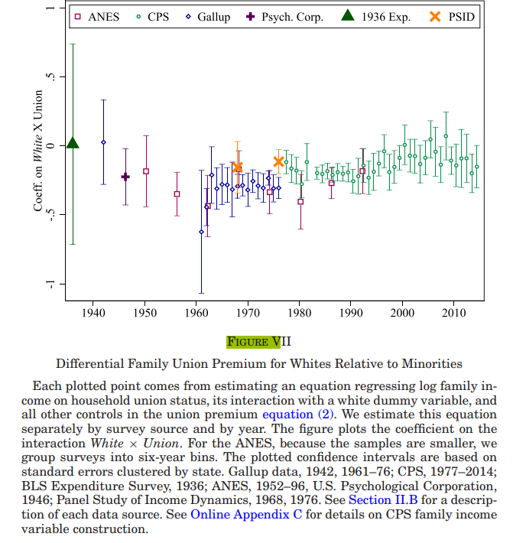
Union membership slightly more beneficial for racial minorities

Slide 48
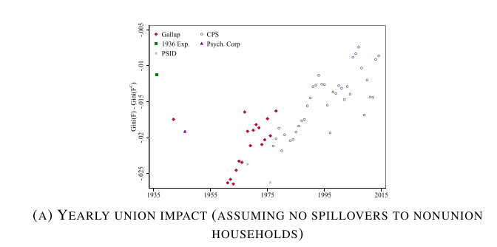

Slide 49
Why raising the minimum wage might not reduce wage inequality?
If employers cut low-wage employment in response.
But little evidence of this in the past
Still, we’re not sure what would happen for an unprecedented, large min wage increase

Slide 50
How might raising the minimum wage reduce wage inequality?
Directly affected workers, or for whom the new minimum wage “binds”
Spillovers for workers near the minimum wage
Evidence: for workers within ≈$4 above the new min wage (Cengiz et al 2019)
Evidence: for workers within several percentile groups of the min wage level (Autor et al 2016)
Any effects should be concentrated at bottom of income distribution (e.g. 50/10)

Slide 51
Minimum wage and inequality: evidence
Overall: “We find that the minimum wage reduces inequality in the lower tail of the wage distribution, though by substantially less than previous estimates” (Autor et al 2016)

Slide 52
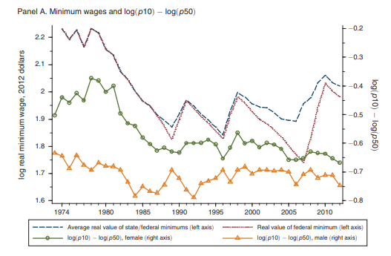
Lower-tail inequality (50/10)

Slide 53
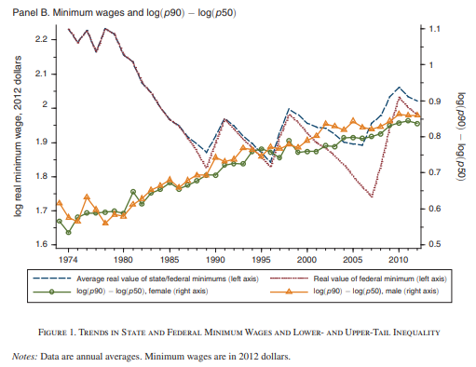
Upper-tail inequality (90/50)

Slide 54
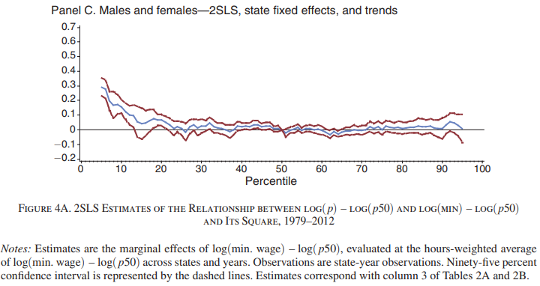
Min wage raises wages at the bottom of the income distribution

Slide 55
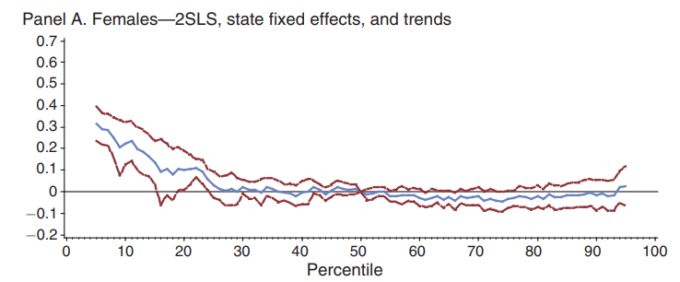
Slightly moreso for women

Slide 56
Expansion of min wage in 1967 reduced the black-white earnings gap
Compared to other policies, the population covered by this policy was more likely to be black
Policy “can explain more than 20% of the reduction in the racial earnings and income gap during the civil rights era”
(Derenoncourt & Montialoux 2021)

Slide 57
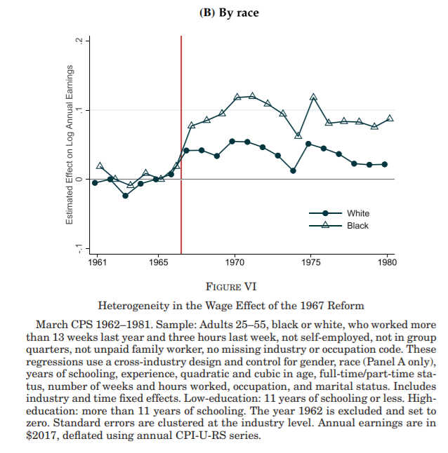
Earnings increased more for black workers

Slide 58
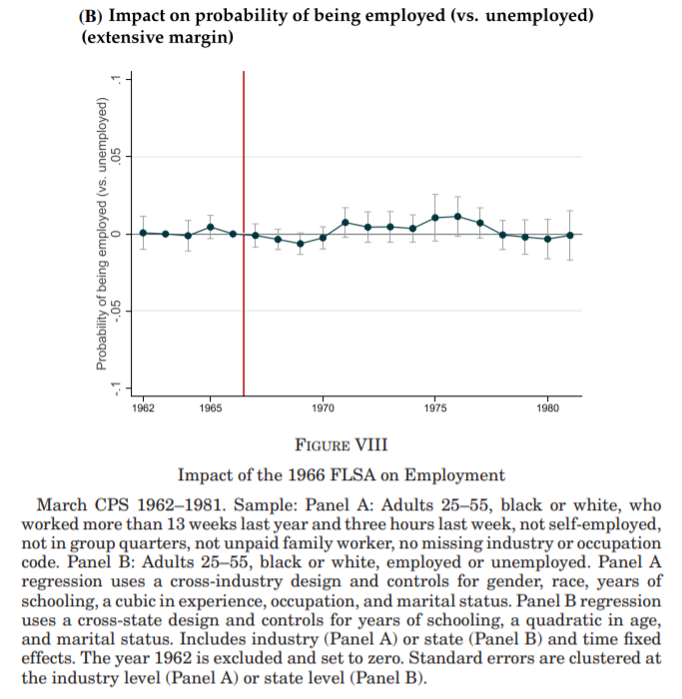
No effect on employment (or hours worked)

Slide 59
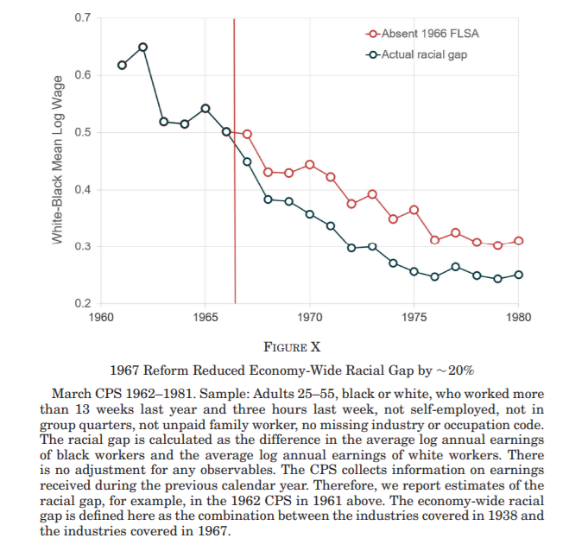
Reform reduced racial wage inequality

