Slide 1
Natural Disasters, Health, and Food Assistance
Kelsey Pukelis
Economics of Health Equity Course
April 23, 2025

Slide 2
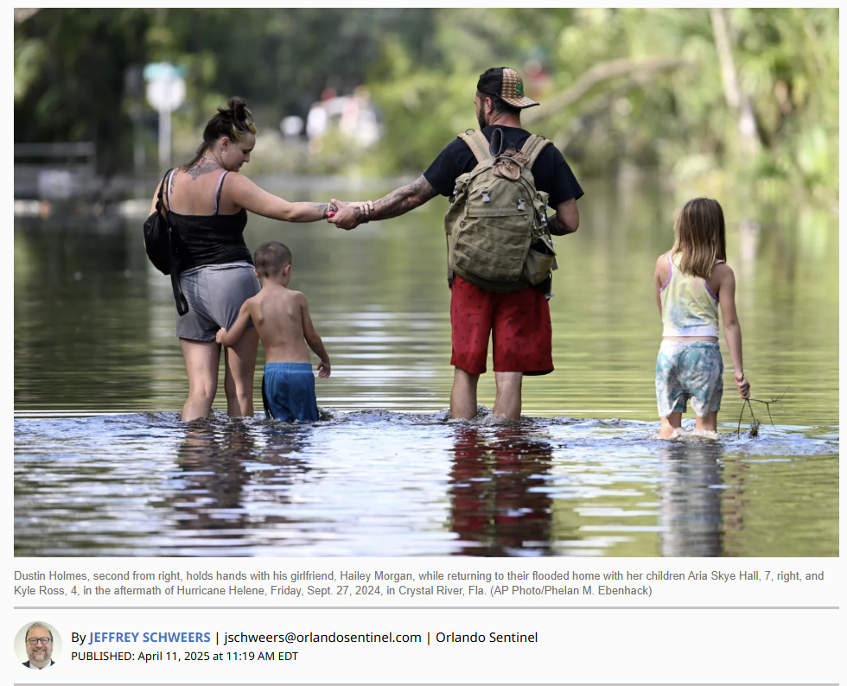
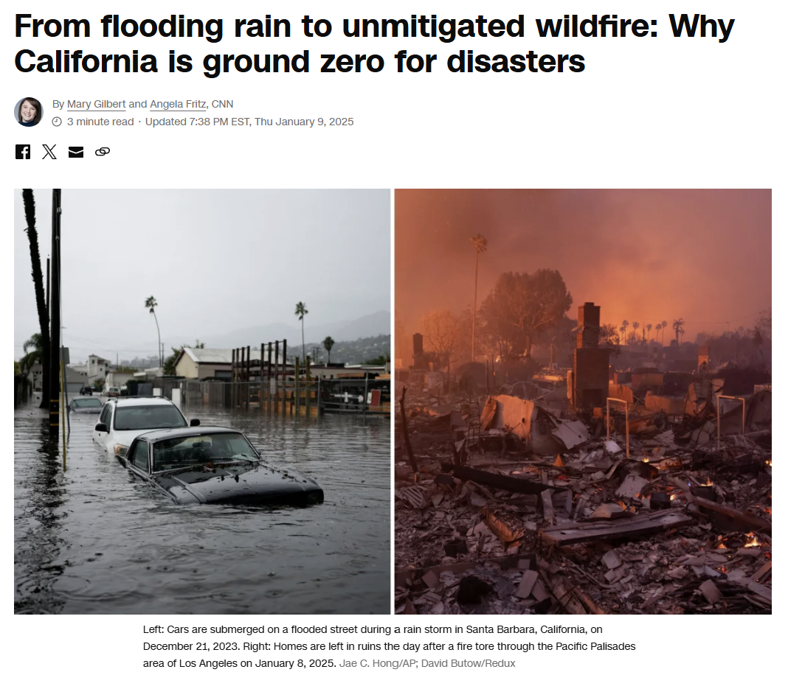
Notes:
https://www.orlandosentinel.com/2025/04/11/fema-slashes-300-million-in-flooding-hurricane-relief-projects-in-florida/
https://edition.cnn.com/2025/01/09/climate/drought-weather-whiplash-california-fires/index.html

Slide 3
Motivation & research questions
Natural disasters have immediate & long-run effects on economic outcomes, local environments, etc.
What are the effects of natural disasters on long-run health & mortality?
What are possible mechanisms for disasters to affect health?
What are possible policy responses to mitigate negative effects?
Focus on food assistance

Slide 4
Agenda
Young, R., & Hsiang, S. (2024). “Mortality caused by tropical cyclones in the United States.” Nature, 635(8037), 121-128.
Laura Carper & Kelsey Pukelis. (Work in Progress) “Health and Economic Effects of Disaster Food Assistance: Evidence from Disaster SNAP and Policy Waivers”

Slide 5
Mortality caused by tropical cyclones in the United States
Young & Hsiang (2024)

Slide 6
Young & Hsiang (2024) summary
Study effects of tropical cyclones (TC’s) on mortality
TC’s = hurricanes & tropical storms
501 disaster events between 1930-2015
3,317 state-by-TC events
Construct predictive model of mortality & determine long-run effects of disasters on mortality using deconvolution methods

Slide 7
Young & Hsiang (2024) summary
Find disasters ↑ excess mortality that persists ≈15 years later
Indirect, long-run deaths far exceed immediate, direct deaths
7,000-11,000 avg. excess deaths per disaster vs. 24 immediate deaths
Accounts for 3-5% of all U.S. deaths annually
More than motor vehicle accidents, infectious diseases, or US war battle deaths
Less than, but comparable to deaths due to high temperatures (7%)
Larger effects for Black populations & younger ages (< 44)

Slide 8
Outline
Possible mechanisms
Data & methods
Results
Main results
Heterogeneity
Mortality Burden
Conclusion

Slide 9
Possible mechanisms

Slide 10
Many effects of disasters
Possible mechanisms for affecting health
damage to infrastructure, homes, & businesses
population relocation
social and economic disruptions
ecological changes
reduced access to basic services
increased pollution
crop damage
insurance payouts
political actions
(-) likely negative health impacts
(+) likely positive health impacts / (-)
(-)
(-)
(-)
(-)
(-)
(+) / (-)
(+) / (-)

Slide 11
5 hypotheses for mortality effects of disasters
Economic disruption
job loss
health insurance
retirement savings drawn down to repair property damage
Social network changes
E.g. out-migration could reduce social support for older dependents
Fiscal adjustments by state/local gov’t
E.g. restructuring budgets for recovery might reduce healthcare
Natural environment changes
E.g. flooding may expose populations to harmful chemicals
Physical & mental stress from experiencing TCs
Anything
else?

Slide 12
Data & methods

Slide 13
Empirical strategy: high-level
Goal: identify the long-run effects of disasters on mortality
Challenges:
Observe only state-level, all-cause mortality
Effects may evolve slowly over time
Solution: Event study using random timing of disasters + deconvolution methods
output = input * impulse response
Deconvolution: extracts the “input” (effect of disaster) from a noisy “output” variable (mortality)
Accounts for overlapping effects from multiple successive events

Slide 14
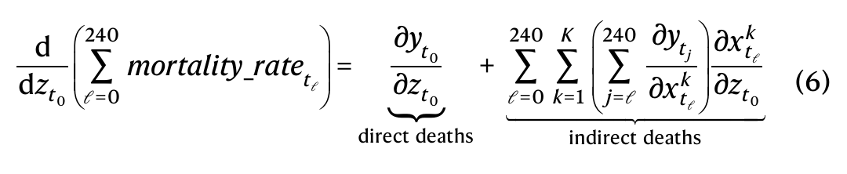
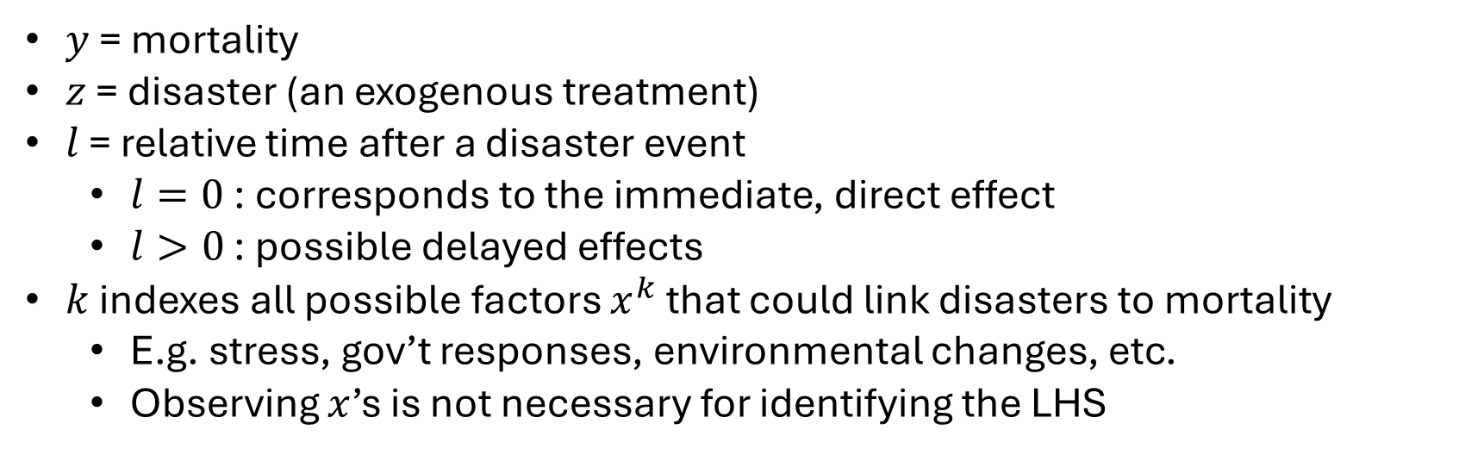
Conceptual model of indirect mortality effects
Full mortality impact of a disaster z over the following 240 months
$y$ = mortality
$z$ = disaster (an exogenous treatment)
$l$ = relative time after a disaster event
$l=0$ : corresponds to the immediate, direct effect
$l>0$ : possible delayed effects
$k$ indexes all possible factors $x^{k}$ that could link disasters to mortality
E.g. stress, gov’t responses, environmental changes, etc.
Observing $x$’s is not necessary for identifying the LHS

Slide 15
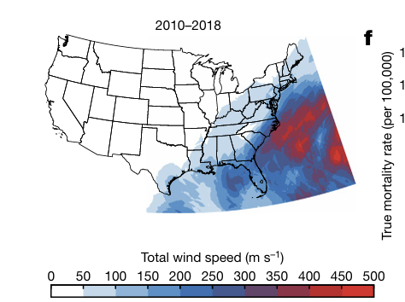
Data
Time period: 1930-2015
Storm list: International Best Track Archive for Climate Stewardship (IBTrACS) database
Storm severity: hyper-local maximum wind speed
From Limited Information Cyclone Reconstruction & Integration for Climate & Economics (LICRICE) model
Proxy for storm severity
Mortality, state-month level: CDC Multiple Cause of Death (MCOD) files & Underlying Cause of Death database
Disaster-specific mortality: NOAA National Hurricane Center & National Weather Service

Slide 16
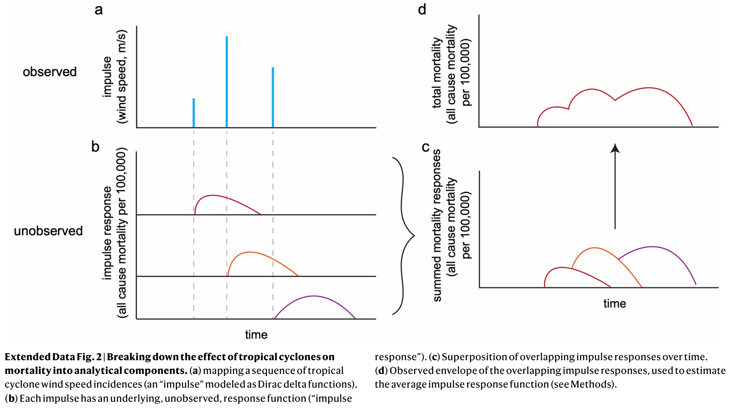
Intuition for deconvolution methods
Use deconvolution to recover the characteristic impulse-response function for a TC impulse
Assumptions:

Slide 17
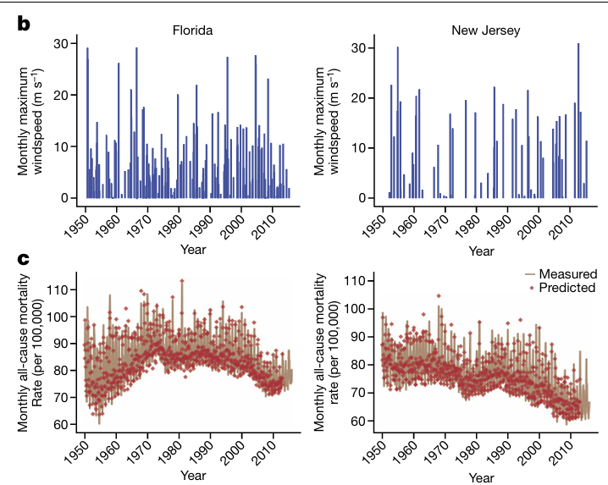
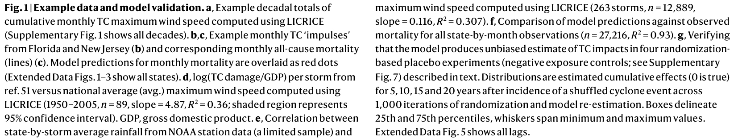
Application of deconvolution methods
Series of “impulses”
Predictive model of mortality using the impulse response function

Slide 18
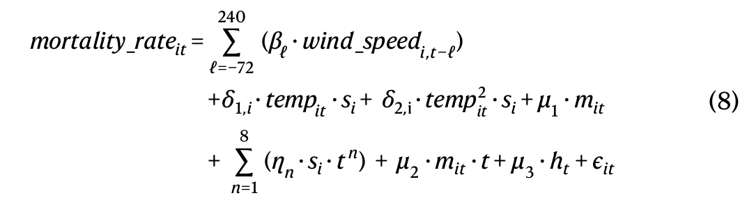
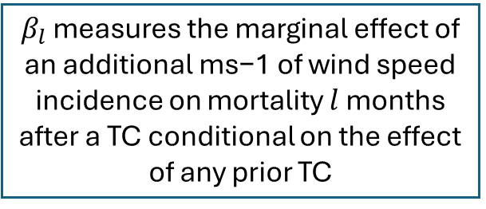
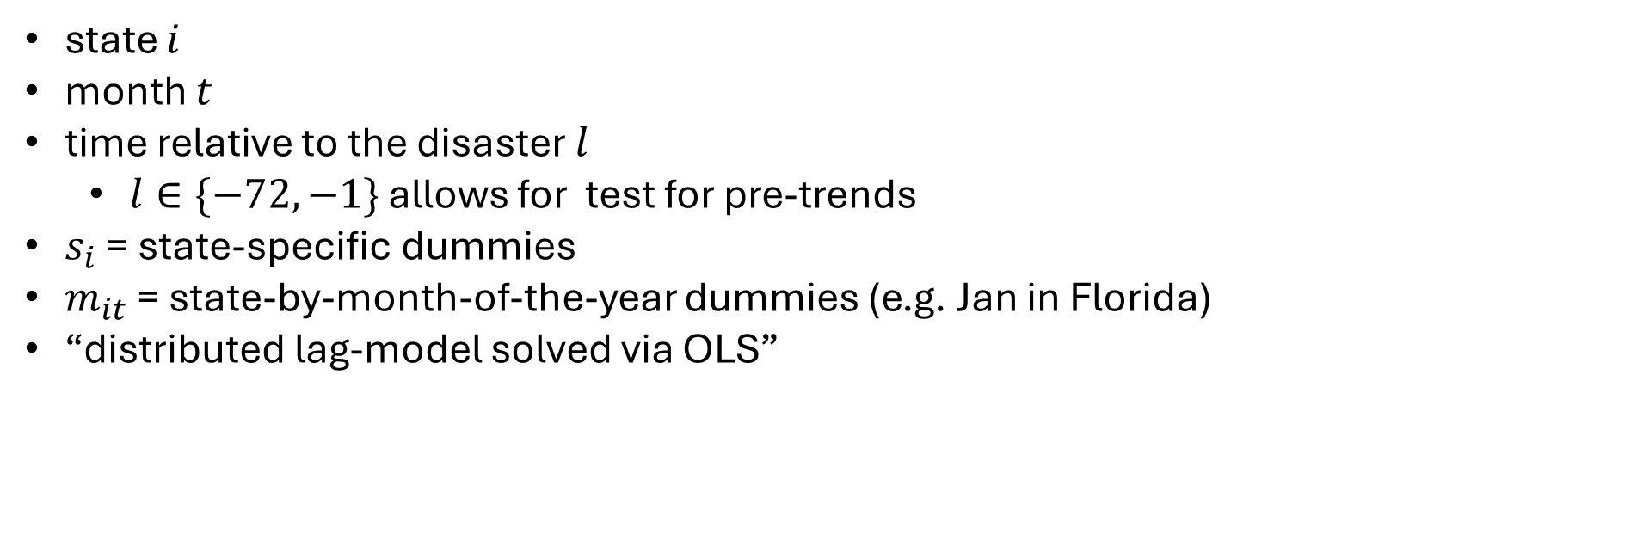
Predictive model / event study
$β_{l}$ measures the marginal effect of an additional ms−1 of wind speed incidence on mortality $l$ months after a TC conditional on the effect of any prior TC
state $i$
month $t$
time relative to the disaster $l$
$l∈\{−72,−1\}$ allows for test for pre-trends
$s_{i}$ = state-specific dummies
$m_{it}$ = state-by-month-of-the-year dummies (e.g. Jan in Florida)
“distributed lag-model solved via OLS”
Notes:
I think a state-month observation could be used multiple times if it is, for example l=-4 for one event and l = 0 for another disaster.
“each state before a TC serves as the control for the same state after it receives TC treatment”

Slide 19
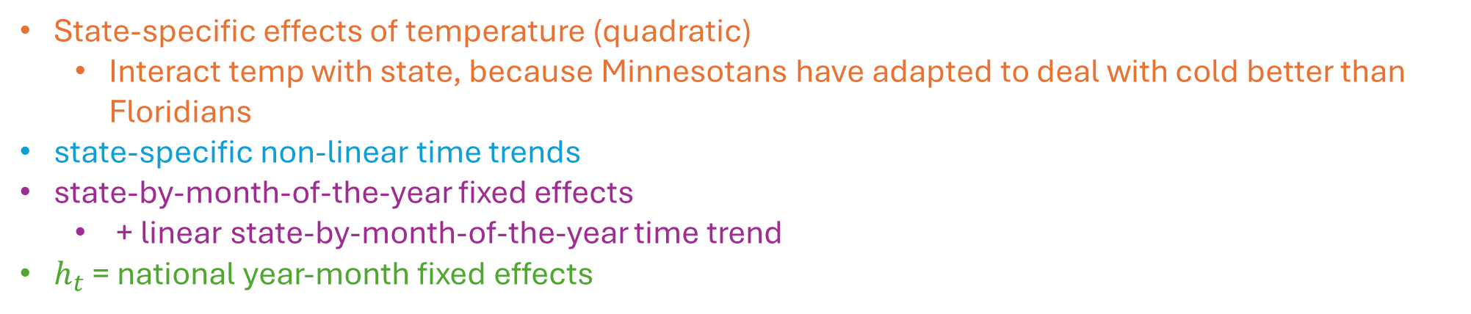
Predictive model / event study
$β_{l}$ measures the marginal effect of an additional ms−1 of wind speed incidence on mortality $l$ months after a TC conditional on the effect of any prior TC
State-specific effects of temperature (quadratic)
Interact temp with state, because Minnesotans have adapted to deal with cold better than Floridians
state-specific non-linear time trends
state-by-month-of-the-year fixed effects
+ linear state-by-month-of-the-year time trend
$h_{t}$ = national year-month fixed effects

Slide 20
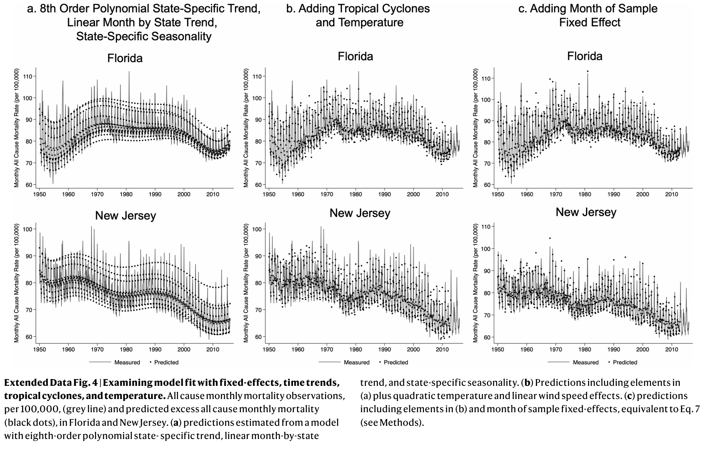
Is the model predictive? Overfitted?
R-squared = 0.93

Slide 21
Main Results

Slide 22
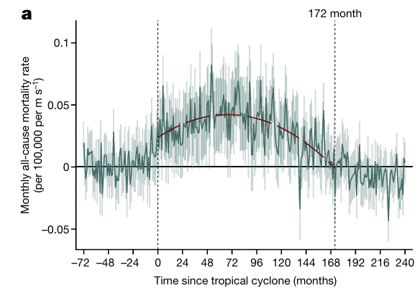
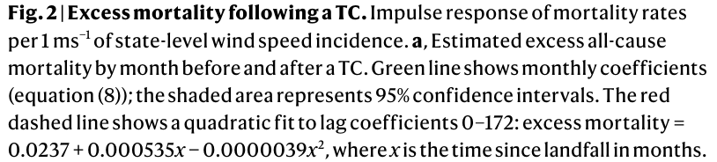
Event study of disaster event
= 14.3 years
The average storm is associated with a cumulative excess mortality rate of 37.05 deaths per 100,000 people after 14.3 years

Slide 23
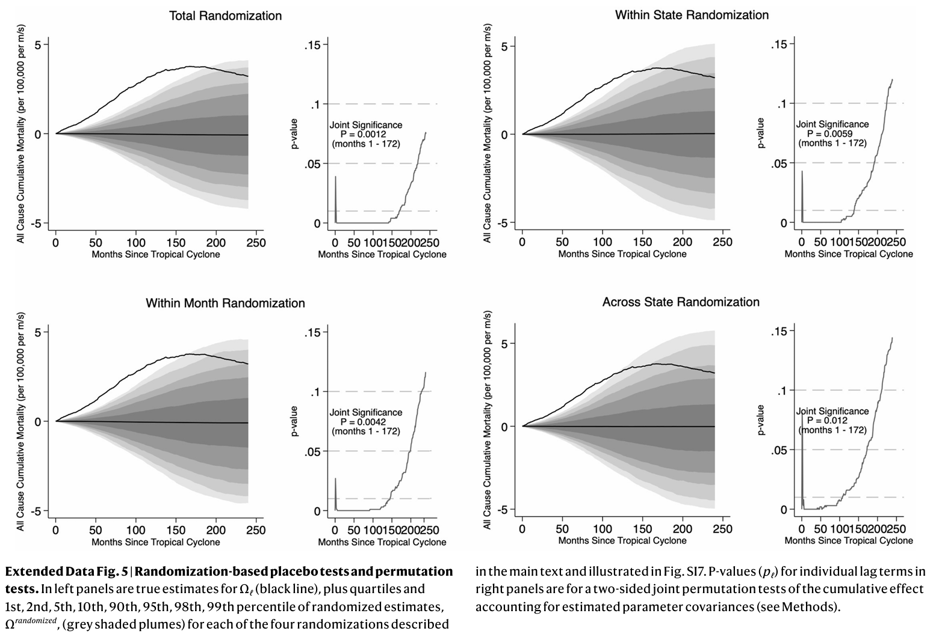
Placebo & permutation tests
Descriptions:

Slide 24
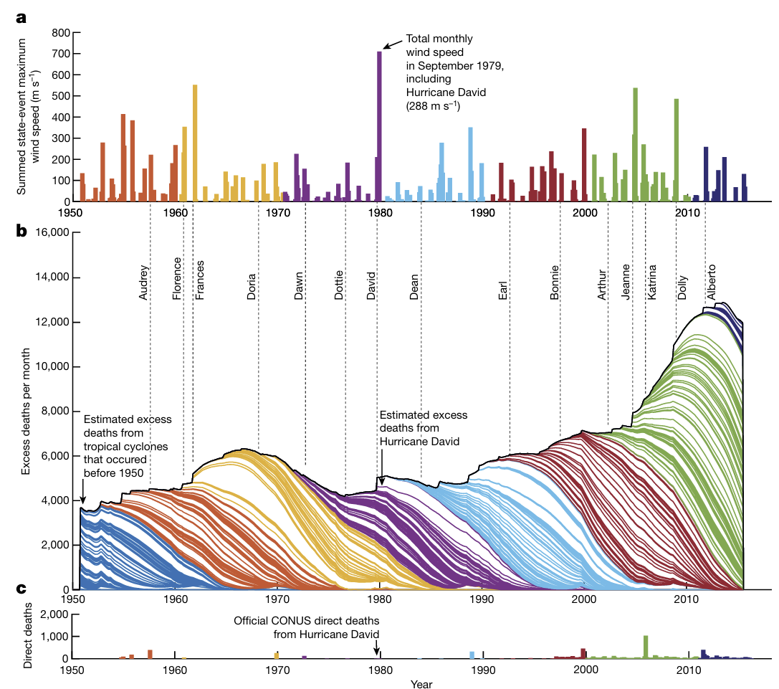
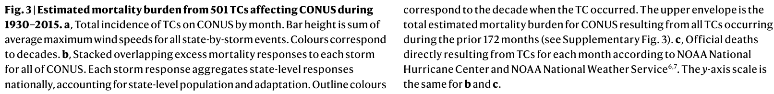
A total of 3.6–5.7 million excess deaths from 1930-2015
Accounts for 3.2–5.1% of all U.S. deaths annually
TCs contributed to more deaths than:
all motor vehicle accidents (2 million)
infectious diseases (1.9 million) or
US battle deaths in wars (1.3 million)
Comparable to annual deaths due to high temperatures (7%)
Calculating burden:
Robustness:

Slide 25
Results: Heterogeneity

Slide 26
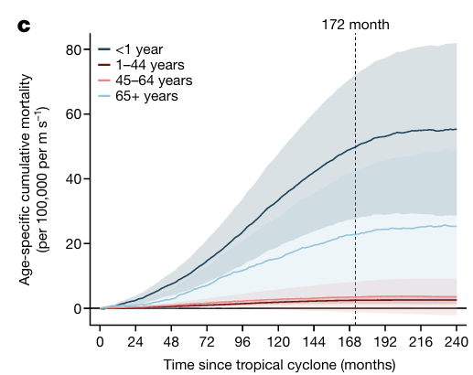
Heterogeneity by age
All mortality rates expressed as cumulative excess deaths per 100,000 over 14.3 years.
Group | Cum. excess deaths rate | % of excess deaths
Infants < 1 | 49.8 | 14%
1 ≤ age ≤ 44 | 2.5 | 32%
45 ≤ age ≤ 64 | 3.5 | 8%
Aged ≥ 65 | 22.8 | 46%
Overall | 37.05 | 100%
(Limited to these groups because of historical data)

Slide 27
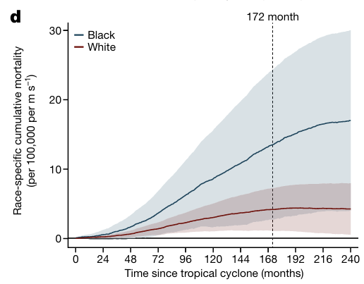
Heterogeneity by race
All mortality rates expressed as cumulative excess deaths per 100,000 over 14.3 years.
(Data limitations for other racial groups)
Group | Cum. excess deaths rate | % of excess deaths
Black pop. | 13.53 | 34%
White pop. | 4.19 | 66%
Overall | 37.05 | 100%
(Limited to these groups because of historical data)

Slide 28
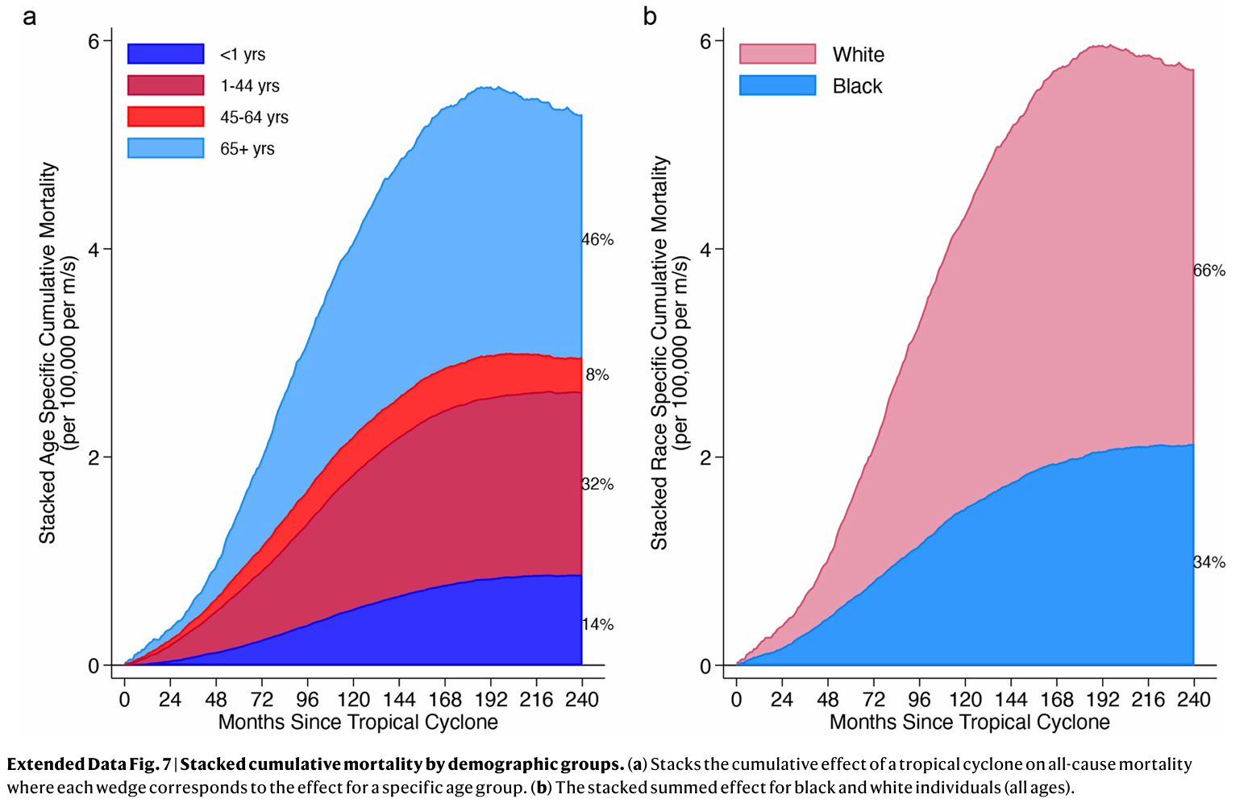
Cumulative mortality by demographic group
Time profile is interesting, and suggests there may be multiple mechanisms:
More Black & young deaths earlier on?
More White & older deaths later on?

Slide 29
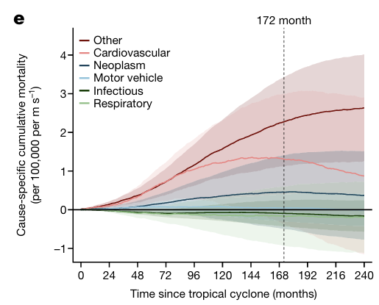
Heterogeneity by cause of death
All mortality rates expressed as cumulative excess deaths per 100,000 over 14.3 years.
“Other” includes diabetes, suicide, sudden infant death syndrome, and other causes not recorded
→ consistent with stress as a possible mechanism
Group | Cum. excess deaths rate | % of excess deaths
Other | 2.27 | 59%
Cardiovascular | 1.3 | 36%
Neoplasms (cancer) | 0.46 | 12%
Overall | 37.05 | 100%

Slide 30
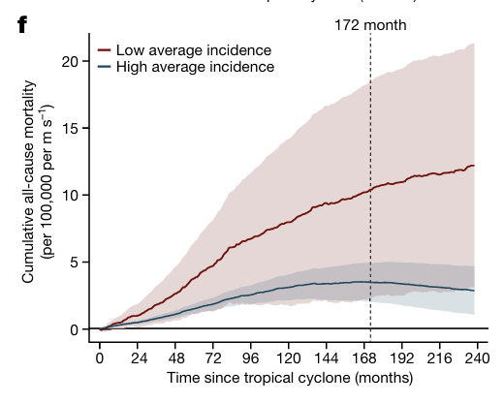
Heterogeneity by local climatological risk
All mortality rates expressed as cumulative excess deaths per 100,000 over 14.3 years.
→ suggests (imperfect) climate adaptation
Group | Cum. excess deaths rate
States w/ less frequent disasters (quartile 1) | 10.4
States w/ more frequent disasters (quartiles 2-4) | 3.5
Overall | 37.05
No differential effects for living on the coast:

Slide 31
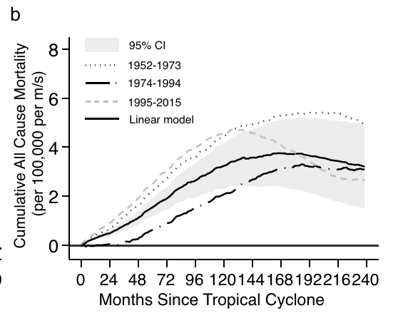
Heterogeneity by calendar year
All mortality rates expressed as cumulative excess deaths per 100,000 over 14.3 years
→ suggests limited climate adaptation over time

Slide 32
Results: Mortality Burden
Calculating mortality burden:

Slide 33
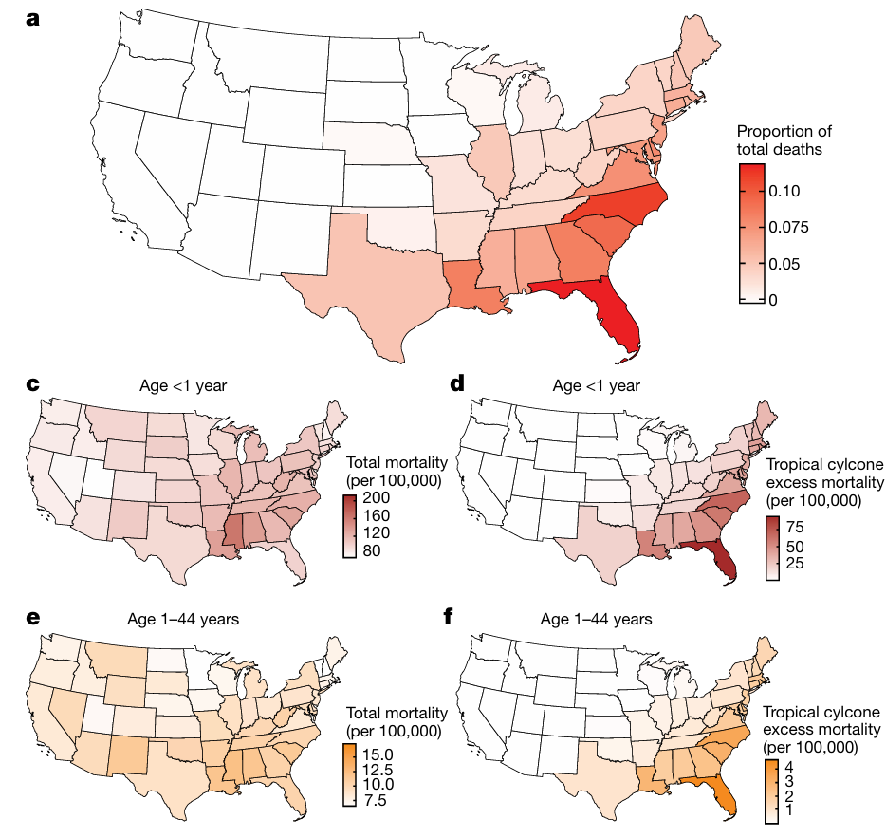
Accounts for 13% of deaths in Florida during this period
Accounts for 25% of overall mortality for infants < 1
Accounts for 15% of overall mortality for people aged 1-44
Accounts for <4% of overall mortality for people aged >65

Slide 34
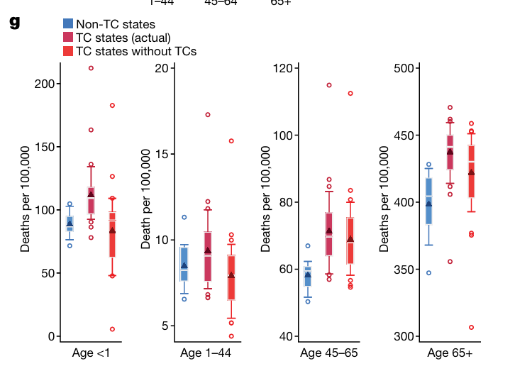
Without TC’s, mortality in coastal states would look more similar to other states
Distributions of average state mortality by age group for:
States that never experience a TC (n = 14)
States that ever experience a TC (n = 35)
Estimated counterfactual distributions for TC states without TC mortality burdens
Notes:
Distributions of average state mortality by age group for states that never experience a TC (non-TC states, n = 14) and the states that experience non-zero TC incidence (TC states (actual), n = 35). Red distributions (TC states without TCs, n = 35) are estimated counterfactual distributions for TC states after mortality burdens from TC climates are removed. In box plots, boxes represent inner quartiles, white bars show the median, triangles indicate the mean, whiskers extend to 10th and 90th percentiles and circles show outliers.

Slide 35
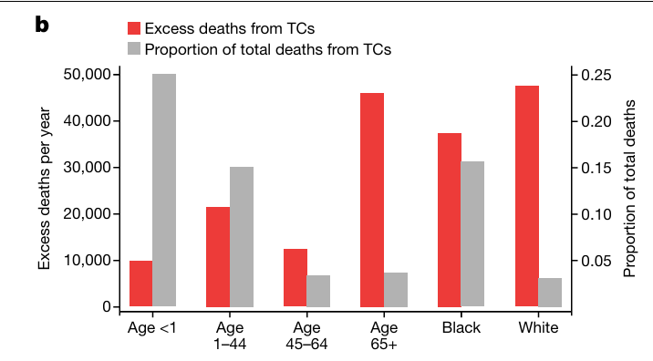
Estimated mortality burden by group
Estimated average excess total TC-related deaths per year by demographic group (left axis) and
as a fraction of all deaths in each group (right axis).

Slide 36
Limitations / open questions
Don’t account for migration; flooding / rain intensity
Non-linearity of mortality effects
For most extreme (1.4%) events, excess mortality is (insignificantly) lower
Larger responses to high-profile vs. still harmful but low-profile events? (Heath 2024)
Only consider mortality; not any non-fatal health outcomes
Cannot investigate impacts on other demographic groups
Do not consider other disaster types, outside of hurricanes & tropical storms
Mechanisms remain unclear

Slide 37
Thank you!
pukeliskelsey@gmail.com

Slide 39
Appendix

Slide 40
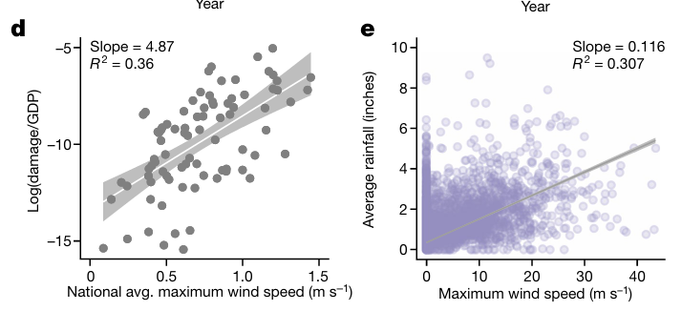
Evaluation of proxy for storm severity
Note: Avoid using social variables(e.g. direct economic damage) as a proxy for physical hazard severity because they may be affected by people migrating selectively towards or away from these locations → selection bias
Instead, focus on independent variables that are physical measures of TC incidence (e.g. wind speed), because they are plausibly exogenous

Slide 41
Intuition for deconvolution methods
Use deconvolution to recover the characteristic impulse-response function for a TC impulse
“This approach searches for an impulse-response function…
“…that best fits the observed outcome data”
→ evaluate predictiveness + placebo checks
→ concern about overfitting?
“…subject to the constraint that TCs share a characteristic impulse-response function”
→ assumes that mortality responds similarly for all disaster events
“…that estimates the effect of each TC accounting for the potential overlapping impact of all other TCs,”
→ identifies long-run effects of a single disaster
“…assumes that the overlapping responses influencing mortality at a moment in time are additively separable”
→ additive separability assumption rules out compounding effects of multiple disasters close together
Notes:
“…if applied to all TCs in the data simultaneously, best fits the observed outcome data.”

Slide 42
4 permutation tests
“We use these randomizations to examine the likelihood of randomly obtaining an entire impulse-response function similar our actual estimate, if in reality no such relationship exists in the data.”
“In each case, this shuffling should break any correlation between TC incidence and mortality such that an unbiased estimate of the effect of shuffled TCs on mortality is zero.”
(1) total randomization: we shuffle all TC observations
“Our model does not generate spurious associations between mortality and… the unconditional distribution of TC events”
(2) within state randomization: shuffle the sequence of TCs each state experiences
…average cross-sectional patterns across states
(3) within month randomization: shuffle the TC experienced across states within each month of sample
…secular national trends
(4) across state randomization: we block-shuffle complete TC time series across states, keeping the sequence of storms as blocks
…temporal-trends within states

Slide 43
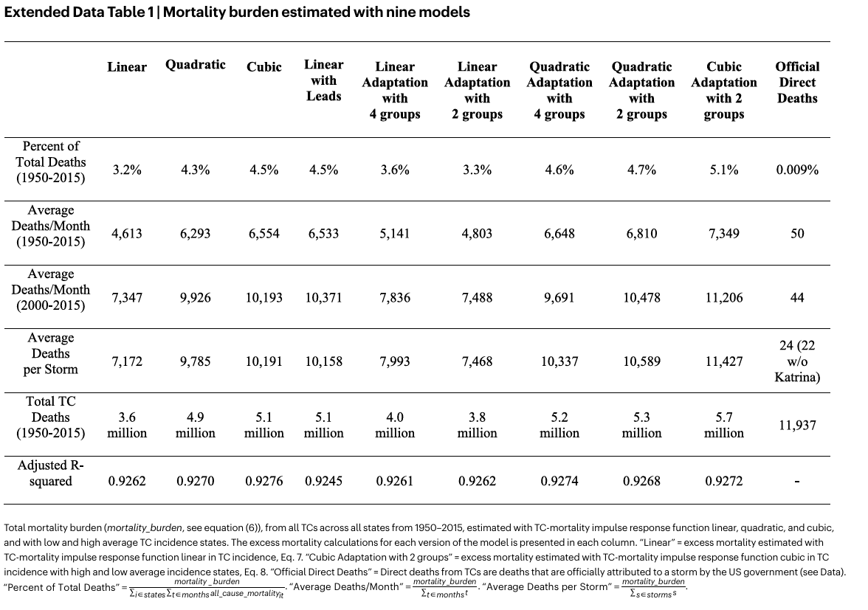
Robustness to modelling assumptions

Slide 44
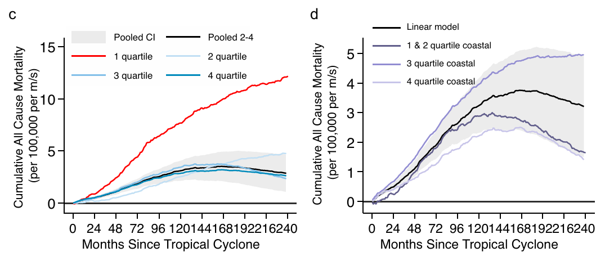
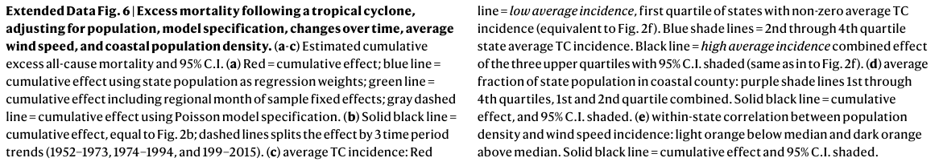
Effects by TC incidence; coastal pop. size

Slide 45
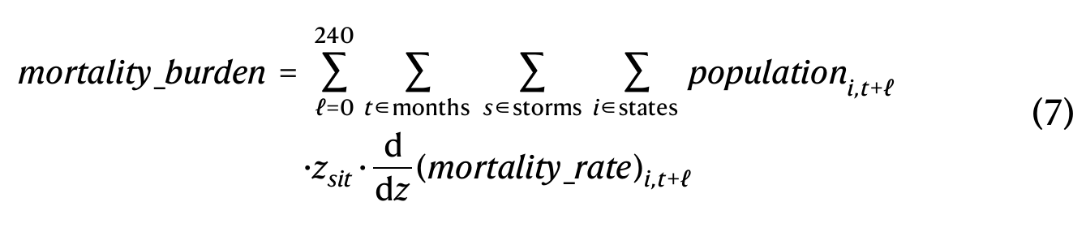
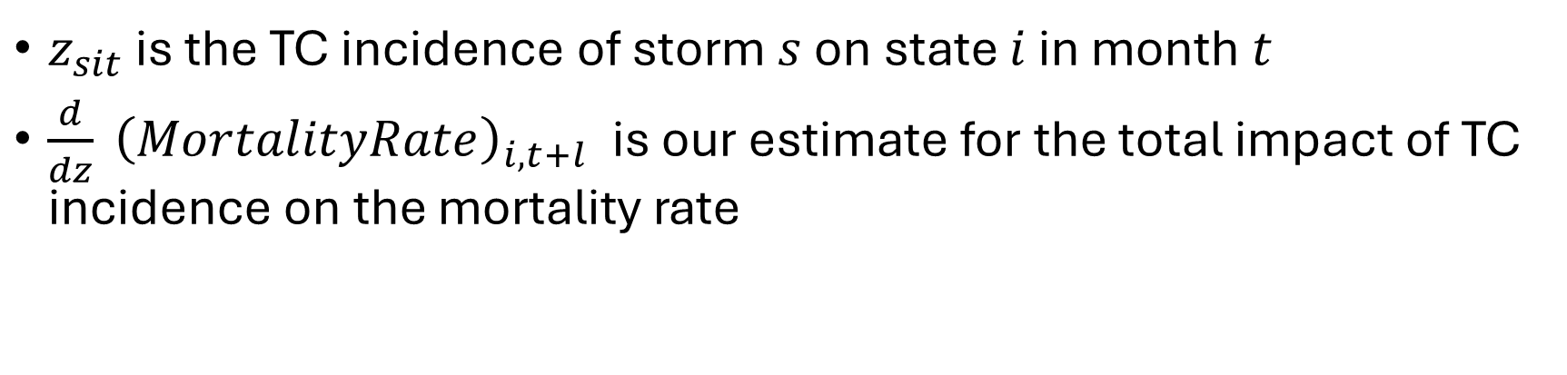
Calculating mortality burden
Main
figure
Burden section
$z_{sit}$ is the TC incidence of storm $s$ on state $i$ in month $t$
$\frac{d}{dz} {\left(MortalityRate\right)}_{i,t+l}$ is our estimate for the total impact of TC incidence on the mortality rate

