Slide 1
Section #6: Cost-Benefit Analysis Continued + Housing
API 102A
Kelsey Pukelis
2022-03-11

Slide 2
Outline
Cost-benefit “difference” (NPV) vs. cost-benefit ratio
Problem of the Week #5
Work through extended example problem: SSI removal
Problem of the Week #6 / real-life
Eviction evidence

Slide 3
Cost-benefit “difference” (NPV) vs. cost-benefit ratio (CBR)

Slide 4
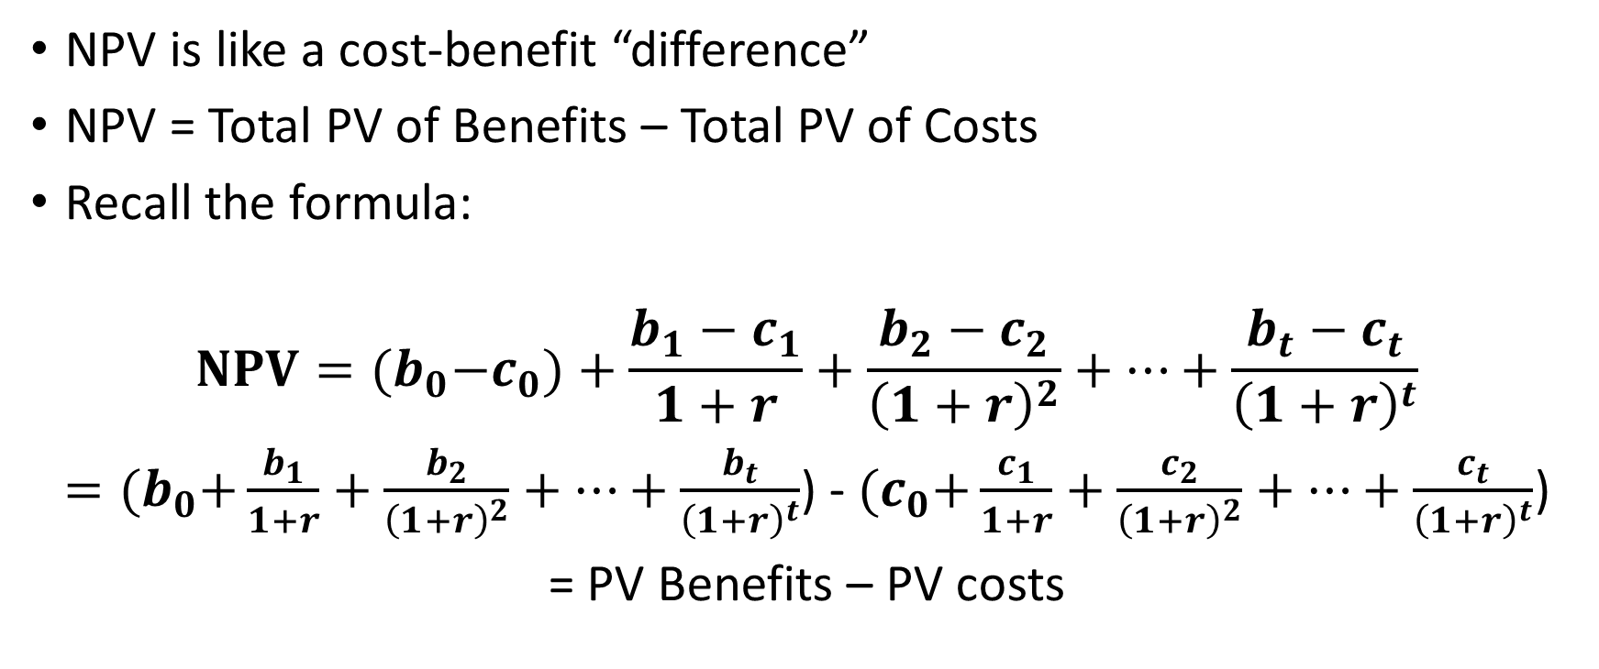
Review: net present value (NPV)
NPV is like a cost-benefit “difference”
NPV = Total PV of Benefits – Total PV of Costs
Recall the formula:
$$NPV={(b}_{0}−c_{0})+\frac{b_{1}−c_{1}}{1+r}+\frac{b_{2}−c_{2}}{{\left(1+r\right)}^{2}}+…+\frac{b_{t}−c_{t}}{{\left(1+r\right)}^{t}}$$
$={(b}_{0}+\frac{b_{1}}{1+r}+\frac{b_{2}}{{\left(1+r\right)}^{2}}+…+\frac{b_{t}}{{\left(1+r\right)}^{t}}$) - ${(c}_{0}+\frac{c_{1}}{1+r}+\frac{c_{2}}{{\left(1+r\right)}^{2}}+…+\frac{c_{t}}{{\left(1+r\right)}^{t}}$)
= PV Benefits – PV costs

Slide 5
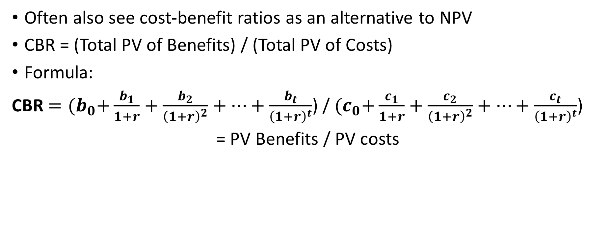
Cost benefit ratio (CBR)
Often also see cost-benefit ratios as an alternative to NPV
CBR = (Total PV of Benefits) / (Total PV of Costs)
Formula:
CBR $={(b}_{0}+\frac{b_{1}}{1+r}+\frac{b_{2}}{{\left(1+r\right)}^{2}}+…+\frac{b_{t}}{{\left(1+r\right)}^{t}}$) / ${(c}_{0}+\frac{c_{1}}{1+r}+\frac{c_{2}}{{\left(1+r\right)}^{2}}+…+\frac{c_{t}}{{\left(1+r\right)}^{t}}$)
= PV Benefits / PV costs

Slide 6
Cost-benefit ratio (CBR)
Best used when projects are easily scalable
Misleading in two cases
Comparing non-scalable projects with very different scales
Comparing projects where its easy to relabel benefits as “cost savings”

Slide 7
Practice: Cases Where B/C Ratio Can Be Misleading
Projects with different scales: Suppose a govt. has to choose between two discrete projects. Which is more desirable?
Project A: Costs $10,000 and yields benefits of 10x its cost
Project B: Costs $10 million and yields benefits of 1.1x its cost
To see, let’s calculate both NPV and CBR for each project and evaluate.

Slide 8
Practice: Cases Where B/C Ratio Can Be Misleading

Slide 9
Examples Where B/C Ratio Can Go Wrong
Suppose a govt. has to choose between two discrete projects. Which is more desirable?
Project A: Costs $10,000 and yields benefits of 10x its cost
Project B: Costs $10 million and yields benefits of 1.1x its cost
Project B is more desirable – it yields $1 million of net benefits vs. $90,000 for A – even though its B/C ratio is much lower.
This illustrates how B/C ratio can mislead when programs have very different scales of operation. Project B is more desirable (even though lower B/C ratio) because it is much larger in size.
Of course, if these projects could be arbitrarily scaled up, then the B/C ratio would be a more accurate guide.

Slide 10
Practice: Cases Where B/C Ratio Can Be Misleading
Relabeling benefits as cost savings: Suppose an education program costs $10,000 per student and generates two benefits:
Higher lifetime earnings of $10,000 per student
Savings on remedial education of $5,000 per student
How does the B/C ratio differ if we label (b) as a benefit vs. as a decrease in costs?

Slide 11
Practice: Cases Where B/C Ratio Can Be Misleading

Slide 12
Examples Where B/C Ratio Can Go Wrong
Suppose an early child education program costs $10,000 per student and generates two benefits:
Higher lifetime earnings of $10,000 per student
Savings on remedial education of $5,000 per student
How does the B/C ratio differ if we label (b) as a benefit vs. as a decrease in costs? (Why might an ECE advocate prefer the latter?)
If label (b) as a benefit: Benefits = $10k + $5k = $15k per student; Costs = $10k → B/C ratio = 1.5
If label (b) as a cost saving, then Benefits = $10k; Costs = $10k - $5k = $5k → B/C ratio = 2.0.
The program looks more desirable if we label (b) as a cost saving, even though it is economically equivalent. This is why B/C ratio can mislead.

Slide 13
Summary table: NPV vs. CBR
 | Formula | Math | Do a project if…(where only alternative is status quo) | Do a project… (when multiple policy options on the table) | Preferred? | Drawbacks
NPV | PV Benefits – PV costs | “difference” | If NPV > 0 | With the highest (positive) NPV | In most cases
CBR | PV Benefits / PV costs | ratio | If CBR > 1 | With the highest CBR (greater than 1) | Maybe if all policy options are easily scalable | If benefits can easily be relabeled as cost savings, or vis versa If programs are on different scales and not all are easily scalable

Slide 14
CBA extended application

Slide 15
Goals of section
Last time: Principles for cost benefit analysis
Accounting for time: Calculation of net present value
Benefits:
willingness to pay
how to value market and non-market benefits
Costs: opportunity costs
This time: Application of CBA principles
closer to a problem you might encounter in the real world

Slide 16
SSI background
SSI = Supplemental Security Income
Income support for (families of) disabled individuals
Not same as SSDI = Supplemental Security Disability Insurance, which supports individuals who become disabled as adults after many years of work
Children are eligible for SSI
Received by the family, parents of a disabled child
Maximum annual amount for an individual in 2022: $10,092
Couple: $15,137 (ssa.gov)
(Amount is reduced by income, including earned & unearned income, cash & in-kind)

Slide 17
SSI removal policy background
Children receiving SSI now receive a medical review when they turn 18 to determine if they are still eligible as adults.
Possibility 1: “favorable” review -> still considered disabled, stay on SSI (no change)
Possibility 2: “unfavorable” review -> no longer considered disabled, removed from SSI, loss of SSI benefits

Slide 18
SSI removal policy background
Policy change: 1996 welfare reform added these medical reviews
for individuals with an 18th birthday on or after August 22, 1996
Use this policy variation to study effects of medical reviews

Slide 19
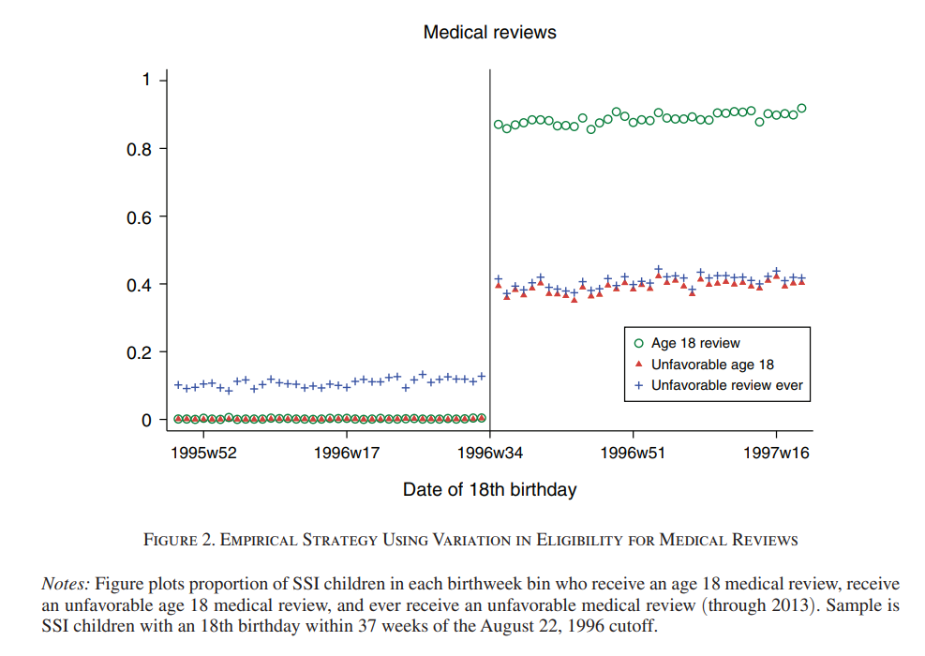
Likelihood of unfavorable review increases for those subject to the policy
Deshpande 2016

Slide 20
SSI removal policy background
Policy change: 1996 welfare reform added these medical reviews
for individuals with an 18th birthday on or after August 22, 1996
Use this policy variation to study effects of medical reviews
What are the policy options here (in the present day)?

Slide 21
SSI removal policy background
Policy change: 1996 welfare reform added these medical reviews
for individuals with an 18th birthday on or after August 22, 1996
Use this policy variation to study effects of medical reviews
What are the policy options here (in the present day)?
(1) Status quo: keep reviews and possible removal of 18-year-olds from SSI
(2) Change to consider: Eliminate reviews, allowing 18-year-olds to continue receiving SSI
(3) Possible intermediate option: make reviews more lenient
We’ll just focus on (1) vs. (2). In particular, we will evaluate the status quo

Slide 22
Down the rabbit hole
Suppose we are considering eliminating the medical reviews for 18-year-olds on SSI.
Can you think of possible benefits and costs of this policy?

Slide 23
Down the rabbit hole
Suppose we are considering eliminating the medical reviews for 18-year-olds on SSI.
Can you think of possible benefits and costs of this policy?
As a starter, who are the relevant agents?
What are some relevant outcomes?
What are agents’ possible behavioral responses to this policy?

Slide 24
Down the rabbit hole
Suppose we are considering eliminating medical reviews for 18-year-olds receiving SSI benefits.
Can you think of possible benefits and costs of that policy?
As a starter, who are the relevant agents?
What are some relevant outcomes?
What are agents’ possible behavioral responses to this policy?
Answers can vary. But to start, the 18-year-olds who undergo medical review are certainly relevant. Their parents or other relatives in their household who would otherwise receive SSI benefits could also be affected. Both 18-year-olds and their parents may increase earned income in response to losing SSI benefits, in order to replace that now “missing” income. The relevant outcomes here would then be employment and earnings of 18-year-olds and their parents or relatives. Alternatively, 18-year-olds removed from SSI may turn to (property) crime as an alternative source of income. Then, relevant outcomes are crime and incarceration rates. With crime, victims also become relevant agents; crime has social costs.

Slide 25
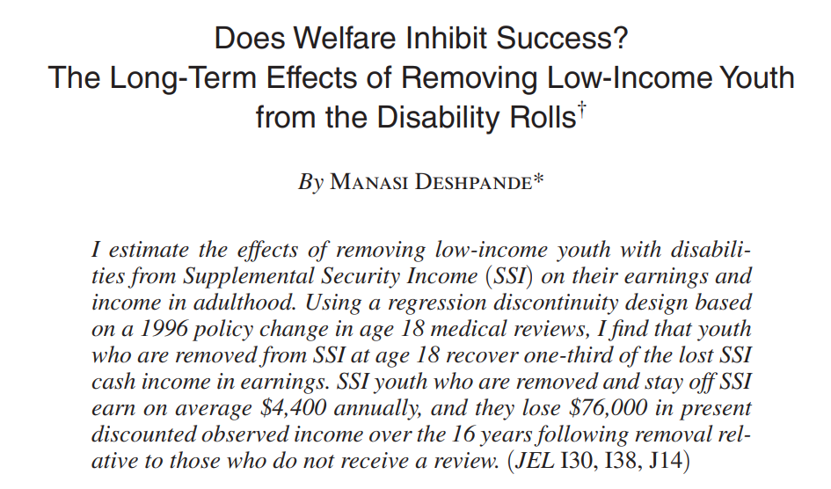
What are the costs discussed here? What are the benefits?

Slide 26
What are the costs discussed here? What are the benefits?

Slide 27
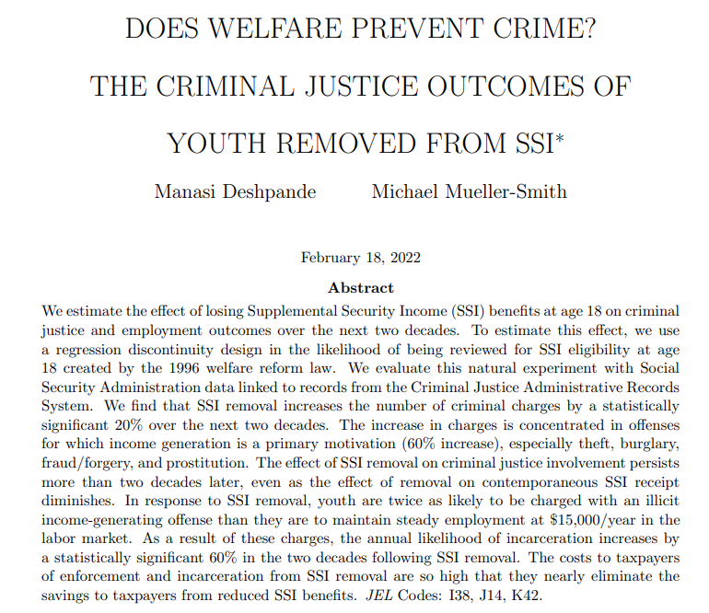

Slide 28
What are the costs discussed here? What are the benefits?

Slide 29
What are the costs discussed here? What are the benefits?

Slide 30
What are the costs discussed here? What are the benefits?
Framing in terms of the medical review policy (status quo), which leads to some SSI removals of 18-year-olds:
Benefits
Cost-saving for government on SSI spending
Cost-saving for government on Medicaid spending
Additional tax revenue from higher earnings
Costs
police and court costs
incarceration costs
victim costs
These are taken directly from the paper. (Not all of these are in the abstracts above, such as Medicaid spending.)
In theory more could be added here, as we considered in our “rabbit hole” exercise…

Slide 31
A NPV calculation
Consider the medical review policy (status quo), which leads to some SSI removals of 18-year-olds
Amounts below are per removal, over 20 years (already discounted)
Reduction of $37,700 in SSI spending
Reduction of $8,400 in Medicaid spending
Increase of $10,800 in police and court costs
Increase of $30,200 in incarceration costs
Increase of $85,600 in victim costs
Additional tax revenue from higher earnings: $3,000
What is the NPV of this policy?
In light of the NPV, what should we do?

Slide 32
A NPV calculation
Reduction of $37,700 in SSI spending – benefit (cost-saving for gov)
Reduction of $8,400 in Medicaid spending – benefit (cost-saving for gov)
Increase of $10,800 in police and court costs – cost
Increase of $30,200 in incarceration costs – cost
Increase of $85,600 in victim costs – cost
Additional tax revenue from higher earnings: $3,000 – benefit to gov (additional tax revenue)
NPV = 37,700 + 8,400 + 3000 - 10,800 - 30,200 – 85,600 = -$77,500
NPV is negative, suggesting we shouldn’t have the medical review and removal policy. We should retract this policy.

Slide 33
Aside: equity and CBA

Slide 34
A note on equity and CBA
Idea that equity enters into how we compare MVPF’s or NPV’s (outside the actual numerical value)
Equity doesn’t enter into the CBA calculation itself
There is a way to weight affected individuals more or less based on income, or other characteristics, but this is a different kind of analysis – welfare analysis with social welfare weights
This analysis still requires assumptions –this time also normative assumptions!
CBA and MVPF, although requiring many assumptions, sticks to positive assumptions only

Slide 35
Effects of eviction
Eviction and poverty in American cities: evidence from Chicago and New York 2022. (Winnie van Dijk with Rob Collinson, John Eric Humphries, Nick Mader, Davin Reed, and Daniel Tannenbaum)
Previous draft: Does Eviction Cause Poverty? Quasi-Experimental evidence from Cook County, IL. 2019. (John Eric Humphries, Nicholas Mader, Daniel Tannenbaum & Winnie van Dijk)
Key highlights taken from above papers as well as Winnie van Dijk’s slides for Harvard course ECON 2245.

Slide 36
Motivation
Over 2 million eviction cases filed in the U.S. each year
Costs of providing homeless services high (Evans et al. 2019)
$3.2 billion a year in NYC
Eviction as both a cause and consequence of poverty

Slide 37
Households are struggling when facing possible eviction
Prior to housing court, tenants experience:
earnings decline
Employment loss
Increases in financial distress
Worsening health, as measured by increased hospital visits

Slide 38
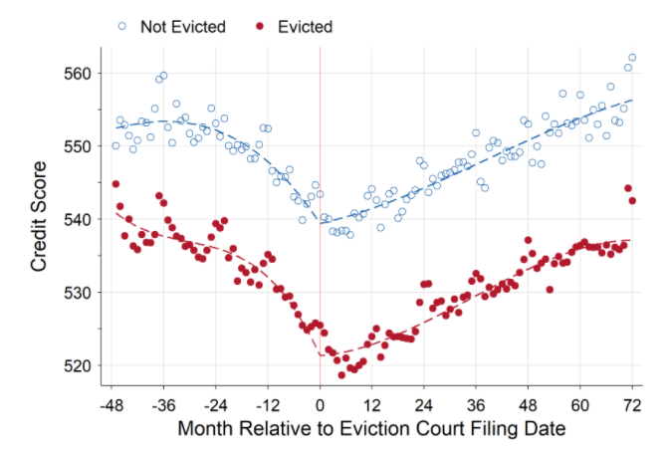
Households are struggling when facing possible eviction
Source: Humphries, Mader, Tannenbaum, and van Dijk (2019)
These difference in “pre-trends” make it hard to disentangle correlation and causation.

Slide 39
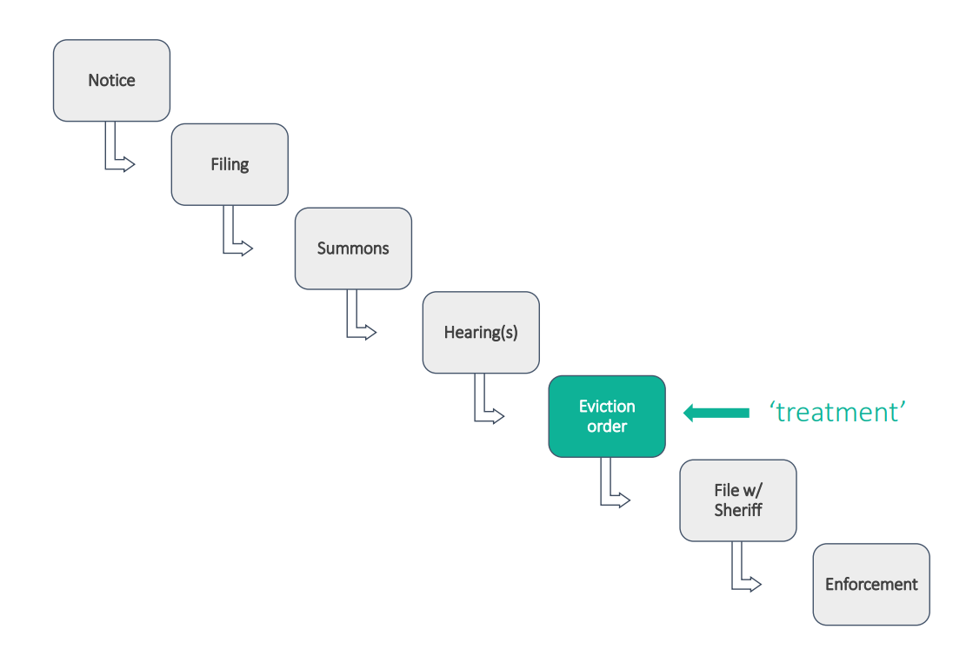
Research question: what is the effect of an eviction court order?
From Winnie van Dijk’s slides for Harvard course ECON 2245

Slide 40
How to study? Random assignment to judges
When faced with a case, some judges are more or less lenient (or, equivalently strict) at ordering evictions
Cases are randomly assigned to judges
So effectively, some cases will receive an eviction order due to random chance
This randomness allows economists to study the causal effects of eviction orders.

Slide 41
Effects of receiving an eviction order
increases housing instability---as measured by:
residential mobility
homeless shelter use
interactions with homeless services
reduces
earnings
credit access
durable goods consumption
Equity concerns: driven by impacts for female and Black tenants

Slide 42
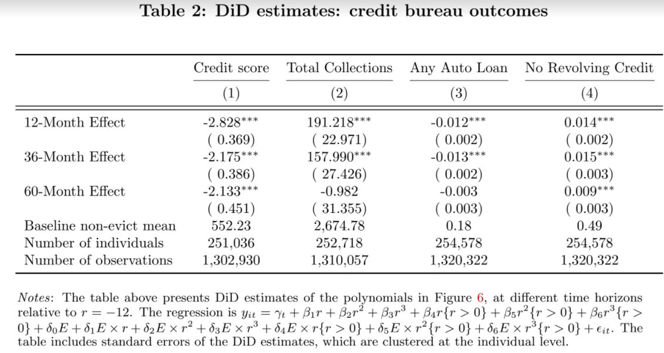
Source: Humphries, Mader, Tannenbaum, and van Dijk (2019)

Slide 43
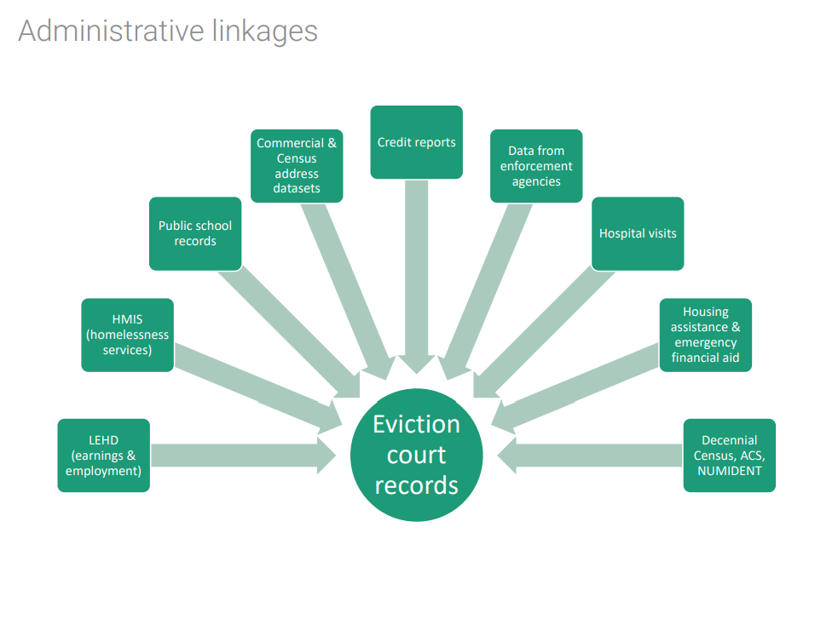
Data difficulties
Data on housing and homelessness is somewhat hard to come by
…and even harder to link with data from other relevant agencies
Personal plea: if you work for a government agency or nonprofit in the future, please be willing to work with researchers on data sharing!
While still protecting privacy
From Winnie van Dijk course slides: relevant data sources for eviction paper

Slide 44
References
Deshpande, M. (2016). Does welfare inhibit success? The long-term effects of removing low-income youth from the disability rolls. American Economic Review, 106(11), 3300-3330.
Deshpande, M. (2016). The effect of disability payments on household earnings and income: Evidence from the SSI children's program. Review of Economics and Statistics, 98(4), 638-654.
Deshpande, M., & Mueller-Smith, M. G. (2022). Does Welfare Prevent Crime? The Criminal Justice Outcomes of Youth Removed from SSI (No. w29800). National Bureau of Economic Research.
Eviction and poverty in American cities: evidence from Chicago and New York. 2022. (Winnie van Dijk with Rob Collinson, John Eric Humphries, Nick Mader, Davin Reed, and Daniel Tannenbaum)
Previous draft: Does Eviction Cause Poverty? Quasi-Experimental evidence from Cook County, IL. 2019. (John Eric Humphries, Nicholas Mader, Daniel Tannenbaum & Winnie van Dijk)

