Slide 1
VIRTUAL AI RECEPTIONIST
Bukowy Dwór — Thermal Spa & Resort
Case Study: Enterprise Deployment of ElevenLabs Conversational AI
Deployment Strategist Candidate — 2026
Notes:
Start with 30 seconds of pure business context, demographics, and commercial impact.

Slide 2
BUSINESS PROBLEM & CONTEXT
Senior Guests Wait. Front Desk Can't Keep Up.
60–70% Senior Guests
Core demographic (60+) prefers direct phone calls over mobile apps or complex forms.
Call Spikes & Drop-offs
Peak morning & afternoon waves create call queues, abandoned calls, and guest frustration.
Lost Spa Revenue
Unanswered inquiries equal lost high-margin treatments (– per session).
Front Desk Bottlenecks
Staff burdened by repetitive FAQs, leaving zero time for pre-arrival guest outreach.
Notes:
Frame the problem from both user experience and hotel profitability perspectives before presenting solutions.

Slide 3

USER PERSONA & COGNITIVE MODEL
Target Persona: Mrs. Sophia, 72 Years Old
• Speech Patterns & Pacing: Speaks slowly with natural pauses mid-sentence to formulate thoughts.
• Vocabulary & Recall: Does not recall exact clinical names ('that mud bath for back pain').
• Sensitivity to Interruptions: Hangs up immediately if interrupted, rushed, or spoken to in a robotic tone.
• Multi-Channel Confirmation: Expects immediate SMS confirmation sent to her phone or her daughter's.
• Engineering Implication: Every latency, turn-timeout (3.0s), and TTS setting is engineered around Sophia.
Notes:
Sophia is not a hypothetical persona — she is the actual archetype of a health resort guest.

Slide 4
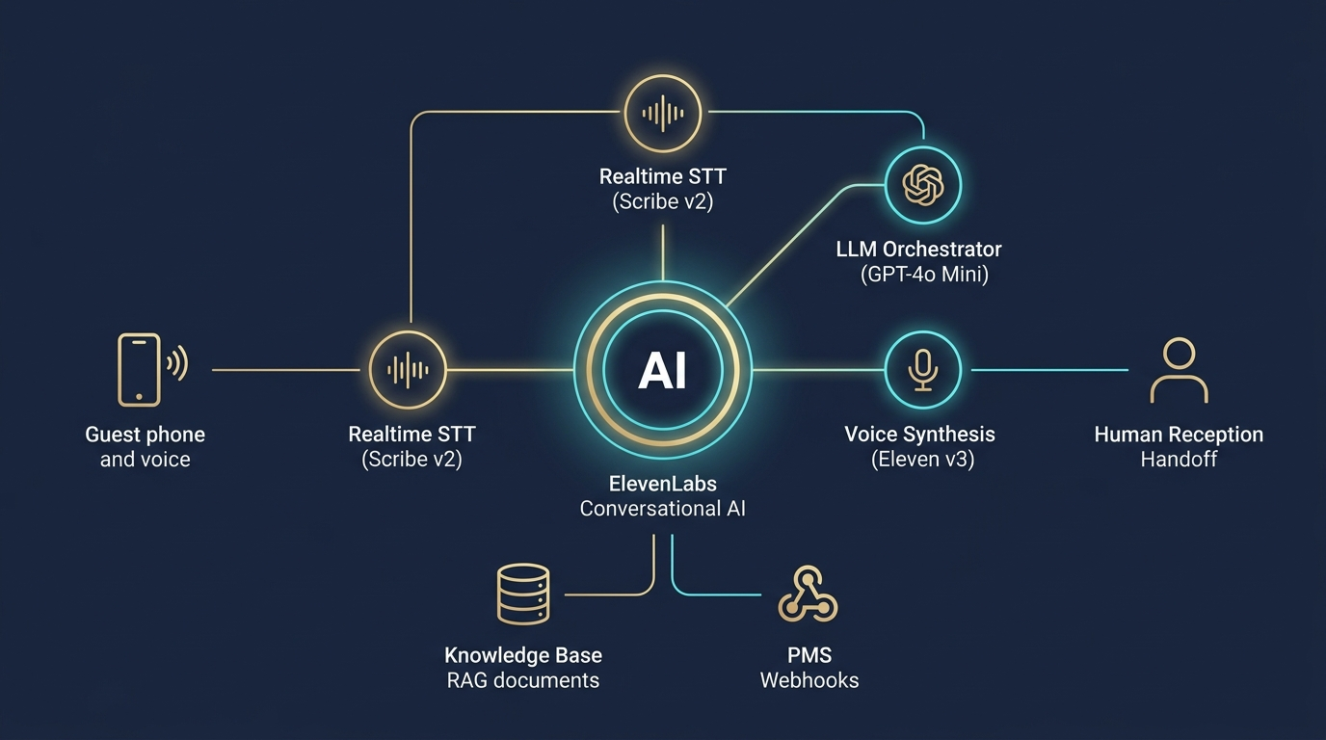
PRODUCT ARCHITECTURE
The Solution: Anna — Available 24/7 with Sub-500ms Latency
Unified Conversational AI Loop
Native integration of STT + LLM Orchestrator + TTS in a single cloud pipeline (~430ms latency).
Warm & Calibrated Voice
Eleven v3 Conversational (Jessica) clocked at 0.85x speed with patient turn-taking.
Reliable Action Execution
Deterministic webhook tool calling to PMS and SMS gateway without hallucinations.
Omnichannel Reach
One consistent AI brain serving both Telephone (SIP PBX) and Web/Mobile Widget.
Notes:
Show the unified loop architecture and why sub-500ms latency is mandatory for trust.

Slide 5
ENGINEERING DECISIONS
3 Core Architectural Trade-Offs
1. Native Agent vs. Cascaded Pipeline
Kaskada STT→LLM→TTS exceeds 2.0s latency. Native loop achieves ~430ms. For seniors, latency directly equals trust.
2. Eleven v3 vs. Flash Model
Flash is fast (75ms) but sounds robotic. Eleven v3 (~280ms) delivers emotional warmth and natural pacing.
3. Turn Timeout 3.0s & Patient Mode
Default 1.0–1.5s cuts off seniors mid-sentence. 3.0s timeout ensures comfortable dialogue.
Notes:
Every choice was an intentional trade-off between pure benchmark speed vs. domain-specific guest conversion.

Slide 6
DATA & RETRIEVAL STRATEGY
Knowledge Base (RAG) — Zero Hallucination Guardrails
Vector RAG Architecture
• 5 Curated Markdown files
• Prompt Mode: Pricing & Emergency rules in permanent context
• Auto Mode: Semantic chunking for treatments & access
• Scales to 100+ documents seamlessly
Balneological Safety Protocol
• Mandatory contraindication check for thermal baths
• Cardiac & skin inflammation screening
• Strict Grounding: Missing info = immediate warm transfer
• Hallucinated medical advice = legal liability
Notes:
In medical wellness, a hallucinating AI is worse than no AI.

Slide 7
BACKEND INTEGRATION LAYER
Tool Calling & Deterministic PMS Integration
Tool Name | Action Performed | Integration Type | Payload Example
check_spa_availability | Queries available time slots in PMS | HTTPS POST Webhook | service_name, date
book_spa_appointment | Reserves appointment & returns SPA-XXXX | HTTPS POST Webhook | service, date, time, guest
check_room_availability | Validates room inventory & calculates total price | HTTPS POST Webhook | room_type, check_in, check_out
send_sms_summary | Dispatches SMS/Telegram booking confirmation | HTTPS POST Webhook | phone_number, summary, id
transfer_to_number | Initiates warm transfer to front desk or medical nurse | Native SIP REFER | destination_phone
Notes:
Tool calling enables actionable execution with mock backend simulating production PMS.

Slide 8
UNIFIED CLIENT EXPERIENCE
Omnichannel Deployment: Phone & Web Widget
Telephone (SIP PBX Channel)
• Direct SIP Trunking into hotel PBX
• 24/7 pickup on +48 18 123 45 67
• Turn timeout 3.0s & patient listening
• Real-time SMS dispatch to caller
Web / Mobile Widget Channel
• Floating branded gold FAB on website
• Real-time animated avatar states
• Live streaming transcript & quick chips
• Instant booking summary card
Notes:
Same AI agent brain serves both phone and web without duplicated configuration.

Slide 9
SYSTEM DEMONSTRATION
Live Demo: 3 Test Scenarios
Path A: SPA Booking Flow
Book Sulphur Bath for tomorrow afternoon → Medical check → Paraphrase → SMS confirmation code SPA-4821.
Path B: Knowledge Base (RAG)
Inquire about diabetic diets and golf cart transport → Grounded response without hallucination.
Path C: Medical Escalation (Live)
Guest reports severe chest tightness → Immediate priority transfer to on-duty nurse desk.
Notes:
Run live voice demo on web widget or phone. Keep fallback response screenshots ready.

Slide 10

DATA GOVERNANCE & COMPLIANCE
Enterprise Security, Healthcare Privacy & GDPR
• Zero Retention Mode (ZRM)
Audio streams and transcripts exist solely in volatile RAM — zero disk storage.
• Conversation PII Redaction
Automated token masking for national ID, phone numbers, and health records in logs.
• EU Data Residency (Frankfurt/Dublin)
Inference, vector embeddings, and storage remain strictly in the EEA.
• Signed URLs (15-min TTL)
Frontend widget connects securely without exposing backend xi-api-key.
Notes:
For healthcare and resort management, compliance and security are non-negotiable requirements.

Slide 11
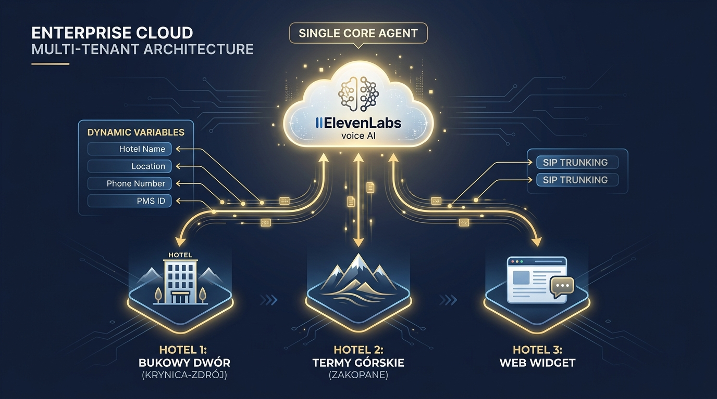
MULTI-TENANT ARCHITECTURE
Multi-Hotel Scaling: 1 Master Agent, 10 Properties
The Challenge
10 hotel properties typically means 10 separate agents, 10 siloed knowledge bases, and linear maintenance costs.
The Solution: Centralized Agent Core
1 Master Agent with dynamic variables injected in real time (hotel_name, location, phone, pms_id).
SIP UUI Protocol (RFC 7433)
Context metadata passed directly inside the telephony signaling header per inbound number.
Sub-Linear Scaling
Adding a new hotel requires updating metadata in PMS — zero prompt duplication.
Notes:
Key commercial argument — ROI across 10 properties scales sub-linearly.

Slide 12
COMMERCIAL IMPACT & METRICS
Cost Structure & Hard Business ROI
Parameter | Creator Plan (PoC) | Scale Plan (Production) | Enterprise Scale (10 Hotels)
Monthly Cost | / mo | / mo | Custom Contract (~,200/mo)
Included Voice Minutes | 275 min | 3,738 min (~.027/min) | 20,000+ min pool
Concurrent Call Lines | 10 lines | 30 lines (+Burst 90) | 100+ dedicated lines
Human Labor Parity | ~ ≈ 1h receptionist wage | Replaces 1 FTE night shift | Saves 3 FTEs across hotel chain
Core Financial Insight: The After-Hours Revenue Engine
Average spa stay booking = –. Capturing just 5 after-hours bookings/month (when front desk is offline) generates ,000–,000 in new revenue, paying for the entire annual ElevenLabs contract in under 60 days.
Notes:
Do not frame AI as a cost-cutting tool — frame it as an after-hours revenue generator.

Slide 13
IMPLEMENTATION TIMELINE
Deployment Roadmap: PoC → Production → Proactive AI
Phase I: PoC & Validation (Live Now)
• RAG Knowledge Base (5 files)
• Mock backend (FastAPI, 4 webhooks)
• Web widget with Quick Reply Chips
• Acoustic and latency calibration
Phase II: Production Pilot (Months 1-2)
• Bi-directional PMS API (Opera/Mews)
• Twilio SMS confirmation pipeline
• PBX SIP Trunk integration
• Multilingual expansion (DE, EN, UK)
Phase III: Proactive Outbound AI (Months 3+)
• Automated pre-arrival guest calls
• Golf cart shuttle scheduling
• Personalized medical SPA upselling
• Deep intent & CSAT analytics
Notes:
Phase III transitions the agent from a reactive contact center to a proactive revenue generator.

Slide 14
Thank You for Your Attention.
Open for Discussion, Q&A, and Excalidraw System Design (V2).
Notes:
Transition actively into collaborative system design.

