Slide 1
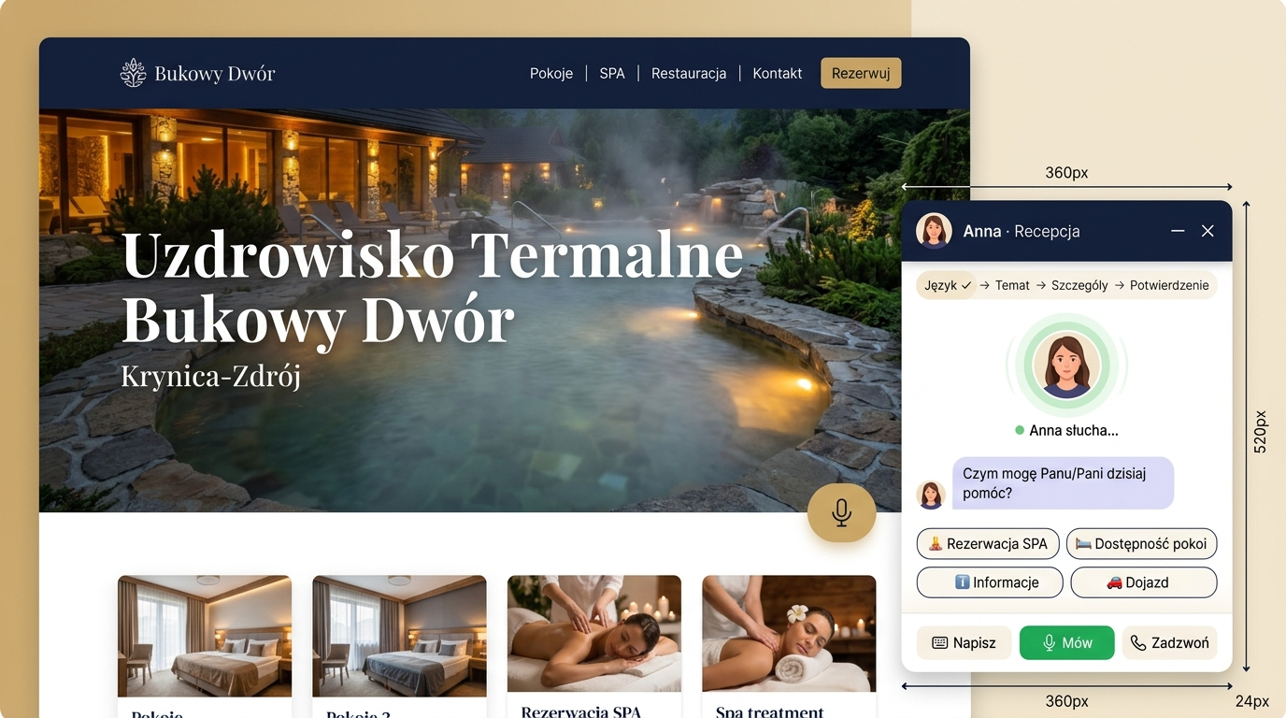
Virtual AI Receptionist
Bukowy Dwór — Thermal Spa & Health Resort × ElevenLabs
Native conversational agent deployment for a demanding 60+ guest base across a spa resort chain.
Phase V1 & V2: Case Study, Product Design & System Architecture | 2026
Notes:
Start with 30 seconds of business context: why a health resort and why seniors, before touching the technology.

Slide 2
BUSINESS CHALLENGE
Senior Guests Wait. Front Desk Can't Keep Up.
📞 60–70% Senior Guests
The 60+ demographic strongly prefers voice calls over mobile apps and web forms.
⏰ Peak Call Spikes
Call surges at 8:00–10:00 and 16:00–18:00 create busy lines and guest frustration.
💰 Lost High-Margin Revenue
An unanswered call is a lost treatment ($30–$80) or room booking ($100–$250).
👥 Front Desk Bottlenecks
Staff are overloaded with check-ins and have no bandwidth for pre-arrival outbound calls.
Notes:
This is the business problem slide. Before explaining your solution, ask the interviewer what questions the problem raises for them.

Slide 3

USER PERSONA & EMPATHY
Who Is Calling? Mrs. Sophia, 72 Years Old.
• Profile & Speech: Speaks slowly, pauses naturally mid-sentence, takes time to think before answering.
• Vocabulary Gaps: Does not recall clinical treatment names — asks for “that massage that helps my lower back”.
• Zero Error Tolerance: If the bot interrupts or fails to understand twice, a senior hangs up immediately.
• Confirmation Need: Expects a clear SMS summary, often asked to be sent to her daughter.
• Engineering Rule: Every technical parameter (3.0s timeout, 0.85x pace, paraphrasing) stems directly from this persona.
Notes:
Stress that this is not an abstract persona — it is the archetype of a health-resort patient.

Slide 4
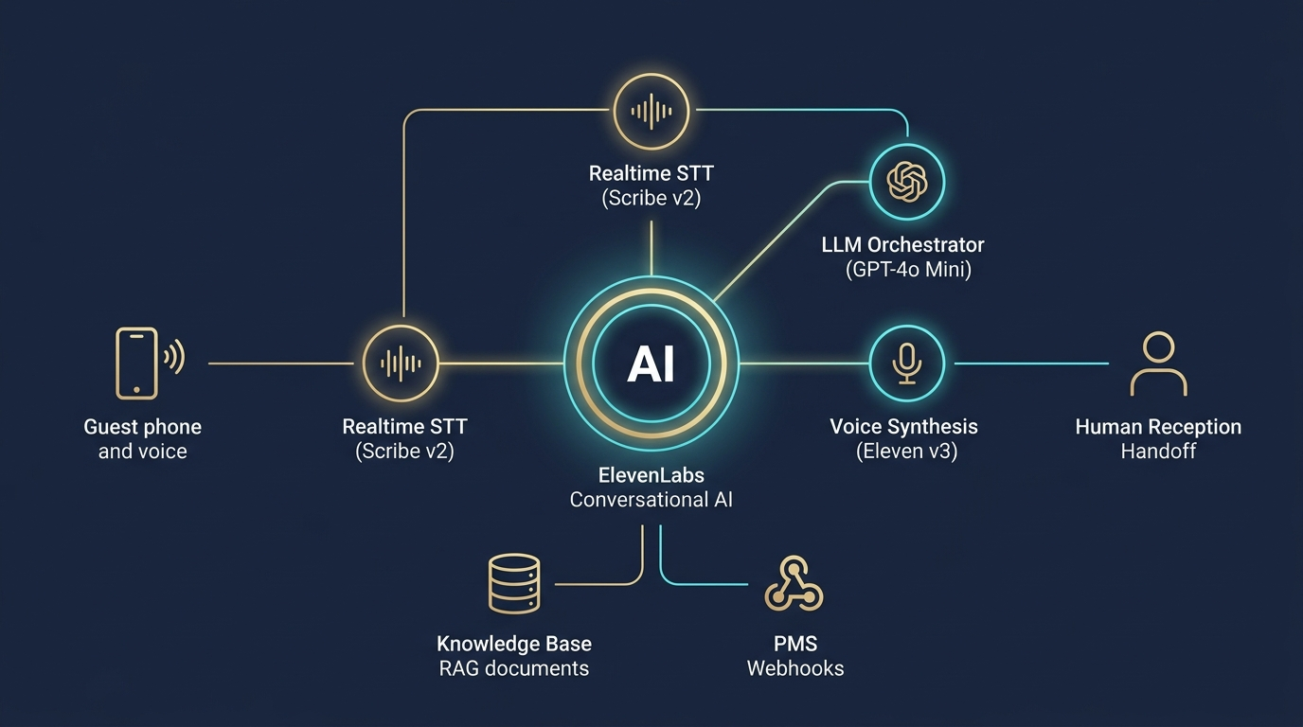
SYSTEM ARCHITECTURE (HIGH LEVEL)
Unified ElevenLabs Conversational Loop
Single Loop vs Cascade
• Integrated loop: STT + LLM + TTS in a single WebRTC/SIP channel
• Response time: ~430 ms instead of >2.0 s in a classic cascaded backend
• Strict grounding: answers come only from the 5 RAG files
• Tool calling: native webhooks into the hotel PMS
• Deterministic handoff: transfer to reception whenever in doubt
Notes:
Why a native ElevenLabs loop? Latency elimination. A cascade of three services loses a senior guest inside two seconds of silence.

Slide 5
STRATEGIC TRADE-OFFS
3 Core Architectural Decisions
1. Native Agent (vs Custom LLM)
A cascaded pipeline (STT -> external LLM -> TTS) adds more than 2 s of latency. The native ElevenLabs loop drops to ~430 ms. For a senior, every second of silence erodes trust.
2. Eleven v3 (vs Flash 75 ms)
Flash is ultra-fast but sounds technical. Eleven v3 Conversational (280 ms) delivers warmth, intonation and empathy. For a 70+ guest, a natural voice matters more than 100 ms.
3. UX Parameters: 3.0 s & Patient
The default 1.2 s timeout cuts in while a senior takes a breath. turn_timeout: 3.0 s, turn_eagerness: Patient and speed: 0.85x remove the stress.
Notes:
Show that you know the cost and the trade-offs: when to pick Flash, and why v3 wins in a health resort.

Slide 6
KNOWLEDGE BASE & ZERO HALLUCINATION
Knowledge Base (RAG) & Strict Grounding
Structure of the 5 Markdown Files
• 01_access.md — parking, shuttle, step-free access
• 02_spa_catalogue.md — 7 treatments and pools
• 03_rooms_and_pricing.md — 3 room types
• 04_restaurant.md — diabetic and light diets
• 05_procedures.md — house rules and safety
RAG mode split:
• Prompt Mode (in context): pricing + procedures
• Auto Mode (semantic search): descriptions and access
Medical Protocol & Safety
• Strict grounding:
No information in the knowledge base = immediate transfer to reception. Never guess prices or availability.
• Balneological screening:
Before booking a sulphur or peat bath the agent asks about cardiovascular contraindications.
• Immediate escalation:
Emergency symptoms (chest pain, shortness of breath) trigger a transfer to the on-duty nurse station.
Notes:
In a health resort a wrong price is a commercial issue, but a hallucinated treatment is a health risk.

Slide 7
TOOL CALLING & INTEGRATION
Anna Doesn't Just Chat — She Acts in the PMS
Tool (Function) | Business Role / Flow | Integration Type
check_spa_availability | Checks free treatment slots in the calendar | POST Webhook (FastAPI/PMS)
book_spa_appointment | Books the guest and returns an ID (e.g. SPA-4821) | POST Webhook (FastAPI/PMS)
cancel_spa_appointment | Cancels a treatment (free >2 h, 50% <2 h, 0% with medical release) | POST Webhook (FastAPI/PMS)
reschedule_spa_appointment | Moves a treatment to a new slot (free, new SPA code) | POST Webhook (FastAPI/PMS)
check_room_availability | Checks room availability and calculates the total stay price | POST Webhook (FastAPI/PMS)
send_sms_summary | Sends an SMS / Telegram summary with the booking ID and directions | POST Webhook (SMS gateway)
transfer_to_simulated_handoff | Hands off to reception / nurse station (log + Telegram alert) | POST Webhook (simulated handoff — no SIP)
Notes:
Point out that the human handoff is simulated by a webhook in the PoC (log + Telegram alert) because there is no telephony/SIP — a native SIP REFER will replace it in production.

Slide 8
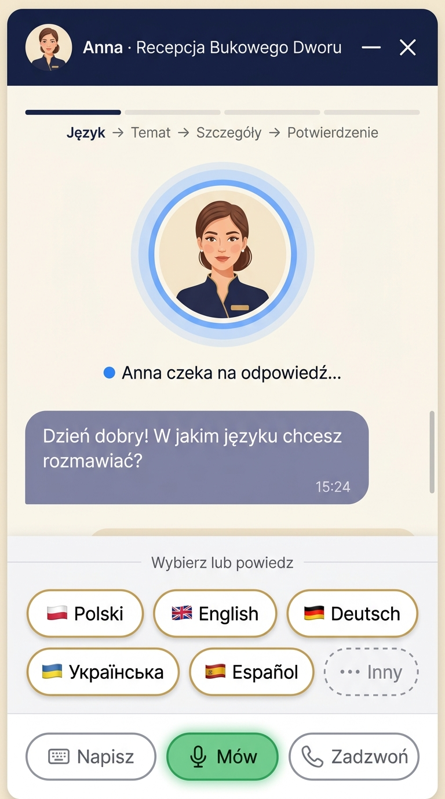
OMNICHANNEL DEPLOYMENT
Two Channels, One Unified Assistant
Channel 1: Traditional Telephony (SIP Trunk) — target state
• Same agent and prompt once SIP Trunk is connected (Phase II — no telephony in the PoC)
• Direct number to the hotel reception
• 24/7 availability with no queueing
• Turn timeout 3.0 s, paraphrased confirmations, SMS after the call
Channel 2: Interactive Web Widget on the Hotel Website
• Quick Reply Chips: pick a language (6 options) and a topic
• Live Transcript: follow the conversation in real time
• Success Card: instant booking confirmation with an option to send it to a carer
• Signed URL: 15-minute secure WebSocket token without exposing the API key
Notes:
In the PoC the agent runs only as a web widget; the SIP Trunk phone channel is the target state with the very same agent configuration.

Slide 9
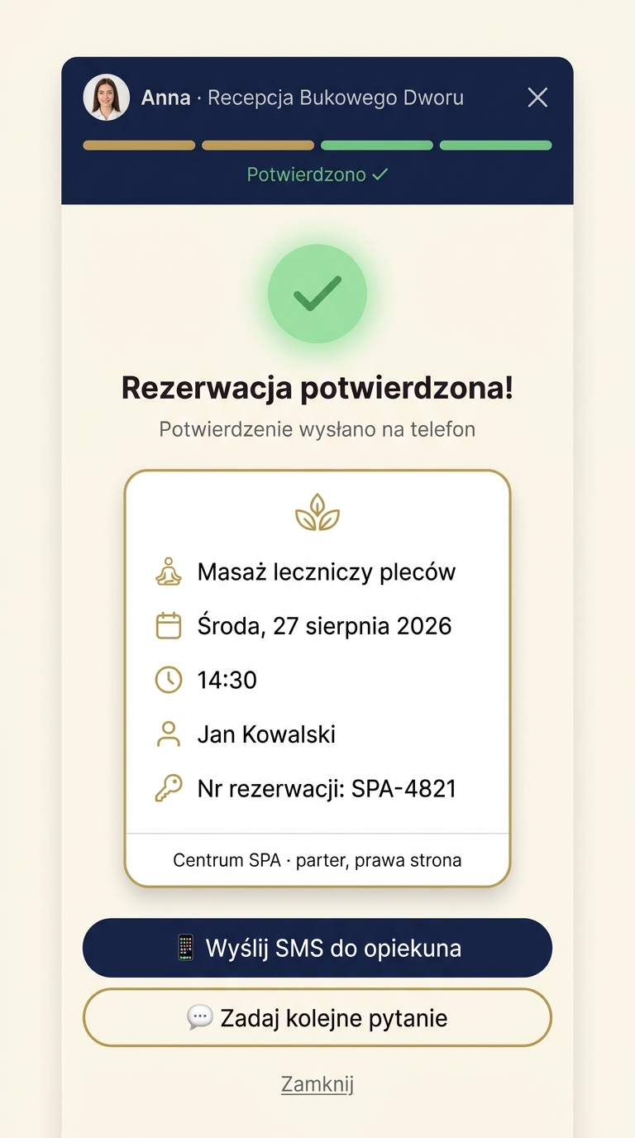
LIVE SCENARIOS
Demo: 3 Validation Paths
Path A: SPA Treatment Booking (Happy Path)
Guest asks about a therapeutic massage -> Anna checks the calendar -> proposes 14:30 -> paraphrases the details -> confirms booking SPA-4821 -> sends the SMS.
Path B: Grounded Knowledge Question (RAG)
Question about diabetic meal times and the shuttle -> a precise answer from the knowledge base with no hallucination.
Path C: Medical Escalation / Contraindication
Guest reports cardiac symptoms before a sulphur bath -> Anna transfers to the nurse station immediately.
Notes:
Have a fallback ready: if the network drops, show the FastAPI logs or the audio recordings.

Slide 10

SECURITY & COMPLIANCE
Enterprise Ready: GDPR & Medical Data Protection
🔒 Zero Retention Mode (ZRM):
Audio and transcripts are processed in RAM only — nothing is written to ElevenLabs disks.
🔒 Data Redaction:
Automatic masking of personal (PII) and medical data in logs.
🔒 Data Residency EU:
Data processed inside the European Union, full GDPR / DPA compliance.
🔒 Signed URLs:
Secure one-time tokens that keep the API key out of the browser.
Notes:
For a hotel-chain board, medical compliance is a sine qua non condition.

Slide 11
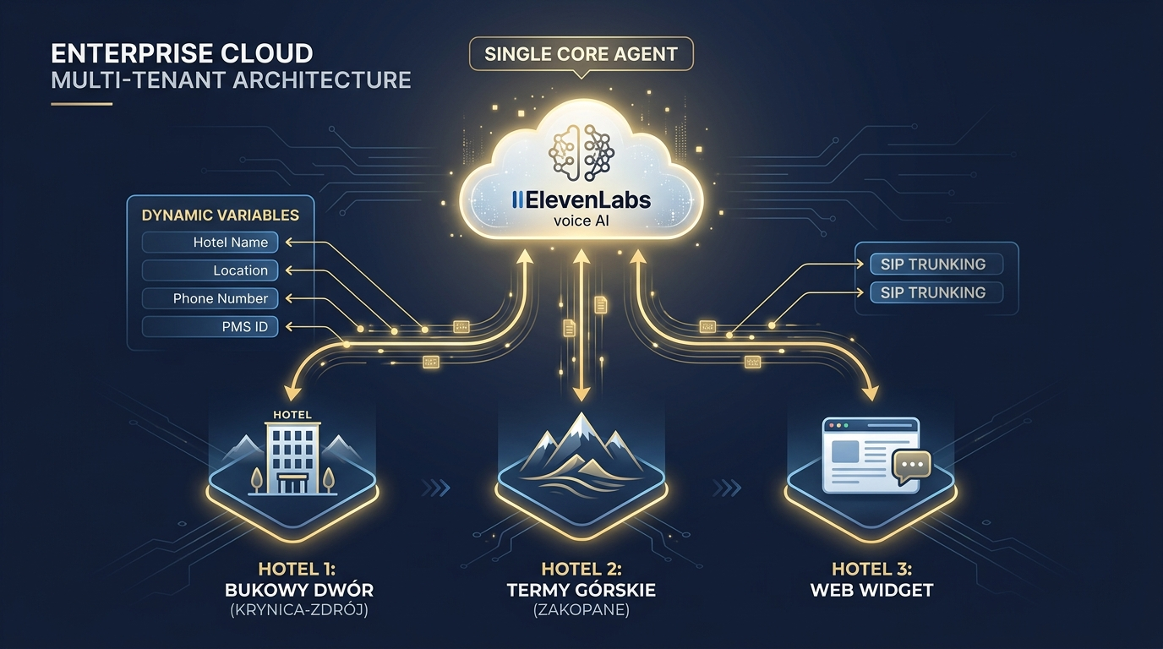
MULTI-TENANT ARCHITECTURE
One Agent, Ten Hotels — Network Scaling
Multi-Hotel Architecture
• 1 Central Agent: instead of 10 separate bots we maintain a single system-prompt core.
• Dynamic Variables: injected when the call starts:
- hotel_name, location
- reception_phone
- pms_hotel_id
• SIP UUI signalling: the PBX passes the hotel ID in the call headers.
• Scalability: adding an 11th property is 5 minutes of variable configuration.
Notes:
Show how you think as a Deployment Strategist: maintenance cost and agent governance optimisation.

Slide 12
BUSINESS CASE & FINANCIALS
Deployment Cost & Hard Return on Investment (ROI)
Parameter | Pilot / PoC Phase (Creator) | Scaling Phase (Scale)
Platform cost | $22 / month | $299 / month
Included minutes | 275 call minutes | 3,738 call minutes
Concurrent calls (Concurrency) | 10 channels | 30 channels (+burst to 90)
ROI calculation:
• 275 min of AI ($22) costs as much as just 3.5 hours of a receptionist (~25 PLN/h).
• Revenue protection: two room bookings at night (2 x 500 PLN) cover the monthly Scale subscription.
• Value for staff: no burnout and full focus on guests physically present at the property.
Notes:
Do not position AI as headcount reduction. It protects revenue at night and during call peaks.

Slide 13
IMPLEMENTATION TIMELINE
Implementation Roadmap: from PoC to Proactive AI
Phase I: PoC & Validation (Now)
• RAG knowledge base (5 files)
• Mock backend (FastAPI, 7 webhook tools, :8011)
• Web widget with Quick Reply Chips
• Latency and prompt testing
Phase II: Production Integration (Month 1-2)
• Direct PMS API (Opera/KWHotel)
• Twilio SMS gateway (confirmations)
• SIP PBX telephony integration
• Multilingual (DE, EN, UA)
Phase III: Proactive Outbound AI (Month 3+)
• Automated pre-arrival calls
• Shuttle confirmation
• Personalised treatment recommendations
• Advanced intent and CSAT analytics
Notes:
Phase III moves the agent from a reactive hotline to a proactive revenue generator.

Slide 14
Thank you.
Time for discussion, questions and the System Design session (V2).
Notes:
Open the discussion and move into the design workshop.

