Slide 1
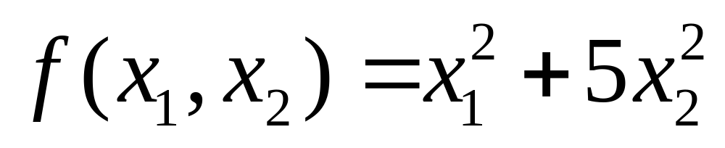
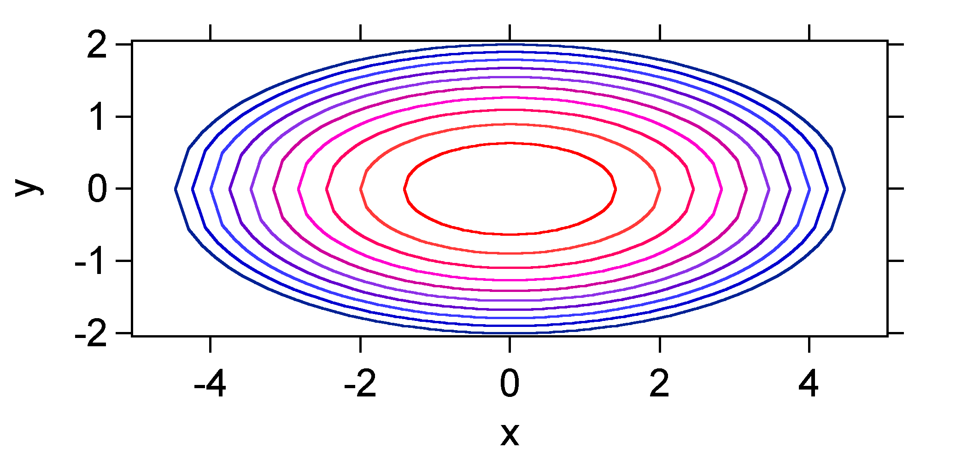
Steepest Descent Method
Contours are shown below

Slide 2
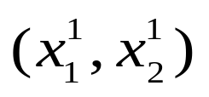
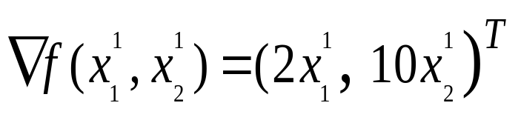
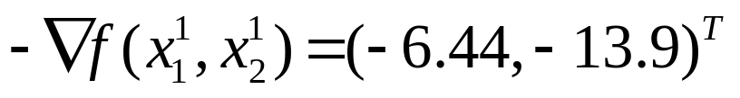
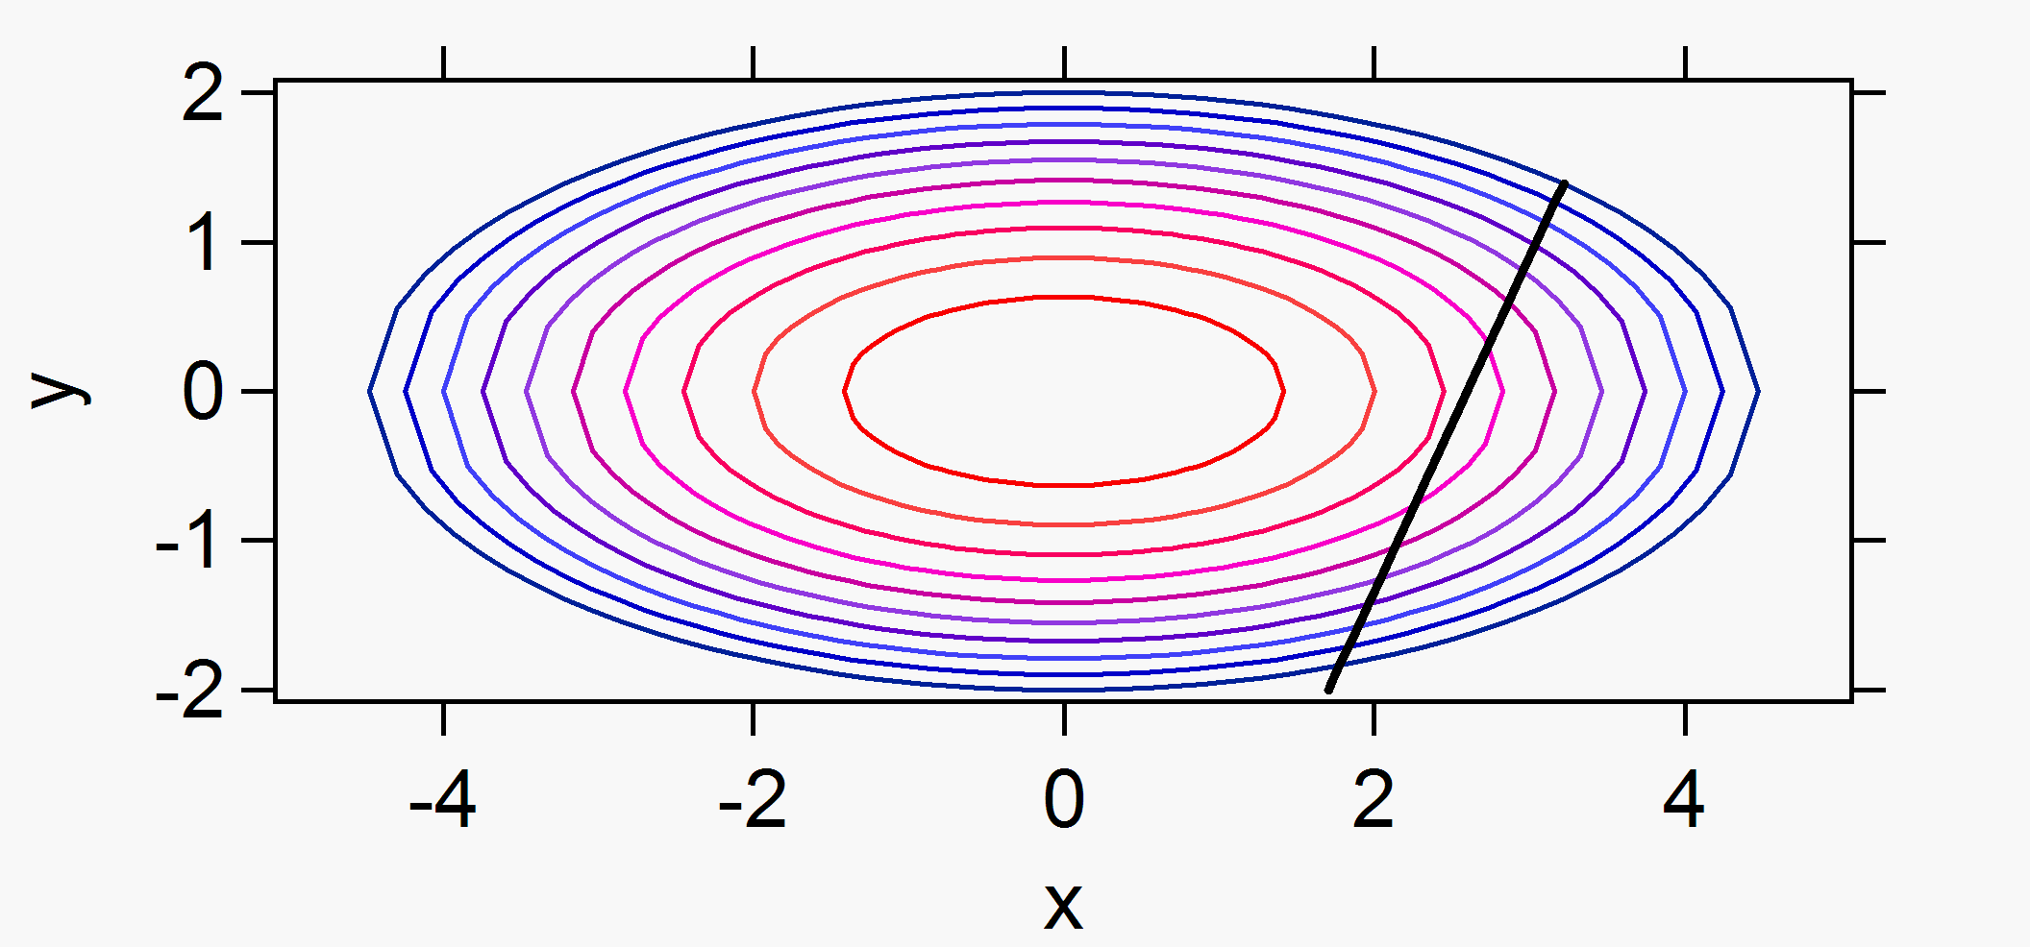
Steepest Descent
The gradient at the point is
If we choose x₁¹ = 3.22, x₂¹ = 1.39 as the starting point
represented by the black dot on the figure, the black line shown
in the figure represents the direction for a line search.
Contours represent from red (f = 2) to blue (f = 20).

Slide 3
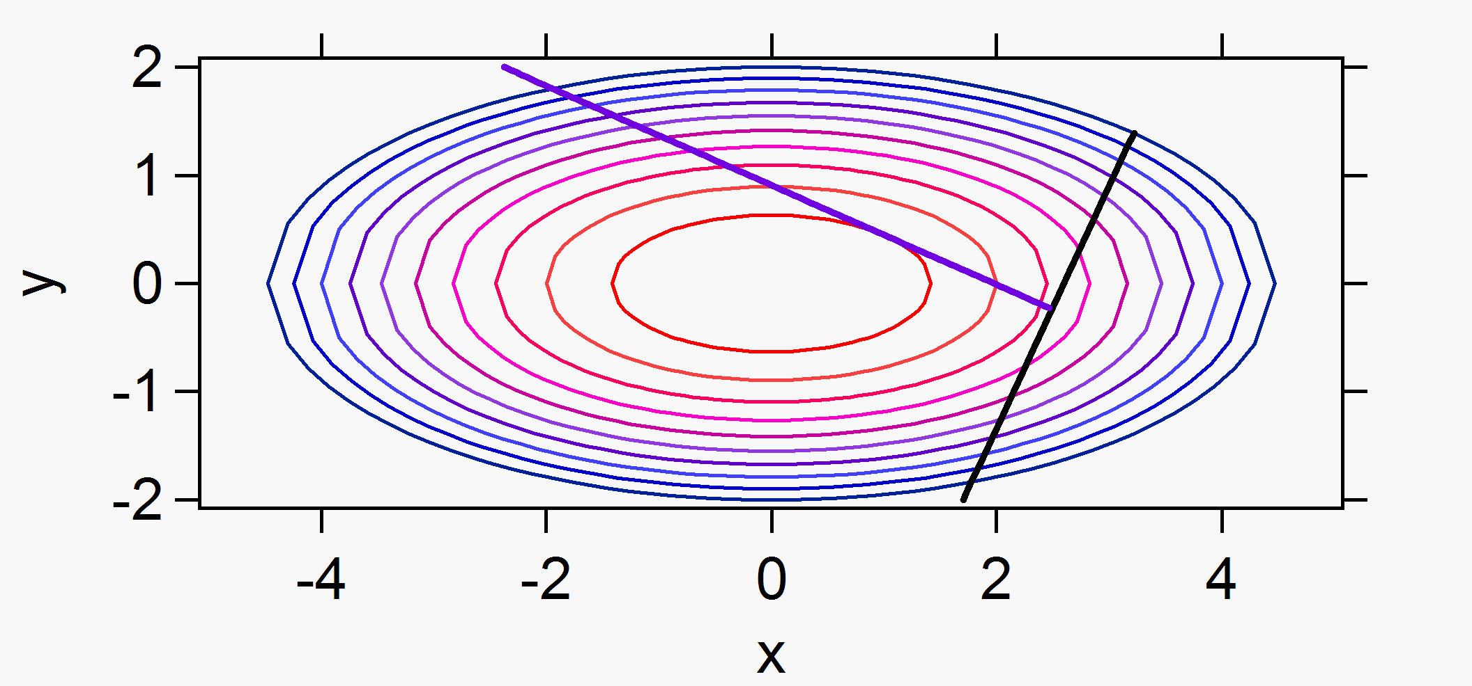
Steepest Descent
Now, the question is how big should the step be along the
direction of the gradient? We want to find the minimum along
the line before taking the next step.
The minimum along the line corresponds to the point where
the new direction is orthogonal to the original direction.
The new point is (x₁², x₂²) = (2.47,-0.23) shown in blue .

Slide 4
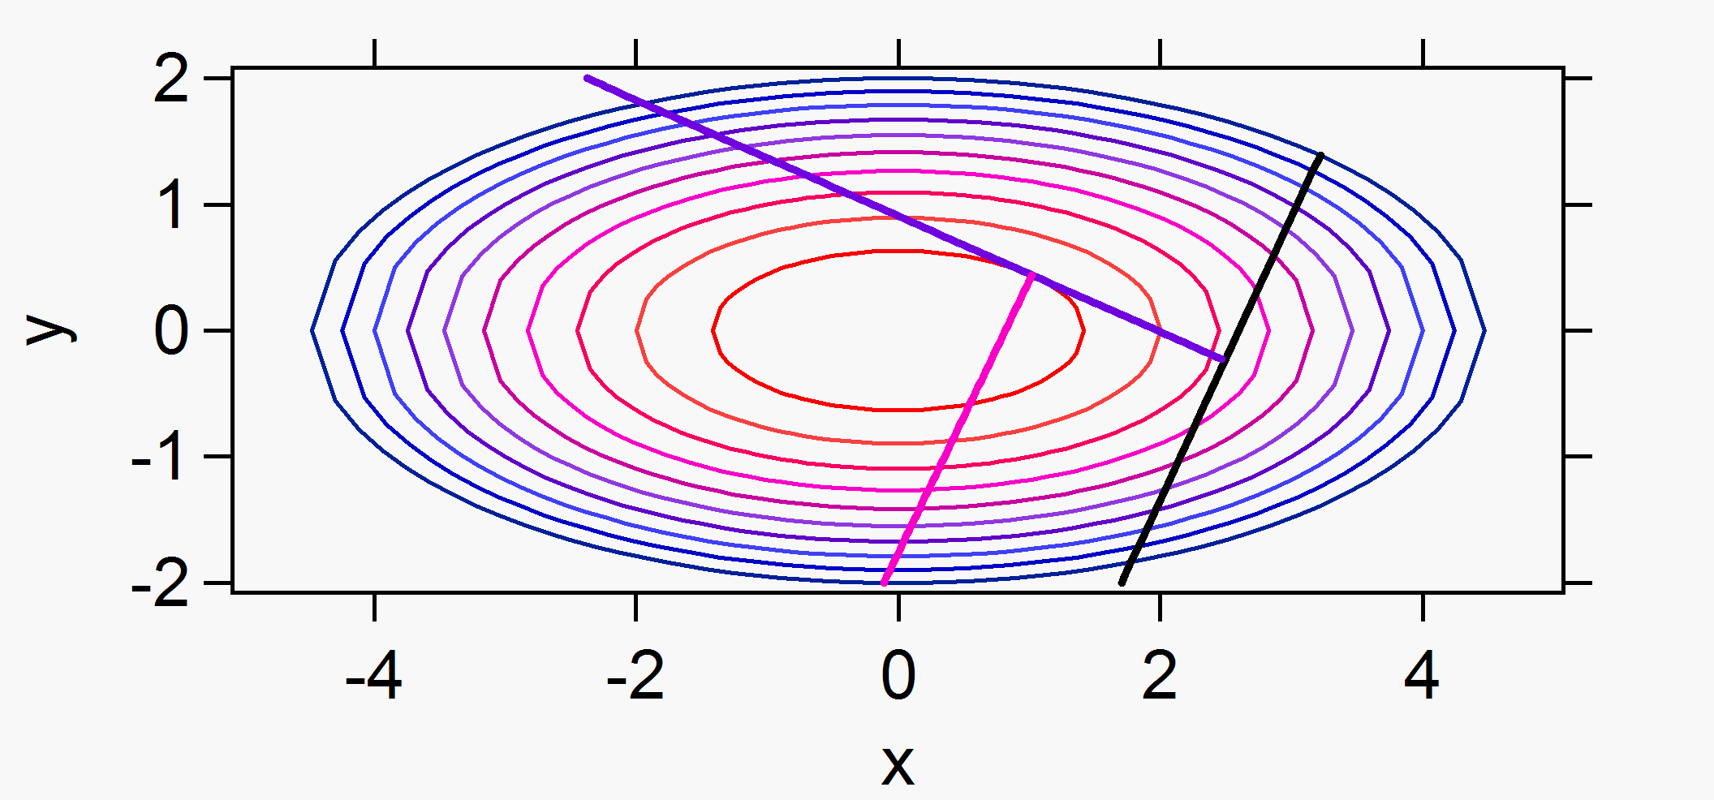
Steepest Descent
By the third iteration we can see that from the point (x₁², x₂²) the
new vector again misses the minimum, and here it seems that
we could do better because we are close.
Steepest descent is usually used as the first technique in a
minimization procedure, however, a robust strategy that
improves the choice of the new direction will greatly enhance
the efficiency of the search for the minimum.

