Slide 1
Experimental Statistics for Engineers - II
ST516
Lecturer 1

Slide 2
Instructor: Paul Savariappan Mail Id: prsavari@ncsu.edu Office: SAS 5232 Phone: (919) 513 2445 Office hours: Tuesday 10.30AM – 12Noon Thursday 10.30AM – 12Noon

Slide 3
Teaching Assistant: Haoyu Chen Email: hchen@ncsu.edu

Slide 4
Today...
Course overview
Course details
Course objective, homework, grading etc
Schedule, lecture overview

Slide 5
After completing this course, a successful student should be:
Able to use statistical methods to analyze specific types of data through estimation, Hypothesis testing, model fitting and recognize when the help of a professional statistician is necessary;
be able to use a statistical software package to aid in the analysis of data.

Slide 6
Homework
There will be 8-10 homework assignments throughout the semester. Generally, assignments will be posted to Moodle.
There will be 7 - 8 in-class quizzes throughout the semester.
No unexcused late work will be accepted for credit.
Students missing a HW and quiz will be assigned a score of zero for that HW and quiz.
You must do your own work.

Slide 7
Exams
There will be two midterm exams, and a cumulative final exam.
The midterms will be 1hour 10 minutes long and are tentatively scheduled on October 03 and November 14 .
The final exam is December 17
You will be allowed one 8.5 by 11 inch sheet of notes for the midterms and 2 sheets for the final.

Slide 8
Grading
Midterm 1: 25% (03-rd Oct)
Midterm 2: 25% (14-th Nov)
Final: 25% (17-th Dec)
Homework & Quiz: 25%
The following criteria will be followed for assigning the letter grade:
A+ = [100-97], A = (97-93], A- = (93-90], B+ = (90-87], B = (87-83], B- = (83-80], C+ = (80-77], C = (77-73], C- = (73-70], D+ = (70-67], D = (67-63] D- = ( 63-60] and F < 60.

Slide 9
HOW TO SUCCEED IN A MATH CLASS
Come to every class meeting.
Arrive early, get yourself settled, spend a few minutes looking at your notes from the previous class meeting, and have your materials ready when class starts.
Read each section before it is discussed in class.
Do some math every day.
Start preparing for the tests at least a week in advance.
Spend about half of your study time working with your classmates.
Take advantage of tutors and office hours, extra help can make a big difference.

Slide 10
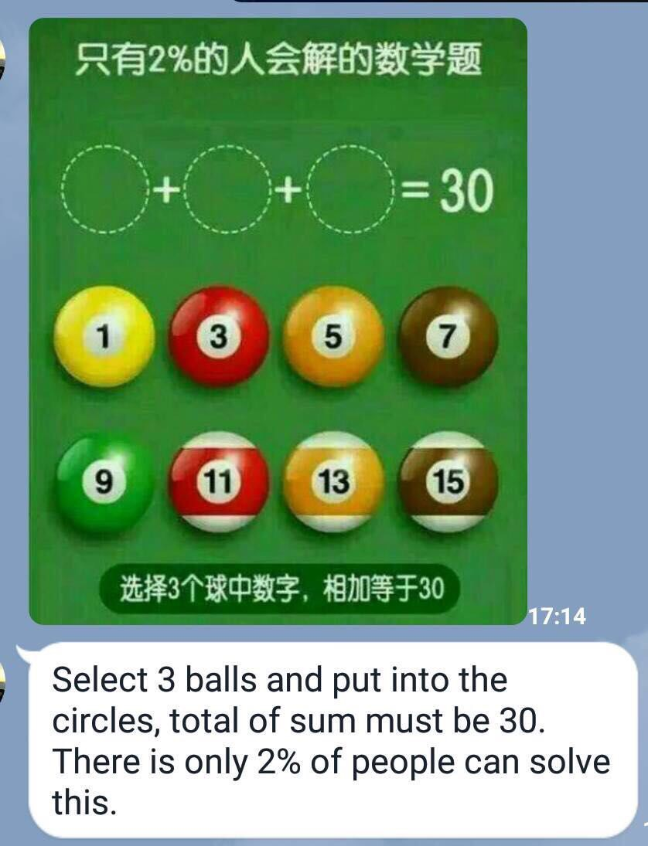

Slide 11
Statistics and their Distributions

Slide 12
Statistic
A statistic is any quantity whose value can be calculated from sample data.
Prior to obtaining data, there is uncertainty as to what value of any particular statistic will result.
Hence statistic is a random variable denoted by an uppercase letter; a lowercase letter is used to represent the calculated or observed value of the statistic.

Slide 13
Sampling Distributions
Theoretical Probability Distribution
Random Variable is Sample Statistic:
(Sample Mean, Sample Proportion, Sample variance….)
Results from taking All Possible Samples of the Same Size
What are all the POSSIBLE sample outcomes and how likely are they?

Slide 14
Developing Sampling Distributions
Suppose there’s a population...
B
C
Random variable, X, is Age of individuals
Values of X: 18, 20, 22, 24
measured in years
EVERYONE is one of these 4 ages in this population
D
A
© 1984-1994 T/Maker Co.

Slide 15
Population Characteristics
Summary Measure
Population Distribution
P(X)
.3
.2
.1
0
A B C D
(18) (20) (22) (24)
X
Uniform Distribution

Slide 16
All Possible Samples of Size n = 2
16 Sample Means
16 Samples
Samples Taken with Replacement

Slide 17
Sampling Distribution of All Sample Means
16 Sample Means
Sample Means Distribution
P(X)
.3
.2
.1
_
0
X
18 19 20 21 22 23 24
# in sample = 2, # in Sampling Distribution = 16

Slide 18
Comparing the Population with its Sampling Distribution
Population
Sample Means Distribution
n = 2
μ = 21, σ = 2.236
P(X)
P(X)
.3
.3
.2
.2
.1
.1
_
0
0
A B C D
(18) (20) (22) (24)
X
18 19 20 21 22 23 24
X

Slide 19
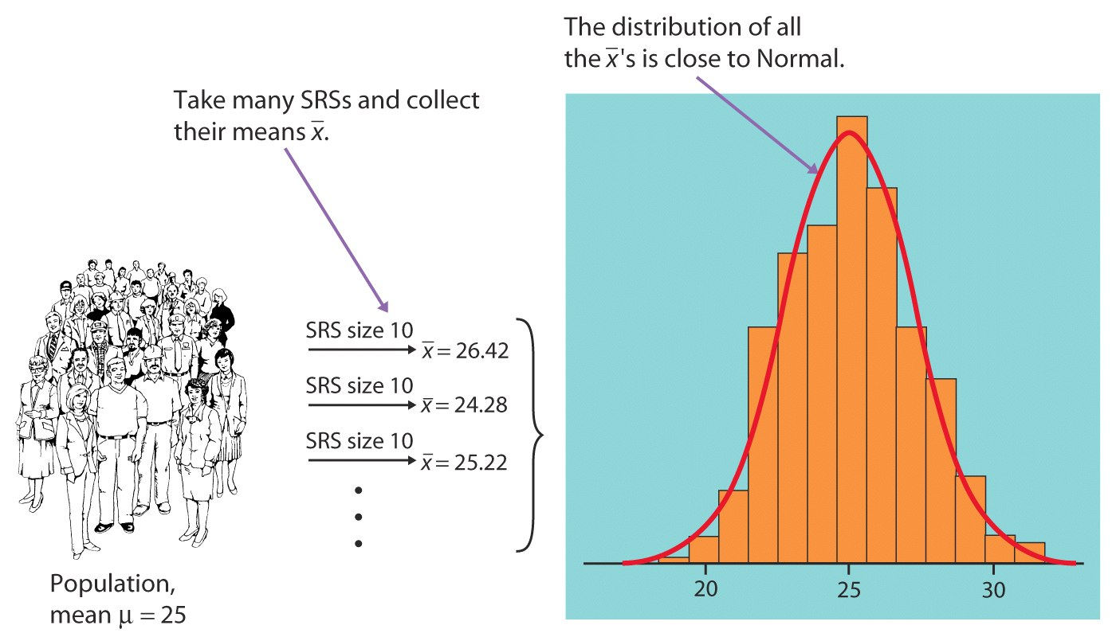
Sampling distribution of (the sample mean)
We take many random samples of a given size n from a population with mean μ and standard deviation σ.
Some sample means will be above the population mean μ and some will be below, making up the sampling distribution.
Sampling distribution of “x bar”
Histogram of some sample averages

Slide 20
For any population with mean μ and standard deviation σ :
The mean, or center of the sampling distribution of , is equal to the population mean μ.
The standard deviation of the sampling distribution is σ /√n, where n is the sample size.
Sampling distribution of
σ/√n
μ

Slide 21


Sampling Distribution of the Mean…
A fair die is thrown infinitely many times,
with the random variable X = # of spots on any throw.
The probability distribution of X is:
…and the mean and variance are calculated as well:
x | 1 | 2 | 3 | 4 | 5 | 6
P(x) | 1/6 | 1/6 | 1/6 | 1/6 | 1/6 | 1/6

Slide 22

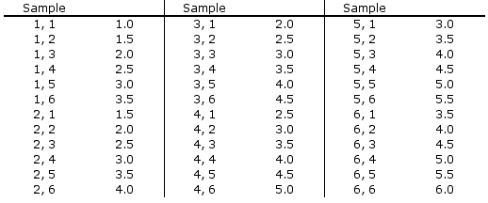
Sampling Distribution of Two Dice
A sampling distribution is created by looking at
all samples of size n=2 (i.e. two dice) and their means…
While there are 36 possible samples of size 2, there are only 11 values for , and some (e.g. =3.5) occur more frequently than others (e.g. =1).

Slide 23


Sampling Distribution of Two Dice…
The sampling distribution of is shown below:
P( )
6/36
5/36
4/36
3/36
2/36
1/36
P( )

Slide 24

Compare…
Compare the distribution of X…
…with the sampling distribution of .
As well, note that:

Slide 25


Generalize…
We can generalize the mean and variance of the sampling of two dice:
…to n-dice:
The standard deviation of the sampling distribution is called the standard error:

Slide 26
The central limit theorem
Take a large (30 or more) random sample of size n from any population with mean μ and standard deviation σ. The sample mean, X is approximately normal with mean μ and standard deviation :
Note – if the original population is exactly Normal, than

Slide 27
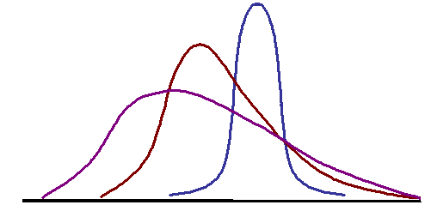
The Central Limit Theorem
small to moderate n
large n
Population distribution

Slide 28
Rule of Thumb
If n > 30, the Central Limit Theorem can be used.

Slide 29
Example
1. The time it takes a student to get to the university by bus every morning varies from day to day. The average of these times is 30 minutes and the standard deviation of the times is 10 minutes.
For 36 days the student recorded the time it took him to get to the university.
Let be the average amount of time in this sample.
The distribution of ___________________
The mean of ________________________
The standard deviation of (SE) _____________
Approximately normal
μ=30
σ=10/√36=1.67

Slide 30
Example
1. The level of nitrogen oxide (NOX) in the exhaust of a particular car model varies with mean 0.9 grams per mile (g/mi) and standard deviation 0.15 g/mi. A company has 125 cars of this model in its fleet.
Let denote the mean NOX nitrogen level in a sample of 125 cars. The distribution of is close to Normal with
μ= __________ and
σ = SE ______________
(b) What is the probability that the mean level of a sample of 125 will exceed 1.0?
(c) What is the probability that the NOX level of a particular car would exceed 1.0?
The distribution of NOX is not specified – cannot compute the probability
0.9
0.15/√125=0.0134
P( > 1) = P(Z > (1 - 0.9) / .0134) = P(Z > 7.46) ≈ 0

Slide 31
2. X has mean of 20 and a standard deviation of 5. The shape of the distribution of X is not specified. For a random sample of size 30:
(a) What can you say about the sampling distribution of the sample mean ?
Distribution of : ______________________________
Mean of : ______________________________
Standard deviation of : ____(SE) ____________________
Find the probability that will exceed 20.75.
Approximately normal
μ=20
σ=5/√30=.91

Slide 32
3. In a certain population, Math SAT scores are N(500,100)
a) Pick 1 student at random. What is the probability that her score X is between 490 and 510?

Slide 33
b) Pick 25 students at random. What is the probability that their sample mean score is between 490 and 510?
X has a mean 500 and standard deviation 100, therefore

Slide 34

c) Pick 400 students at random. What is the probability that their sample mean score is between 490 and 510.
X has a mean 500 and standard deviation 100, therefore

Slide 35
4. A candy company manufactures a candy bar, whose weight is supposed to be 50 grams. In fact, the weight varies according to a normal distribution with mean 49 grams and standard deviation 2 grams. The candy bars are then packed in bags of four units.
What is the probability that an individual candy bar weighs less than 46 grams?
X~N(μ=49, σ=2)

Slide 36
b. What is the probability that the mean weight of the candy bars in a bag is less than 46 grams?

Slide 37
Example
The foreman of a bottling plant has observed that the amount of soda in each “32-ounce” bottle is actually a normally distributed random variable, with a mean of 32.2 ounces and a standard deviation of 0.3 ounce.
If a customer buys one bottle, what is the probability that the bottle will contain more than 32 ounces?
Regular old look up a normal probability.

Slide 38



Example
We want to find P(X > 32), where X is normally distributed and =32.2 and = 0.3
“there is about a 75% chance that a single bottle of soda contains more than 32oz.”

Slide 39
Example
The foreman of a bottling plant has observed that the amount of soda in each “32-ounce” bottle is actually a normally distributed random variable, with a mean of 32.2 ounces and a standard deviation of .3 ounce.
If a customer buys a carton of four bottles, what is the probability that the mean amount of the four bottles will be greater than 32 ounces?

Slide 40


Example
We want to find P(X > 32), where X is normally distributed
with =32.2 and =0.3
Things we know:
X is normally distributed, therefore so will X.
= 32.2 oz.

Slide 41

Example
If a customer buys a carton of four bottles, what is the probability that the mean amount of the four bottles will be greater than 32 ounces?
“There is about a 91% chance the mean of the four bottles will exceed 32oz.”

Slide 42
Example
Suppose that you have a sample of 100 values from a population with mean µ = 500 and with standard deviation σ = 80.
What is the probability that the sample mean will be in the interval (490 510)?
b. Give an interval that covers the middle 95% of the distribution of the sample mean.

Slide 43
Example
Assume that a school district has 10,000 6th graders. In this district, the average weight of a 6th grader is 80 pounds, with a standard deviation of 20 pounds. Suppose you draw a random sample of 50 students. What is the probability that the average weight of a sampled student will be less than 75 pounds?

Slide 44
Reclaimed phospate land in Polk County, Florida, has been found to emit a higher mean radiation level than other non-mining land in the county. Suppose that the radiation level for the reclaimed land has a distribution with mean 5.0 working levels (WL) and a standard deviation of 0.5 WL. Suppose further that 20 houses built on reclaimed land are randomly selected and the radiation level is measured.
What is the probability that the sample mean for the 20 houses exceeds 4.7 WL?
What is the probability that the sample mean is less than 4.8 WL?

