Slide 1
Two Way ANOVA

Slide 2
Two-Way ANOVA
The response variable Y is continuous
There are two categorical explanatory variables or factors

Slide 3
Two-Way ANOVA Data Layout
Factor
Factor B
A
1
2
...
b
Observation k in each cell
1
Y₁₁₁
Y₁₂₁
...
Y_{1b1}
Y_{11n}
Y_{12n}
...
Y_{1bn}
Y_{ijk}
2
Y₂₁₁
Y₂₂₁
...
Y_{2b1}
Y_{21n}
Y_{22n}
...
Y_{2bn}
Level i Factor A
Level j Factor B
:
:
:
:
:
a
Y_{a11}
Y_{a21}
...
Y_{ab1}
Y_{a1n}
Y_{a2n}
...
Y_{abn}
i = 1,…,a j = 1,…,b k = 1,…,n
There are a X b treatment combinations

Slide 4
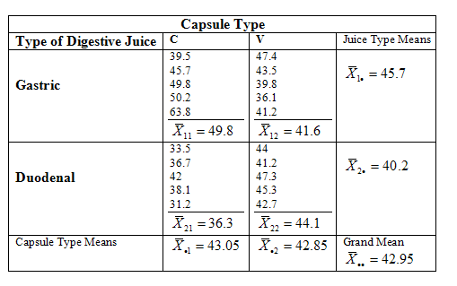
Motivating Example: Capsule Dissolve Time
Suppose are looking at two capsule types (C or V) & two digestive fluids (Gastric or Duodenal)
Randomly assign 5 capsules of each type to each of type of digestive juice and observe dissolve time.
Y_{ijk} = measured dissolve time for capsule k in digestive juice i and capsule type j.
i = 1 or 2 (i.e. G and D) j = 1 or 2 (i.e. C and V) k = 1,2,3,4,5

Slide 5
Questions of Interest
Generally, the questions of interest here (i.e. hypotheses to be tested) concern three questions regarding the potential effects of the factors on the response variable.
Question 1: Do the effects that factors A and B have on the response variable interact,
i.e. is there a significant interaction between factors A and B ?

Slide 6
Questions of Interest
If we conclude there is a significant interaction then we conclude the effects of both factors A and B are significant!
When we have an interaction we cannot consider the effect of either factor independently of the other, therefore both factors matter.

Slide 7
Questions of Interest
If there is not a significant interaction effect then we can consider the main effects separately, i.e. we ask the following:
Question 2: Does factor A alone have a significant effect?
Question 3: Does factor B alone have a significant effect?

Slide 8
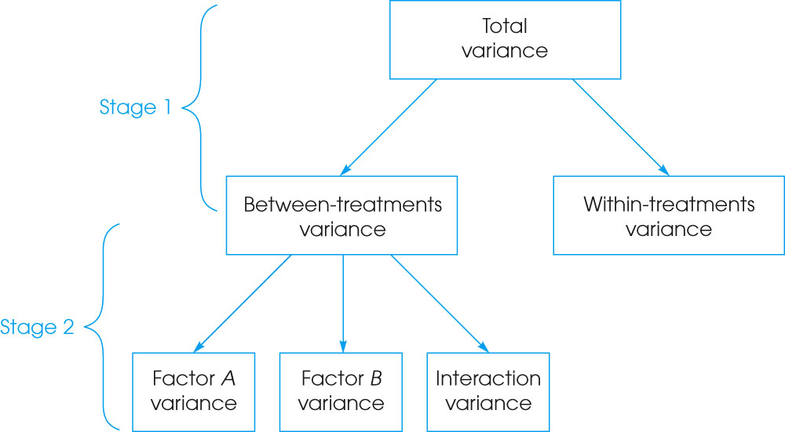
Tests of Hypotheses

Slide 9
Analysis in Two-way ANOVA
SS _{TOTAL}
SS _{WITHIN}
SS _{BETWEEN}
SS _{A}
SS _{B}
SS _{INTERACTION}

Slide 10
Two-way ANOVA Assumptions
1. The observations within each sample must be independent.
2. The populations from which the samples are selected must be normal.
3. The populations from which the samples are selected must have equal variances (homogeneity of variance).

Slide 11
Tests of Hypotheses
Just as we had Sums of Squares and Mean Squares in One-way ANOVA, we have the same in Two-way ANOVA:
Recall, Mean Squares are measures of variability across the levels of the relevant factor of interest.
In balanced Two-way ANOVA, we measure the overall variability in the data by:

Slide 12
Tests of Hypotheses
Sum of Squares for factor A
Measures variation in the response due to the fact that different levels of factor A were used.
Sum of Squares for factor B
Measures variation in the response due to the fact that different levels of factor B were used.

Slide 13
Test of Hypotheses
Interaction Sum of Squares
Measures the variation in the response due to the interaction between factors A and B. If the interaction plot is perfectly parallel this will be 0!
Error or Residual Sum of Squares
Measures the variation in the response within the a x b factor combinations.

Slide 14
Tests of Hypotheses
So the Two-way ANOVA Identity is:
This partitions the Total Sum of Squares into four pieces of interest for our hypotheses to be tested.

Slide 15
Partitioning of total sum of squares
Squaring yields
Interaction sum of squares can be obtained as remainder

Slide 16
Tests of Hypotheses
As in One-way ANOVA, we obtain mean squares for the different effects by dividing the sums of squares by their respective degrees of freedom
i.e.
These are our measures of variance for the analysis.
If an effect is not significant we expect
and if it is we expect

Slide 17
Test of Hypotheses
F-Statistic for Testing an Effect
Numerator df = df_{effect}
Denominator df = df_{error}
If the F-statistic is large we reject that the effect is “zero” in favor of the alternative that the effect of the factor is non-zero.

Slide 18
The Anova table for the two factor model
Source | SS | df | MS
A | SS_{A} | a -1 | SS_{A}/(a – 1)
B | SS_{A} | b - 1 | SS_{B}/(a – 1)
AB | SS_{AB} | (a -1)(b -1) | SS_{AB}/(a – 1) (a – 1)
Error | SS_{Error} | ab(n – 1) | SS_{Error}/ab(n – 1)

Slide 19
Two-way ANOVA Table
Source of Variation | Degrees of Freedom | Sum of Squares | Mean Square | F-ratio | P-value
Factor A | a − 1 | SS_{A} | MS_{A} | F_{A} = MS_{A} / MS_{E} | Tail area
Factor B | b − 1 | SS_{B} | MS_{B} | F_{B} = MS_{B} / MS_{E} | Tail area
Interaction | (a – 1)(b – 1) | SS_{AB} | MS_{AB} | F_{AB} = MS_{AB} / MS_{E} | Tail area
Error | ab(n – 1) | SS_{E} | MS_{E}
Total | abn − 1 | SS_{T}
This is our initial focus which is the p-value for Question 1: Is there an interaction effect?

Slide 20
Tests of Hypotheses
If the interaction is not statistically significant (i.e. p-value > 0.05) then we conclude the main effects (if present) are independent of one another.
We can then test for significance of the main effects separately, again using an F-test.
If a main effect is significant we can then use multiple comparison procedures as usual to compare the mean response for different levels of the factor while holding the other factor fixed.

Slide 21
Tests of Hypotheses
If an interaction is significant (p-value < .05) we conclude the main effects are not independent of one another and that both effects are important!
In this case (i.e. the interaction is significant) the tests for main effects in the Two-way ANOVA table are MEANINGLESS!
We must compare levels of factor A within each level of factor B (and vise versa).

Slide 22
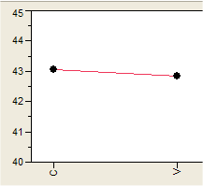
Plotting the Results ~ Capsule Effect
Time Until Bubbles (seconds)
Capsule Type
There appears to be very little difference between the capsule types in terms of the time it takes them to dissolve.

Slide 23
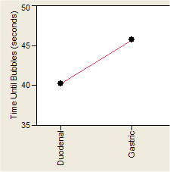
Plotting the Results ~ Fluid Effect
Fluid Type
Capsules take 5.5 seconds longer on average to dissolve in gastric juice compared to duodenal juice.

Slide 24
Preliminary Conclusion
There is very little difference between the capsule types in terms of the length it time it takes them to dissolve.
Capsules take about 5 seconds longer on average to dissolve in gastric juice than in duodenal juice.
THESE CONCLUSIONS ARE COMPLETELY WRONG!! WHY ?!?

Slide 25
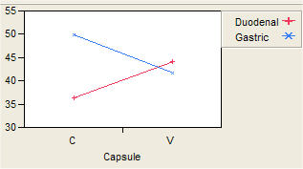
Plotting the Results ~ Capsule Effect Separately
Type C capsules dissolve faster in duodenal juice than do type V capsules where for gastric juice the opposite is true.
Clearly the time to dissolve depends on what capsule is being used and which juice it is being dissolved in.

Slide 26
Interactions
Type C capsules dissolve faster than Type V in duodenal juice, where opposite is true when gastric juice is used to dissolve the capsules.
The
An interaction occurs when the effect of one factor depends on the level of another factor. Here the effect of capsule depends on the type of digestive juice used to dissolve it and vise versa.

Slide 27
Interactions can “mask” main effects
The apparent lack of a capsule effect is caused by the interaction of capsule type and fluid type.
We say the interaction masks the main effect of capsule type.

Slide 28
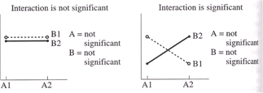
Types of Interactions and Interpreting Interaction Plots
Here both effects are masked by the interaction. This type of interaction is called a “difference in direction” of the effects.
Here the mean response is the same for both levels of both factors.

Slide 29
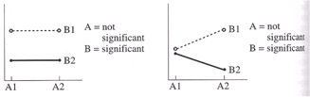
Types of Interactions and Interpreting Interaction Plots
Here the A main effect is “masked” by the interaction. The B main effect is significant, although cannot be talked about independently of the level of A.
Here the mean response differs depending on the level of B but not A.

Slide 30
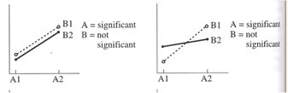
Types of Interactions and Interpreting Interaction Plots
Here the effect of A is the same for both levels of B. There is minimal separation between the two profiles for the levels of B, thus B is not significant
Here the A main effect is differs depending on the level of B. The B main effect is masked by the interaction as the means for B1 and B2 are the same.

Slide 31
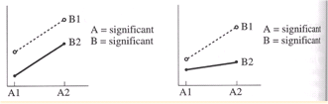
Types of Interactions and Interpreting Interaction Plots
This type of interaction is a difference in magnitude the effect. The direction of A main effect is the same for both levels of B, however the A effect is larger when B is at the 1st level.
Here the effect of A is the same for both levels of B and vise versa. The response differs across the level of both factors and both differences suggest significant A & B effects.
Here the A main effect is differs depending on the level of B. Neither the A or B main effects are masked by the interaction.

