Slide 1
Inference for (or drawing conclusions about) β₀ and β₁
Confidence intervals and hypothesis tests

Slide 2
t Distribution
When is the mean of a random sample of size n from a normal distribution with mean the rv
has a probability distribution called a t distribution with n – 1 degrees of freedom (df).

Slide 3
Student’s t Distribution
Standard Normal
Bell-Shaped
Symmetric
‘Fatter’ Tails
t (df = 13)
t (df = 5)
Z
t
0

Slide 4
t Critical Value
Let = the number on the measurement axis for which the area under the t curve with v df to the right of
is called a t critical value.
Denotes the (1-α)100 percentile of the t distribution with v d.f

Slide 5

Pictorial Definition of
0

Slide 6
Relationship between state latitude and skin cancer mortality?
# State LAT MORT
1 Alabama 33.0 219
2 Arizona 34.5 160
3 Arkansas 35.0 170
4 California 37.5 182
5 Colorado 39.0 149
  
49 Wyoming 43.0 134
Mortality rate of white males due to malignant skin melanoma from 1950-1959.
LAT = degrees (north) latitude of center of state
MORT = mortality rate due to malignant skin melanoma per 10 million people

Slide 7
(1-α)100% t-interval for slope parameter β₁
Formula in words:
Sample estimate ± (t-multiplier × standard error)
Formula in notation:

Slide 8
Recall the One-Sample t Test
Null hypothesis:
Test statistic value:

Slide 9
The One-Sample t Test
Alternative Hypothesis
Rejection Region for Level Test
or

Slide 10
P-Values for a z Test
P-value:
upper-tailed test
lower-tailed test
two-tailed test

Slide 11
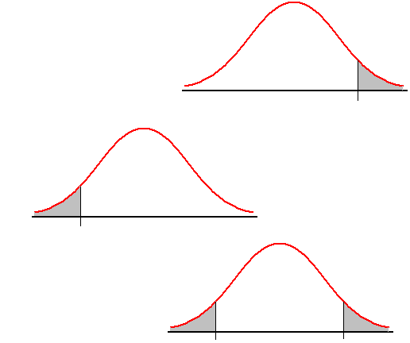
P-Value (area)
Upper-Tailed
0
z
Lower-Tailed
-z
0
Two-Tailed
-z
0
z

Slide 12
P–Values for t Tests
The P-value for a t test will be a t curve area. The number of df for the one-sample t test is n – 1.

Slide 13
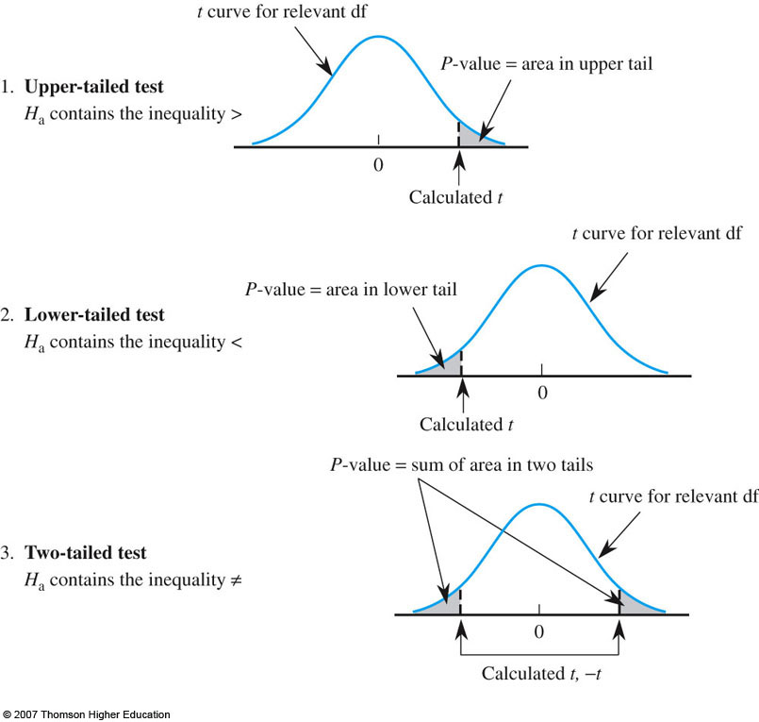

Slide 14
Hypothesis test for slope parameter β₁
Null hypothesis H₀: β₁ = some number β
Alternative hypothesis H_{A}: β₁≠ some number β
Test statistic
P-value = How likely is it that we’d get a test statistic t* as extreme as we did if the null hypothesis is true?
The P-value is determined by referring to a
t-distribution with n-2 degrees of freedom.

Slide 15
Inference for slope parameter β₁ in R
The regression equation is Mort = 389 - 5.98 Lat
Predictor Coef SE Coef T P
Constant 389.19 23.81 16.34 0.000
Lat -5.9776 0.5984 -9.99 0.000
S = 19.12 R-Sq = 68.0% R-Sq(adj) = 67.3%
Analysis of Variance
Source DF SS MS F P
Regression 1 36464 36464 99.80 0.000
Residual Error 47 17173 365
Total 48 53637

Slide 16
(1-α)100% t-interval for intercept parameter β₀
Formula in words:
Sample estimate ± (t-multiplier × standard error)
Formula in notation:

Slide 17
Hypothesis test for intercept parameter β₀
Null hypothesis H₀: β₀ = some number ☺
Alternative hypothesis H_{A}: β₀ ≠ some number ☺
Test statistic
P-value = How likely is it that we’d get a test statistic
t* as extreme as we did if the null hypothesis is true?
The P-value is determined by referring to
a t-distribution with n-2 degrees of freedom.

Slide 18
Inference for intercept parameter β₀ in R
The regression equation is Mort = 389 - 5.98 Lat
Predictor Coef SE Coef T P
Constant 389.19 23.81 16.34 0.000
Lat -5.9776 0.5984 -9.99 0.000
S = 19.12 R-Sq = 68.0% R-Sq(adj) = 67.3%
Analysis of Variance
Source DF SS MS F P
Regression 1 36464 36464 99.80 0.000
Residual Error 47 17173 365
Total 48 53637

Slide 19
(1-α)100% t-interval for mean response E(Y_{h})

Slide 20
“Point estimators”
is the best point estimator in each case.
That is, it is:
the best guess of the mean response at x_{h}
the best guess of a new observation at x_{h}
the best guess of a mean of m new observations at x_{h}
But, as always, to be confident in the answer to our research question, we should put an interval around our best guess.

Slide 21
(1-α)100% t-interval for mean response E(Y_{h})
Formula in words:
Sample estimate ± (t-multiplier × standard error)
Formula in notation:

Slide 22
Implications on precision
The greater the spread in the x_{i} values, the narrower the confidence interval, the more precise the prediction of E(Y_{h}).
Given the same set of x_{i} values, the further x_{h} is from the (sample) mean of the x_{i}, the wider the confidence interval, the less precise the prediction of E(Y_{h}).

Slide 23
Prediction interval for a new response Y_{h(new)}

Slide 24
(1-α)100% prediction interval for new response Y_{h(new)}
Formula in words:
Sample prediction ± (t-multiplier × standard error)
Formula in notation:

Slide 25
Confidence intervals and prediction intervals for response in R
# get confidence interval on E(y_{h}) - page 54 & 55.
new.data <- data.frame(size=65) # Example 1 page 54
predict(mod,new.data,interval="confidence",level=0.90)
predict(mod,data.frame(size=100),interval="confidence",level=0.90)
#Alternate Method
new.data=data.frame(size=c(65,100))predict(mod,new.data,interval="confidence",level=0.90)
# get a 90% prediction interval at X_{h}=100;
predict(mod,data.frame(size=100),interval="prediction",level=0.90)

Slide 26
COEFFICIENT OF DETERMINATION R-SQUARED

Slide 27
SS_{T}: the corrected sum of squares of the observations. It measures the total variability in the observations.
SS_{Res}: the residual or error sum of squares
The residual variation left unexplained by the regression line.
SS_{R}: the regression or model sum of squares
The amount of variability in the observations accounted for by the regression line
SS_{T} = SS_{R} + SS_{Res(Error)}

Slide 28
Simple Linear Regression: ANOVA table
Source | df | Sum of Squares | Mean Squares | F value | p-value
Model | 1 | Σ( − )²=SSModel | SSM = MSM | MSG/MSE = F_{1,n−2} | Pr(F > F_{1, n−2}*)
Residual | n−2 | Σe_{i}² = SSResidual | SSR/( n −2) = MSE
Total | n −1 | Σ(y_{i} − )²= SSTotal | SST/( n −1)=MST

Slide 29
Hypotheses:
H_{o}: β₁ = 0 ( there is no linear relationship between x and y)
H_{A}: β₁ ≠ 0 (there is a stat sig linear relationship between x and y)

Slide 32
Coefficient of determination
R² is a number (a proportion!) between 0 and 1.
If R² = 1:
all data points fall perfectly on the regression line
predictor X accounts for all of the variation in Y
If R² = 0:
the fitted regression line is perfectly horizontal
predictor X accounts for none of the variation in Y

Slide 33
Interpretations of R²
R² ×100 percent of the variation in Y is reduced by taking into account predictor X.
R² ×100 percent of the variation in Y is “explained by” the variation in predictor X.

Slide 34
R-sq on R fitted line plot

Slide 35
R-sq on R regression output
The regression equation is
Mort = 389.189 - 5.97764 Lat
S = 19.1150 R-Sq = 68.0 % R-Sq(adj) = 67.3 %
Analysis of Variance
Source DF SS MS F P
Regression(Lat)1 36464.2 36464.2 99.7968 0.000
Error 47 17173.1 365.4
Total 48 53637.3

Slide 36
What assumptions?
The intervals and tests depend on the assumption that the error terms (and thus responses) follow a normal distribution.
Not a big deal if the error terms (and thus responses) are only approximately normal.
The errors, ε_{i}, and hence the responses Y_{i}, are independent.
The errors, ε_{i}, and hence the responses Y_{i}, have equal variances (σ²) for all x values.

Slide 37
(1-α)100% t-interval for slope parameter β₁
Formula in words:
Sample estimate ± (t-multiplier × standard error)
Formula in notation:

Slide 38
(1-α)100% t-interval for intercept parameter β₀
Formula in words:
Sample estimate ± (t-multiplier × standard error)
Formula in notation:

Slide 39
(1-α)100% t-interval for mean response E(Y_{h})
Formula in words:
Sample estimate ± (t-multiplier × standard error)
Formula in notation:

Slide 40
(1-α)100% prediction interval for new response Y_{h(new)}
Formula in words:
Sample prediction ± (t-multiplier × standard error)
Formula in notation:

