Slide 1
Model Checking
Using residuals to check the validity of the linear regression model assumptions

Slide 2
The simple linear regression model
The mean of the responses, E(Y_{i}), is a linear function of the x_{i}.
The errors, ε_{i}, and hence the responses Y_{i}, are independent.
The errors, ε_{i}, and hence the responses Y_{i}, are normally distributed.
The errors, ε_{i}, and hence the responses Y_{i}, have equal variances (σ²) for all x values.

Slide 3
The simple linear regression model
Assume the response is linear function of trend and error:
with the independent error terms _{i} following a normal distribution with mean 0 and equal variance ².

Slide 4
Why do we have to check our model?
All estimates, intervals, and hypothesis tests have been developed assuming that the model is correct.
If the model is incorrect, then the formulas and methods we use are at risk of being incorrect.

Slide 5
When should we worry most?
All tests and intervals are very sensitive to
departures from independence.
moderate departures from equal variance.
Tests and intervals for β₀ and β₁ are fairly robust against departures from normality.
Prediction intervals are quite sensitive to departures from normality.

Slide 6
What can go wrong with the model?
Regression function is not linear.
Error terms are not independent.
Error terms are not normal.
Error terms do not have equal variance.
The model fits all but one or a few outlier observations.
An important predictor variable has been left out of the model.

Slide 7
The basic idea of residual analysis
The observed residuals:
should reflect the properties assumed for the unknown true error terms:
So, investigate the observed residuals to see if they behave “properly.”

Slide 8
A residuals vs. fits plot
A scatter plot with residuals on the y axis and fitted values on the x axis.
Helps to identify non-linearity, outliers, and non-constant variance.

Slide 9
Example: Alcoholism and muscle strength?

Slide 10
A well-behaved residuals vs. fits plot

Slide 11
Table 1.1 ( Toluca Data)
model=lm(workhrs~lotsize)
plot(workhrs~lotsize, xlab="LOT SIZE",ylab="HOURS",main="Scatter plot of Toluca Data", pch=23,bg="red",cex=2,lwd=2)
abline(model$coef)
plot(model$fitted.values,model$residuals,main="Toluca Data\nDiagnostic",xlab="Fitted values",ylab="Residual", pch=23,bg="red",cex=2,lwd=2)
abline(h=0,col="red")

Slide 13
A residual vs. fits plot suggesting relationship is linear

Slide 14
Characteristics of a well-behaved residual vs. fits plot
The residuals “bounce randomly” around the 0 line. (Linear is reasonable).
No one residual “stands out” from the basic random pattern of residuals. (No outliers).
The residuals roughly form a “horizontal band” around 0 line. (Constant variance).

Slide 15
How a non-linear function shows up on a residual vs. fits plot
The residuals depart from 0 in some systematic manner:
such as, being positive for small x values, negative for medium x values, and positive again for large x values

Slide 16
Residual Analysis for Linearity
Y
Y
x
x
residuals
x
x
residuals
Not Linear
✓
Linear

Slide 17
Example: A linear relationship between tread wear and mileage?
mileage groove
0 394.33
4 329.50
8 291.00
12 255.17
16 229.33
20 204.83
24 179.00
28 163.83
32 150.33
X = mileage in 1000 miles
Y = groove depth in miles

Slide 18
Is tire tread wear linearly related to mileage?

Slide 19
A residual vs. fits plot suggesting relationship is not linear

Slide 20
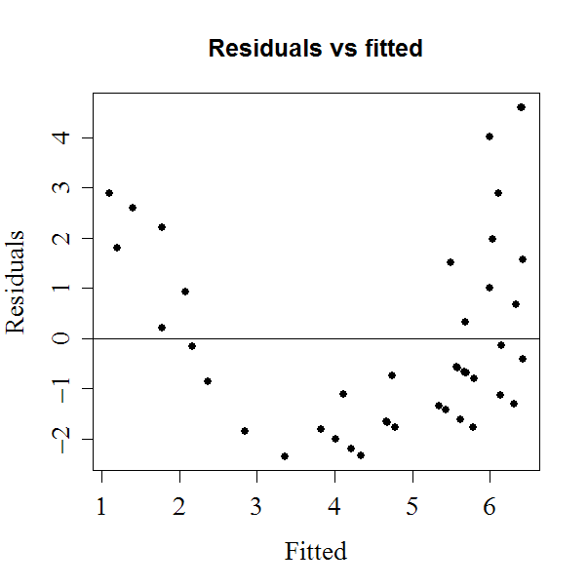
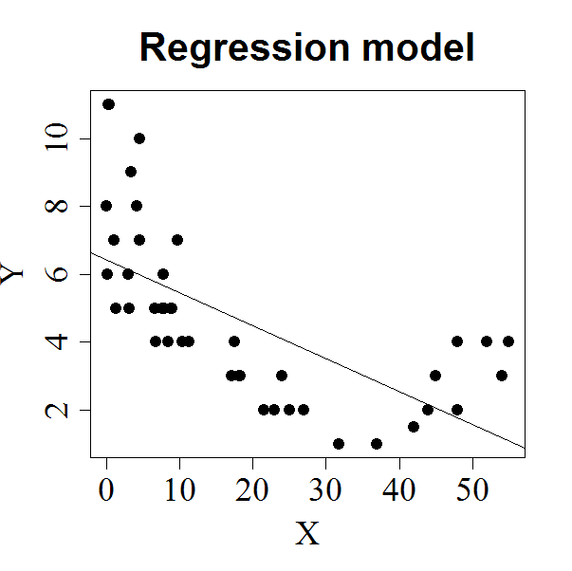
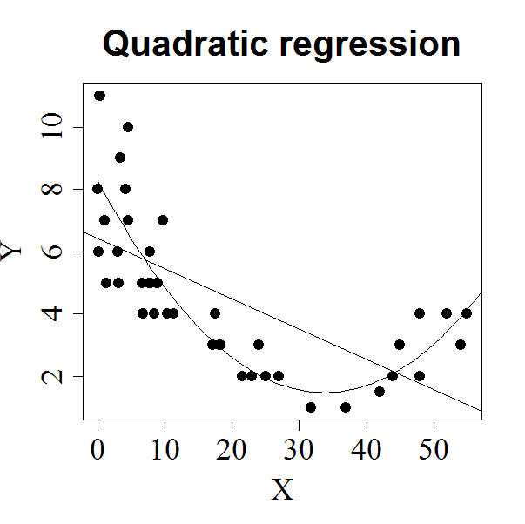
SIMPLE LINEAR REGRESSION
1. Linearity between X and Y?
no
no
yes
NO LINEARITY between X and Y

Slide 21
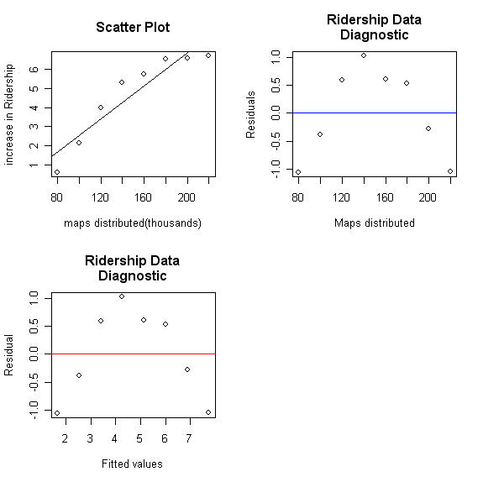
A residual vs. fits plot suggesting relationship is not linear

Slide 22
How non-constant error variance shows up on a residual vs. fits plot
The plot has a “fanning” effect.
Residuals are close to 0 for small x values and are more spread out for large x values.
The plot has a “funneling” effect
Residuals are spread out for small x values and close to 0 for large x values.
Or, the spread of the residuals can vary in some complex fashion.

Slide 23
Residual Analysis for Constant variance
Y
Y
x
x
residuals
x
x
residuals
✓
Non-constant variance
Constant variance

Slide 24
Example: How is plutonium activity related to alpha particle counts?

Slide 25
A residual vs. fits plot suggesting non-constant error variance

Slide 26
A residual vs. fits plot suggesting constant variance

Slide 27
Test for equal (Homogeneous) Variance

Slide 28
Breusch-Pagan Test for the constancy of the error variance
Ho: The error variance is constant
Ha: Not Ho
library(lmtest)
bptest(model, studentize=FALSE)
bptest(model, studentize=FALSE)
Breusch-Pagan test
data: model
BP = 0.8209, df = 1, p-value = 0.3649

Slide 29
Equal (Homogeneous) Variance – Brown-Forsythe Test

Slide 30
BrownForsythe <- function(r,Group1,Group2){
n1 = length(Group1)
n2 = length(Group2)
r1 = r[Group1]
r2 = r[Group2]
rmed1 = median(r1)
rmed2 = median(r2)
D1 <- sum( abs( r1 - rmed1 )) / n1
D2 <- sum( abs( r2 - rmed2 )) / n2
s <- sqrt( ( sum( ( abs(r1 - rmed1) - D1 )^2 ) + sum( ( abs(r2 - rmed2) - D2 )^2 ) ) / (n1+n2-2) )
t <- abs(( D1 - D2 ) / ( s * sqrt( 1/n1 + 1/n2 ) ))
pval = pt(t,n1+n2-2,lower.tail=FALSE)
list(t=t,pval=pval)
}
Group1 = 1:floor(length(ACT)/2)
Group2 = (floor(length(ACT)/2)+1):length(ACT)
BF = BrownForsythe(resid(model), Group1,Group2)

Slide 31
How an outlier shows up on a residuals vs. fits plot
The observation’s residual stands apart from the basic random pattern of the rest of the residuals.
The random pattern of the residual plot can even disappear if one outlier really deviates from the pattern of the rest of the data.

Slide 32
Example: Relationship between tobacco use and alcohol use?
Region Alcohol Tobacco
North 6.47 4.03
Yorkshire 6.13 3.76
Northeast 6.19 3.77
EastMidlands 4.89 3.34
WestMidlands 5.63 3.47
EastAnglia 4.52 2.92 Southeast 5.89 3.20
Southwest 4.79 2.71
Wales 5.27 3.53
Scotland 6.08 4.51
Northern Ireland 4.02 4.56
Family Expenditure Survey of British Dept. of Employment
X = average weekly expenditure on tobacco
Y = average weekly expenditure on alcohol

Slide 33
Example: Relationship between tobacco use and alcohol use?

Slide 34
A residual vs. fits plot suggesting an outlier exists
“outlier”

Slide 35
How large does a residual need to be before being flagged?
The magnitude of the residuals depends on the units of the response variable.
Make the residuals “unitless” by dividing by their standard deviation. That is, use “standardized residuals.”
Then, an observation with a standardized residual greater than 2 or smaller than -2 should be flagged for further investigation.

Slide 36
Standardized residuals vs. fits plot

Slide 37
Other simple plots that might help spot an outlier
Boxplots
Stem-n-leaf plots
Dotplots

Slide 38
Boxplot of residuals for Alcohol (Y) and Tobacco (X) example

Slide 39
Dotplot of residuals for Alcohol (Y) and Tobacco (X) example

Slide 40
Independence of error terms

Slide 41
Residuals vs. order plot or Index Plot
Helps assess serial correlation of error terms.
If the data are obtained in a time (or space) sequence, a “residuals vs. order” plot helps to see if there is any correlation between error terms that are near each other in the sequence.
A horizontal band bouncing randomly around 0 suggests errors are independent, while a systematic pattern suggests not.

Slide 42
Residual Analysis for Independence
Not Independent
✓
Independent
residuals
X
residuals
X
residuals
X

Slide 43
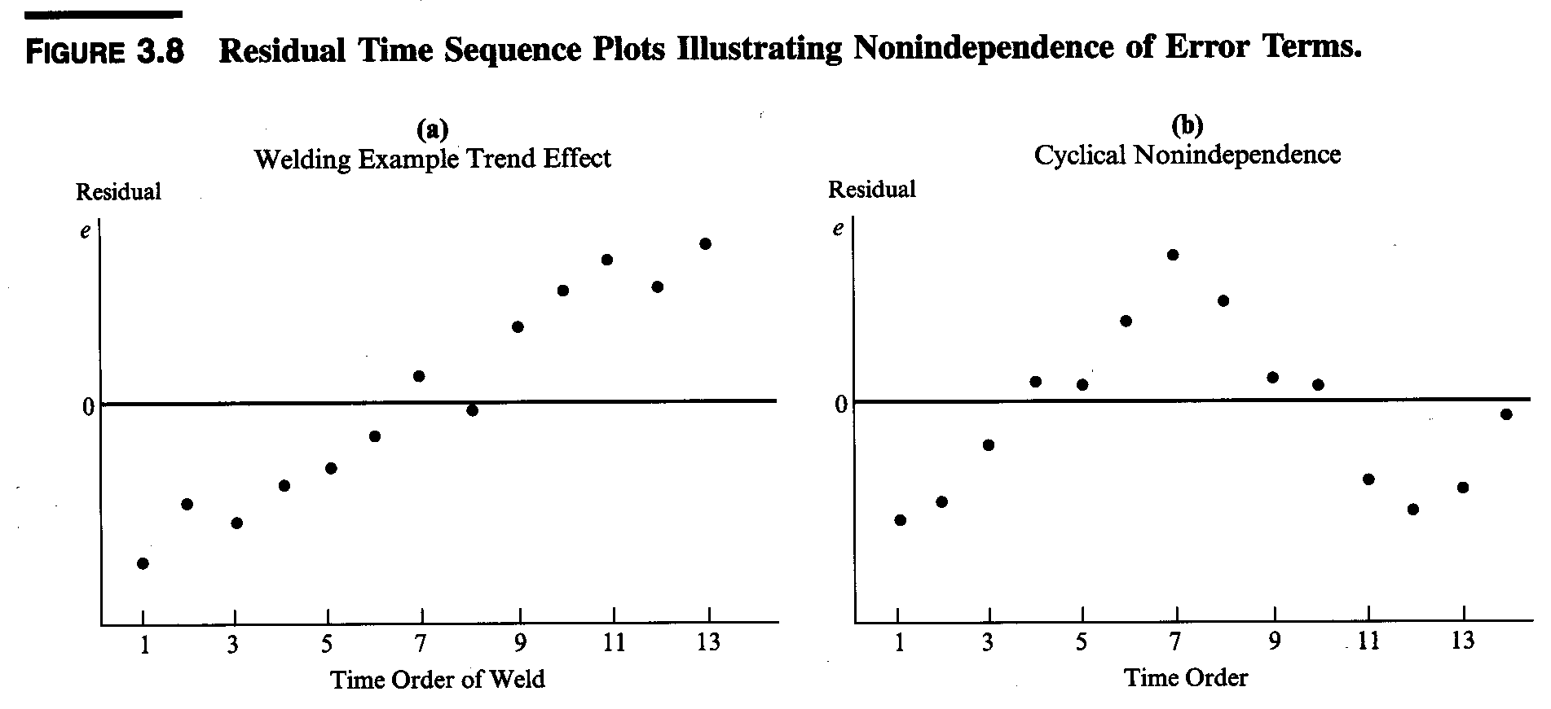
Residuals vs. order plots suggesting non-independence of error terms

Slide 44
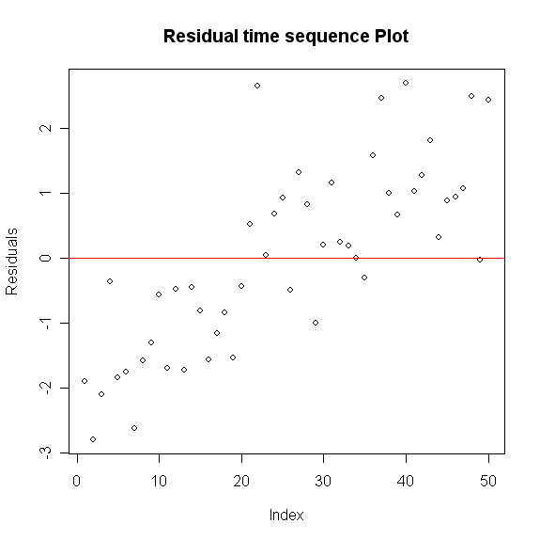
Residuals vs. order plots suggesting non-independence of error terms

Slide 45
Test For Independence - Durbin-Watson Test

Slide 46
R code-Durbin-Watson Test
library(lmtest)
dwtest(Y~X)
For Example
Durbin-Watson statistic = 0.73
Table B.7 with level of significance α=0.01, (p-1)=1 predictor variable, and n=20 gives d_{L}= 0.95 and d_{U}=1.15.
Since D=0.73 < d_{L}=0.95, conclude error terms are positively auto-correlated.

Slide 47
Normal (probability) plot of residuals
Helps assess normality of error terms.
If data are Normal(μ, σ²), then percentiles of the normal distribution should plot linearly against sample percentiles (with sampling variation).
The parameters μ and σ² are unknown. Theory shows it’s okay to assume μ = 0 and σ² = 1.

Slide 48
Normal (probability) plot of residuals (cont’d)
Plot normal scores (theoretical percentiles) on vertical axis against ordered residuals (sample percentiles) on horizontal axis.
Plot that is nearly linear suggests normality of error terms.

Slide 49
Normal probability plot for Alcohol (X) and Strength (Y) example

Slide 50
Normal (probability) plot

Slide 51
Normal probability plot interpretation
skewed left
normal
skewed right

Slide 52
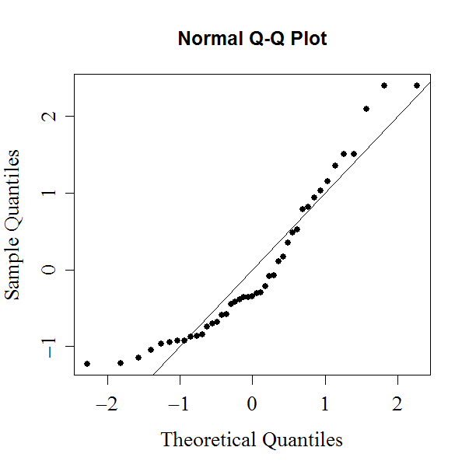
SIMPLE LINEAR REGRESSION:
Normality of the residuals
Q-Q plot + Shapiro-Wilk test on the residuals
no
shapiro.test(residuals)
Shapiro-Wilk normality test
data: residuals
W = 0.8994, p-value = 0.001199
no

Slide 53
Ho: Random error comes from Normal distribution
Ha: Not Ho
> shapiro.test(residuals)
Shapiro-Wilk normality test
data: residuals
W = 0.8994, p-value = 0.001199

Slide 54
Correlation test for Normality
(A high value of correlation is indicative of normality)
StdErr = summary(model)$sigma
n = length(size) #size is explanatory variable
ExpVals = sapply(1: n, function(k) StdErr * qnorm((k-.375)/(n+.25)))
cor(ExpVals,sort(model$residuals))

Slide 55
Correlation test for Normality:
Look at Table B.6, page 1329. To conclude at the alpha level that the residuals are normally distributed, the correlation must exceed the corresponding critical value.
Example: Toluca Company Example.
R= 0.991
From the table for the critical value for n=25 is .959. Since the observed coefficient is higher than the table value, we conclude that distribution of error is normal.

Slide 56
Linearity of Regression

Slide 57
Lack-of-fit test in R
Reduced=lm(y~x) #fit reduced model
Full=lm(y~0+as.factor(x)) #fit full model
anova(Reduced, Full) #get lack-of-fit test
Data = read.table("~/CH01PR19.txt")
names(Data)=c("GPA","ACT")
Reduced = lm( GPA ~ ACT, data = Data )
Full = lm( GPA ~ 0 + as.factor(ACT), data = Data )
anova(Reduced, Full)
#If p-value > 0.05, don't reject the null hypothesis; the model appears to be adequate.

Slide 58
A residuals vs. New predictor plot
A scatter plot with residuals on the y axis and the values of a predictor on the x axis
If the predictor on the x axis is the same predictor used in model, offers nothing new.
If the predictor on the x axis is a new and different predictor, can help to determine whether the predictor should be added to model.

Slide 59
Example: Alcoholism and muscle strength?

Slide 60
A residuals vs. predictor plot offering nothing new.
(Same predictor!)

Slide 61
Example: What are good predictors of blood pressure?
n = 20 hypertensive individuals
age = age of individual
weight = weight of individual
duration = years with high blood pressure

Slide 62
Regression of BP on Age

Slide 63
Residuals (age only) vs. weight plot
(New predictor!)

Slide 64
Residuals (age, weight) vs. duration plot
(New predictor!)

