Slide 1
Fixing problems with the model
Transforming the data so that the simple linear regression model is okay for the transformed data.

Slide 2
Options for fixing problems with the model
Abandon simple linear regression model and find a more appropriate – but typically more complex – model.
Transform the data so that the simple linear regression model works for the transformed data.

Slide 3
Abandoning the model
Try a different function, like a quadratic (Ch. 8) or an exponential function (Ch. 14).
If unequal error variances: use weighted least squares (Ch. 11).
If error terms are not independent: try fitting a time series model (Ch. 13).
If important predictor variables omitted: try fitting a multiple regression model (Ch. 6).
If outlier: use robust estimation procedure (Ch. 10).

Slide 4
Choices for transforming the data
Transform X values only. (If not linear)
Transform Y values only.
Transform both the X and the Y values.

Slide 5
Transforming the X values only

Slide 6
Transforming the X values only
Appropriate when non-linearity is the only problem
– normality and equal variance okay with the model.
Transforming the Y values would likely change the well-behaved error terms into badly-behaved error terms.

Slide 7
Memory retention
Example 1
time prop
1 0.84
5 0.71
15 0.61
30 0.56
60 0.54
120 0.47
240 0.45
480 0.38
720 0.36
1440 0.26
2880 0.20
5760 0.16
10080 0.08
Subjects asked to memorize a list of disconnected items. Asked to recall them at various times up to a week later
Predictor time = time, in minutes, since initially memorized the list.
Response prop = proportion of items recalled correctly.

Slide 8
Fitted line plot
Example 1

Slide 9
Residual vs. fits plot
Example 1

Slide 10
Breusch-Pagan test
Ho: The error variance is constant
Ha: Not Ho
bptest(model, studentize=FALSE)
Breusch-Pagan test
data: model
BP = 0.2115, df = 1, p-value = 0.6456

Slide 11
Normal probability plot
Example 1

Slide 12
Shapiro-Wilk normality test
shapiro.test(model$residuals)
Shapiro-Wilk normality test
data: model$residuals
W = 0.9475, p-value = 0.5616

Slide 13
Transform the X values
Example 1
time prop log10_time
1 0.84 0.00000
5 0.71 0.69897
15 0.61 1.17609
30 0.56 1.47712
60 0.54 1.77815
120 0.47 2.07918
240 0.45 2.38021
480 0.38 2.68124
720 0.36 2.85733
1440 0.26 3.15836
2880 0.20 3.45939
5760 0.16 3.76042
10080 0.08 4.00346
Change (“transform”) the predictor time to log₁₀(time).
R Code:
log10_time=log10(time)

Slide 14
Fitted line plot using transformed X values
Example 1

Slide 15
Before Transform X
After transform X

Slide 16
Residuals vs. fits plot using transformed X values
Example 1

Slide 17
Before Transformation
After Transformation

Slide 18
Normal probability plot using transformed X values
Example 1

Slide 19
Predicting new proportion
Example 1
Estimated regression function:
Therefore, we predict the proportion of words recalled after 1000 minutes is:

Slide 20
Predicting new proportion
Example 1
Predicted Values for New Observations
New Fit SE Fit 95.0% CI 95.0% PI
1 0.299 0.00765 (0.282, 0.316) (0.245, 0.353)
Values of Predictors for New Observations
New Obs log10tim
1 3.00
We can be 95% confident that a person will recall between 24.5% and 35.3% of the words after 1000 minutes.

Slide 21
Transforming the Y values only

Slide 22
Transforming the Y values only
Appropriate when non-normality and/or unequal variances are the problems.
The transformation on Y may also help to “straighten out” a curved relationship.

Slide 23
Gestation time and birth weight for mammals
Example 2
Mammal Birthwgt Gestation
Goat 2.75 155
Sheep 4.00 175
Deer 0.48 190
Porcupine 1.50 210
Bear 0.37 213
Hippo 50.00 243
Horse 30.00 340
Camel 40.00 380
Zebra 40.00 390
Giraffe 98.00 457
Elephant 113.00 670
Predictor Birthwgt = birth weight, in kg, of mammal.
Response Gestation = number of days until birth

Slide 24
Fitted line plot
Example 2

Slide 25
Residual vs. fits plot
Example 2

Slide 26
Normal probability plot
Example 2

Slide 27
Transform the Y values
Example 2
Mammal Birthwgt Gestation log10Gest
Goat 2.75 155 2.19033
Sheep 4.00 175 2.24304
Deer 0.48 190 2.27875
Porcupine 1.50 210 2.32222
Bear 0.37 213 2.32838
Hippo 50.00 243 2.38561
Horse 30.00 340 2.53148
Camel 40.00 380 2.57978
Zebra 40.00 390 2.59106
Giraffe 98.00 457 2.65992
Elephant 113.00 670 2.82607
Change (“transform”) the response Gestation to log₁₀(Gestation).

Slide 28
Fitted line plot using transformed Y values
Example 2

Slide 29
Residual vs. fits plot using transformed Y values
Example 2

Slide 30
Normal probability plot using transformed Y values
Example 2

Slide 31
Predicting new gestation
Example 2
Estimated regression function:
Therefore, since:
we predict the gestation length of another mammal at 50 kgs to be:

Slide 32
Predicting new gestation
Example 2
Predicted Values for New Observations
New Fit SE Fit 95.0% CI 95.0% PI
1 2.5186 0.0306 (2.4494, 2.5878) (2.2951, 2.7421)
Values of Predictors for New Observations
New Birthwgt
1 50.0
We can be 95% confident that the gestation length for a new mammal at 50 kgs will be between 197.3 and 552.2 days.

Slide 33
Transforming both the X and Y values

Slide 34
Transforming both the X and Y values
Appropriate when the error terms are not normal, have unequal variances, and the function is not linear.
Transforming the Y values corrects the problems with the error terms (and may help the non-linearity).
Transforming the X values corrects the non-linearity.

Slide 35
Diameter (inches) and volume (cu. ft.) of 70 shortleaf pines
Example 3

Slide 36
Residuals vs. fits plot
Example 3

Slide 37
Normal probability plot
Example 3

Slide 38
Transform the Y values only
Example 3
Diameter Volume logVol
4.4 2.0 0.69315
4.6 2.2 0.78846
5.0 3.0 1.09861
5.1 4.3 1.45862
5.1 3.0 1.09861
5.2 2.9 1.06471
5.2 3.5 1.25276
5.5 3.4 1.22378
5.5 5.0 1.60944
5.6 7.2 1.97408
5.9 6.4 1.85630
5.9 5.6 1.72277
7.5 7.7 2.04122
7.6 10.3 2.33214
… and so on …
Transform response volume to log_{e}(volume)

Slide 39
Fitted line plot using transformed Y values
Example 3

Slide 40
Residuals vs. fits plot using transformed Y values
Example 3

Slide 41
Normal probability plot using transformed Y values
Example 3

Slide 42
Transform both the X and Y values
Example 3
Diameter Volume logDiam logVol
4.4 2.0 1.48160 0.69315
4.6 2.2 1.52606 0.78846
5.0 3.0 1.60944 1.09861
5.1 4.3 1.62924 1.45862
5.1 3.0 1.62924 1.09861
5.2 2.9 1.64866 1.06471
5.2 3.5 1.64866 1.25276
5.5 3.4 1.70475 1.22378
5.5 5.0 1.70475 1.60944
5.6 7.2 1.72277 1.97408
5.9 6.4 1.77495 1.85630
5.9 5.6 1.77495 1.72277
7.5 7.7 2.01490 2.04122
7.6 10.3 2.02815 2.33214
… and so on …
Transform predictor diameter to log_{e}(diameter)
Transform response volume to log_{e}(volume)

Slide 43
Fitted line plot using transformed X and Y values
Example 3

Slide 44
Residual plot using transformed X and Y values
Example 3

Slide 45
Normal probability plot using transformed X and Y values
Example 3

Slide 46
Transformation strategies

Slide 47
Effects of transformations
Transforming the Y values corrects the problems with the error terms – and may simultaneously help non-linearity.
Transforming the X values can only correct non-linearity.

Slide 48
Transformation strategies
If form of the relationship between x and y is known, then it may be possible to find a linearizing transformation analytically.
Fitting a regression model empirically generally requires trial and error – try different transformations to see which does best.

Slide 49
Transformation strategies
Finding a linearizing transformation analytically

Slide 50
Knowing functional relationship is of the power form
If the relationship between x and y is of the power form:
taking log of both sides transforms it into a linear form:

Slide 51
Knowing functional relationship is of the exponential form
If the relationship between x and y is of exponential form:
taking log of both sides transforms it into a linear form:

Slide 52
Transformation strategies
Look Page 132
Finding a transformation for Non normality and Unequal Error variance

Slide 53
Family of power transformations (Box-Cox Transformation)
The most common transformation involves transforming the response by taking it to some power λ. That is:
Most commonly, for interpretation reasons, λ is a number between -1 and 2, such as -1, -0.5, 0, 0.5, (1), 1.5, and 2.
When λ = 0, the transformation is taken to be the log transformation. That is:

Slide 54
When λ = 2, the transformation is taken to be the square transformation. That is:
When λ = 0.5, the transformation is taken to be the square root transformation. That is:
When λ = - 0.5, the transformation is taken to be
When λ = -1, the transformation is taken to be

Slide 55
The Box-Cox procedure
The Box-Cox procedure chooses an optimal transformation to remediate deviations from the assumptions of the linear regression model.
For the linear model College, we give the R commands:
> library(MASS)
> boxcox(model)

Slide 56
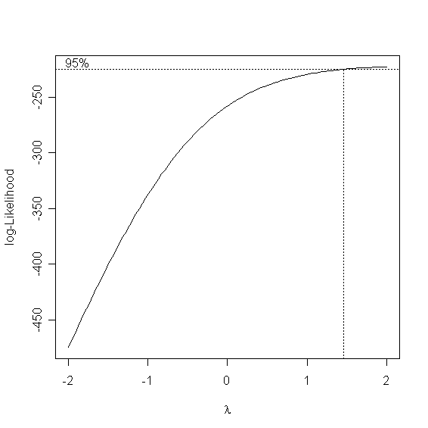
The dotted vertical line indicates that the ideal value of λ is about 1.5. To refine our estimate, we can change the range of λ to, say, from 1 to 2 by steps of 0.1:
> boxcox(College, lambda = seq(1, 2, 0.1))

Slide 57
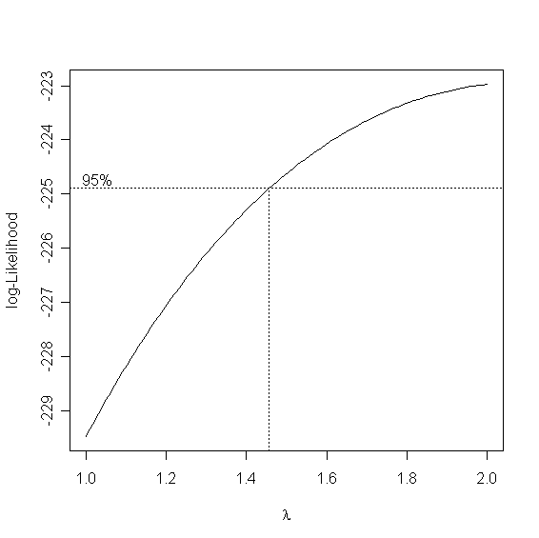

Slide 58
Transformation strategies
Look Page 130
Finding a transformation for Nonlinear with constant Error variance

Slide 59
Possible transformations

Slide 60
Possible transformations

Slide 61
Possible transformations

Slide 62
Possible transformations

Slide 63
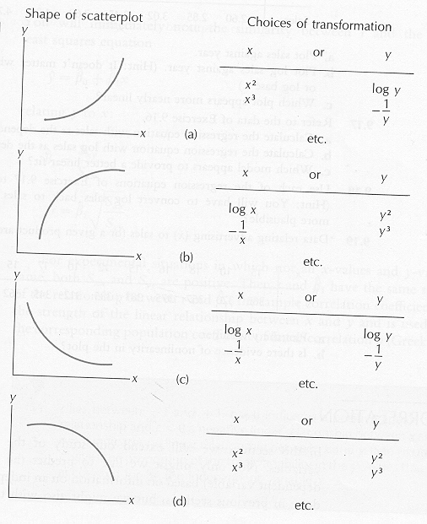

Slide 64
Lowess (Smoothed) Plots
Nonparametric method of obtaining a smooth plot of the regression relation between Y and X
Fits regression in small neighborhoods around points along the regression line on the X axis
Weights observations closer to the specific point higher than more distant points
Re-weights after fitting, putting lower weights on larger residuals (in absolute value)
Obtains fitted value for each point after “final” regression is fit
Model is plotted along with linear fit, and confidence bands, linear fit is good if lowess lies within bands

Slide 65
Example: Predicting brain weight from body weight in mammals via SLR
Data are average brain (Y, g) and body (X, kg) weights for 62 species of mammals (2 omitted). Source: Allison & Chicchetti (1976), Science.
Species (common name) body weight brain weight
Arctic fox 3.385 44.500
Owl monkey 0.480 15.499
Horse 521.000 655.000
Kangaroo 35.000 56.000
Human 62.000 1320.000
African elephant 6654.000 5712.000
Asian elephant 2547.000 4603.000
…
Chimpanzee 52.160 440.000
Tree shrew 0.104 2.500
Red fox 4.235 50.400
Omit

Slide 66
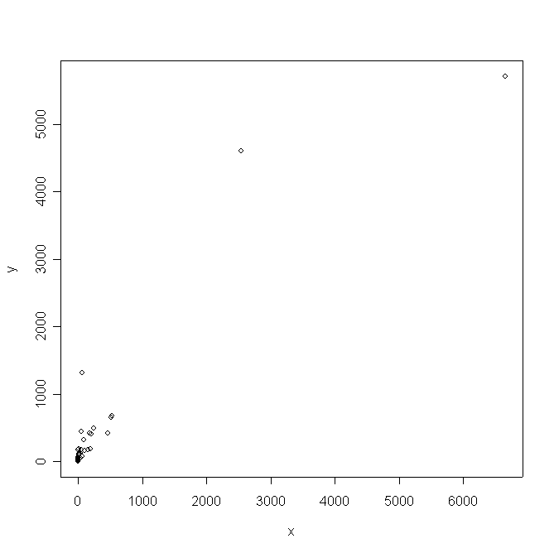
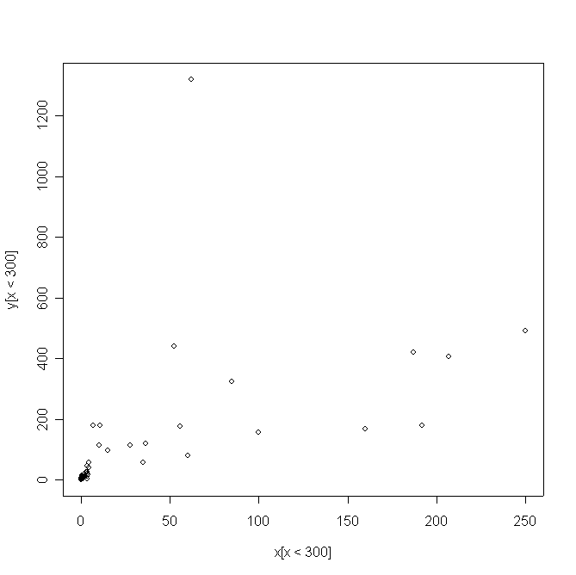
Scatterplot of data is non-informative. Most species have small weights compared to the elephants.
Viewing only those mammals with body weight below 300kgs suggests transforming to a log scale to linearize the relationship .

Slide 67
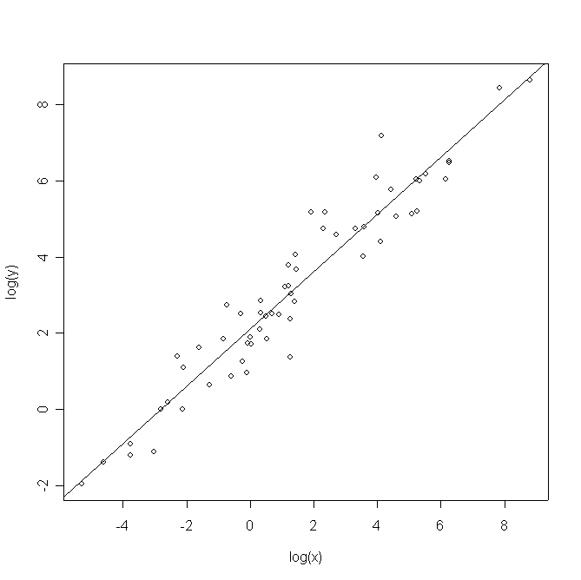
Scatterplot looks linear. Fitted regression equation is:
Body weight is a very significant predictor of brain weight (p-value<0.0001). Also, R²=0.922.

Slide 68
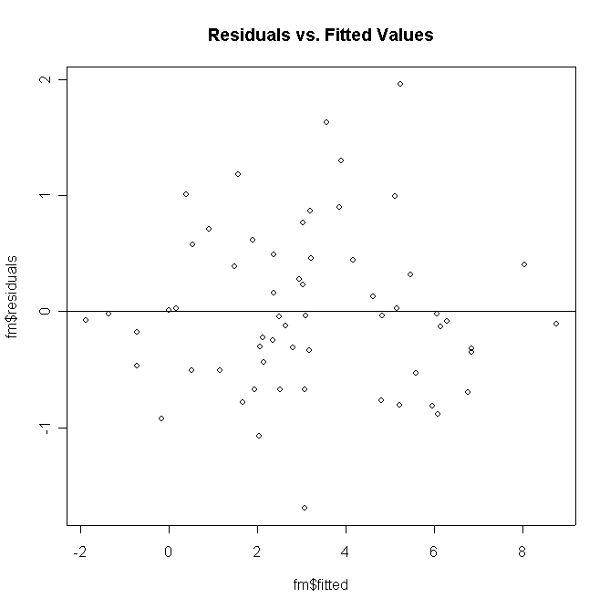
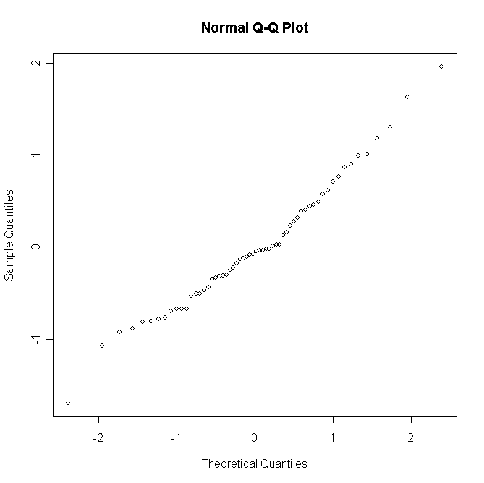
human
opossum
Residual plot shows no obvious violations of the zero mean and constant variance assumption.
QQ-Plot demonstrates that the normality assumption for the residuals is plausible.

Slide 69
Decision: Leave out man (he doesn’t really fit in with the rest of the mammals) and re-run the analysis.
Feature Full Model Omit Human
2.111 2.090
0.755 0.745
0.029 0.027
R² 0.922 0.929
Slope p-value < 0.0001 < 0.0001
Even though results don’t change much, we will go with this last model:

