Slide 1
Chapter 7
Statistical Intervals Based on a Single Sample

Slide 2
PROPOSITION
Let X₁,…, X_{n} be a random sample from a distribution with mean value μ and standard deviation σ. Then

Slide 3
Normal Population Distribution
Let X₁,…, X_{n} be a random sample from a normal distribution with mean value μ and standard deviation σ. Then for any n, is normally distributed.

Slide 4
The Central Limit Theorem
Let X₁,…, X_{n} be a random sample from a distribution with mean value μ and variance Then if n sufficiently large, has approximately a normal distribution with
The larger the value of
n, the better the approximation.

Slide 5
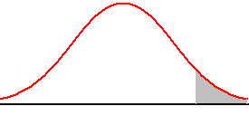
Notation
will denote the value on the Z axis for which α of the area under the z curve lies to the right of
0

Slide 6
Confidence Intervals
An alternative to reporting a single value for the parameter being estimated is to calculate and report an entire interval of plausible values – a confidence interval (CI). A confidence level is a measure of the degree of reliability of the interval.

Slide 7
7.1
Basic Properties of Confidence Intervals

Slide 8
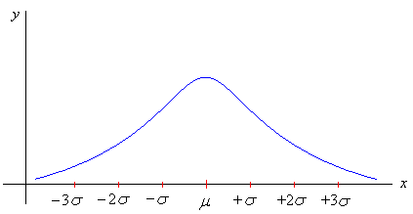
Symmetric Curve
Approximate percentage of area within given standard deviations (empirical rule).
99.7%
95%
68%

Slide 9
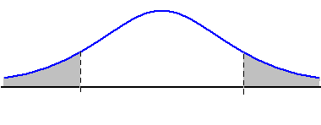
Other Levels of Confidence
0

Slide 10
Confidence Intervals
Confidence
Intervals
Population
Mean
Population
Proportion
σ Known
σ Unknown

Slide 11
The general formula for all confidence intervals is:
Point Estimate ± (Critical Value)*(Standard Error)

Slide 12
Other Levels of Confidence
A confidence interval for the mean of a normal population when the value of σ is known is given by

Slide 13
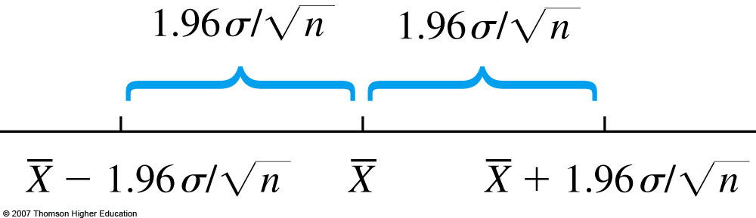

Slide 14
Interval and Level of Confidence
Sampling Distribution of the Mean
x
Intervals extend from
to
x₁
x₂
100(1-α)% of intervals constructed contain μ;
100α% do not.
Confidence Intervals

Slide 15
Margin of Error
Margin of Error (e): the amount added and subtracted to the point estimate to form the confidence interval
Example: Margin of error for estimating μ, σ known:

Slide 16
Sample Size
The general formula for the sample size n necessary to ensure an interval width w is

Slide 17
Determining Sample Size
The required sample size can be found to reach a desired margin of error (e) and level of confidence (1 - α)
Required sample size, σ known:

Slide 18
Sample Size Example
If σ = 45, what sample size is needed to be 90% confident of being correct within ± 5?
So the required sample size is n = 220
(Always round up)

Slide 19
Sample Size Example
A research worker want to determine the average time it takes a mechanic to rotate the tires of a car, and she wants to be able to assert with 95% confidence that the mean of her sample is off by at most 0.5 minute. If she can presume from past experience that minutes, how large a sample will she have to take?

Slide 20
Example
A CI is desired for the true average stray-load loss (watts) for a certain type of induction motor when the line current is held at 10 amps for a speed of 1500 rpm. Assume that stray-load loss is normally distributed with = 3.0.
How large must n be if the width of the 99% interval for is to be 1.0?

Slide 21
Sample Size
The general formula for the sample size n necessary to ensure an interval width w is
= 239.62 so n = 240.

Slide 22

Case Study
A sample of 11 circuits from a large normal population has a mean resistance of 2.20 ohms. We know from past testing that the population standard deviation is 0.35 ohms.
Determine a 95% confidence interval for the true mean resistance of the population.

Slide 23

Solution – Case Study
A sample of 11 circuits from a large normal population has a mean resistance of 2.20 ohms. We know from past testing that the population standard deviation is 0.35 ohms.
Solution:

Slide 24
Interpretation
We are 98% confident that the true mean resistance is between 1.9932 and 2.4068 ohms
Although the true mean may or may not be in this interval, 98% of intervals formed in this manner will contain the true mean
An incorrect interpretation is that there is 98% probability that this interval contains the true population mean.

Slide 25
7.2
Large-Sample Confidence Intervals for a Population Mean

Slide 26
Large-Sample Confidence Interval
If n is sufficiently large, the standardized variable
has approximately a standard normal distribution. This implies that
is a large-sample confidence interval for with level

Slide 27
Case Study
Police Chief Ackert has recently instituted a crackdown on drug dealers in her city. Since the crackdown began, 750 of the 12,368 drug dealers in the city have been caught. The mean dollar value of drugs found on these 750 dealers is $250,000. The SD of the dollar value of drugs for these 750 dealers is $41,000.
Construct a 90% confidence interval for the mean dollar value of drugs possessed by the city’s drug dealers.

Slide 28
Large-Sample Confidence Bounds for
Upper Confidence Bound:
Lower Confidence Bound:

Slide 29
7.3
Intervals Based on a Normal Population Distribution

Slide 30
Normal Distribution
The population of interest is normal, so that X₁,…, X_{n} constitutes a random sample from a normal distribution with both

Slide 31
t Distribution
When is the mean of a random sample of size n from a normal distribution with mean the rv
has a probability distribution called a t distribution with n – 1 degrees of freedom (df).

Slide 32
Student’s t Distribution
Standard Normal
Bell-Shaped
Symmetric
‘Fatter’ Tails
t (df = 13)
t (df = 5)
Z
t
0

Slide 33
Properties of t Distributions
Let t_{v} denote the density function curve for v df.
Each t_{v} curve is bell-shaped and centered at 0.
Each t_{v} curve is spread out more than the standard normal (z) curve.

Slide 34
Properties of t Distributions
3. As v increases, the spread of the corresponding t_{v} curve decreases.
4. As , the sequence of t_{v} curves approaches the standard normal curve (the z curve is called a t curve with df = ).

Slide 35
t Critical Value
Let = the number on the measurement axis for which the area under the t curve with v df to the right of
is called a t critical value.

Slide 36

Pictorial Definition of
0

Slide 37
Confidence Interval
Let and s be the sample mean and standard deviation computed from the results of a random sample from a normal population with mean The

Slide 38
x=c(25.2, 21.3, 22.8, 17.0, 29.8, 21.0, 25.5, 16.0, 20.9, 19.5 )
qqnorm(x)
qqline(x)
shapiro.test(x)

Slide 39
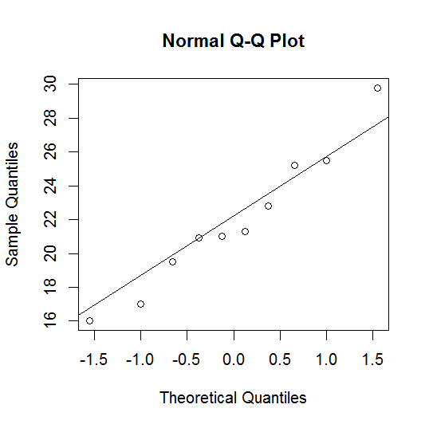

Slide 40
shapiro.test(x)
Shapiro-Wilk normality test
data: x
W = 0.9646, p-value = 0.8363

Slide 41
Prediction Interval
A prediction interval (PI) for a single observation to be selected from a normal population distribution is
The prediction level is

Slide 42
Prediction Interval
Example: Consider the following sample of fat content ( in percentage) of n = 10 randomly selected hot dogs.
25.2, 21.3, 22.8, 17.0, 29.8, 21.0, 25.5, 16.0, 20.9, 19.5
Assume that these were selected from a normal population.
The point estimate of population mean is 21.90.

Slide 43
7.4
Confidence Intervals for the Variance and Standard Deviation of a Normal Population

Slide 44
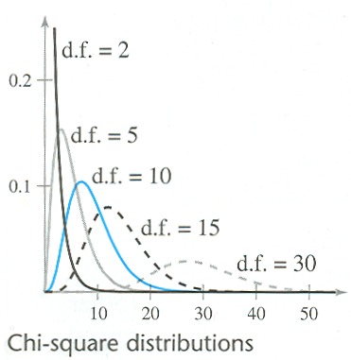

Slide 45
Normal Population
Let X₁,…, X_{n} be a random sample from a normal distribution with parameters
Then the rv
has a chi-squared probability distribution with n – 1 df.

Slide 46
Chi-squared Critical Value
Let , called a chi-squared critical value, denote the number of the measurement axis such that of the area under the chi-squared curve with v df lies to the right of

Slide 47
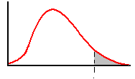
Notation Illustrated

Slide 48
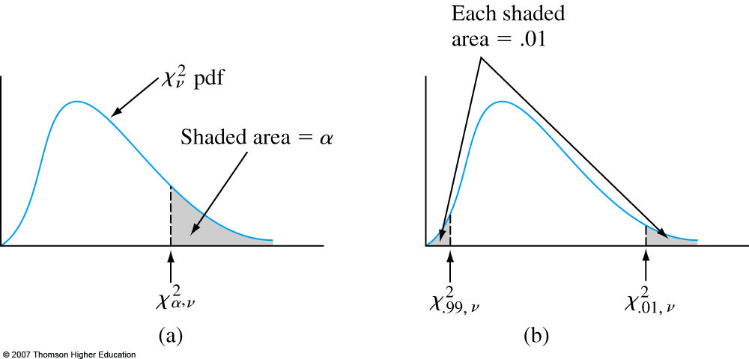

Slide 49
Confidence Interval
confidence interval for
for the variance of a normal population has
lower limit
upper limit
For a confidence interval for , take the square root of each limit above.

