Slide 1
Multiple Regression
An example

Slide 2
Treadmill Example
n=43 individuals subjected to treadmill test
VO2MAX = measure of oxygen consumption
DURATION = how long, in seconds, individual lasted on treadmill
AGE = age, in years, of individual

Slide 4
Model only with age
The estimated regression equation is
vo2 = 65.6 - 0.518 age
Predictor Coef SE Coef T P
Constant 65.583 4.419 14.84 0.000
age -0.51800 0.09063 -5.72 0.000
S = 6.570 R-Sq = 44.3% R-Sq(adj) = 43.0%
----------------------------------------------------
Analysis of Variance
Source DF SS MS F P
Regression 1 1410.0 1410.0 32.67 0.000
Residual Error 41 1769.6 43.2
Total 42 3179.5

Slide 6
Model only with duration
The estimated regression equation is
vo2 = 0.30 + 0.0626 duration
Predictor Coef SE Coef T P
Constant 0.297 3.043 0.10 0.923
duration 0.062628 0.004600 13.61 0.000
S = 3.748 R-Sq = 81.9% R-Sq(adj) = 81.4%
------------------------------------------------------
Analysis of Variance
Source DF SS MS F P
Regression 1 2603.6 2603.6 185.33 0.000
Residual Error 41 576.0 14.0
Total 42 3179.5

Slide 8
Model with both age and duration
The regression equation is
vo2 = 8.39 + 0.0571 duration - 0.0945 age
Predictor Coef SE Coef T P
Constant 8.393 6.560 1.28 0.208
duration 0.057076 0.006056 9.42 0.000
age -0.09452 0.06807 -1.39 0.173
S = 3.706 R-Sq = 82.7% R-Sq(adj) = 81.9%
------------------------------------------------------
Analysis of Variance
Source DF SS MS F P
Regression 2 2630.1 1315.0 95.73 0.000
Residual Error 40 549.5 13.7
Total 42 3179.5

Slide 9
Linear regression model with 3 predictors
Dwaine Studios Example from your text, page 236.

Slide 10
(KNNL p 236)
Dwaine Studios, Inc. operates portrait studios in 21 cities of medium size
Y_{i} is sales in city i
X₁ : population aged 16 and under
X₂ : per capita disposable income

Slide 11
young income sales
68.5 16.7 174.4
45.2 16.8 164.4
91.3 18.2 244.2
47.8 16.3 154.6
46.9 17.3 181.6
66.1 18.2 207.5
49.5 15.9 152.8
52.0 17.2 163.2
48.9 16.6 145.4
38.4 16.0 137.2
87.9 18.3 241.9
72.8 17.1 191.1
88.4 17.4 232.0
42.9 15.8 145.3
52.5 17.8 161.1
85.7 18.4 209.7
41.3 16.5 146.4
51.7 16.3 144.0
89.6 18.1 232.6
82.7 19.1 224.1
52.3 16.0 166.5
Y_{i} is sales in city i
X₁ : population aged 16 and under
X₂ : per capita disposable income

Slide 12
Multiple Regression with two Predictor Variables.
data <- read.table(file.choose(),header=F)
targ.pop <- data[,1]
disp.inc <- data[,2]
sales <- data[,3]

Slide 13
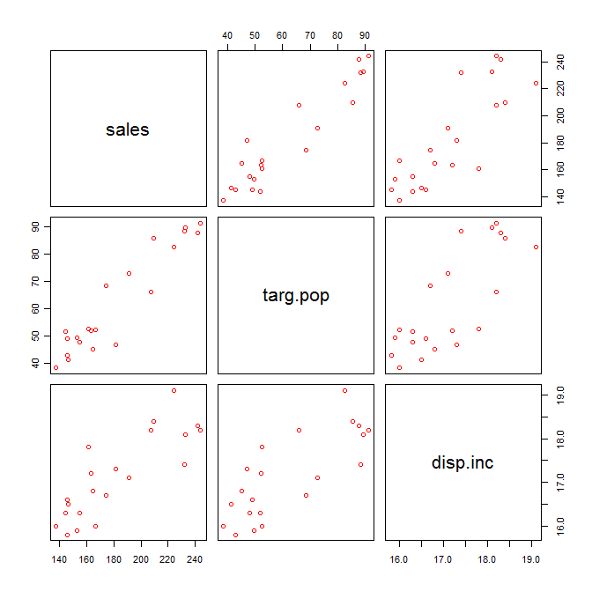
Scatter plot matrix look for shape of function, outliers
pairs(~sales+targ.pop+disp.inc, col=“red”)
Or
pairs(data, col=“blue”)

Slide 14
Model Fit
model <- lm(sales~targ.pop+disp.inc)
summary(model)
Coefficients:
Estimate Std. Error t value Pr(>|t|)
(Intercept) -68.8571 60.0170 -1.147 0.2663
targ.pop 1.4546 0.2118 6.868 2e-06 ***
disp.inc 9.3655 4.0640 2.305 0.0333 *
---
Signif. codes: 0 ‘***’ 0.001 ‘**’ 0.01 ‘*’ 0.05 ‘.’ 0.1 ‘ ’ 1
Residual standard error: 11.01 on 18 degrees of freedom
Multiple R-squared: 0.9167, Adjusted R-squared: 0.9075
F-statistic: 99.1 on 2 and 18 DF, p-value: 1.921e-10

Slide 15
Testing for the Overall Model - F-test
Tests whether any of the explanatory variables are associated with the response
H₀: β₁= β₂ =0 (None of X^{s} associated with Y)
H_{A}: Not all β_{i} = 0
The P-value is based on the F-distribution with k numerator and (n-(k+1)) denominator degrees of freedom

Slide 16
F-test for Regression Relation
anova(model)
Analysis of Variance Table
Response: sales
Df Sum Sq Mean Sq F value Pr(>F)
targ.pop 1 23371.8 23371.8 192.8962 4.64e-11 ***
disp.inc 1 643.5 643.5 5.3108 0.03332 *
Residuals 18 2180.9 121.2
---
SSR = 23371.8 + 643.5 = 24015.3
MSR =24015.3/2 = 12007.65
F value = MSR/MSE = 12007.65/121.2 = 99.07 with 2, 18 df

Slide 17
Residual Analysis
fit <- predict(model) or model$fitted
res <- residuals(model) or model$residuals
plot(res~fit)
abline(h=0,col="red")

Slide 18
Simultaneous CI for the parameters
we want a 90% family interval for β0, β1 and β2, so we use the Bonferroni correction and use 1-alpha/2*3.
level=(1-.1/3) # Note in R alpha is alpha/2
since alpha=0.10, we use 95% confidence level.
confint(model,level=(1-0.1/3))
(Intercept) -194.9480130 57.233867
targ.pop 1.0096226 1.899497
disp.inc 0.8274411 17.903560

Slide 19
Confidence Interval for mean Responses ( page 246)
new.data=data.frame(targ.pop=65.4,disp.inc=17.6)
predict(model,new.data,interval="confidence",level=(1-.05))
fit lwr upr
1 191.1039 185.2911 196.9168

Slide 20
Simultaneous Prediction interval on mean at a new point(Page 247).
new.data2=data.frame(targ.pop=c(65.4,53.1),disp.inc=c(17.6,17.7))
predict(model, new.data2,interval="prediction", level=(1-.1/2)
fit lwr upr
1 191.1039 167.2589 214.9490
2 174.1494 149.0867 199.2121

Slide 21
Linear regression model with 3 predictors

Slide 22
Example: Brain and body size predictive of intelligence?
Sample of n = 38 college students
Response (Y): intelligence based on the PIQ (performance) scores from the (revised) Wechsler Adult Intelligence Scale.
Predictor (X₁): Brain size based on MRI scans (given as count/10,000)
Predictor (X₂): Height in inches
Predictor (X₃): Weight in pounds

Slide 23
Linear regression model with 3 predictors
where:
Y_{i} = intelligence (PIQ) of student i
X_{i1} = brain size of student i (MRI)
X_{i2} = height of student i (Height)
X_{i3} = weight of student i (Weight)

Slide 24
Scatter matrix plots
Scatter plots of response versus predictor helps in determining nature and strength of relationships.
Scatter plots of predictor versus predictor helps in studying their relationships, as well as identifying scope of model and outliers.

Slide 25
Scatter matrix plot

Slide 26
Matrix plot in R
pairs(~PIQ+MRI+Height+Weight,pch=19 col=“red”)
Or
pairs(data, col=“blue”)

Slide 27
Correlation matrix
cor(data)
Correlations: PIQ, MRI, Height, Weight
PIQ MRI Height
MRI 0.378
Height -0.093 0.588
Weight 0.003 0.513 0.700
Cell Contents: Pearson correlation

Slide 28
Fitting multiple regression model in R
model=lm(response~x1+x2+….)
Summary(model)
model=lm(PIQ~MRI+Height+Weight)
Summary(model)

Slide 29
The regression equation is
PIQ = 111.35 + 2.06*MRI - 2.73*Height + 0.001*Weight
Predictor Coef SE Coef T P
Constant 111.35 62.97 1.77 0.086
MRI 2.0604 0.5634 3.66 0.001
Height -2.732 1.229 -2.22 0.033
Weight 0.0006 0.1971 0.00 0.998

Slide 30
Recall: confidence intervals (Simple linear regression)
For β₀:
For β₁:

Slide 31
Confidence intervals for β_{k} _{(Multiple linear regression)}
Sample estimate ± margin of error
(P-1) predictor variables.
n-(p-1)-1)=n-p
Predictor Coef SE Coef T P
Weight 0.0006 0.1971 0.00 0.998

Slide 32
The regression equation is
PIQ = 111 + 2.06 MRI - 2.73 Height
Predictor Coef SE Coef T P
Constant 111.28 55.87 1.99 0.054
MRI 2.0606 0.5466 3.77 0.001
Height -2.7299 0.9932 -2.75 0.009
S = 19.51 R-Sq = 29.5% R-Sq(adj) = 25.5%
Coefficient of (multiple) determination
Adjusted coefficient of (multiple) determination

Slide 33
Coefficient of (multiple) determination
R² = SSR/SSTO = proportionate reduction in total variation in Y associated with using set of X₁, …, X_{p-1} variables.
Again, a large R² value does not necessarily imply that the fitted model is a useful one.

Slide 34
Adjusted coefficient of multiple determination
Problem: adding more X variables can only increase R², because SSTO never changes for a given set of data.
But, the remaining error (quantified by SSE) can only get smaller (or stay the same) when more predictor variables are considered.
Solution: adjust R² to take into account the number of predictors in the model.

Slide 35
Adjusted coefficient of multiple determination
(P-1) predictor variables. n-(p-1+1)=n-p

Slide 36
PIQ = 111 + 2.06 MRI - 2.73 Height
S = 19.51 R-Sq = 29.5% R-Sq(adj) = 25.5%
Analysis of Variance
Source DF SS MS F P
Regression 2 5572.7 2786.4 7.32 0.002
Error 35 13321.8 380.6
Total 37 18894.6
Calculation of R²(adj):
Interpretation of R²(adj):

Slide 37
Impact of the adjustment
It’s a trade-off. R-Sq(adj) may even become smaller when another predictor variable is introduced into the model.
The regression equation is
PIQ = 111 + 2.06 MRI - 2.73 Height
S = 19.51 R-Sq = 29.5% R-Sq(adj) = 25.5%
The regression equation is
PIQ = 111 + 2.06 MRI - 2.73 Height + 0.001 Weight
S = 19.79 R-Sq = 29.5% R-Sq(adj) = 23.3%

Slide 38
The regression equation is
PIQ = 111 + 2.06 MRI - 2.73 Height
Analysis of Variance
Source DF SS MS F P
Regression 2 5572.7 2786.4 7.32 0.002
Error 35 13321.8 380.6
Total 37 18894.6
Is there a relationship between the response variable and the set of predictor variables?
How likely is it that the sample would yield such an extreme F-statistic if the null hypothesis were true?

Slide 39
Predicted Values for New Observations
New Obs Fit SE Fit 95.0% CI 95.0% PI
1 113.16 3.21 (106.64,119.68) (73.02,153.30)
2 108.99 4.33 (100.19,117.78) (68.41,149.56)
Values of Predictors for New Observations
New Obs MRI Height
1 91.0 68.0
2 85.0 65.0 S = 19.51

Slide 40
Diagnostics and remedial measures
Most procedures carry directly over (with minor modification) from simple linear regression to multiple linear regression.
But, some procedures are specific only to multiple linear regression (chapters 10, 11)

Slide 41
Residuals against each predictor
Gives an indication of the adequacy of the regression function with respect to each specific predictor variable.

Slide 43
Unusual Observations
Obs MRI PIQ Fit SEFit Residual StResid
13 86 147.00 95.31 5.34 51.69 2.75R
R denotes an obs’n with a large standardized residual

