Slide 1
Chapter 8
Tests of Hypotheses Based on a Single Sample

Slide 2
8.1
Hypotheses and Test Procedures

Slide 3
What’s a Hypothesis?
I believe the mean GPA of this class is 3.5!
1.A Belief about a Population Parameter
Parameter is
Population Mean, Proportion, Variance
Must Be Stated Before Analysis
© 1984-1994 T/Maker Co.

Slide 4
Hypotheses
The null hypothesis, denoted H₀, is the claim that is initially assumed to be true.
The alternative hypothesis, denoted by H_{a}, is the assertion that is contrary to H₀.
Possible conclusions from hypothesis-testing analysis are reject H₀ or fail to reject H₀.

Slide 5
A Test of Hypotheses
A test of hypotheses is a method for using sample data to decide whether the null hypothesis should be rejected.

Slide 6
Basic Idea
It is unlikely that we would get a sample mean of this value ...
Sampling Distribution
... if in fact this were the population mean
20
H₀

Slide 7
Test Procedure
A test procedure is specified by
A test statistic, a function of the sample data on which the decision is to be based.
A rejection region or critical region , the set of all test statistic values for which H₀ will be rejected (null hypothesis rejected iff the test statistic value falls in this region.)

Slide 8
Errors in Hypothesis Testing
A type I error consists of rejecting the null hypothesis H₀ when it was true.
A type II error involves not rejecting H₀ when H₀ is false.

Slide 9
Decision Results
H₀: Innocent

Slide 10
Hypothesis Testing
Goal: Keep α, β reasonably small

Slide 11
Rejection Region:
Suppose an experiment and a sample size are fixed, and a test statistic is chosen. The decreasing the size of the rejection region to obtain a smaller value of results in a larger value of for any particular parameter value consistent with H_{a}.

Slide 12
Example
A certain type of automobile is known to sustain no visible damage 25% of the time in 10-mph crash test. A modified bumper design has been proposed in an effort to increase this percentage.
Let p denote the proportion of all 10-mph crashes with this new bumper that result in no visible damage.
The hypothesis to be tested: Ho : p = 0.25
Ha : p > 0.25
The test will be based on an experiment involving n = 20 independent crashes with 10 pmh

Slide 13
Test Statistic : X = # of crashes with no visible damage in 20 crashes.
Let us say our rejection region is
R₈ = { 8, 9, …….19, 20}
Inotherwords, reject Ho if x ≥ 8, where x is the observed value in 20 crashes.
This rejection region is called upper-tailed rejection region.
When Ho is true, X has a binomial distribution with n = 20 and p = 0.25.

Slide 14
α = p(type I error)
= p( Ho is rejected when Ho is true)
= p( x ≥ 8 when Ho is true)
= p( x ≥ 8, when X ~ Bin( n=20, p=0.25)
= 1 – p( x ≤ 7)
= 1 – 0.898 = 0.102
When Ho is actually true, roughly 10% of all experiments consisting of 20 crashes would result in Ho is being incorrectly rejected.

Slide 15
Calculating β
β ( ) = p( fail to reject Ho when Ho is false)
= p( x ≤ 7 when Ho is false )
Ho is false means p > 0.25 , so p can be any value greater than 0.25.
Let us suppose p = 0.3, then
β( 0.3) = p( x ≤ 7 when X ~Bin( n = 20, p = 0.3)
= B( 7,20, 0.3) = 0.772
When actually p = 0.3 rather than p = 0.25, roughly 77% of all experiments of this type would result in Ho being incorrectly not rejected(accepted).

Slide 16
Significance Level
Specify the largest value of that can be tolerated and find a rejection region having that value of . This makes as small as possible subject to the bound on . The resulting value of is referred to as the significance level.

Slide 17
Level Test
A test corresponding to the significance level is called a level test. A test with significance level is one for which the type I error probability is controlled at the specified level.

Slide 18
8.2
Tests About a Population Mean

Slide 19
Case I: A Normal Population With Known
Null hypothesis:
Test statistic value:

Slide 20
Case I: A Normal Population With Known
Alternative Hypothesis
Rejection Region for Level Test
or

Slide 21
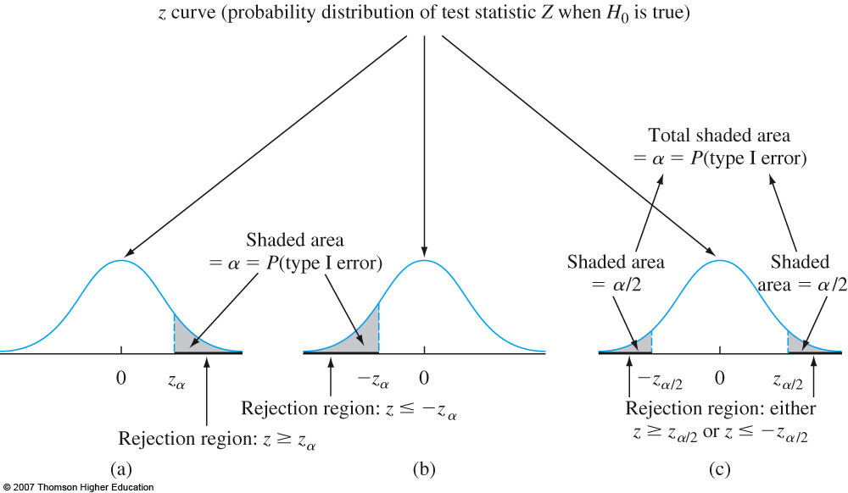

Slide 22
P - Value
The P-value is the smallest level of significance at which H₀ would be rejected when a specified test procedure is used on a given data set.

Slide 23
P-Values for a z Test
P-value:
upper-tailed test
lower-tailed test
two-tailed test

Slide 24
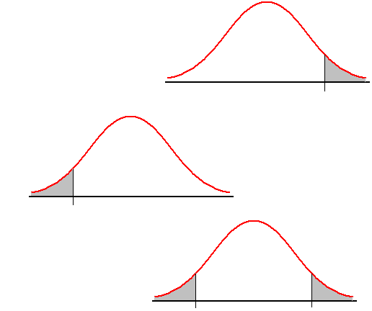
P-Value (area)
Upper-Tailed
0
z
Lower-Tailed
-z
0
Two-Tailed
-z
0
z

Slide 25
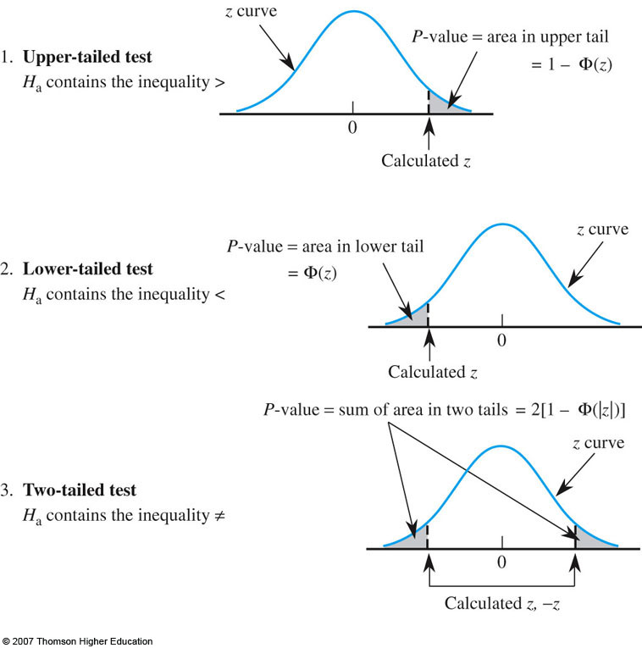

Slide 26
Recommended Steps in Hypothesis-Testing Analysis
Identify the parameter of interest and describe it in the context of the problem situation.
Determine the null value and state the null hypothesis.
State the alternative hypothesis.

Slide 27
Hypothesis-Testing Analysis
Give the formula for the computed value of the test statistic.
State the rejection region for the selected significance level
Compute any necessary sample quantities, substitute into the formula for the test statistic value, and compute that value.

Slide 28
Hypothesis-Testing Analysis
7. Decide whether H₀ should be rejected and state this conclusion in the problem context.
The formulation of hypotheses (steps 2 and 3) should be done before examining the data.

Slide 29
library(TeachingDemos)
z.test(x, mu = 0, stdev, alternative = c("two.sided", "less", "greater"), sd = stdev, conf.level = 0.95, ...)
# For example
x <- rnorm(25, 100, 5)
z.test(x, 99, 5)
One Sample z-test
data: x
z = 1.6712, n = 25, Std. Dev. = 5, Std. Dev. of the sample mean = 1,
p-value = 0.09468
alternative hypothesis: true mean is not equal to 99
95 percent confidence interval:
98.71123 102.63115
sample estimates:
mean of x
100.6712

Slide 30
library(Devore7)
data=xmp08.08
DCP=data$DCP
library(TeachingDemos)
z.test(DCP,30,12.26, alternative="less", conf.level = 0.95)
One Sample t-test
data: DCP
t = -0.7282, df = 51, p-value = 0.2349
alternative hypothesis: true mean is less than 30
95 percent confidence interval:
-Inf 31.61088
sample estimates:
mean of x
28.76154

Slide 31
alpha=0.05
zalpha=qnorm(1-alpha/2) # for two tail test alpha/2 otherwise aplha
zalpha

Slide 32
Case II: Large-Sample Tests
When the sample size is large, the z tests for case I are modified to yield valid test procedures without requiring either a normal population distribution or a known

Slide 33
Large Sample Tests (n > 30)
For large n, s is close to
Test Statistic:
The use of rejection regions for case I results in a test procedure for which the significance level is approximately

Slide 34
Case III: A Normal Population Distribution
If X₁,…,X_{n} is a random sample from a normal distribution, the standardized variable
has a t distribution with n – 1 degrees of freedom.

Slide 35
The One-Sample t Test
Null hypothesis:
Test statistic value:

Slide 36
The One-Sample t Test
Alternative Hypothesis
Rejection Region for Level Test
or

Slide 37
Example: 8.8
library(Devore7)
data=xmp08.08
DCP=data$DCP
t.test(DCP, mu = 30, alt = "less",conf.level = 0.95)
One Sample t-test
data: DCP
t = -0.7282, df = 51, p-value = 0.2349
alternative hypothesis: true mean is less than 30
95 percent confidence interval:
-Inf 31.61088
sample estimates:
mean of x
28.76154

Slide 38
P–Values for t Tests
The P-value for a t test will be a t curve area. The number of df for the one-sample t test is n – 1.

Slide 39
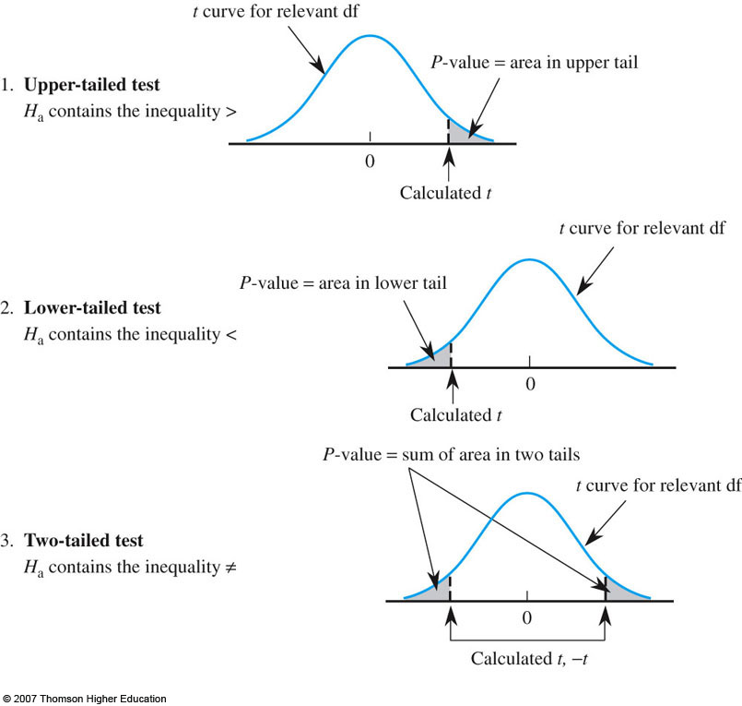

Slide 40
Tests Concerning a Population Variance

Slide 41
Hypothesis Testing About a Population Variance
Left-Tailed Test
Hypotheses
where is the hypothesized value
for the population variance
Test Statistic

Slide 42
Hypothesis Testing About a Population Variance
Left-Tailed Test (continued)
Rejection Rule
Critical value approach:
Reject H₀ if
p-Value approach:
Reject H₀ if p-value < α
where is based on a chi-square
distribution with n - 1 d.f.

Slide 43
Hypothesis Testing About a Population Variance
Right-Tailed Test
Hypotheses
where is the hypothesized value
for the population variance
Test Statistic

Slide 44
Hypothesis Testing About a Population Variance
Right-Tailed Test (continued)
Rejection Rule
Critical value approach:
Reject H₀ if
p-Value approach:
Reject H₀ if p-value < α
where is based on a chi-square
distribution with n - 1 d.f.

Slide 45
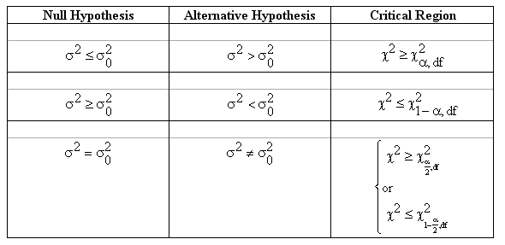

Slide 46
Interval Estimation of σ ²
.025
.025
95% of the
possible χ² values
χ²
0

Slide 47
Example1. A dairy processing company claims that the variance of the amount of fat in the whole milk processed by the company is no more than 0.25. You suspect this is wrong and find that a random sample of 41 milk containers has a variance of 0.27. At α = 0.05, is there enough evidence to reject the company’s claim? Assume the population is normally distributed.
Claim → σ² ≤ 0.25 This is the null hypothesis, H₀. H_{a}: σ² > 0.25. (Right-tail test)
n = 41 d.f. = 40 s² = 0.27 σ² = 0.25 α = 0.05

Slide 48
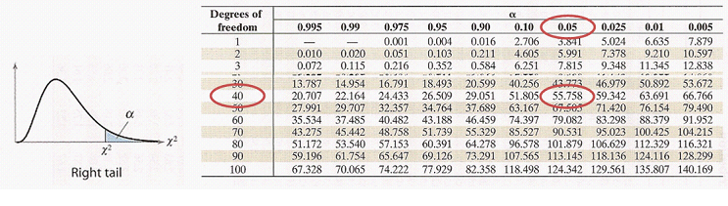

Slide 49
Example 2. A police chief claims that the standard deviation in the length of response times is less than 3.7 minutes. A random sample of nine response times has a standard deviation of 3.0 minutes. At α = 0.05, is there enough evidence to support the police chief’s claim? Assume the population is normally distributed.
Ha → σ < 3.7 This is the alternate hypothesis,
H_{a} - Left-tail test. H₀: σ ≥ 3.7
n = 9 d.f. = 8 s = 3.0 => s² = 9 σ = 3.7 => σ² = 13.69 α = 0.05

Slide 50
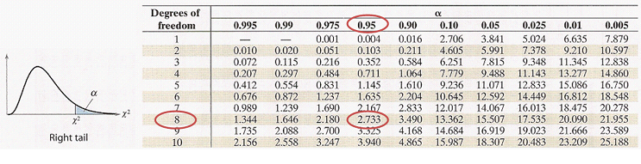

Slide 51
Example3. A tire manufacturer claims that the variance of the diameters in a certain tire model is 8.6. A random sample of ten tires has a variance of 4.3. At α = 0.01, is there enough evidence to reject the manufacturer’s claim? Assume the population is normally distributed.
Claim → σ² = 8.6 This is the null hypothesis, H₀. H_{a}: σ² ≠ 8.6 Two-tailed test.
n = 10 d.f. = 9 s² = 4.3 σ² = 8.6 α = 0.01

Slide 52
