Slide 1
Chapter 9
Inferences Based on Two Samples

Slide 2
9.1
z Tests and Confidence Intervals for a Difference Between Two Population Means

Slide 3
The Difference Between Two Population Means
Assumptions:
1. X₁,…,X_{m} is a random sample from a population with
2. Y₁,…,Y_{n} is a random sample from a population with
3. The X and Y samples are independent of one another

Slide 4
Expected Value and Standard Deviation of
The expected value is
So is an unbiased estimator of
The standard deviation is

Slide 5
Estimating the difference between two means
Properties of the sampling distribution of ( ), the difference two sample means:
When independent random samples of n₁ and n₂ observations have been selected from population with means and and variances and respectively, the sampling distribution of the difference will have the following properties:
1) The mean and standard deviation of ( ) will be
and

Slide 6
2) If the sampled populations are normally distributed, then the sampling distribution of ( ) is exactly normally distributed, regardless of the sample size.
3) If the sample populations are not normally distributed, then the sampling distribution of ( ) is approximately normally distributed when n₁ and n₂ are large, due to the Central Limit Theorem.

Slide 7
Point Estimation of ( ) Large Sample
A (1- ) 100% confidence interval for ( )
If population variance are unknown, they can be approximated by the sample variances.

Slide 8
Test Procedures for Normal Populations With Known Variances
Null hypothesis:
Test statistic value:

Slide 9
Case I: A Normal Population With Known
Alternative Hypothesis
Rejection Region for Level Test
H_{a} :μ₁ - μ₂ > Δ₀
H_{a} :μ₁ - μ₂ < Δ₀
or
H_{a} :μ₁ - μ₂ ≠ Δ₀

Slide 10
Large-Sample Tests
The assumptions of normal population distributions and known values of are unnecessary. The Central Limit Theorem guarantees that has approximately a normal distribution when the sample sizes are large.

Slide 11
Large-Sample Tests
Use of the test statistic value
m, n >40
along with previously stated rejection regions based on z critical values give large-sample tests whose significance levels are approximately

Slide 12
Confidence Interval for
Provided m and n are large, a CI for
with a confidence level of
is
confidence bounds can be found by replacing

Slide 13
Example: n₁=30 n₂=30, sample mean are 1.32 and 1.04 respectively, sample variance are 0.9734 and 0.7291 respectively.
Point estimate of difference of mean
90% confidence interval estimate of difference of mean
Notes:
.28
.28 +- .392

Slide 14
Example
Let denote true average tread life for a premium brand of radial tire and let denote the true average tread life for an economy brand of the same size. Test
versus
at level .01 using the following statistics:

Slide 15
Solution
The test statistic is
Since z = 2.66 > 2.33( Z _{.01} ) so we reject and conclude that the true average life for radials exceeds that for economy brand by more than 5000.

Slide 16
9.2
The Two-Sample t Test and Confidence Interval

Slide 17
Assumptions
Both populations are normal, so that X₁,…,X_{m} is a random sample from a normal distribution and so is Y₁,…,Y_{n}. The plausibility of these assumptions can be judged by constructing a normal probability plot of the x_{i}’s and another of the y_{i}’s.

Slide 18
t Distribution
When the population distributions are both normal, the standardized variable
has approximately a t distribution…

Slide 19
t Distribution
df v can be estimated from the data by
(round down to the nearest integer)

Slide 20
Two-Sample CI for
The two-sample CI for
with a confidence level of
is

Slide 21
Two-Sample t Test
Null hypothesis:
Test statistic value:

Slide 22
The Two-Sample t Test
Alternative Hypothesis
Rejection Region for Approx. Level Test
H_{a} :μ₁ - μ₂ > Δ₀
H_{a} :μ₁ - μ₂ < Δ₀
H_{a} :μ₁ - μ₂ ≠ Δ₀
or

Slide 23
Pooled t Procedures
Assume two populations are normal and have equal variances. If denotes the common variance, it can be estimated by combining information from the two-samples. Standardizing using the pooled estimator gives a t variable based on m + n – 2 df.

Slide 24
9.3
Analysis of Paired Data

Slide 25
Paired Data (Assumptions)
The data consists of n independently selected pairs (X₁,Y₁),…, (X_{n},Y_{n}), with
Let D₁ = X₁ – Y₁, …, D_{n} = X_{n} – Y_{n}. The D_{i}’s are assumed to be normally distributed with mean value and variance

Slide 26
The Paired t Test
Null hypothesis:
Test statistic value:
are the sample mean and standard deviation of the d_{i}’s.

Slide 27
The Paired t Test
Alternative Hypothesis
Rejection Region for Level Test
or

Slide 28
Confidence Interval for
The paired t CI for is
confidence bounds can be found by replacing

Slide 29
Paired Data and Two-Sample t
Independence between X and Y
Positive dependence

Slide 30
Pros and Cons of Pairing
For great heterogeneity and large correlation within experimental units, the loss in degrees of freedom will be compensated for by an increased precision associated with pairing (use pairing).
If the units are relatively homogeneous and the correlation within pairs is not large, the gain in precision due to pairing will be outweighed by the decrease in degrees of freedom (use independent samples).

Slide 31
9.5
Inferences Concerning Two Population Variances

Slide 32
The F Distribution
The F probability distribution has parameters v₁ (number of numerator df) and v₂ (number of denominator df). If X₁ and X₂ are independent chi-squared rv’s with v₁ and v₂ df, then

Slide 33
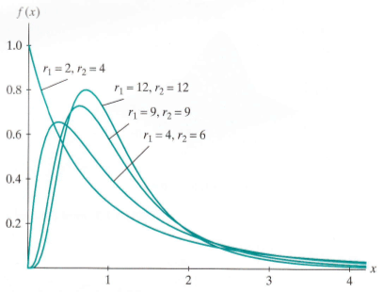

Slide 34
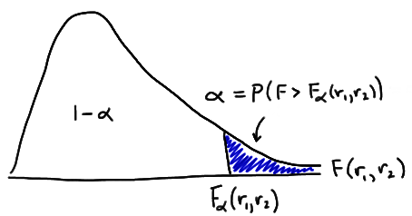
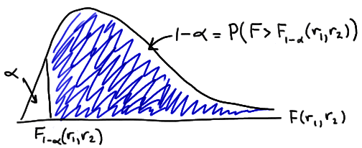

Slide 35
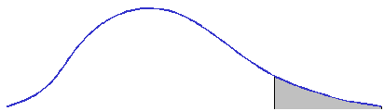
The F Distribution Density Curve Property
F density curve
Shaded area =
f

Slide 36
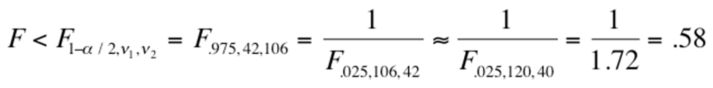


Slide 37
Inferential Methods
Let X₁,…,X_{m} and Y₁,…,Y_{n} be random (independent) samples from normal distributions with variances
respectively. Let
the two sample variances, then

Slide 38
F Test for Equality of Variances
Null hypothesis:
Test statistic value:

Slide 39
F Test for Equality of Variances
Alternative Hypothesis
Rejection Region
or

Slide 40
P-Values for F Tests
The P-value for an upper-tailed F test is the area under the F curve with appropriate numerator and denominator df to the right of the calculated f.

Slide 41
(1-α)100% Confidence Interval for σ₁²/σ₂²
Obtain ratio of sample variances s₁²/s₂² = (s₁/s₂)²
Choose α, and obtain:
F_{L} = F_{1−α/2, n2-1, n1-1} = 1/ F_{α/2, n1-1, n2-1}
F_{U} = F_{α/2, n2-1, n1-1}
Compute Confidence Interval:
Conclude population variances unequal if interval does not contain 1

Slide 42
Example
The variability in the amount of impurities present in a batch of chemicals used for a particular process depends on the length of time that the process is in operation.
Suppose a sample of size 25 is drawn from the normal process which is to be compared to a sample of a new process that has been developed to reduce the variability of impurities.
Sample 1 Sample 2
n 25 25
s² 1.04 0.51

Slide 43
Example continued
H₀: σ₁² = σ₂²
H_{a}: σ₁² > σ₂²
F* = s₁²/s₂² = 1.04/.51 = 2.04
Assuming α = 0.05
cv = 1.98 < 2.04
Thus, reject H₀ and conclude that the variability in the new process (Sample 2) is less than the variability in the original process.
Rejection Region

Slide 44
Example
Two methods are used to measure the business acumen expressed by heroines of romance novels. The mean of method 1 is 88.6 with a variance of 109.63 in a sample of size 41. The mean of method 2 is 85.1 with a variance of 65.99 in a sample of size 21.
Before you test if the means of these two methods are the same, you should test if they possess homogeneous variances.

Slide 45
H₀: σ₁² = σ₂² H_{a}: σ₁² > σ₂²
Ho: No difference in variance
Ha: Difference in variance
Observed F* = 109.63 / 65.99 = 1.66
Critical F (40,20) at alpha (0.1) = 1.99
Retain Ho, and proceed to use a method that pools sample variances.

Slide 46
Example
You are an investor skeptical of the value added by Jupiter Fund, an actively managed large-cap mutual fund. An examination of the prospectus reveals that it has tracked its target index fund very closely over the past 10 years, yet it incurs a 1.51% annual expense fee, far in excess of what one might pay to invest in a large-cap index fund. You wonder if Jupiter achieves a smaller standard deviation in asset values, to justify its higher costs.
You obtain monthly net asset values for both Jupiter Fund and the market index for the past 10 years. You find that Jupiter fund has a sample variance of 0.0016 and that the market index has a sample variance of 0.0025. At the alpha = 0.05 significance value, is the variance for Jupiter statistically less than that for the market index fund? Assume independence of observations and normally distributed populations.

