Slide 1
”A framework to balance privacy and data usability using data degradation”
Kimmo Puputti
Geert Kemps

Slide 2
Problem domain
Personal data in databases
Free services
Data valuable for the sevice providers
Users unaware of the risks
Security is never perfect
  Data can always be leaked to third parties

Slide 3
Problem domain
Traditionally data kept in the database for a certain amount of time
  Then it is removed completely
Full value for service providers
  Until after removal zero value
High risk for users
  Until after removal zero risk

Slide 4
Degrading data over time
Data is generalized over time
Applied in several steps
Data kept usable longer
Risk factor smaller for old data

Slide 5
Use case: AOL
AOL released search logs for research use
  Turned out to be a horrible idea
We used a part of the data
  1 user
  3 months
  3646 search queries

Slide 6
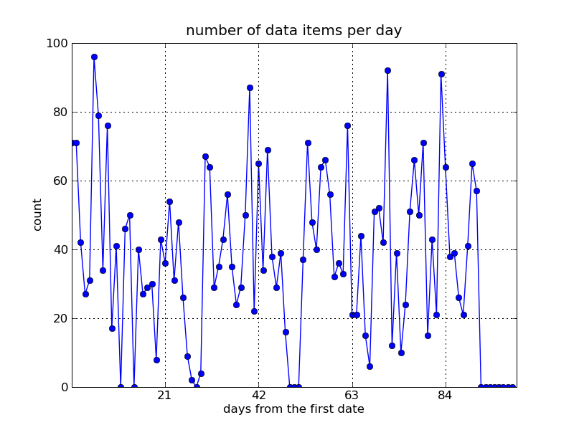
Queries per date

Slide 7
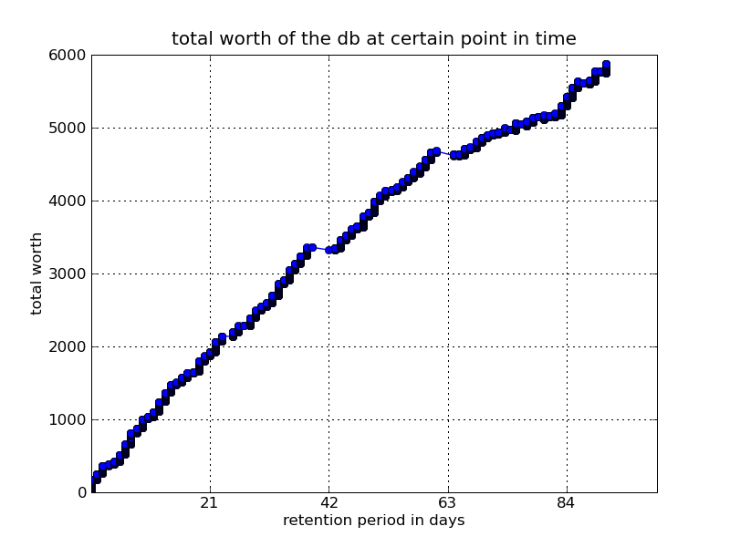
Total worth of the data per date

Slide 8
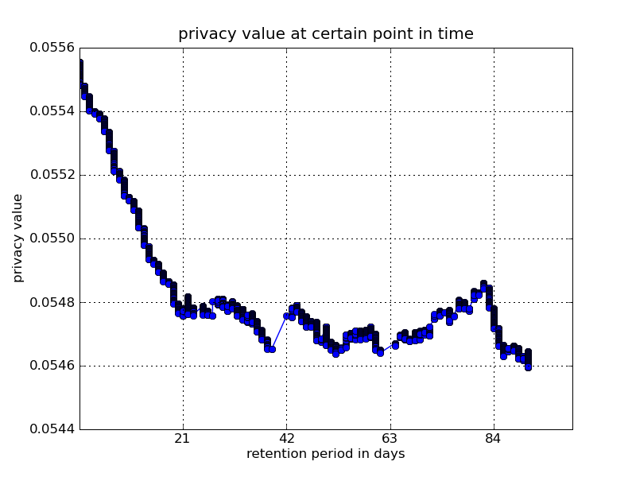
Privacy per date

Slide 9
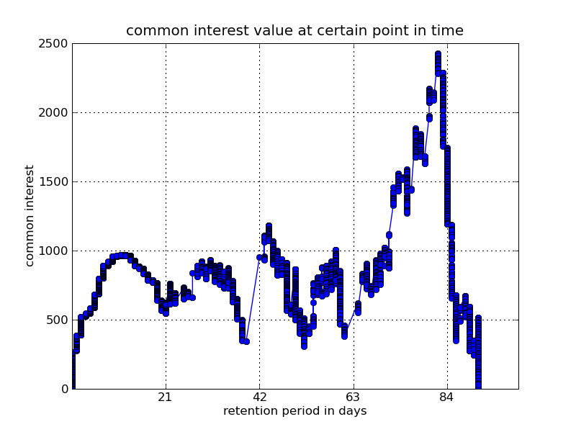
Common interest

Slide 10
Results
Common interest graph didn't provide any useful results
  Bad methodologies
  Data not suitable for the methodologies

