Slide 1
Mobile HTML5:
Implementing a Responsive Cross-Platform Application
Thesis seminar Friday May 11 2012
Kimmo Puputti

Slide 2
HTML5

Slide 3
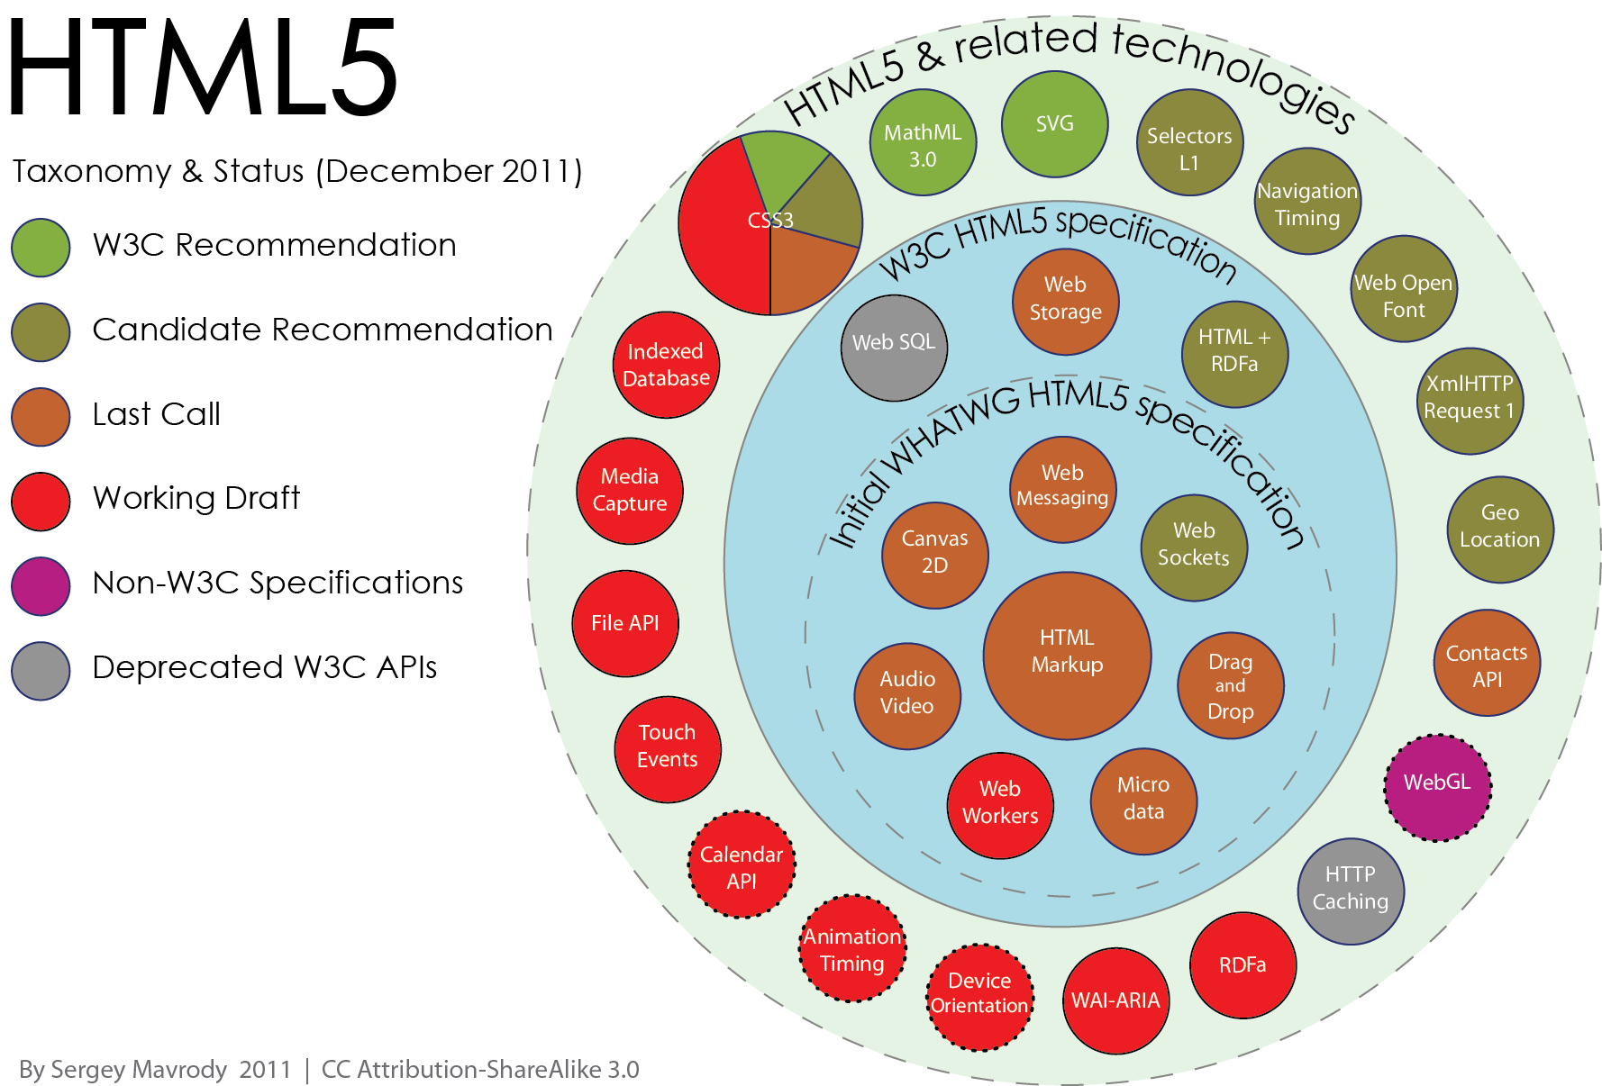
http://en.wikipedia.org/wiki/File:HTML5-APIs-and-related-technologies-by-Sergey-Mavrody.png

Slide 4
Motivation

Slide 5
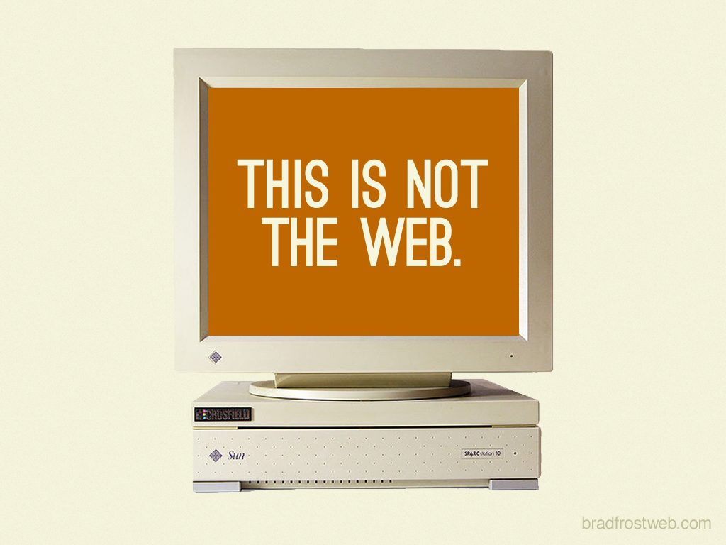
http://bradfrostweb.com/blog/notes/this-is-the-web/

Slide 6
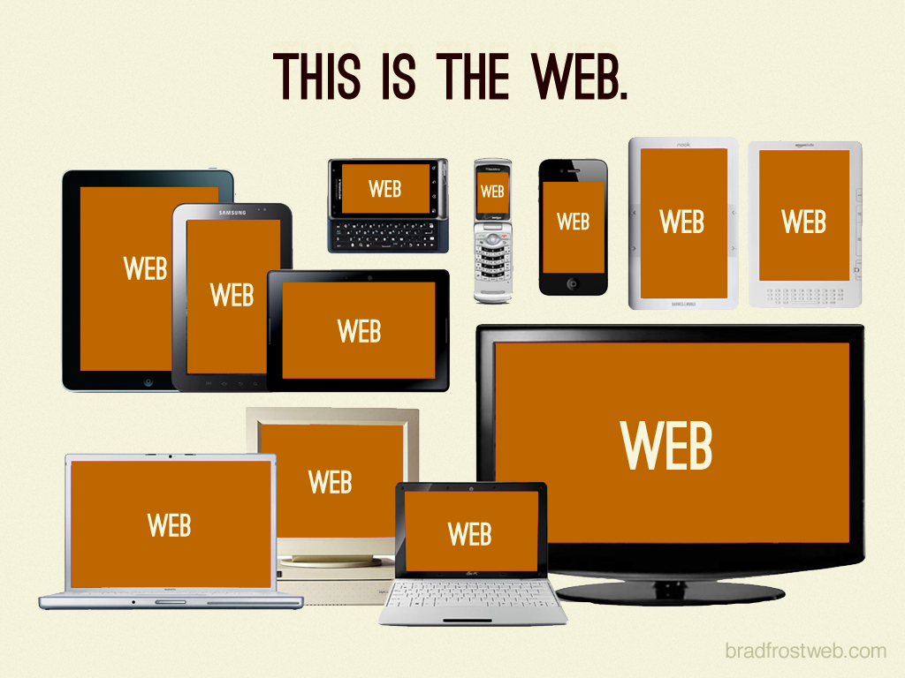
http://bradfrostweb.com/blog/notes/this-is-the-web/

Slide 7

http://bradfrostweb.com/blog/notes/this-is-the-web/

Slide 8
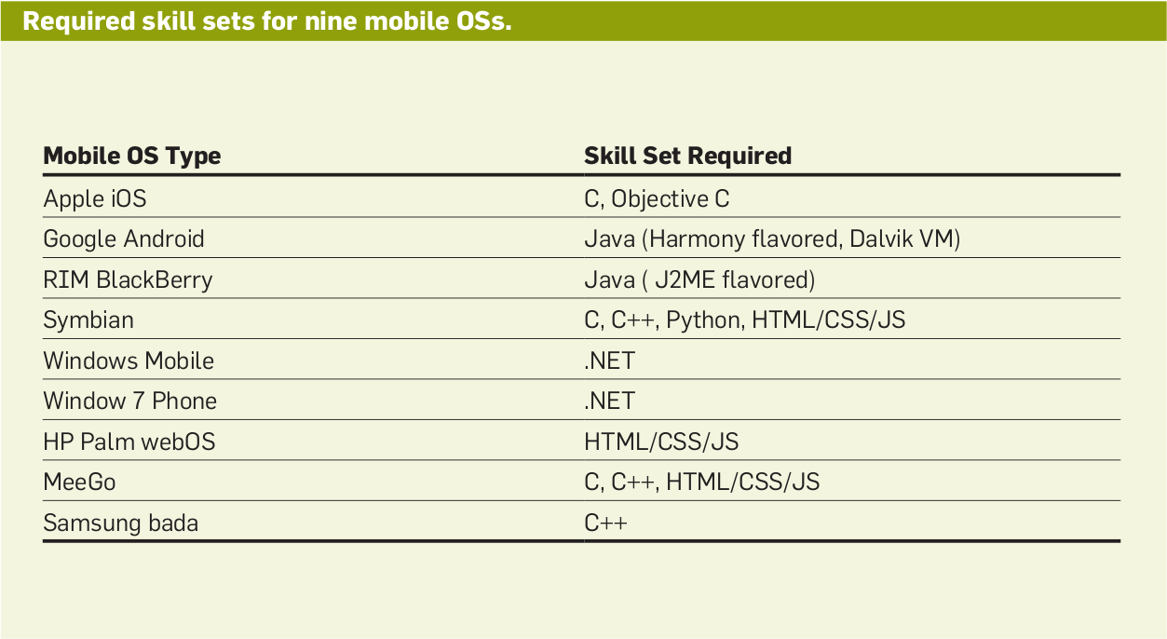
Cross-platform
Charland, A., and Leroux, B. Mobile Application Development:
Web vs. Native. Communications of the ACM 54, 5 (2011), 49{53.

Slide 9
Thanks!
Thesis and slides available at:
http://kpuputti.github.com/thesis/
kpuputti@gmail.com
http://kpuputti.fi
@kpuputti

