Slide 1
Predicting Success of Musicians: Total Album sales
Kaitlin Puryear

Slide 2
Can we predict how many albums an artist will sell globally?
Yes.

Slide 3
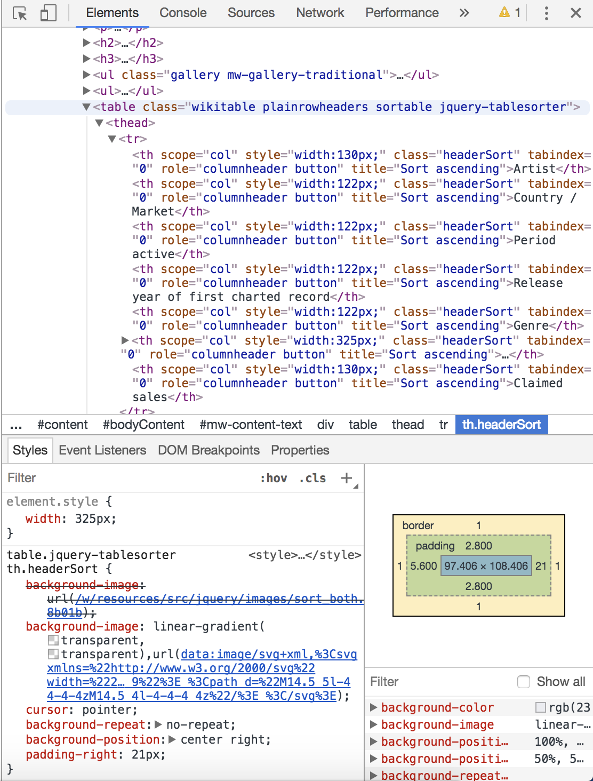
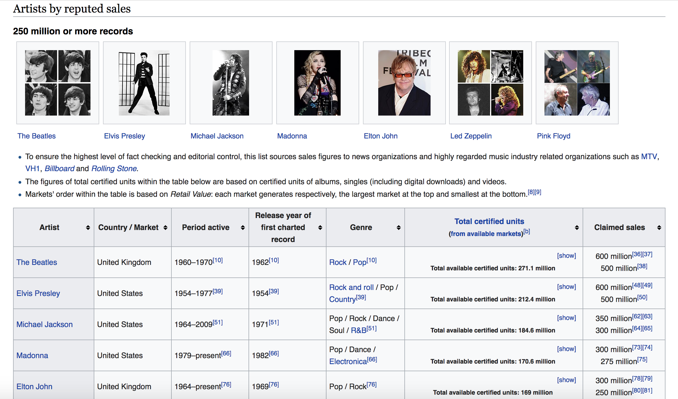
Data Scraping Wikipedia

Slide 4
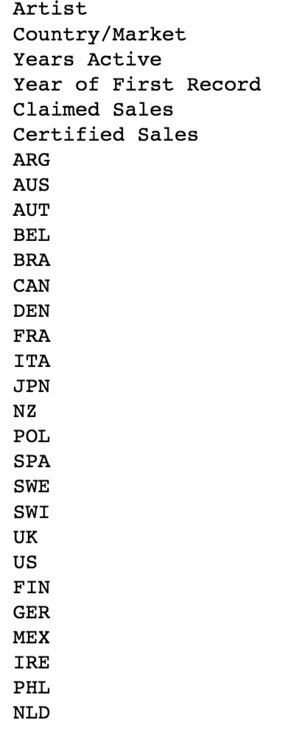
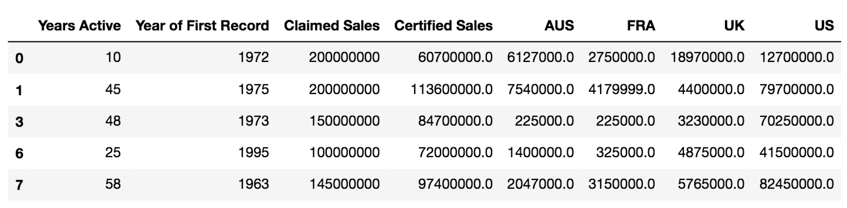
Formatting the Data
Cull the features
Only include data that:
Has more than 70 responses
Is numerical
Notes:
89 rows x 29 columns originally

Slide 5
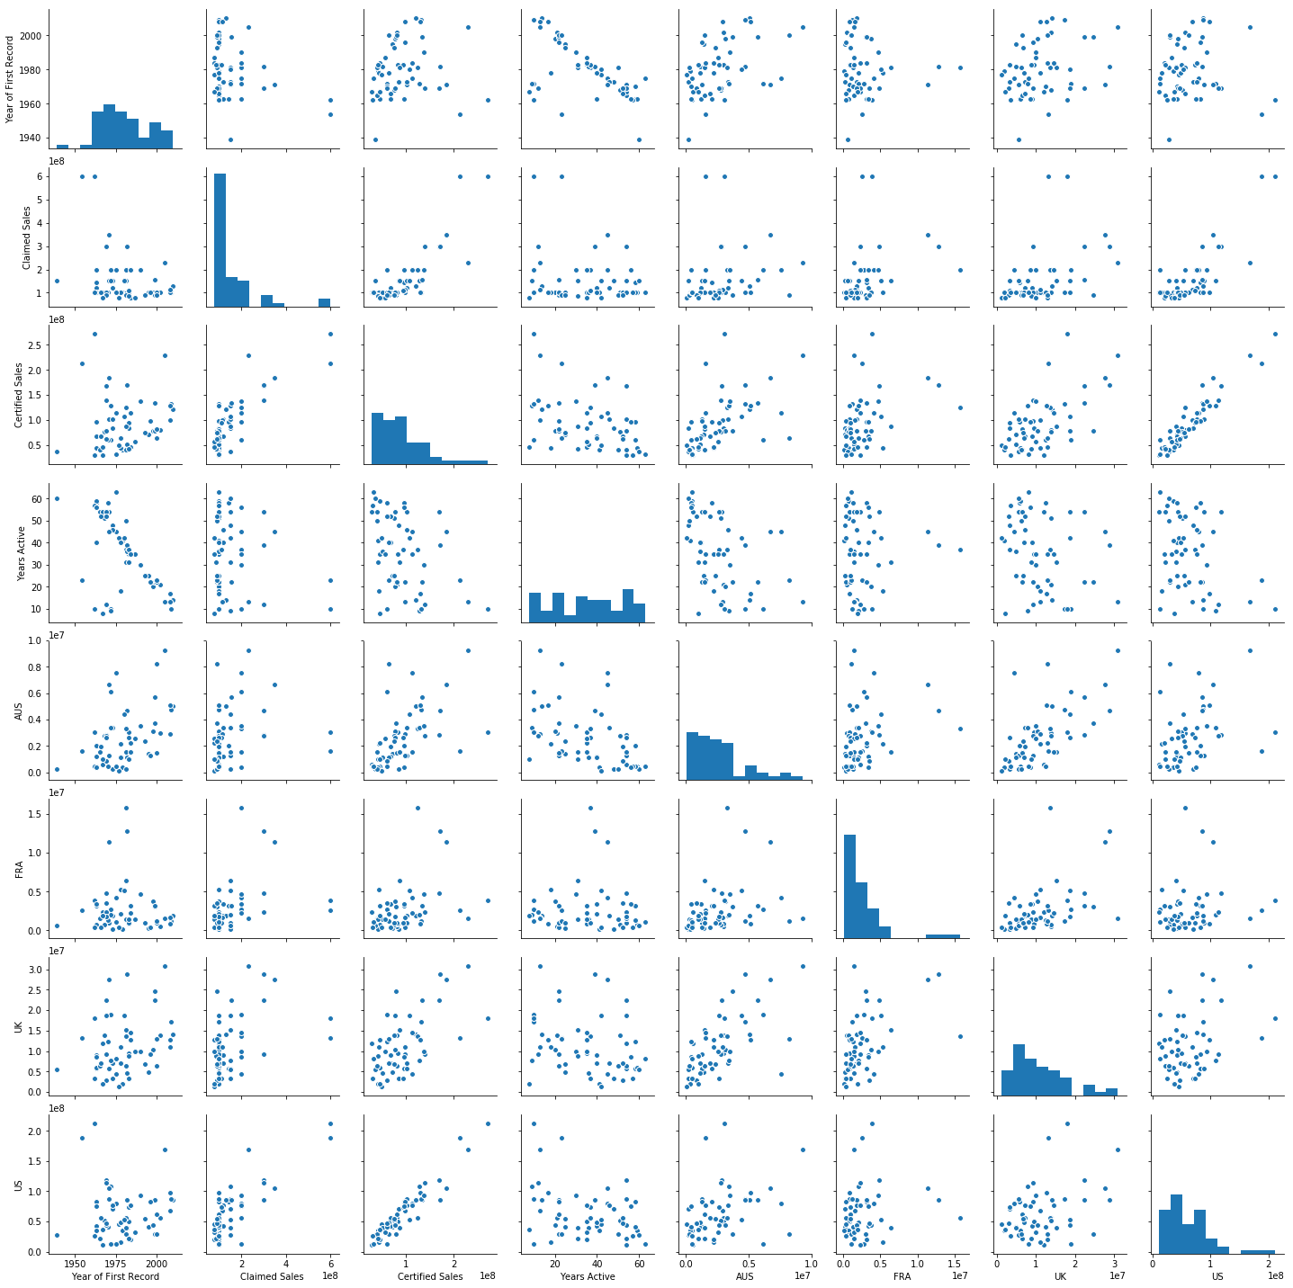
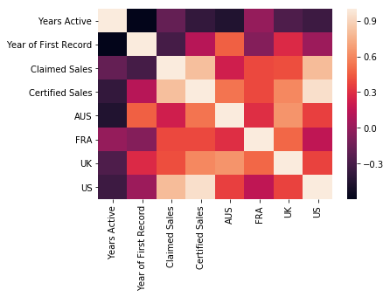
Finding Correlations
Notes:
Years Active,
Year of First Record,
Claimed Sales
Certified Sales,
AUS, FRA, UK, US

Slide 6
Finding Correlations
c
c
c
Notes:
Years Active,
Year of First Record,
Claimed Sales
Certified Sales,
AUS, FRA, UK, US

Slide 7
Fitting a Linear Regression
Model will use:
To Predict:
Year of First Album Release
Albums sold, according to Artist
US album sales
AUS album sales
Total
Album Sales
Notes:
Removed Features
“FRA”
P-Value too low
“UK”
P-Value too low
“Years Active”
Co-linear with “Start”

Slide 8
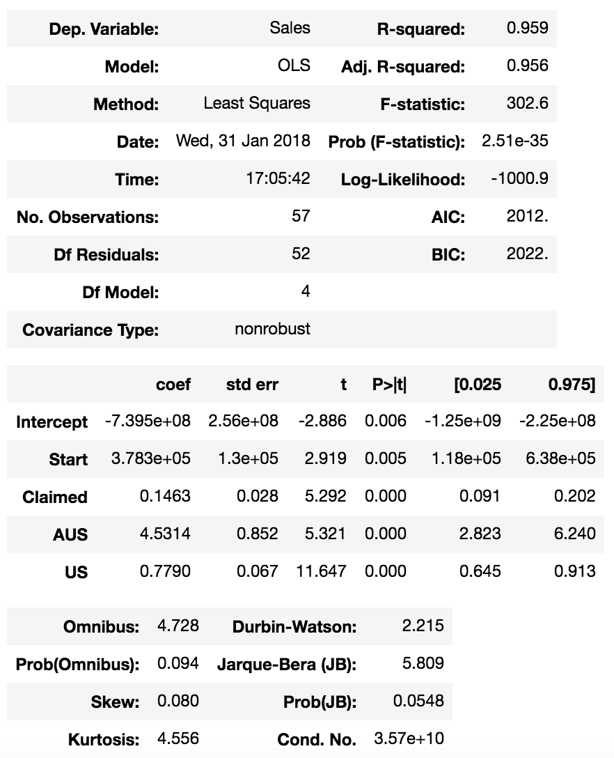
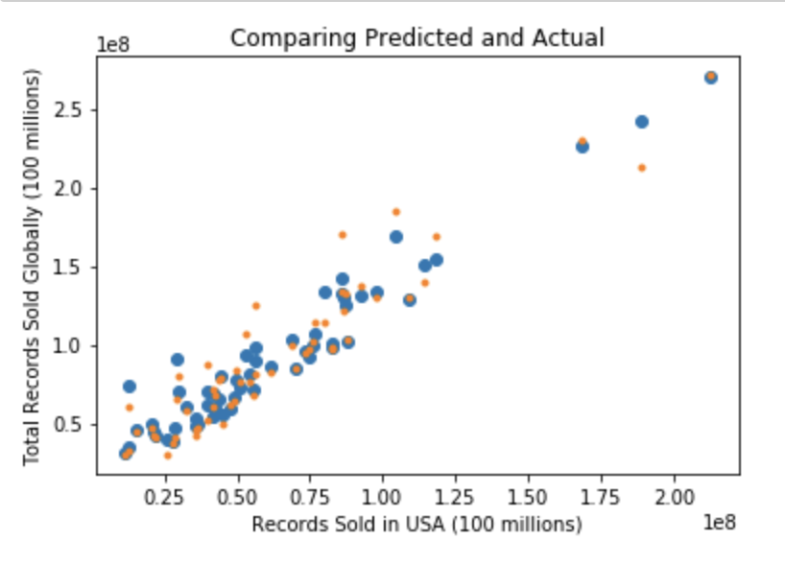
Results
Notes:
Statsmodels
Orange = actual
Blue = predicted

Slide 9
Results

Slide 10
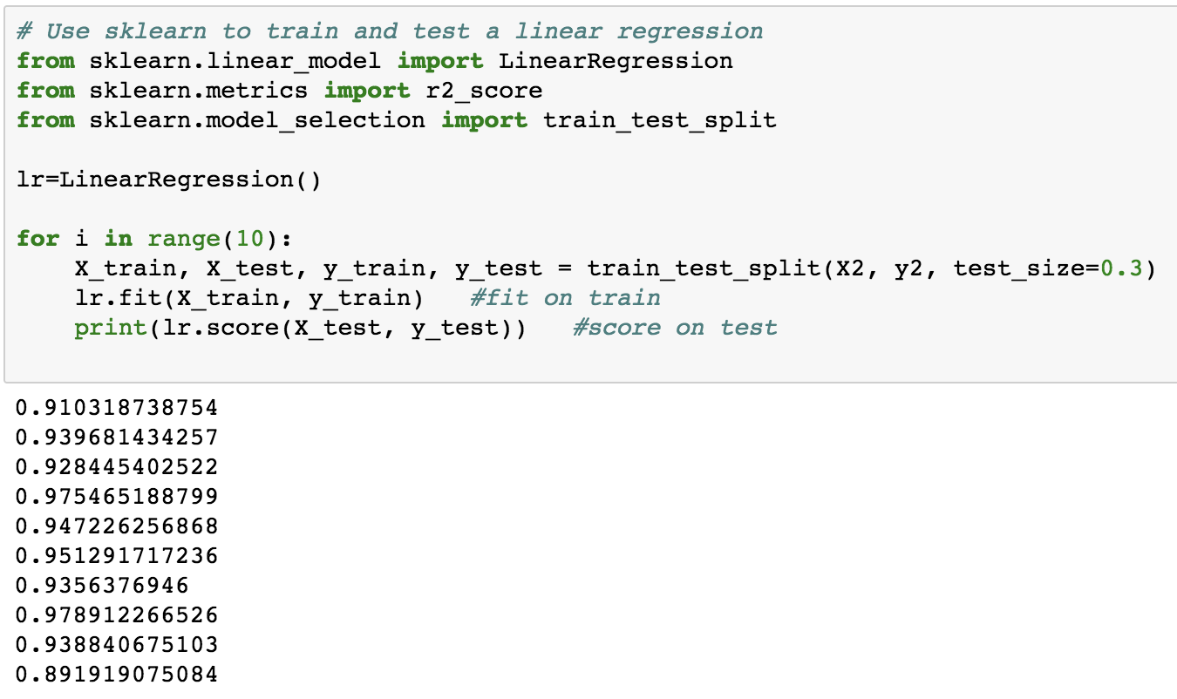
Train Test Split
Average:
0.9397738449749

Slide 11
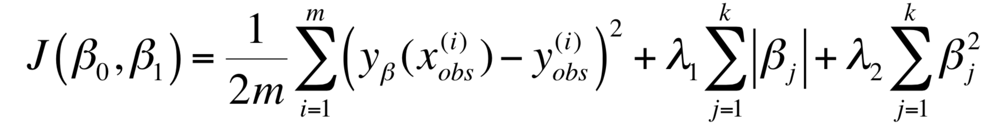

Regularization
Elastic Net CV
Our optimized Cost Function generates these values:
$α^{′}s$: 1.0 e9
$R^{2}$: 0.952
MSE: 1.219 e14
RMSE: 1.1039 e7
Notes:
1 billion
121,900,000,000,000 = 121 trillion
11,038,000 = 11 million

Slide 12
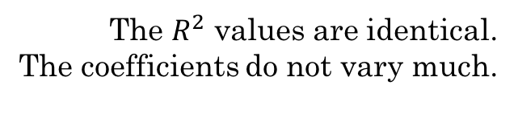
statsmodels vs. sklearn
The $R^{2}$ values are identical.
The coefficients do not vary much.
 | Statsmodels | Sklearn | % difference
Intercept | -7.39 e8 | -6.54 e8 | 12.25%
Year of First Record | 3.783 e5 | 3.348 e5 | 12.2%
Claimed Sales | 0.146 | 0.133 | 9.37%
Australia Sales | 4.531 | 6.229 | 31.56%
US Sales | 0.779 | 0.736 | 5.67%
R^2 | 0.95 | 0.95 | 0%

Slide 13
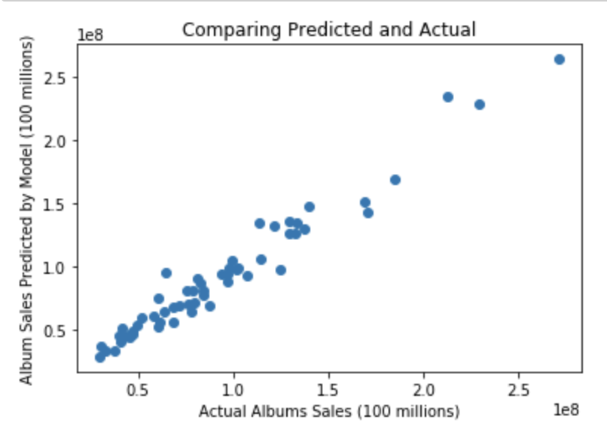
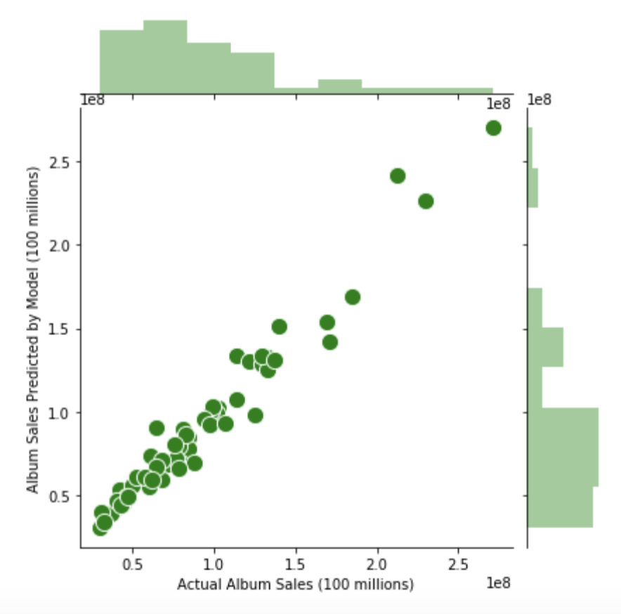
Sklearn Statsmodels

Slide 14
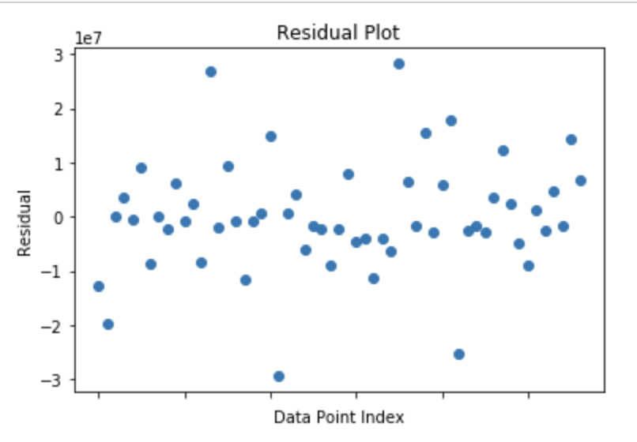
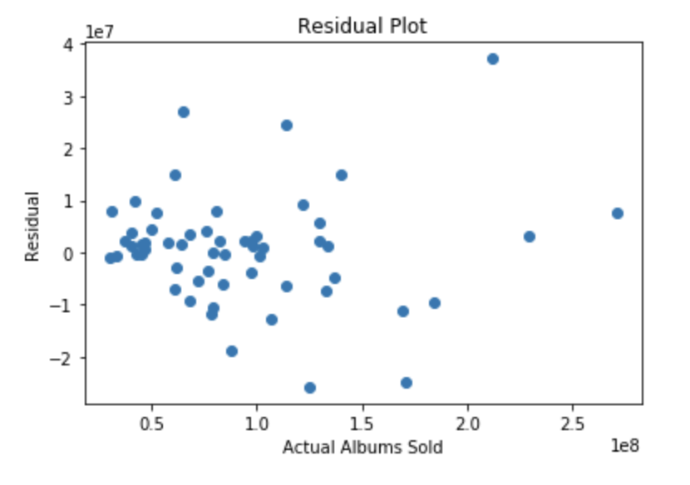
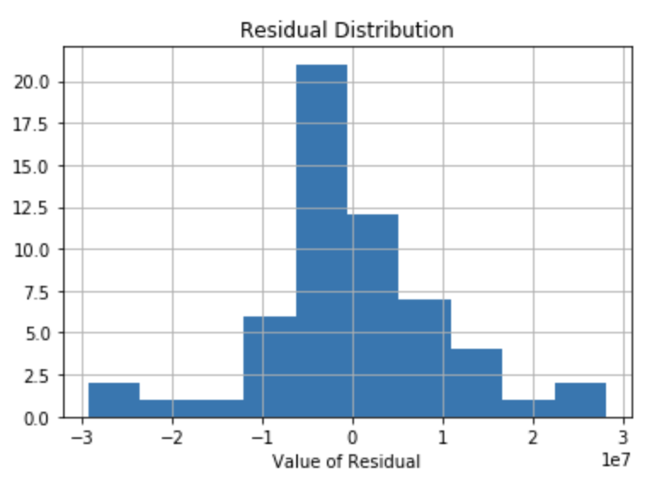
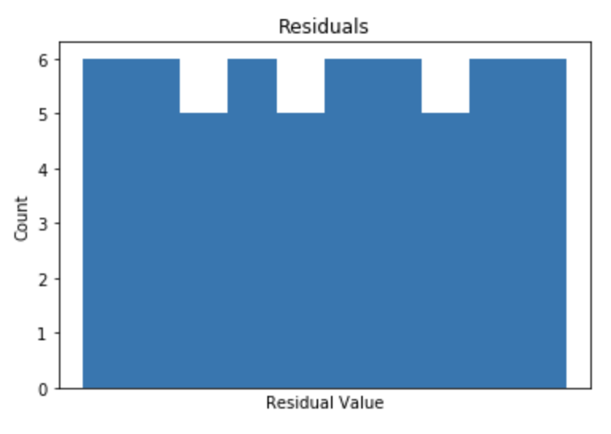
Residuals
statsmodels
sklearn
Notes:
Sklearn shows way more heteroskedacitity. (they are not normally distributed at all)
Statsmodels is also not great, since it is not centralized along 0.

Slide 15
Overall
The statsmodels model is more accurate
(relatively accurate until you get to super groups like the Beatles.)
Being popular in Australia and the US is a good indicator that your band will do well overall.
If you want your band to gain popularity, focus advertising in the US and Australia

Slide 16
Questions?

Slide 17
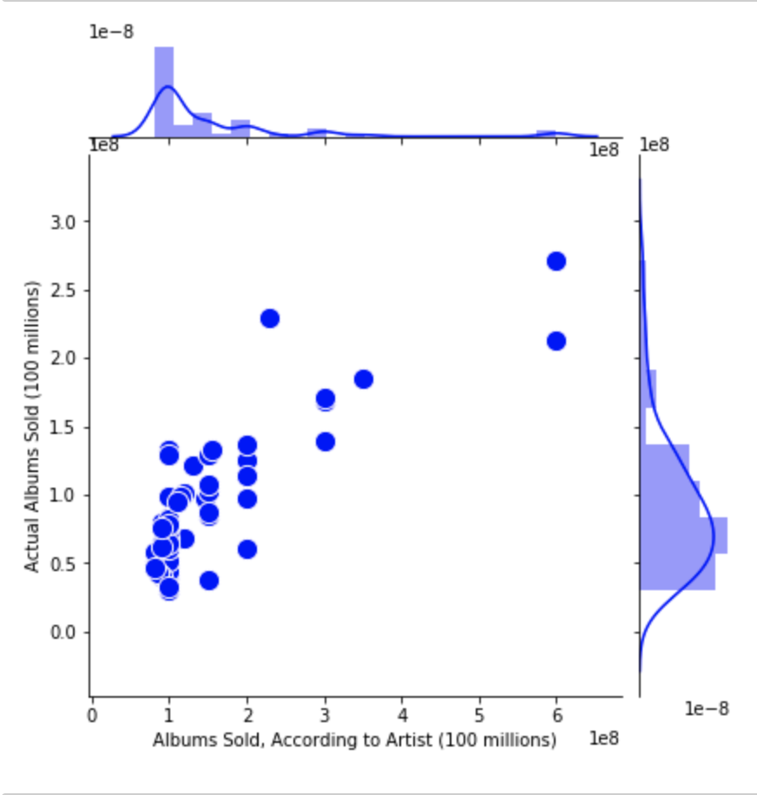
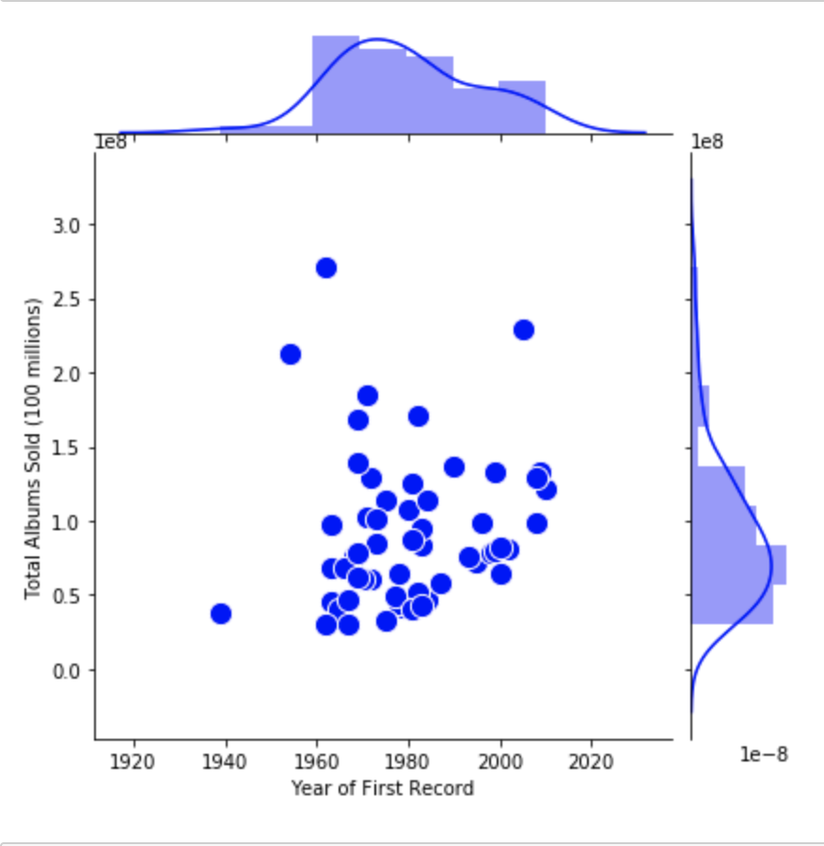
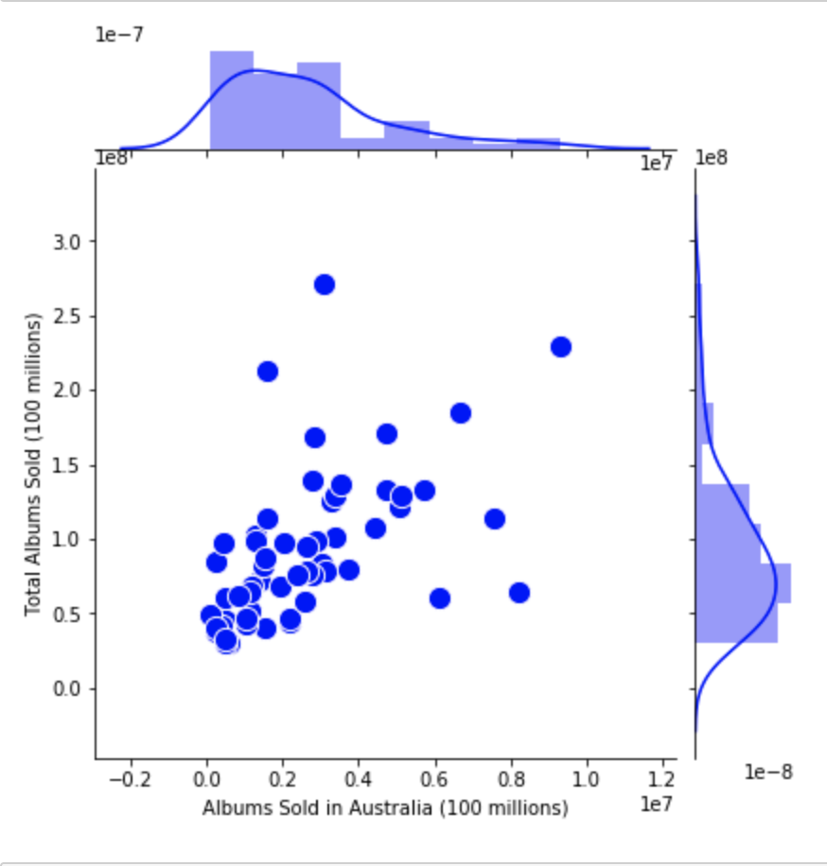
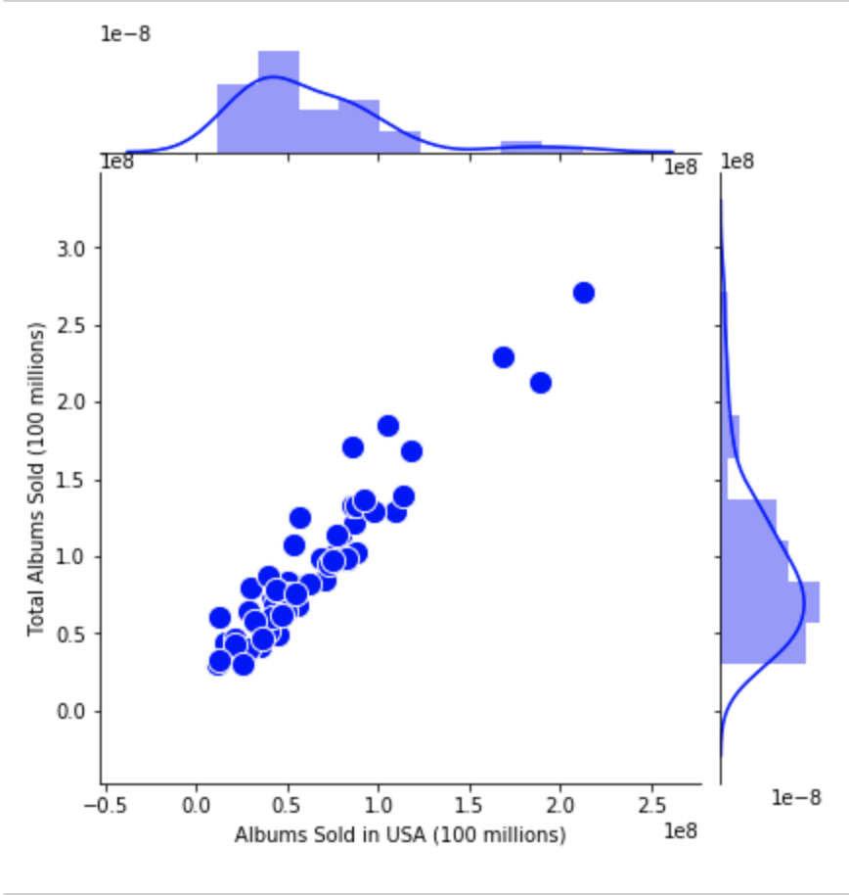
Individual features

Slide 18
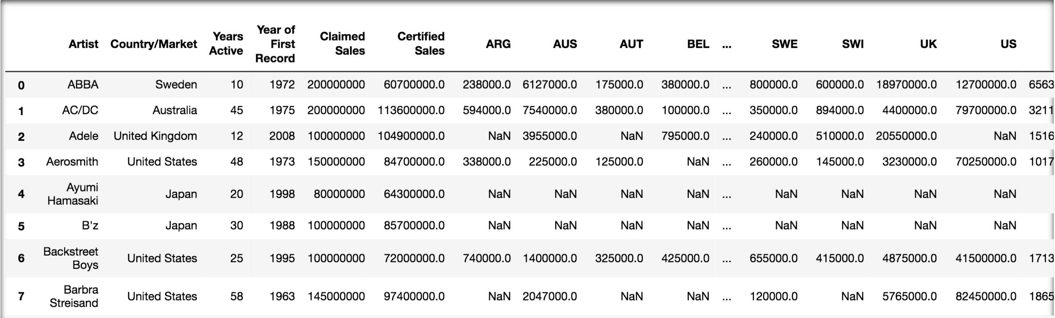
Formatting the Data
89 rows x 29 columns

