Slide 1
PREDICTING
PATIENT
CANCELLATIONS
Kaitlin Puryear
Notes:
CASE STUDY FROM BRAZIL 2016

Slide 2
THE PROBLEM
In Central and Coastal Brazil, 1 in 5 people don’t show up to their scheduled doctors appointments
This is a strain on economic resources and a waste of time for the doctors
Create a model to predict “no-show”s in medical offices

Slide 3
PREDICTING NO-SHOWS
Feature Name | Type | Description
Age | Int | Age of patient
Scholarship | Boolean | Is this visit covered by insurance?
Hypertension | Boolean | Visiting the doctor to treat Hypertension?
Diabetes | Boolean | Visiting the doctor to treat Diabetes?
Alcoholism | Boolean | Visiting the doctor to treat Alcoholism?
Handicap | Boolean | Visiting the doctor to treat a disability?
Text_Sent | Boolean | Did the patient receive a reminder text?
woman | Boolean | Is the patient female?
delta | Int | How many days in advance did they schedule the appointment?
2+problems | Boolean | Are they visiting the doctor for more than one medical problem?
Notes:
Dataset from Kaggle. It focuses on a region of Brazil that is coastal and southern. There were 110,000 rows to this dataset, and initially 80 columns

Slide 4
PREDICTING NO-SHOWS
Feature Name | Type | Description | returns
Age | Int | Age of patient | Showed_up Boolean True: Arrived False: No_show
Scholarship | Booelan | Is this visit covered by insurance?
Hypertension | Boolean | Visiting the doctor to treat Hypertension?
Diabetes | Boolean | Visiting the doctor to treat Diabetes?
Alcoholism | Boolean | Visiting the doctor to treat Alcoholism?
Handicap | Boolean | Visiting the doctor to treat a disability?
Text_Sent | Boolean | Did the patient receive a reminder text?
woman | Boolean | Is the patient female?
delta | Int | How many days in advance did they schedule the appointment?
2+problems | Boolean | Are they visiting the doctor for more than one medical problem?
Notes:
Dataset from Kaggle. It focuses on a region of Brazil that is coastal and southern. There were 110,000 rows to this dataset, and initially 80 columns

Slide 5
imported all the data to AWS in a SQL database
PREDICTING NO-SHOWS
Feature Name | Type | Description | returns
Age | Int | Age of patient | Showed_up Boolean True: Arrived False: No_show
Scholarship | Booelan | Is this visit covered by insurance?
Hypertension | Boolean | Visiting the doctor to treat Hypertension?
Diabetes | Boolean | Visiting the doctor to treat Diabetes?
Alcoholism | Boolean | Visiting the doctor to treat Alcoholism?
Handicap | Boolean | Visiting the doctor to treat a disability?
Text_Sent | Boolean | Did the patient receive a reminder text?
woman | Boolean | Is the patient female?
delta | Int | How many days in advance did they schedule the appointment?
2+problems | Boolean | Are they visiting the doctor for more than one medical problem?
Notes:
Dataset from Kaggle. It focuses on a region of Brazil that is coastal and southern. There were 110,000 rows to this dataset, and initially 80 columns

Slide 6
BUSINESS LOGIC
Actually Absent
Doctor expects patient, but patient never arrives
Doctor does not expect patient to arrive, but they do. Oh no!
Actually Present
Predicted Absent
Predicted Present
Notes:
I inserted a threshold value

Slide 7
BUSINESS LOGIC
Want to minimize false negatives
Doctor expects patient, but patient never arrives
Actually Absent
Set a threshold value:
“True” = (proba>=0.4)
Doctor does not expect patient to arrive, but they do. Oh no!
Actually Present
Predicted Absent
Predicted Present
Notes:
Minimize False Negatives. I inserted a threshold value

Slide 8
SUCCESS INDICATORS
Test the success of each model using:
F1
harmonic mean of precision and recall
Accuracy
Accurate Predictions/ All Predictions
Area under the ROC curve (AUC)
a measure of how well a parameter(or model) can distinguish between two different groups
Notes:
Precision = “out of all the times I said I was positive, how many were actually right?”
Recall = ”When it was actually positive, how many times did I catch it?”

Slide 9
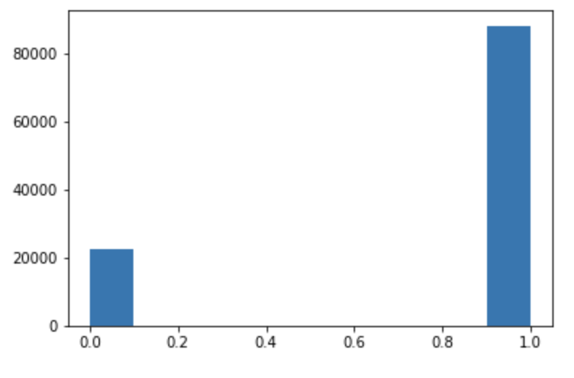
FEATURE FUN
Imbalanced classes
Upsampled my minority class by sampling with replacement (bagging)

Slide 10
MODELS
Used 5 different models:
K Nearest Neighbors
Logistic Regression
Naïve Bayes
Decision Tree
Random Forest

Slide 11
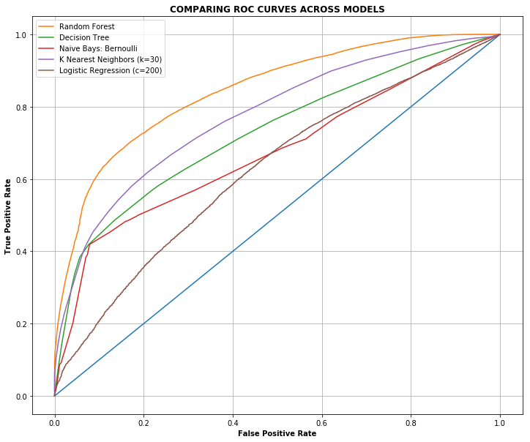
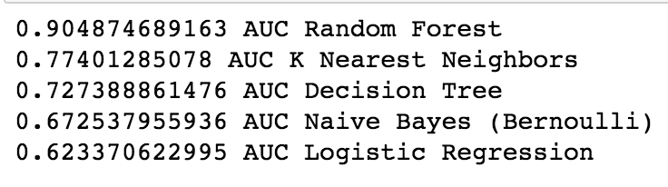
COMPARING ACROSS ALL MODELS

Slide 12

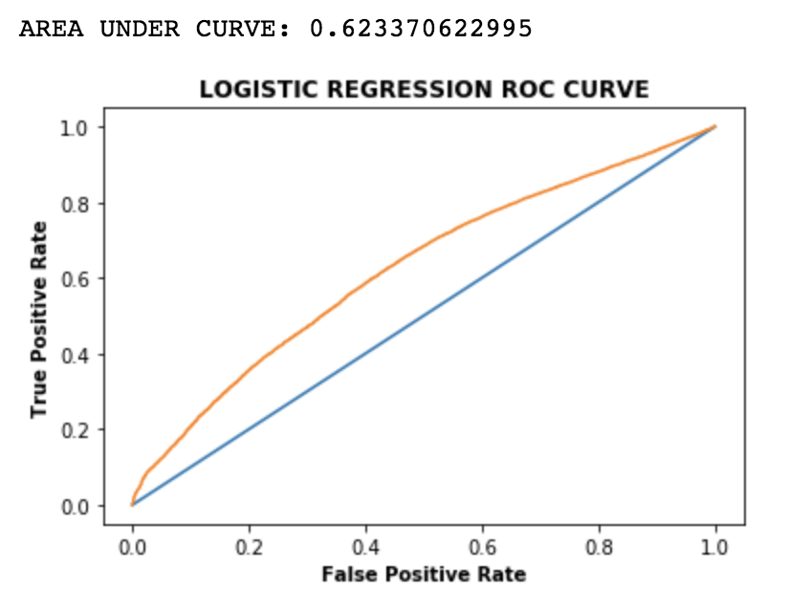
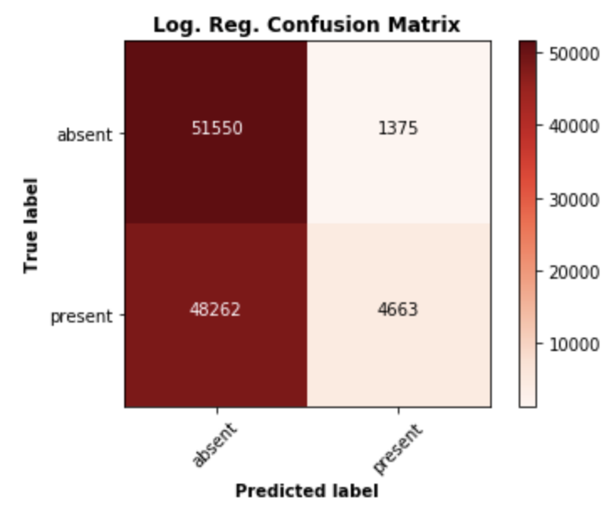
BAD EXAMPLE: LOGISTIC REGRESSION

Slide 13
BAD EXAMPLE: LOGISTIC REGRESSION
LAME

Slide 14

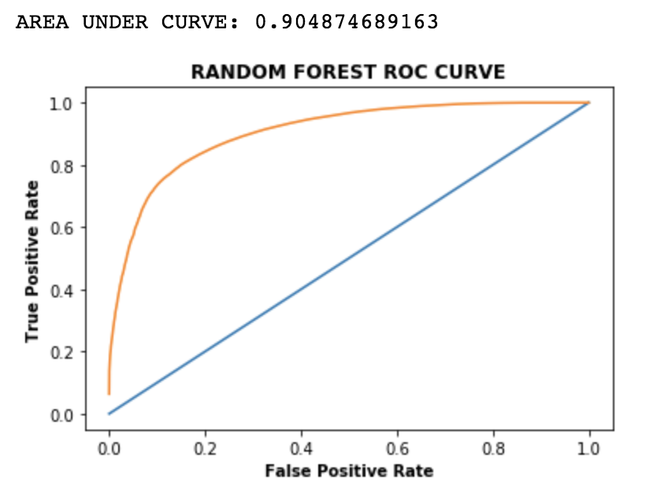
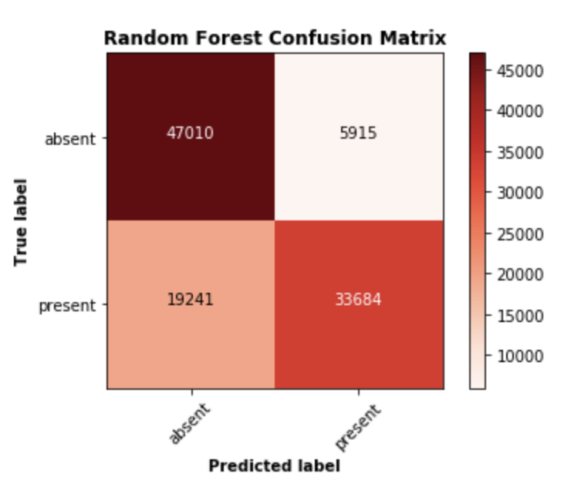
GOOD EXAMPLE: RANDOM FOREST

Slide 15
PARAMETERS FOR RANDOM FOREST
After GridSearch:
max_depth = 20
n_estimators = 100
predict_proba threshold “True” >= 0.4

Slide 16
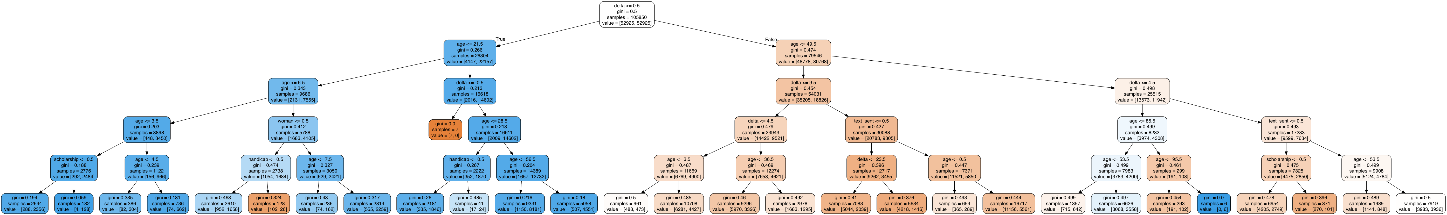
WHICH DECISIONS ARE IMPORTANT?

Slide 17
WHICH DECISIONS ARE IMPORTANT?

Slide 18
WHICH DECISIONS ARE IMPORTANT?

Slide 19
NOW FOR SOME RESULTS
Lets turn our attention to my interactive visualization!

