Slide 1
Predicting Success of Musicians: Total Album sales
Kaitlin Puryear

Slide 2
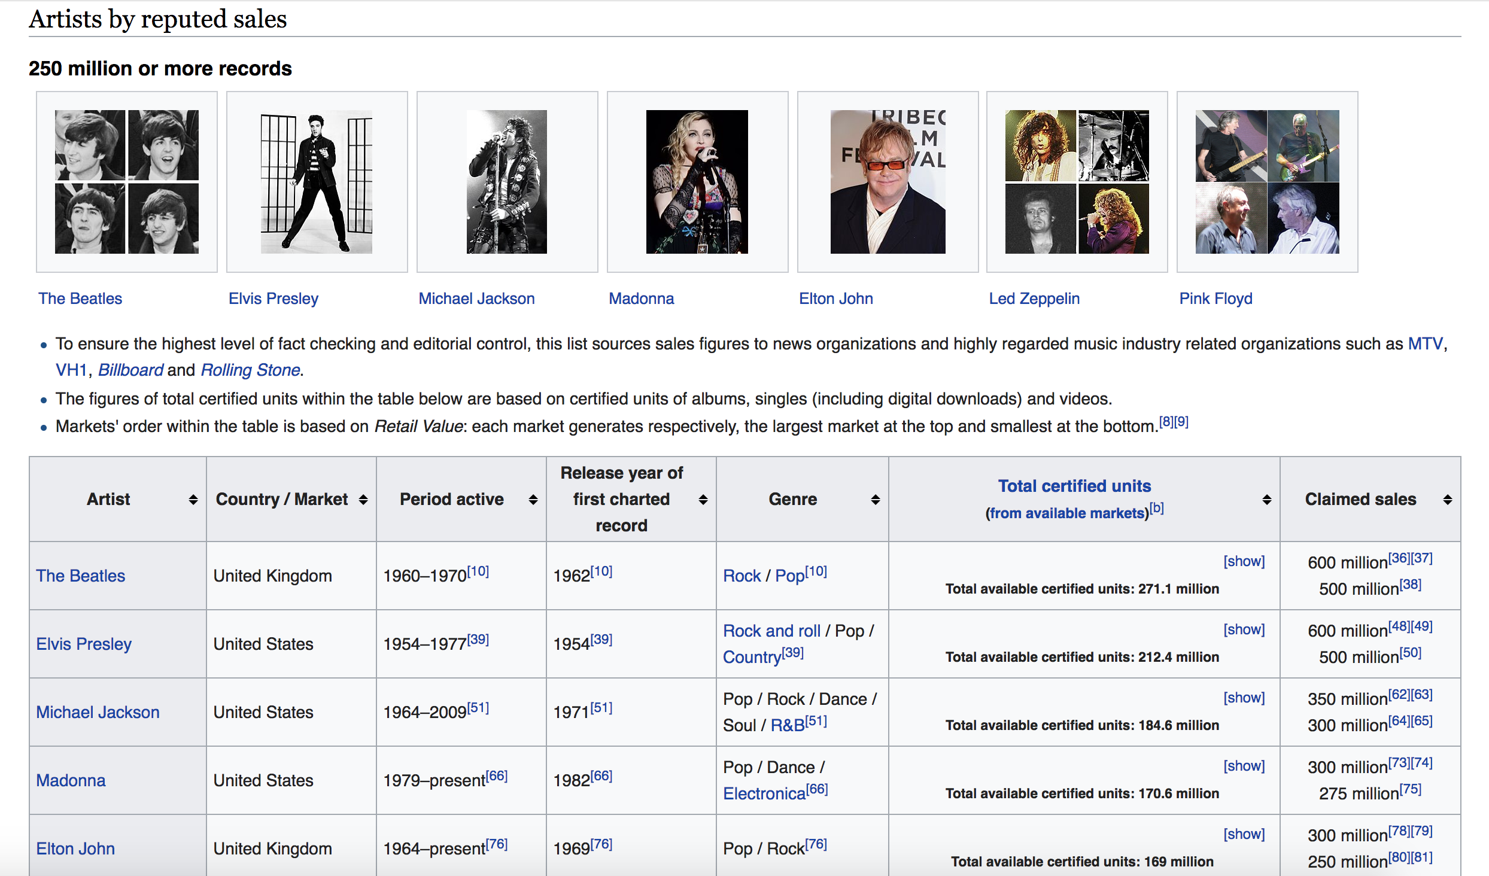
Where did the data come from? Scraping Wikipedia

Slide 3
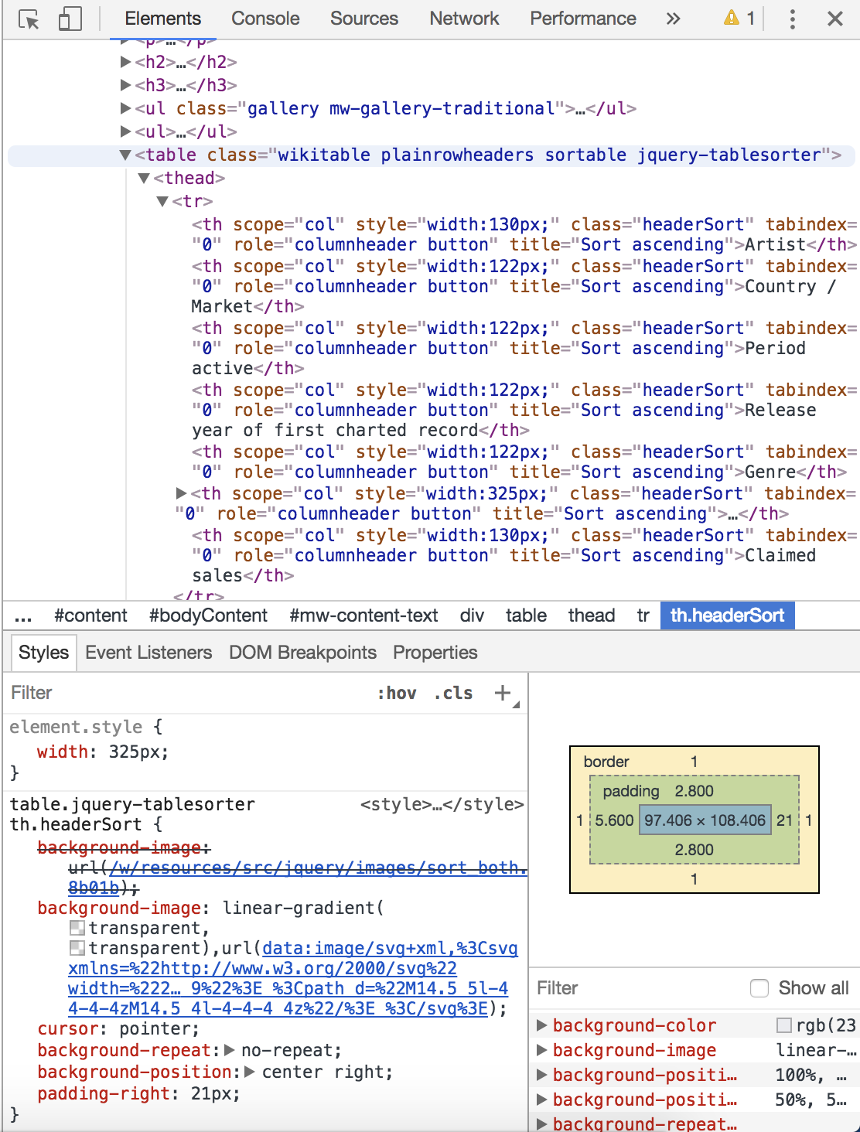
Where did the data come from? Scraping Wikipedia

Slide 4
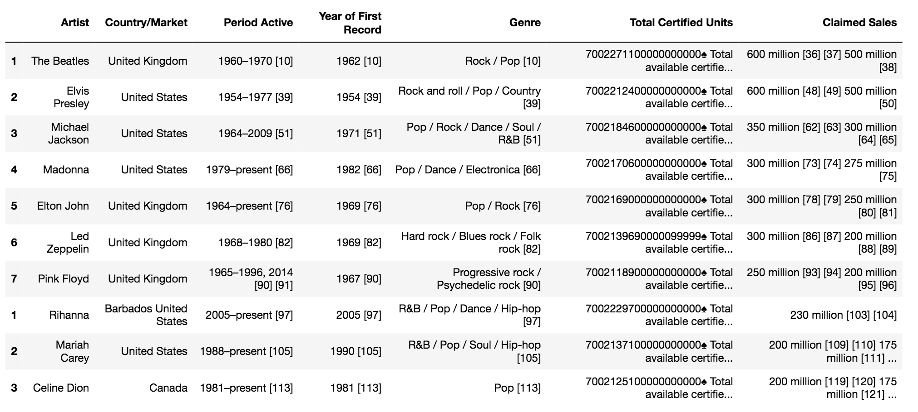
Formatting the Data
Concatenate 5 tables, clean off headers, and re-index
Set a Regex to get rid of the reference links
Write a function to switch “Period Active” to “Years Active”

Slide 5
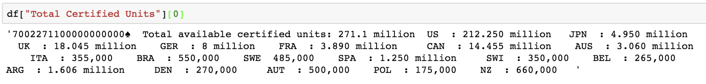
Formatting the Data
Unpack “Total Certified Units” column:
Write some Regex formulas and functions to create a “Total Certified Units” dictionary per band.

Slide 6
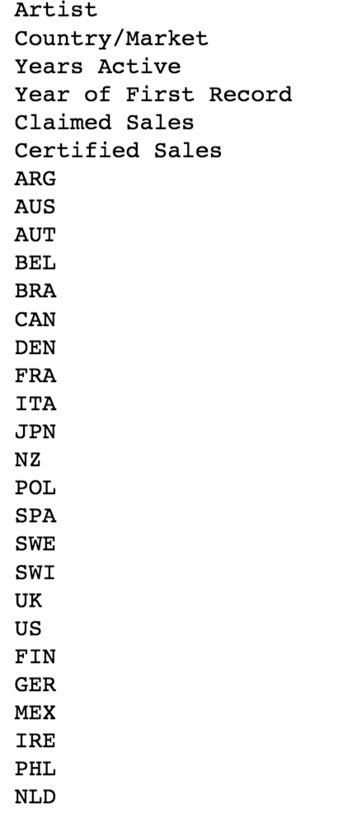
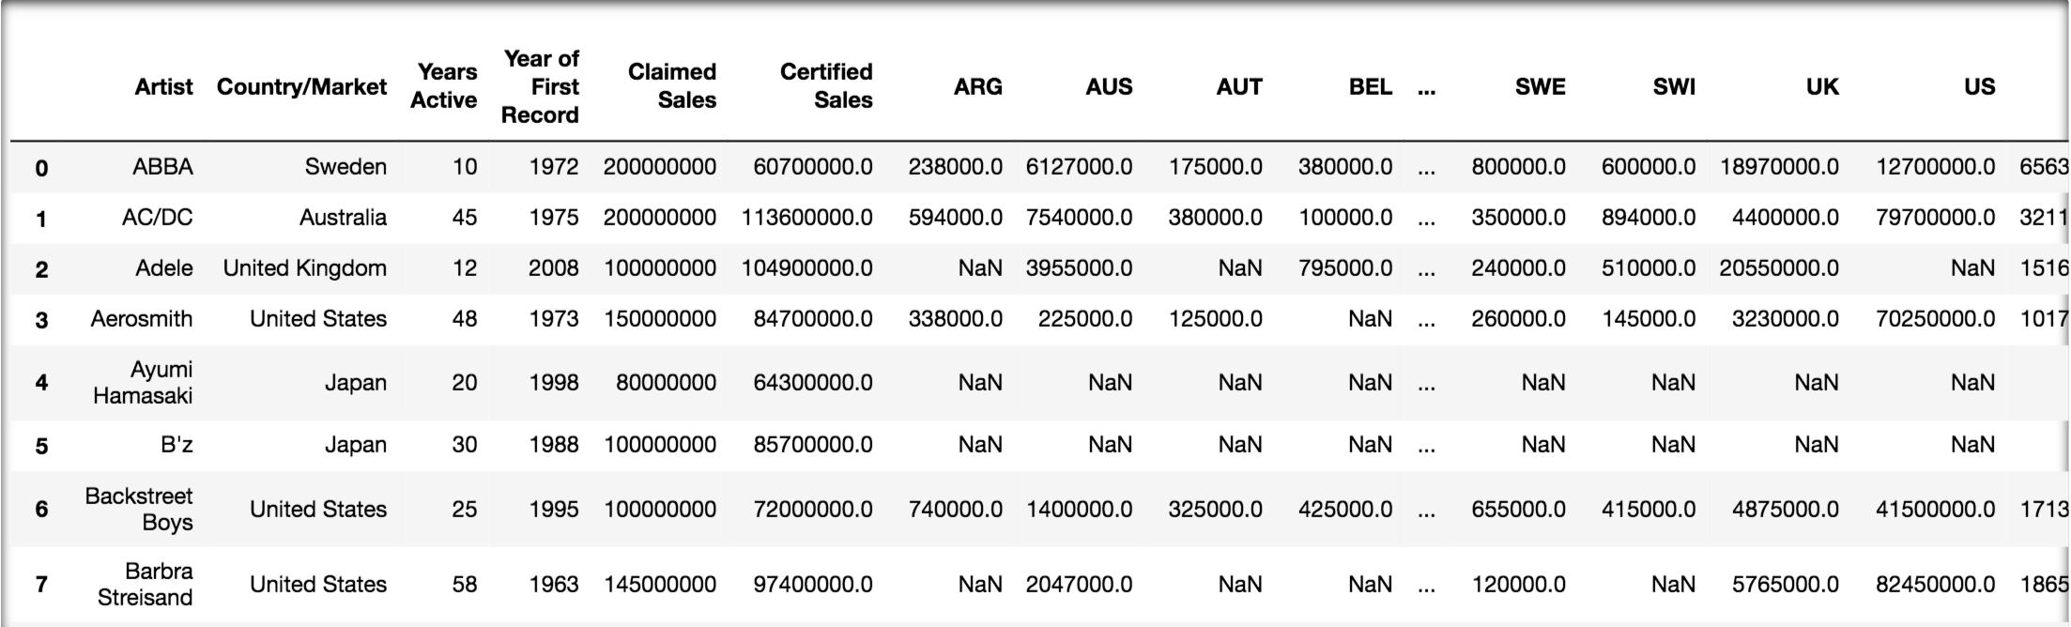
Formatting the Data
89 rows x 29 columns

Slide 7
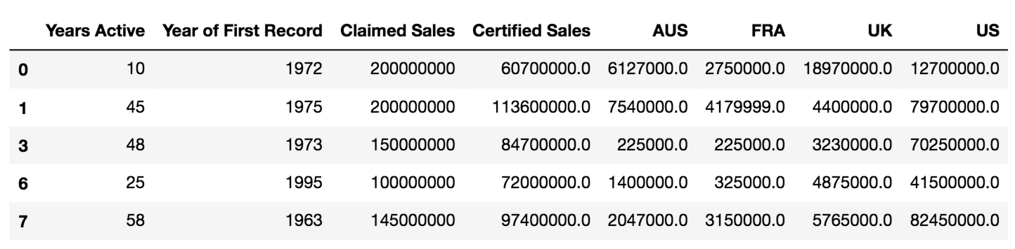
Formatting the Data
Cull the features
Drop NaNs
Only include data that:
Has more than 70 responses
Is numerical

Slide 8
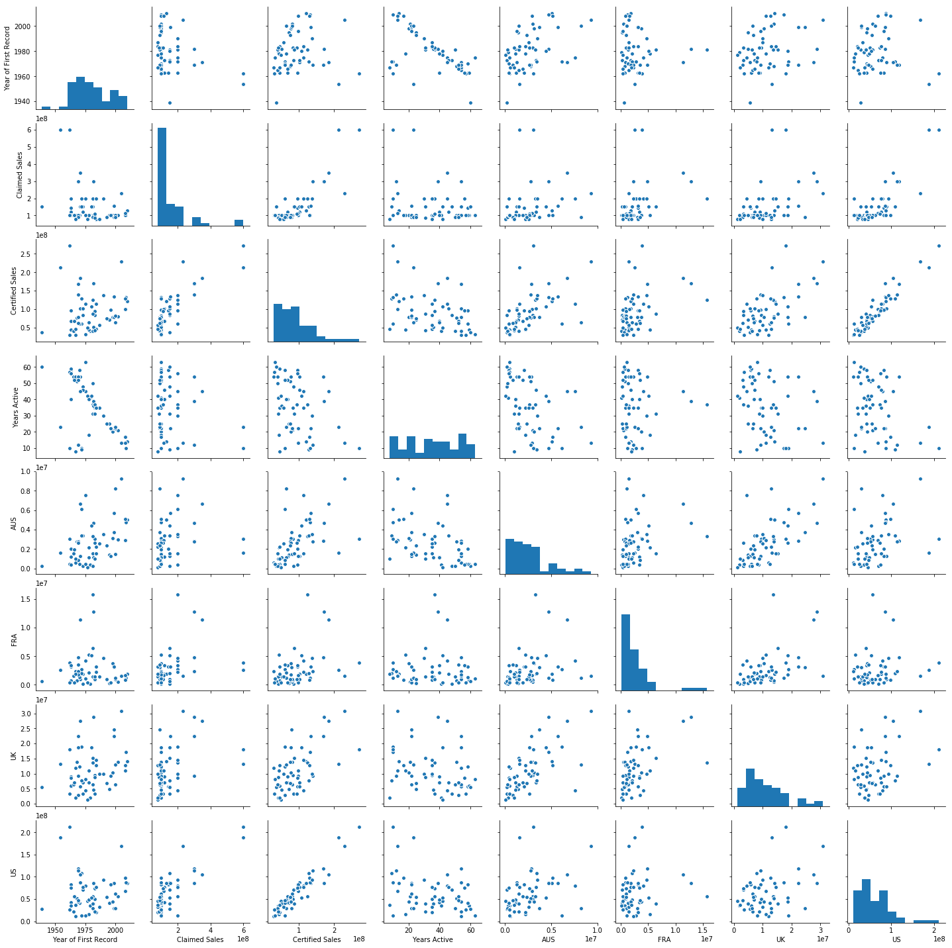
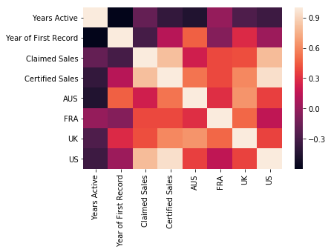
Finding Correlations

Slide 9
Fitting a Linear Regression
Model will use:
To Predict:
Year of First Album Release
Albums sold, according to Artist
US album sales
AUS album sales
Total
Album Sales
Removed Features
“FRA”
P-Value too low
“UK”
P-Value too low
“Years Active”
Colinear with “Start”

Slide 10
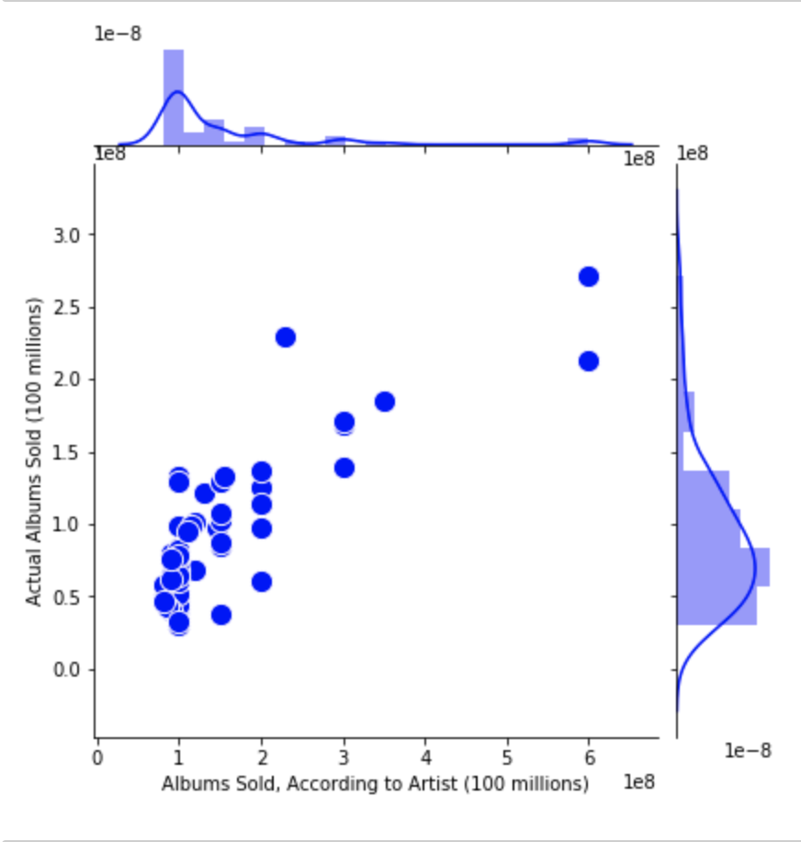
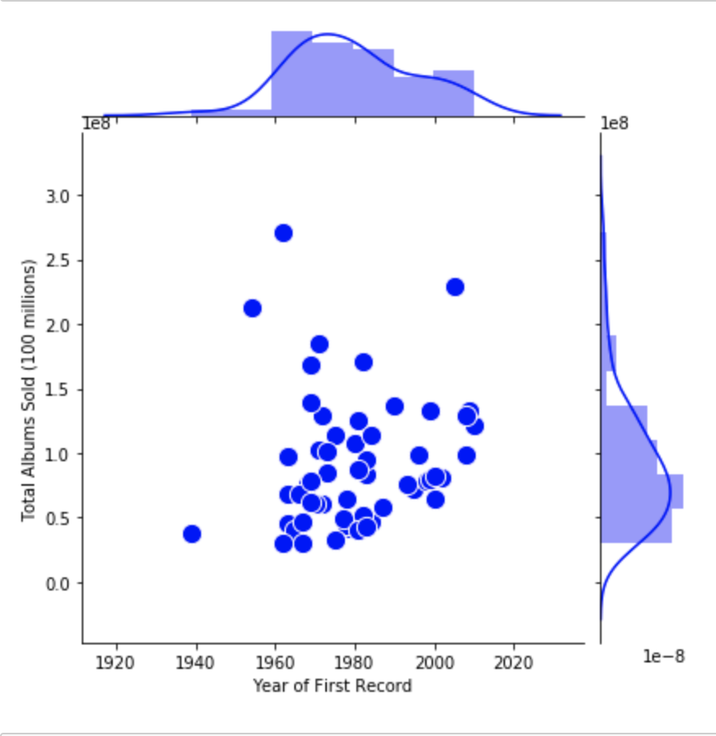
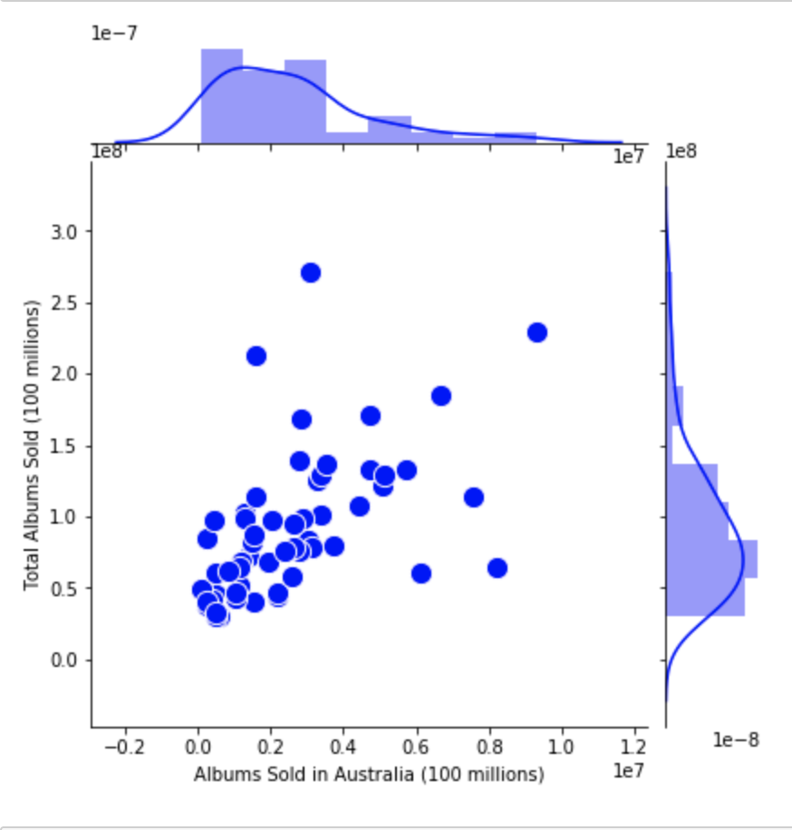
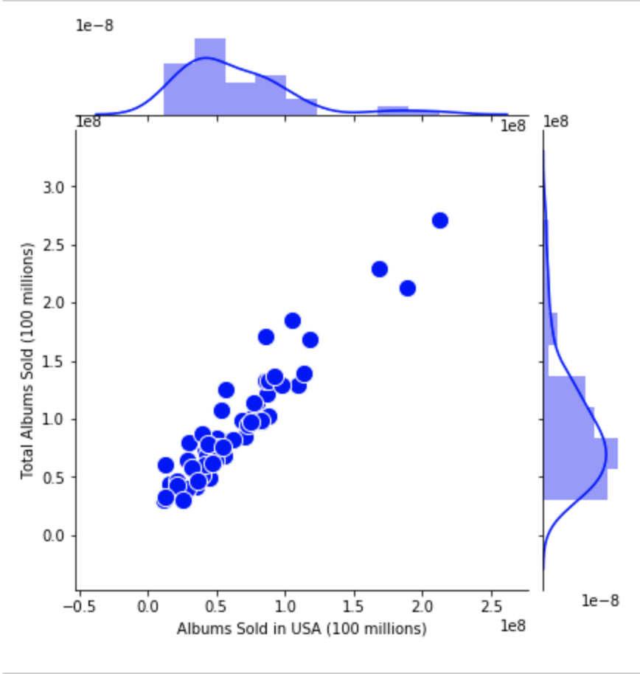
Optimizing the Linear Regression

Slide 11
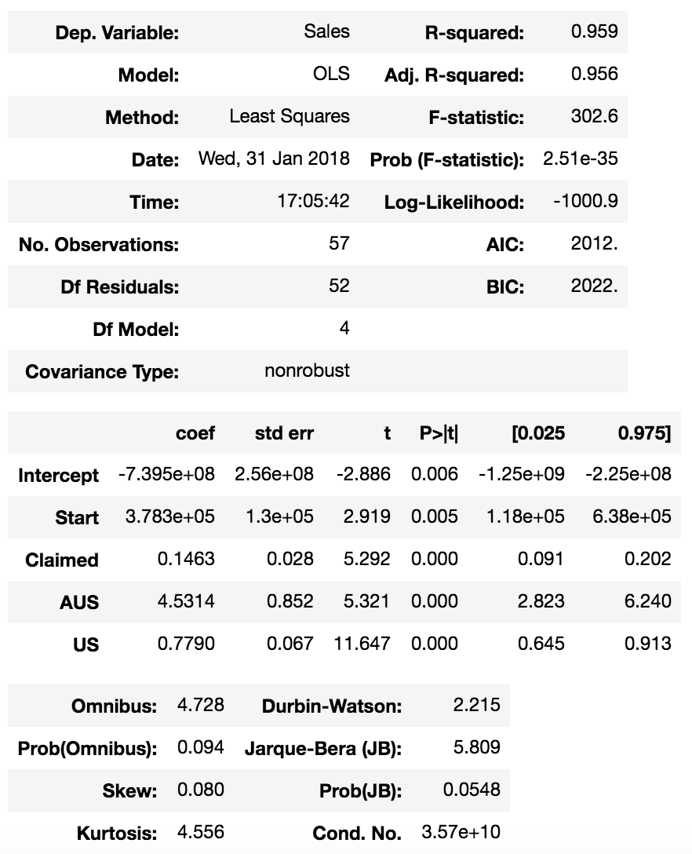
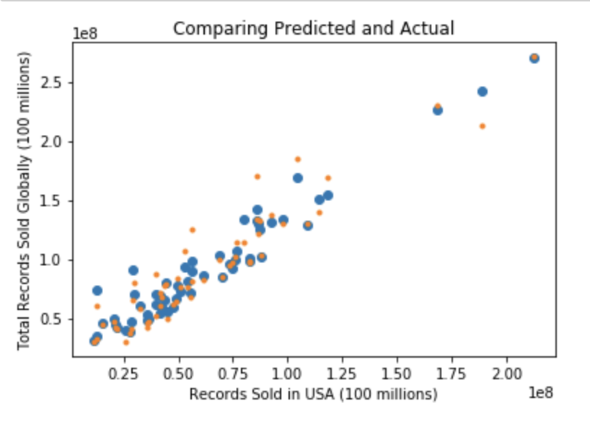
Result

Slide 12
Train/Test Split

Slide 13
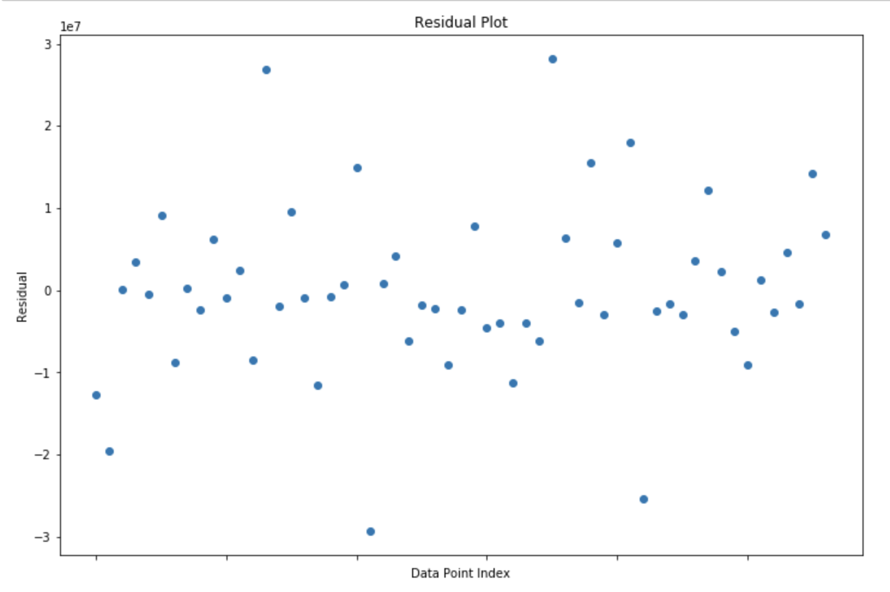
Residuals

Slide 14
Questions

