Slide 1
Predicting Success of Musicians: Total Album sales
Kaitlin Puryear

Slide 2
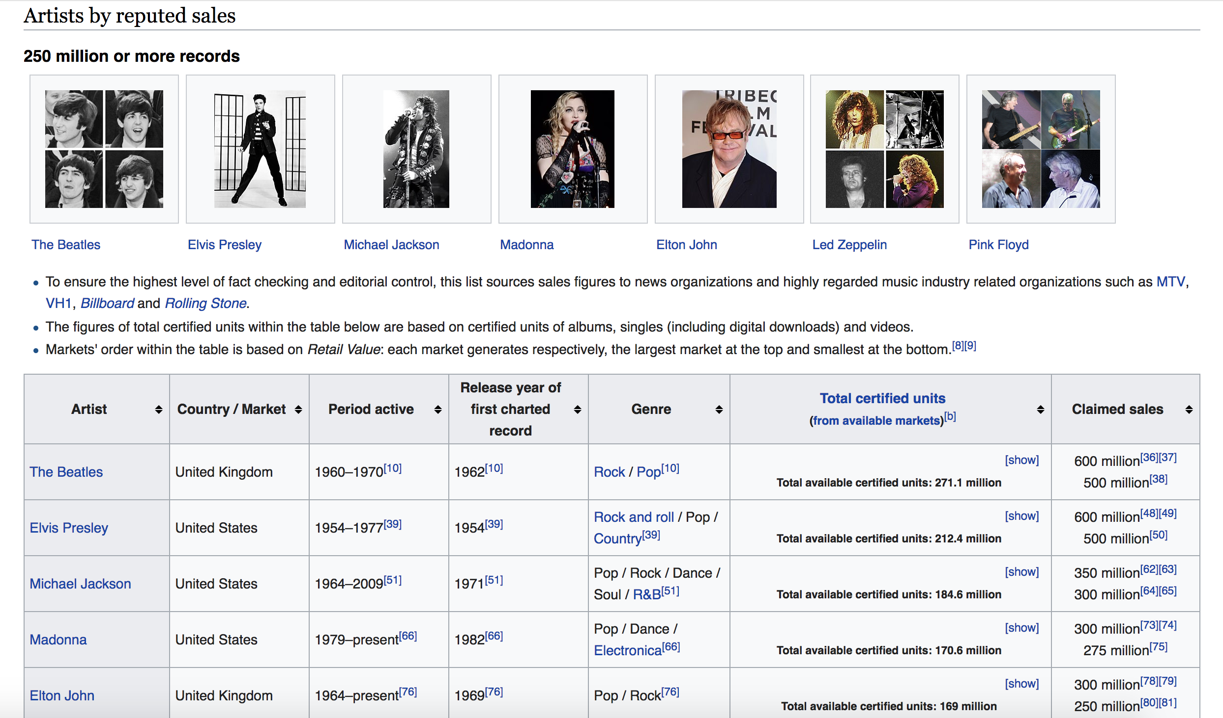
Where did the data come from? Scraping Wikipedia

Slide 3
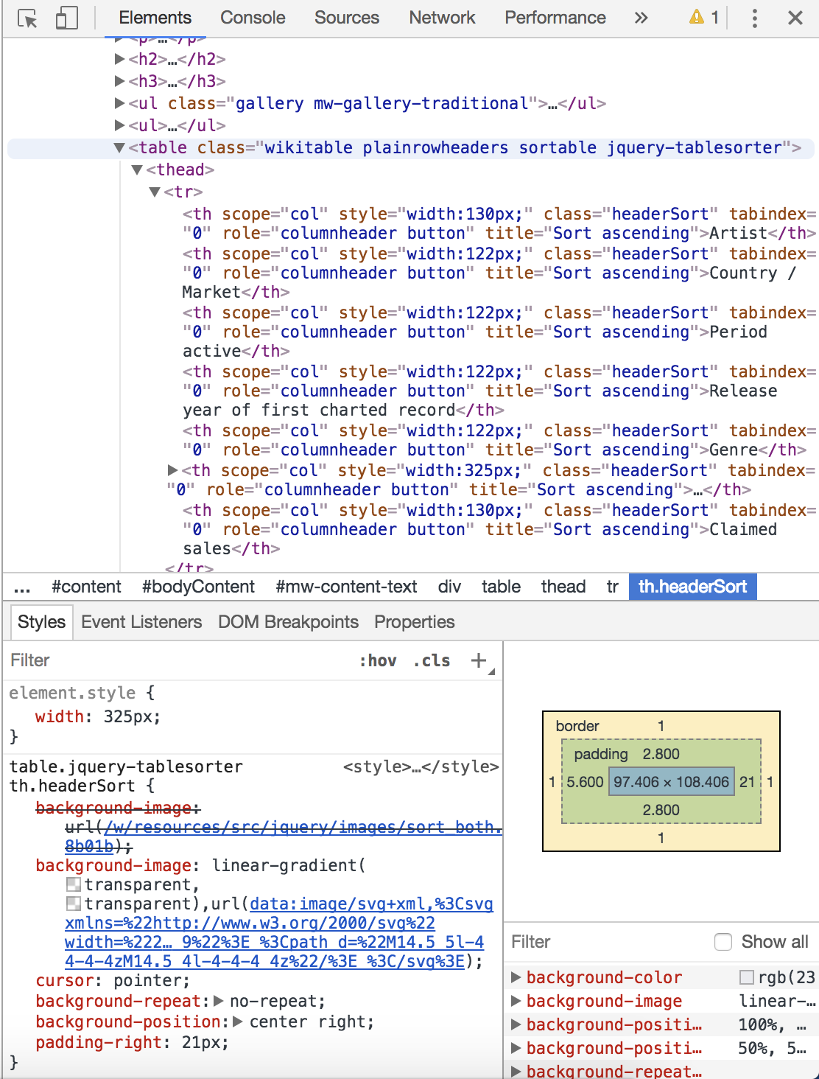
Where did the data come from? Scraping Wikipedia

Slide 4
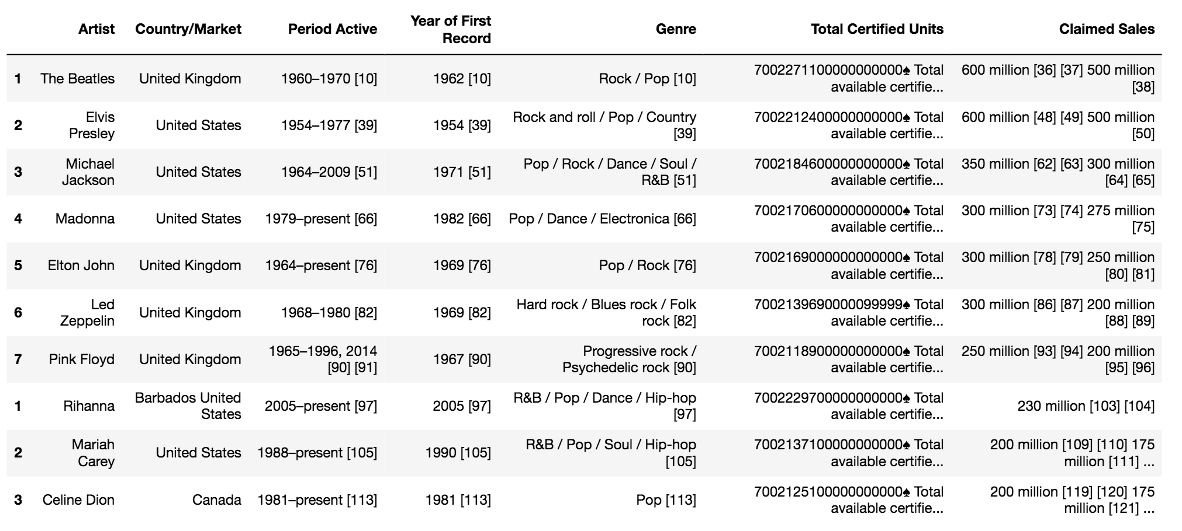
Formatting the Data
Concatenate 5 tables, clean off headers, and re-index
Set a Regex to get rid of the reference links
Write a function to switch “Period Active” to “Years Active”

Slide 5
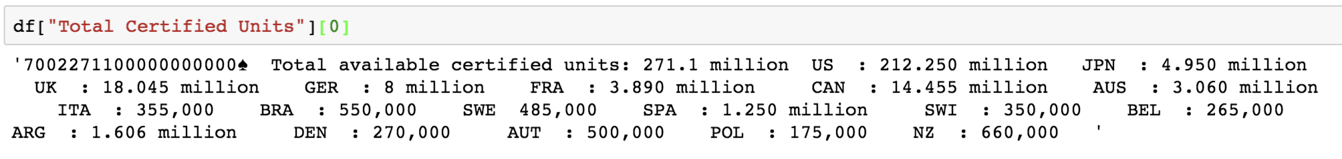
Formatting the Data
Unpack “Total Certified Units” column:
Write some Regex formulas and functions to create a “Total Certified Units” dictionary per band.

Slide 6
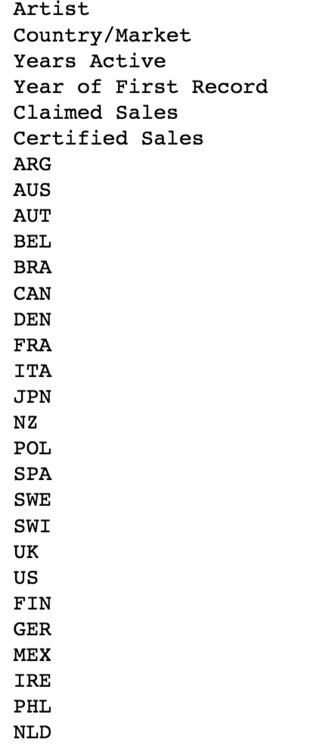
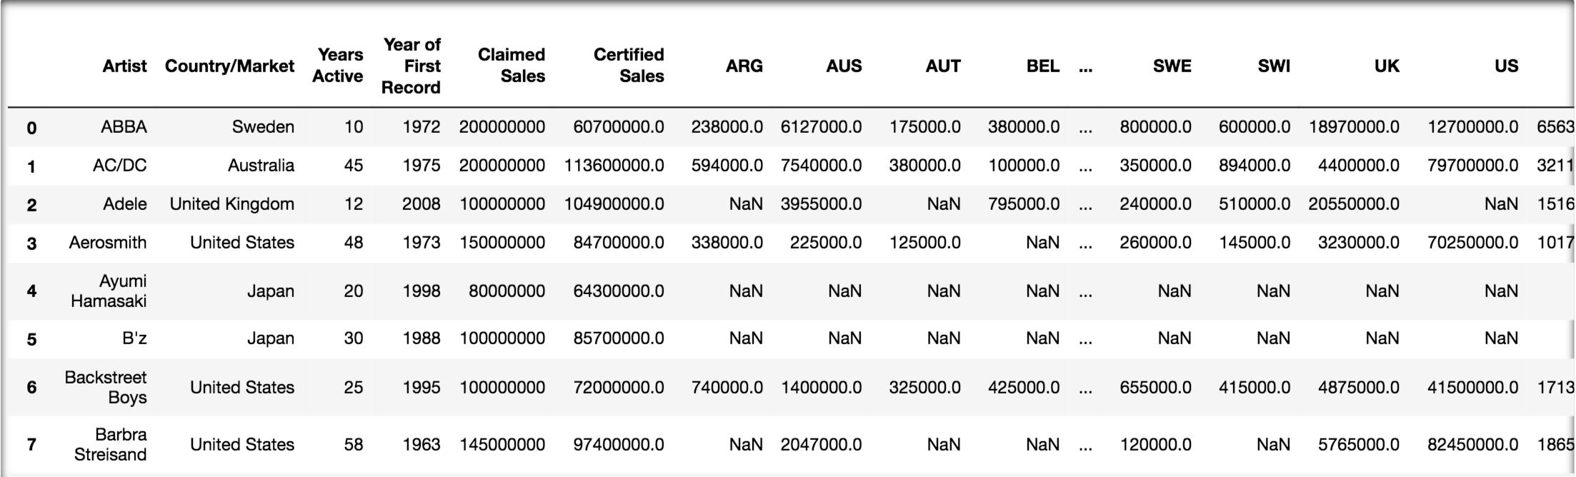
Formatting the Data
89 rows x 29 columns

Slide 7
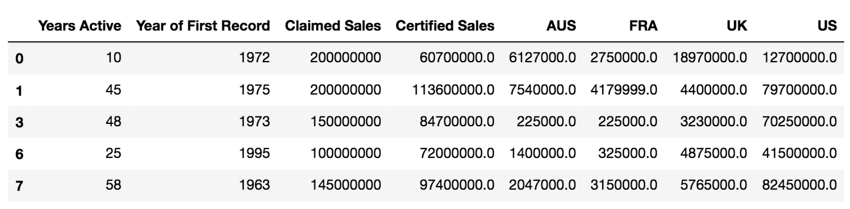
Formatting the Data
Cull the features
Drop NaNs
Only include data that:
Has more than 70 responses
Is numerical

Slide 8
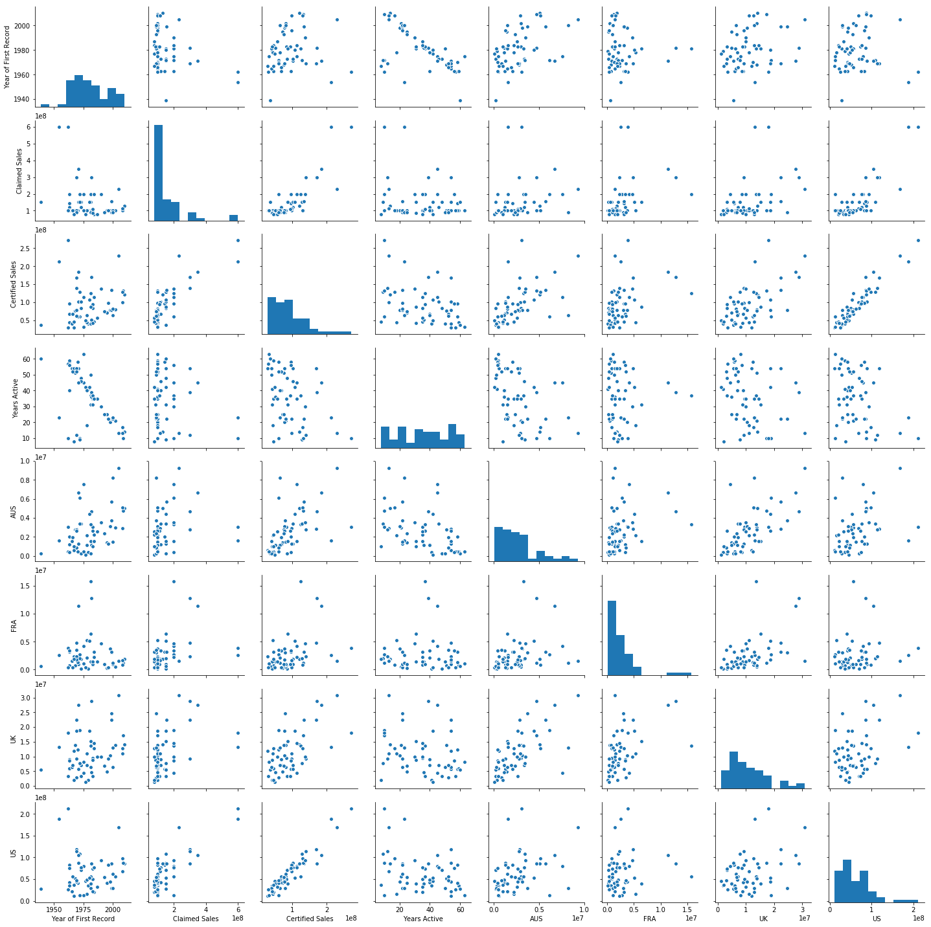
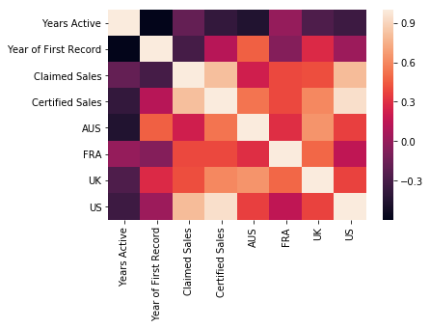
Finding Correlations

Slide 9
Fitting a Linear Regression
Model will use:
To Predict:
Year of First Album Release
Albums sold, according to Artist
US album sales
AUS album sales
Total
Album Sales
Removed Features
“FRA”
P-Value too low
“UK”
P-Value too low
“Years Active”
Co-linear with “Start”

Slide 10
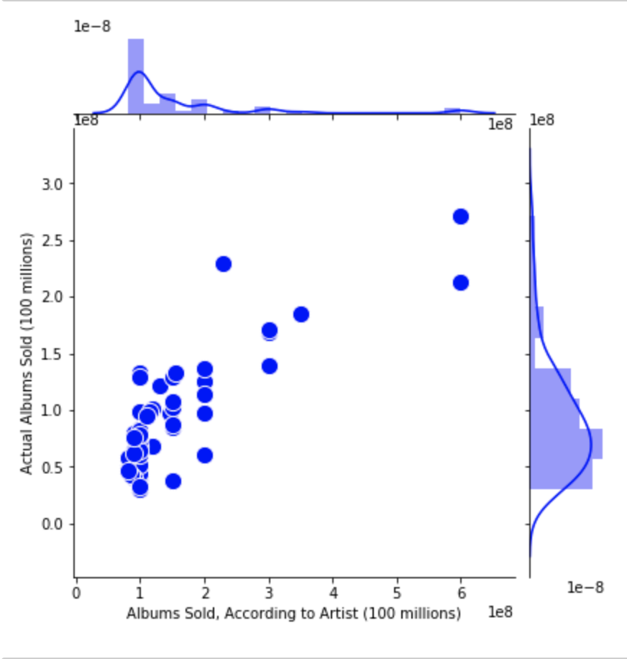
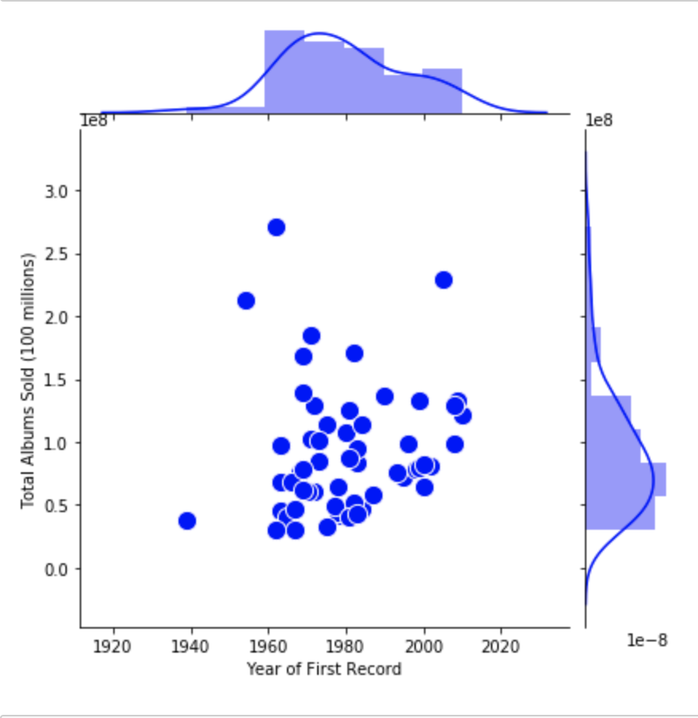
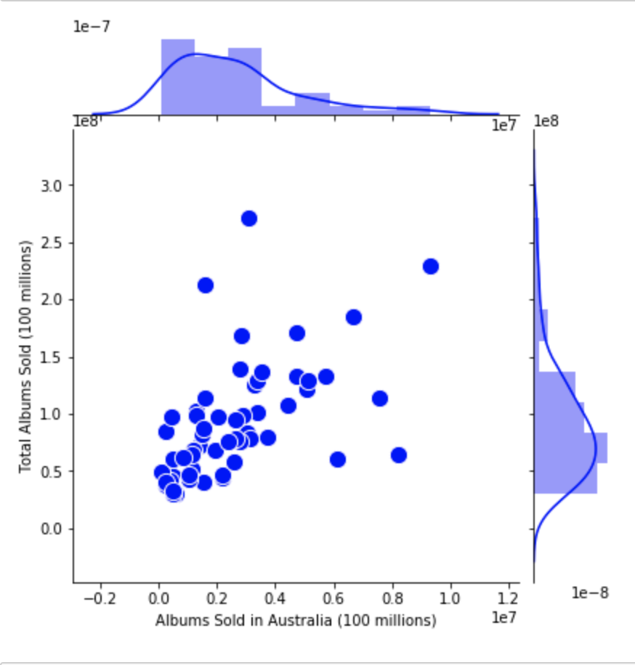
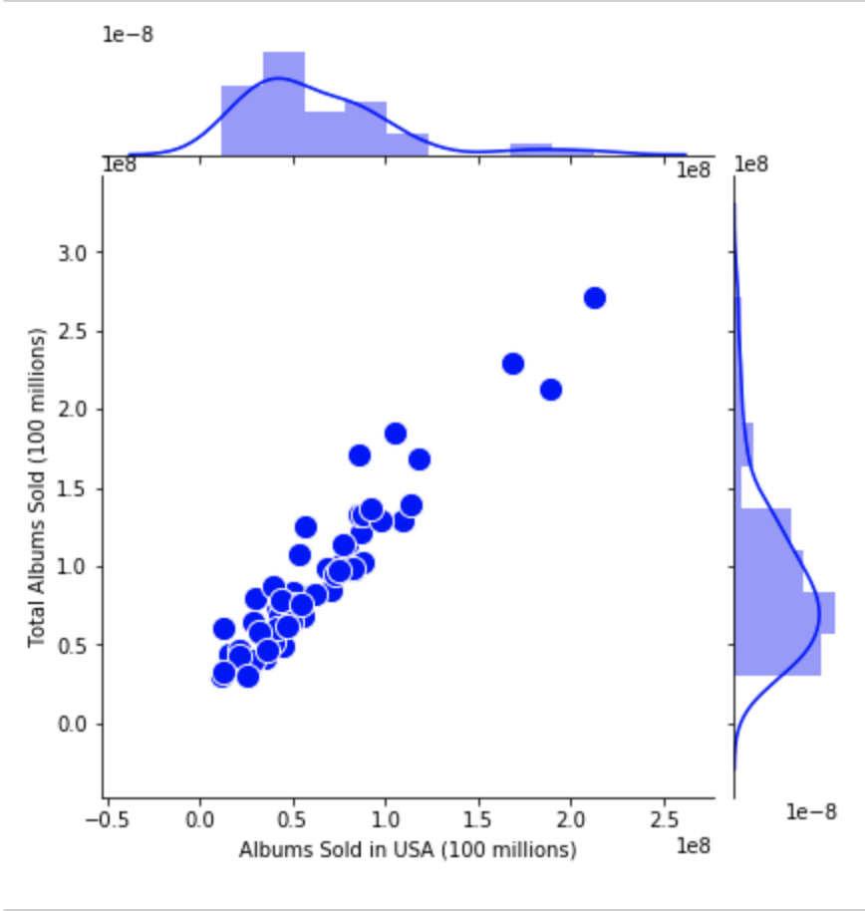
Optimizing the Linear Regression

Slide 11
statsmodels vs. sklearn
The R2 Values are identical.
The coefficients do not vary much.
We will make an approximation that both models are the same.
 | Statsmodels | Sklearn | % difference
Intercept | -7.39 e8 | -6.54 e8 | 12.25%
Year of First Record | 3.783 e5 | 3.348 e5 | 12.2%
Claimed Sales | 0.146 | 0.133 | 9.37%
Australia Sales | 4.531 | 6.229 | 31.56%
US Sales | 0.779 | 0.736 | 5.67%
R^2 | 0.95 | 0.95 | 0%

Slide 12
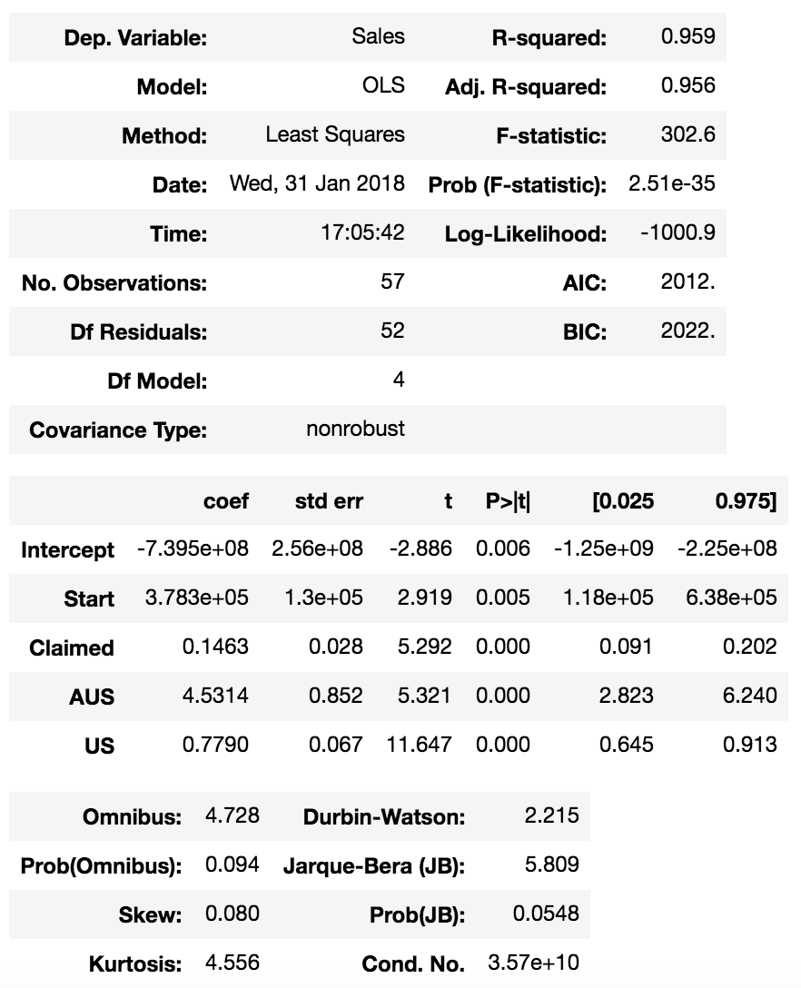
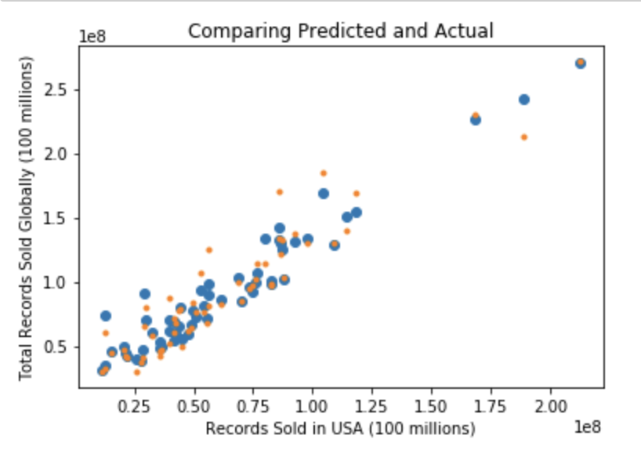
Results

Slide 13
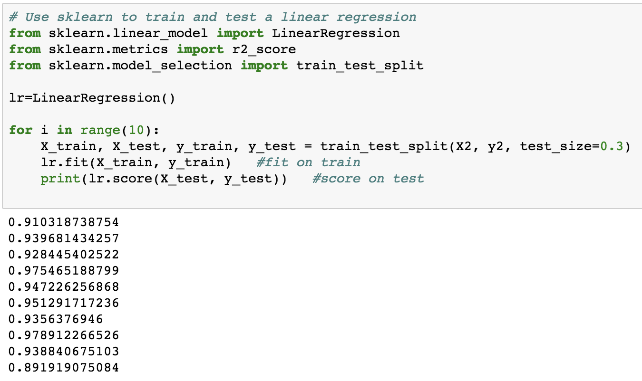
Train Test Split
Average:
0.9397738449749

Slide 14
Regularization
ElasticNet Regularization
alpha: 1 e9
R^2: 0.95205484861
MSE: 1.21871813475 e14
(RMSE: 1.104 e8)

Slide 15
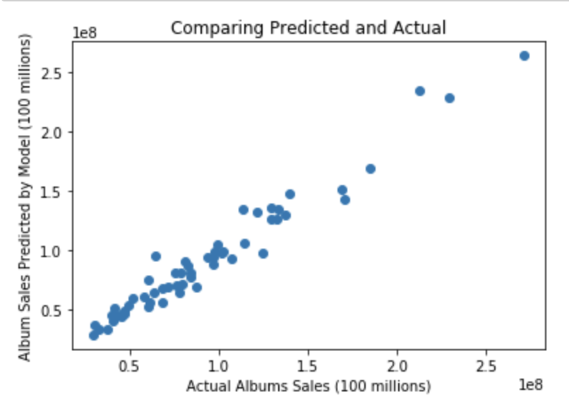
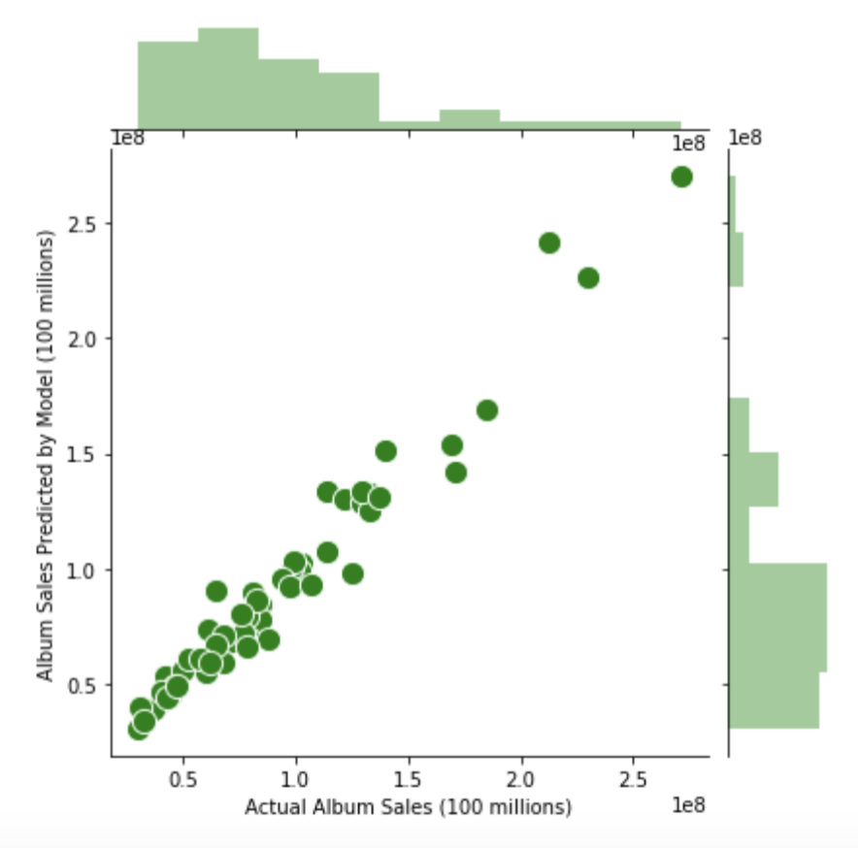
Sklearn Statsmodels

Slide 16
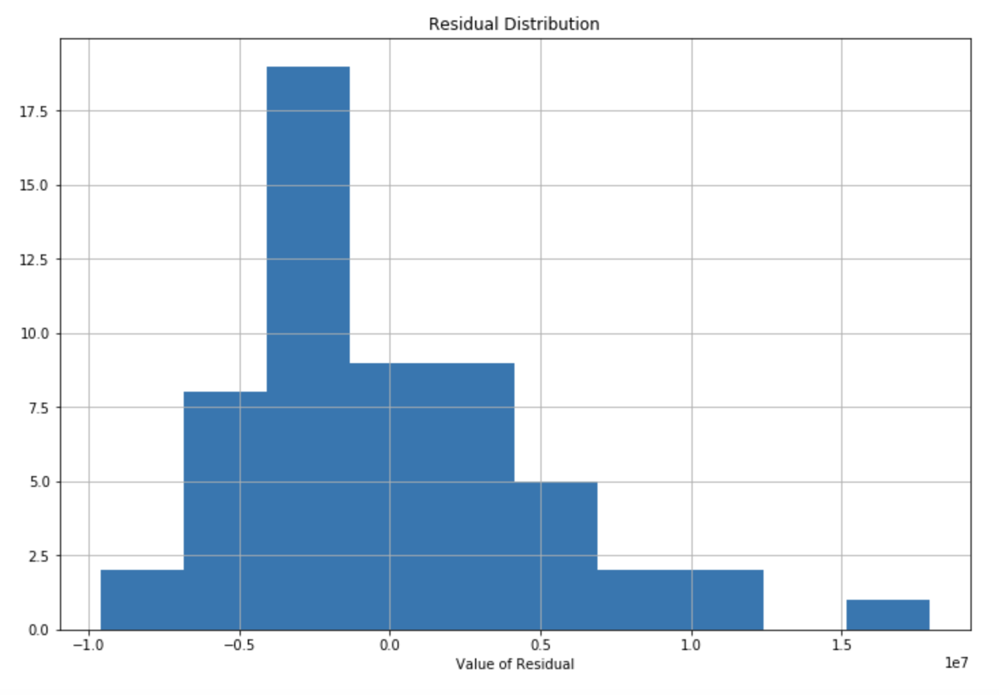
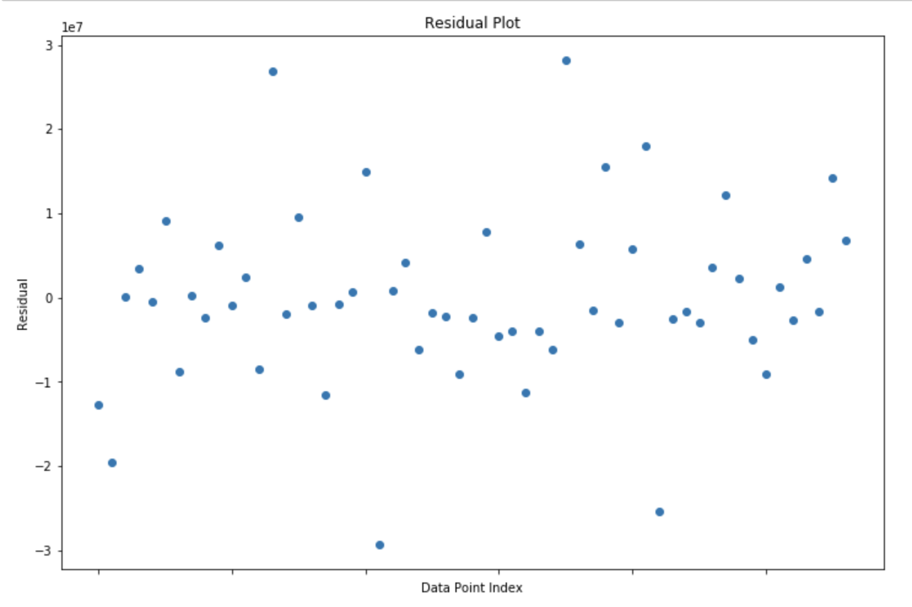
Residuals
0.25

Slide 17
Questions

