Slide 1
Predicting if someone will show up for their scheduled Doctors Appointment
Feature Name | Type | Description
Age | Int | Age of patient
Scholarship | Booelan | Is this visit covered by insurance?
Hypertension | Boolean | Visiting the doctor to treat Hypertension?
Diabetes | Boolean | Visiting the doctor to treat Diabetes?
Alcoholism | Boolean | Visiting the doctor to treat Alcoholism?
Handicap | Boolean | Visiting the doctor to treat a disability?
Text_Sent | Boolean | Did the patient receive a reminder text?
woman | Boolean | Is the patient female?
delta | Int | How many days in advance did they schedule the appointment?
2+problems | Boolean | Are they visiting the doctor for more than one medical problem?

Slide 2
This dataset is from Kaggle
It is a collection of patients in Brazil. Southern and inland Brazil!

Slide 3
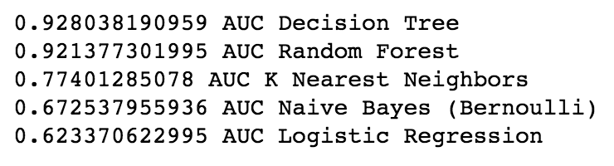
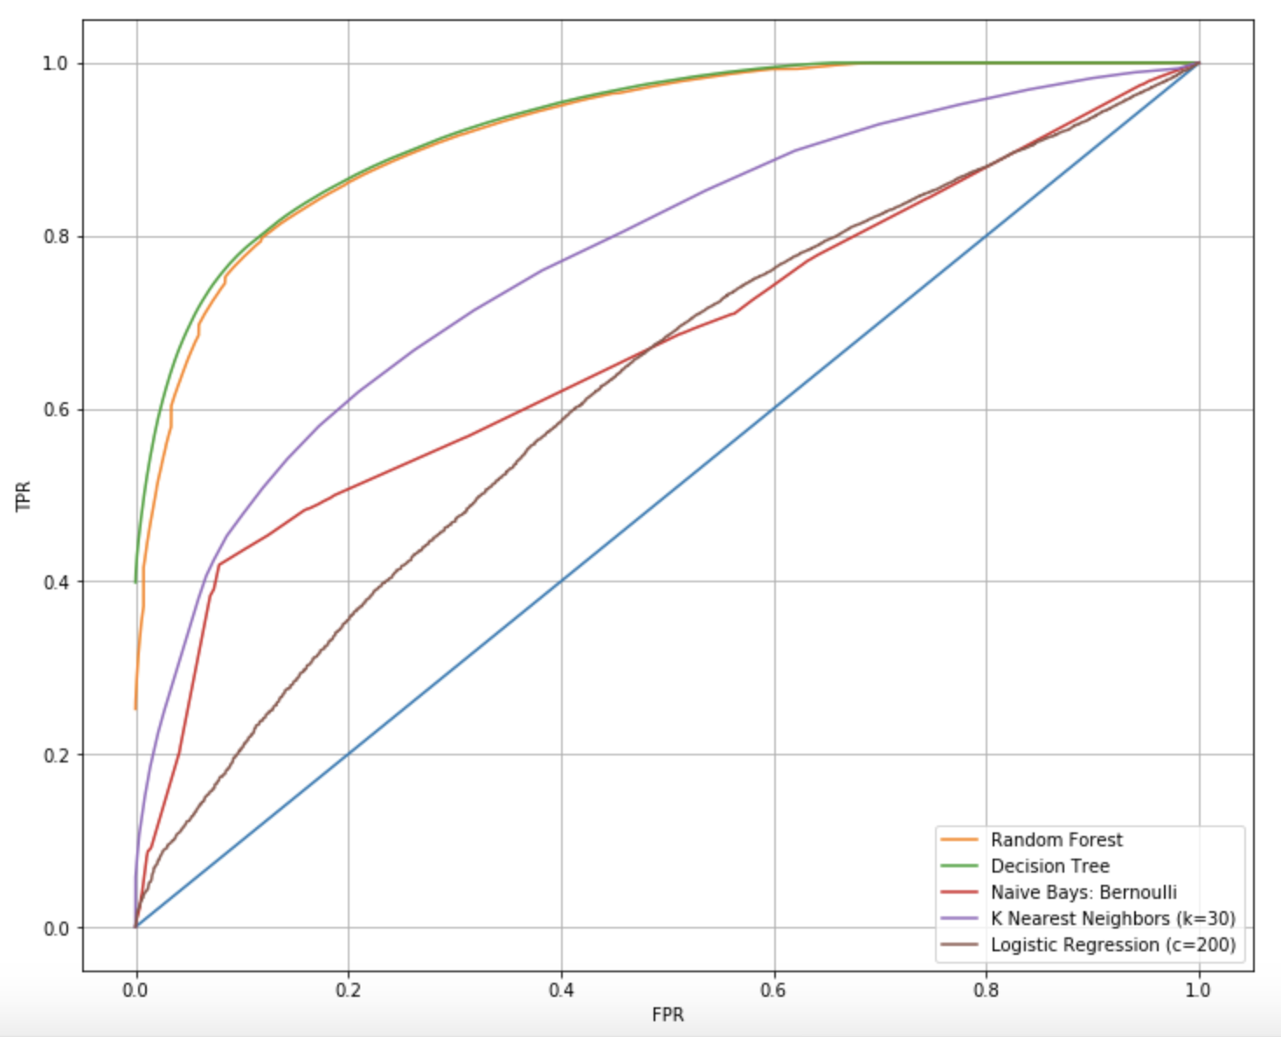
ROC CURVES
(And AUC!)

Slide 4
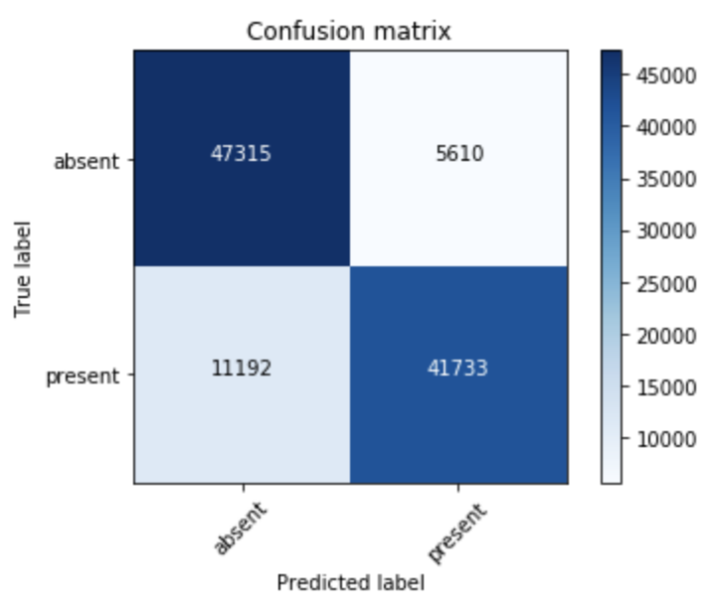
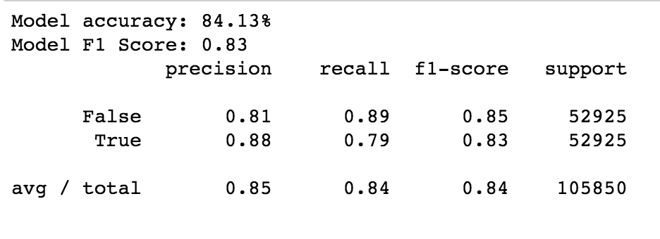
Best Model
Decision Tree!
Accuracy: 84.13%
F1 Score: 0.83

Slide 5
Doctor doesn’t expect patient,
Patient doesn’t show up.
No problem.
Doctor expects patient,
Patient doesn’t show up.
This wastes the doctors’ time. But doesn’t damage the overall schedule or anything
44%
7%
Doctor expects patient,
Patient arrives!
This is normal and good
Doctor doesn’t expect patient,
But patient arrives! (oh no!)
This is a big problem because now the whole schedule is thrown off and the patients who come in later in the day will have to wait for the doctor a long time.
10%
39%

