Slide 1
Detecting Variable Stars
Kaitlin Puryear

Slide 2

Stellar Physics 101
Stars form when huge amounts of dust and gas collapse in on themselves
“Gravitational static”
Stars can be many sizes and temperatures
Pressure is greatest inside the star
Fusion takes place in the core, works its way out
1st level H-fusion:
2$H^{1}$ → $H^{2}$
$H^{2}+ H^{1}$ →${ He}^{3}$
Produces light and heat

Slide 3
What is a Variable Star?
Star with inconsistent thermonuclear properties:
Varies temperature
Varies in radius
Star that pulsates in brightness
(not the same as pulsars)
Follows a predictable period oscillation
Notes:
Inward pressure is really high. Rate of fusion goes up → star expands with the outward pressure
Star is too large to maintain that fusion rate → fusion rate cannot keep up, fusion rate goes down
Outward pressure decreases, star gets smaller.

Slide 4
Thesis Question:
Can I detect Variable Stars using just a regular DSLR camera and open source software?

Slide 5
Data Collection
Nikon D5200 on the roof of the Science Bldg at Whitman College
Set to take a photo every 10 minutes
Been collecting data for 3 years

Slide 6
Data Munging
Disregard ~90% of the data:
Daytime
Cloudy night
Frost
Snow
Partial clouds
Disregard another 40% of the data
All the images must be of the same region of the sky
Lovely sunset photos, though!

Slide 7
VaST takes in all the raw images and compiles them
Attempts to find the same stars in at least 80 of the photos
Scrutinizes each star to determine how much their flux varies
VaST
Variability
Search
Toolkit
Flux – Calculation of energy per unit area, generally written as (Joules/Area)
Best way to measure output from stars

Slide 8
VaST
Variability
Search
Toolkit
VaST generates a sigma-magnitude plot
Helps us narrow in on ~20 stars
http://scan.sai.msu.ru/vast/

Slide 9
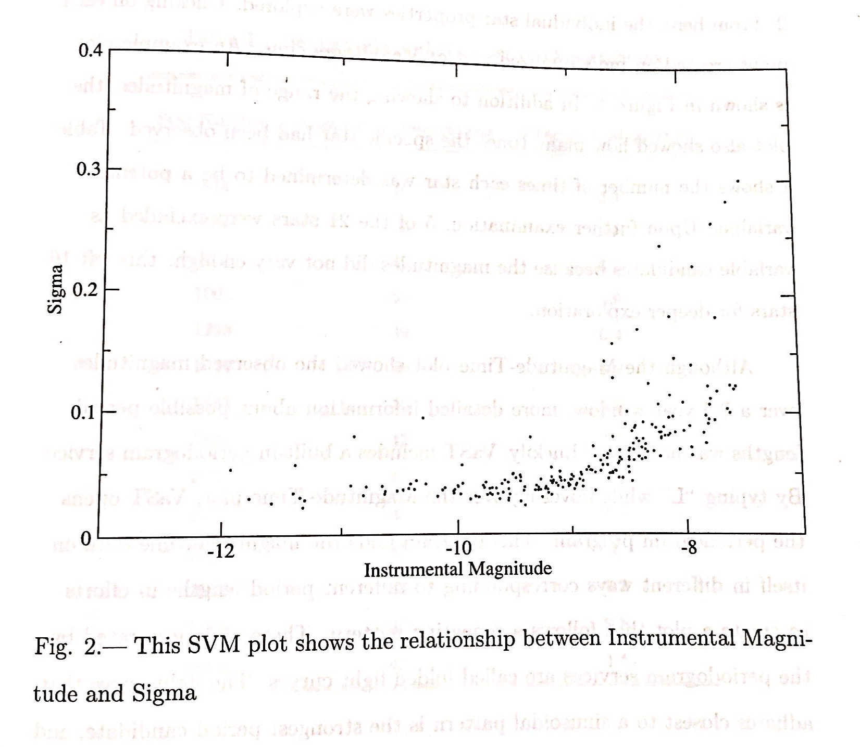
Sigma v. Magnitude Plot
Words words

Slide 10
VaST
Variability
Search
Toolkit
For each of the candidate stars:
Periodogram (i.e. Folded light curve)
http://scan.sai.msu.ru/vast/

Slide 11
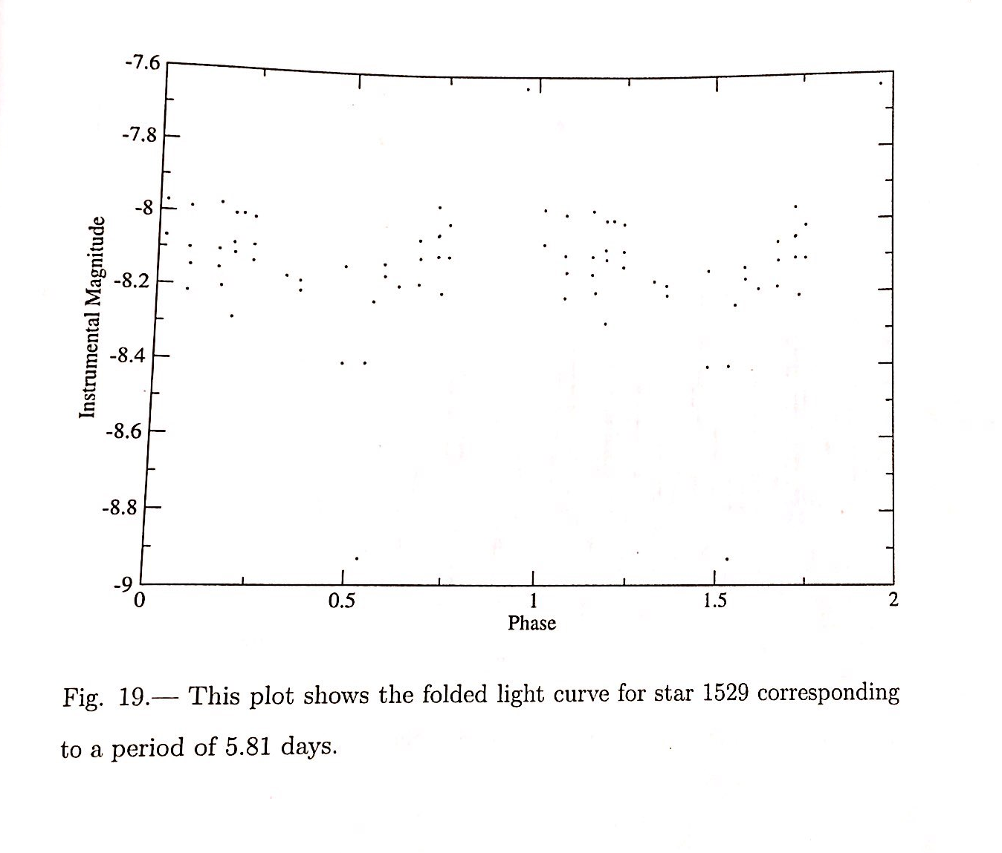
Folded Light
Curve

Slide 12
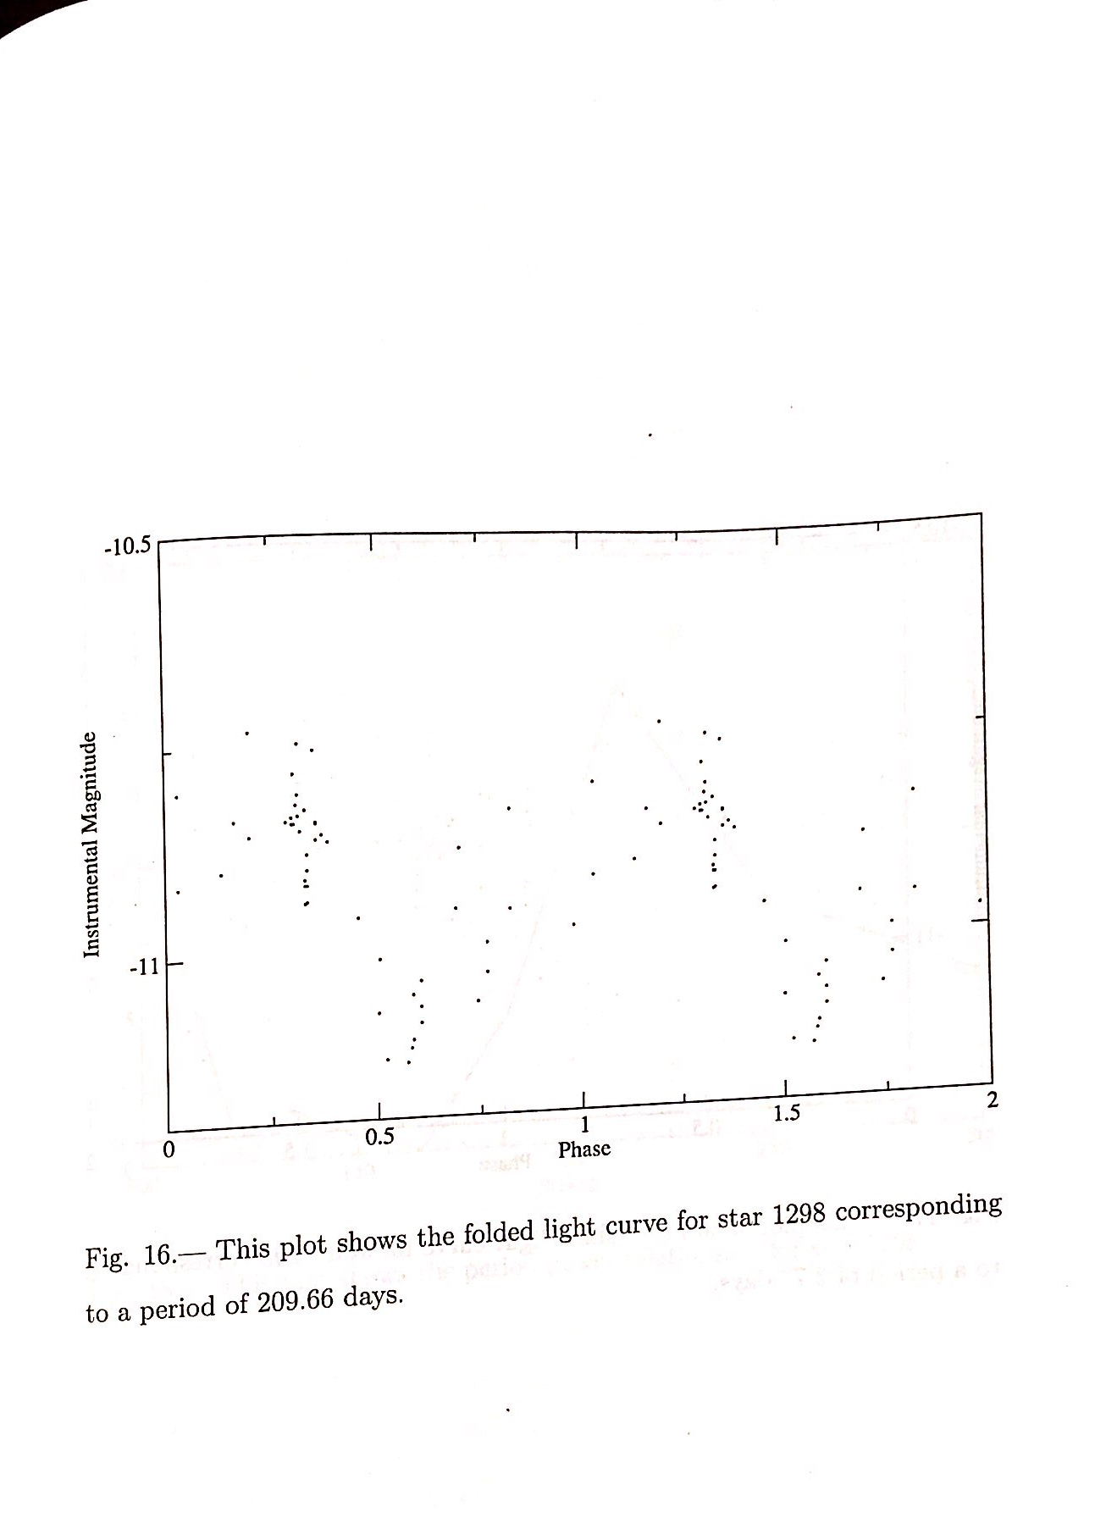
Folded Light
Curve

Slide 13
VaST
Variability
Search
Toolkit
For each of the candidate stars:
Period v. Power plot
http://scan.sai.msu.ru/vast/

Slide 14
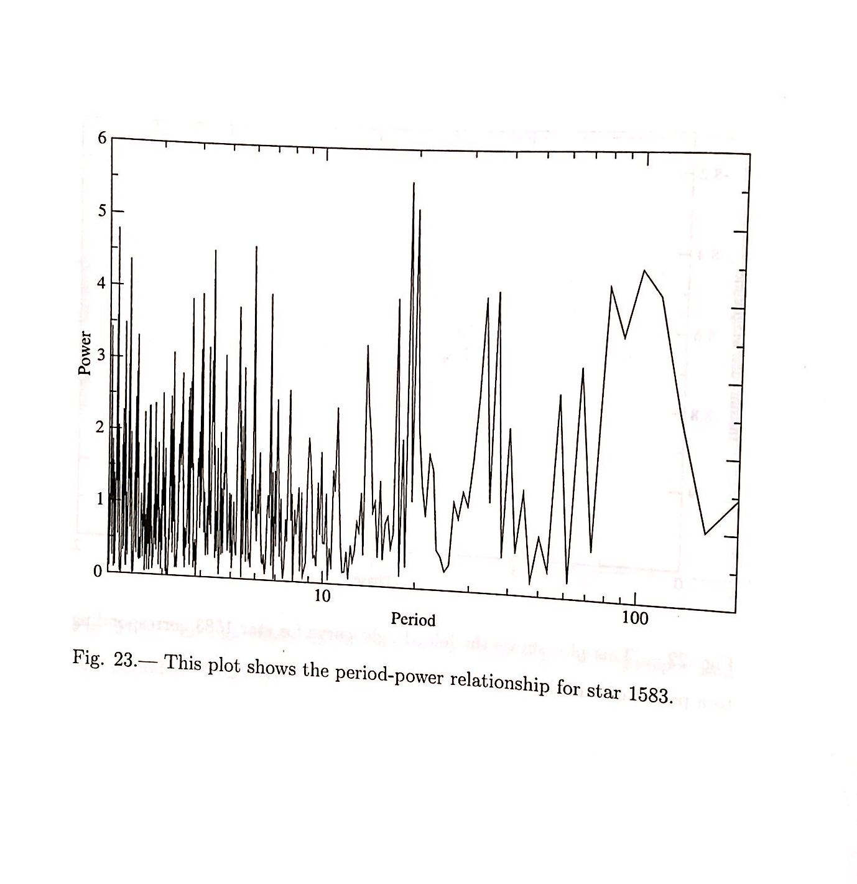
Folded Light
Curve

Slide 15
Results
I used several other open source programs to cross check my findings
Investigated 16 variable stars in total
Confirmed 6 of them to be variable stars!
(3 previously unknown!)

Slide 16
Questions?
Thoughts?
Concerns?
Astronomy is cool!

