Slide 1
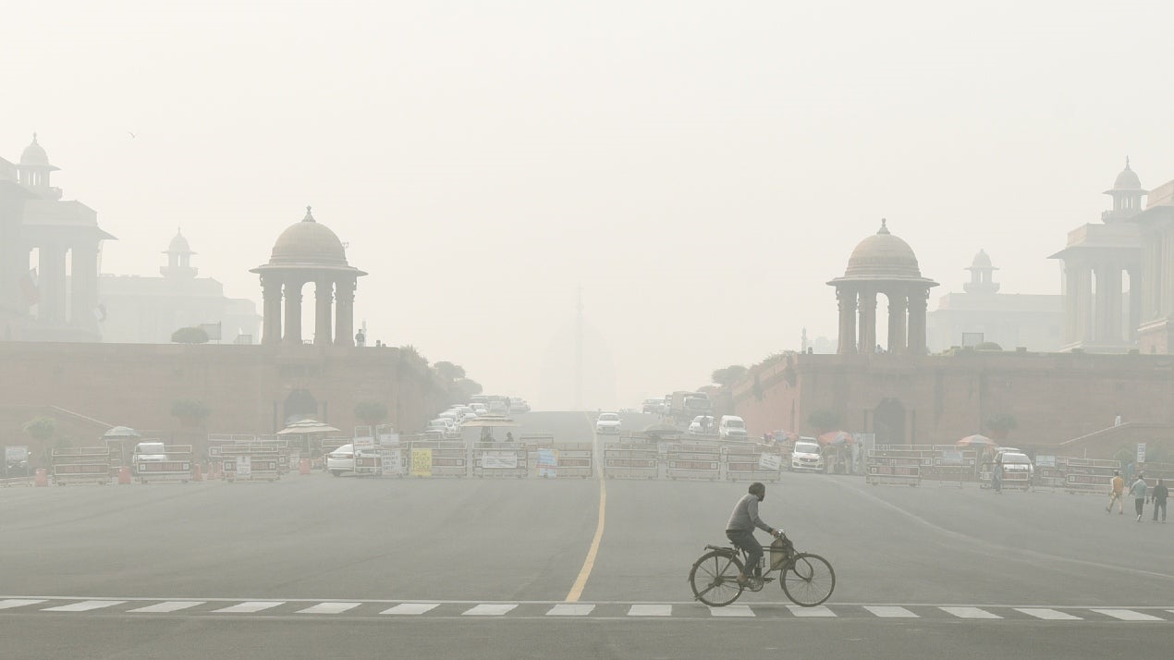
Name – Pushpender Kumar
Roll No. – 234161020

Slide 2
Motivation: Understanding Air Quality through Visualization
Importance of Air Quality:
Environmental Impact: Urbanization and industrial activities contribute to air pollution.
Public Health: Poor air quality directly affects respiratory health and well-being.
Need for Understanding:
Monitoring air quality is crucial for environmental conservation and public health.
Raw data often inaccessible to the general public.
Visualization transforms complex data into accessible insights.
Uncover patterns and trends in air quality data.

Slide 3
Block diagram
Pollutants Data
Clean
AQI
Pollutants Analysis
Seasonal
Monthly
Yearly
Seasonal
Yearly

Slide 4
Some Pythonic features:
Function Application:
df['AQI'] = df.apply(calculate_aqi, axis=1)
df['AQI_Category'] = df['AQI'].apply(get_AQI_Category)
Pandas Grouping and Resampling:
monthly_data = yearly_data.groupby(yearly_data.index.month).mean()
monthly_mean = df.resample('M').mean()
Matplotlib Plotting:
plt.plot(monthly_data.index, monthly_data['pm2.5'], marker='o', linestyle='-')
plt.pie(values, labels=None, autopct='%1.1f%%', startangle=140)

Slide 5
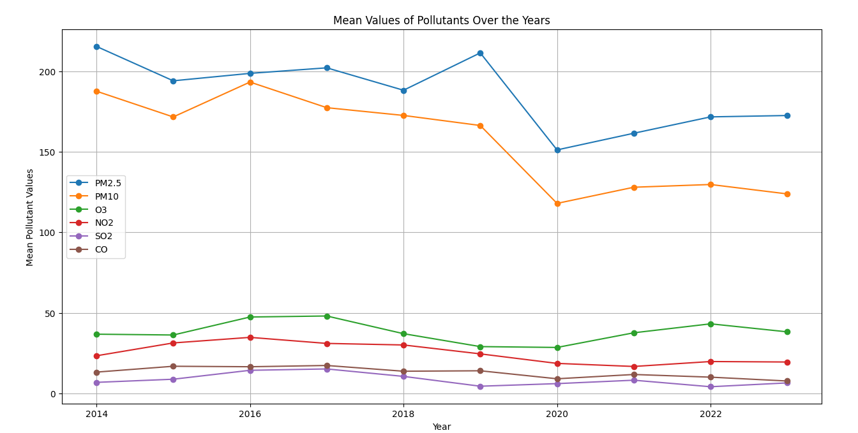

Slide 6
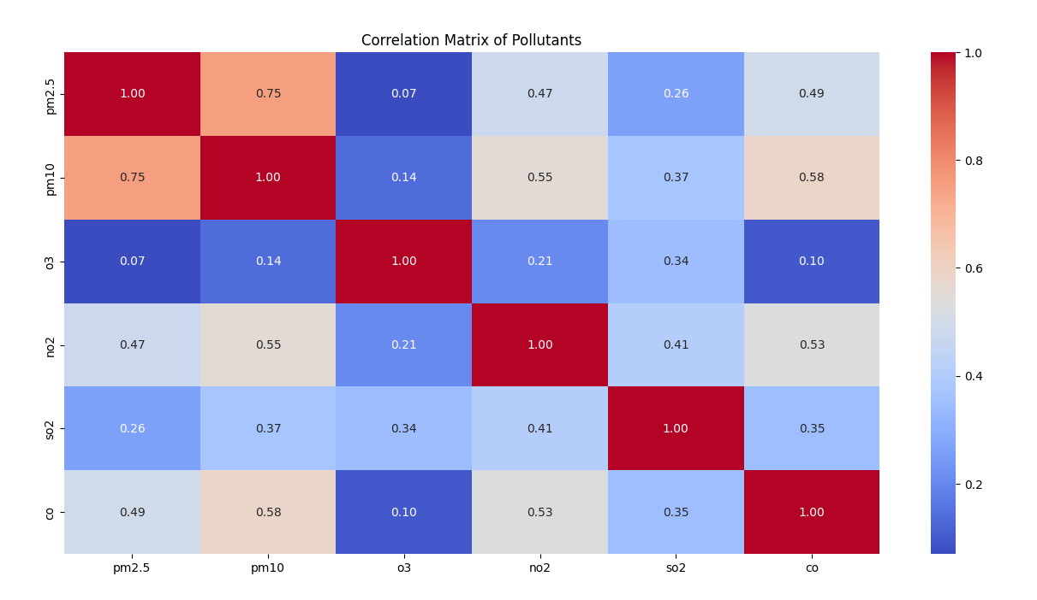

Slide 7
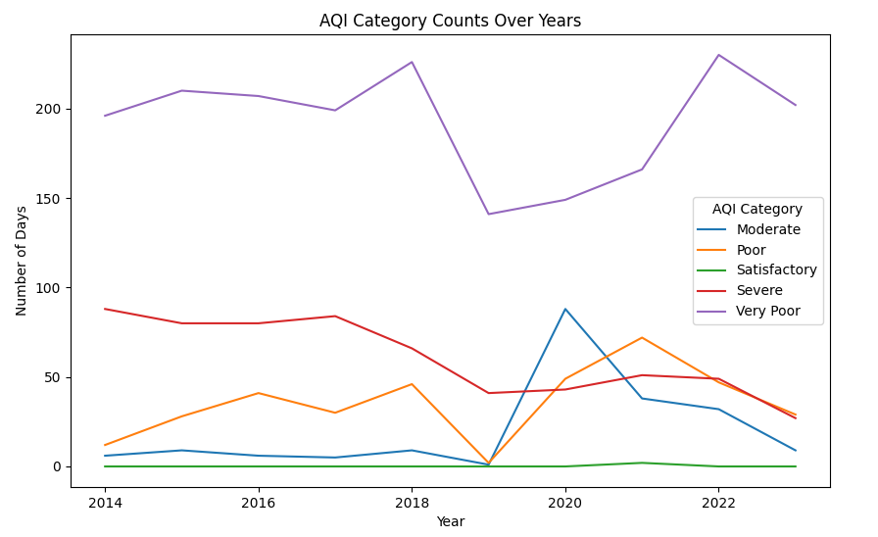

Slide 8
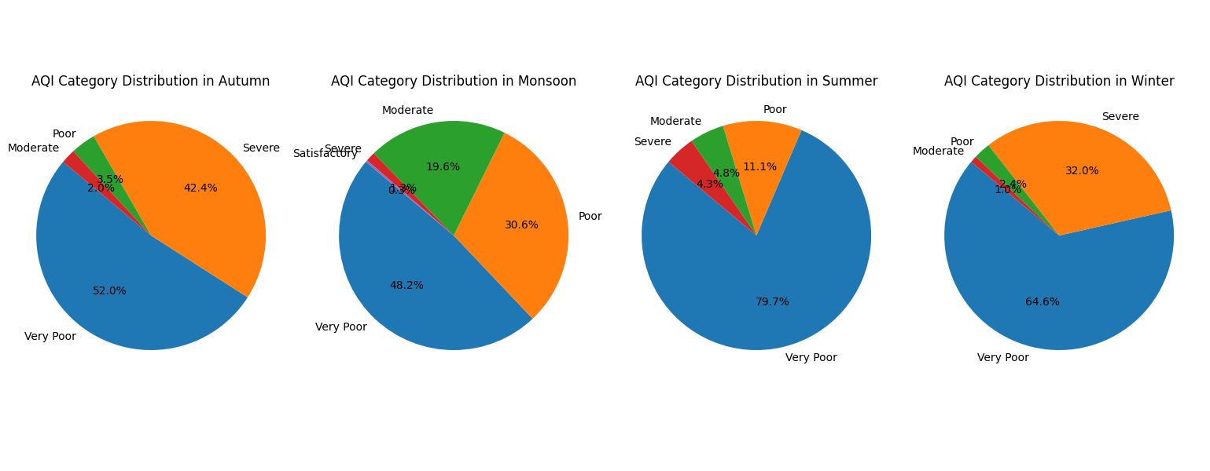

Slide 9
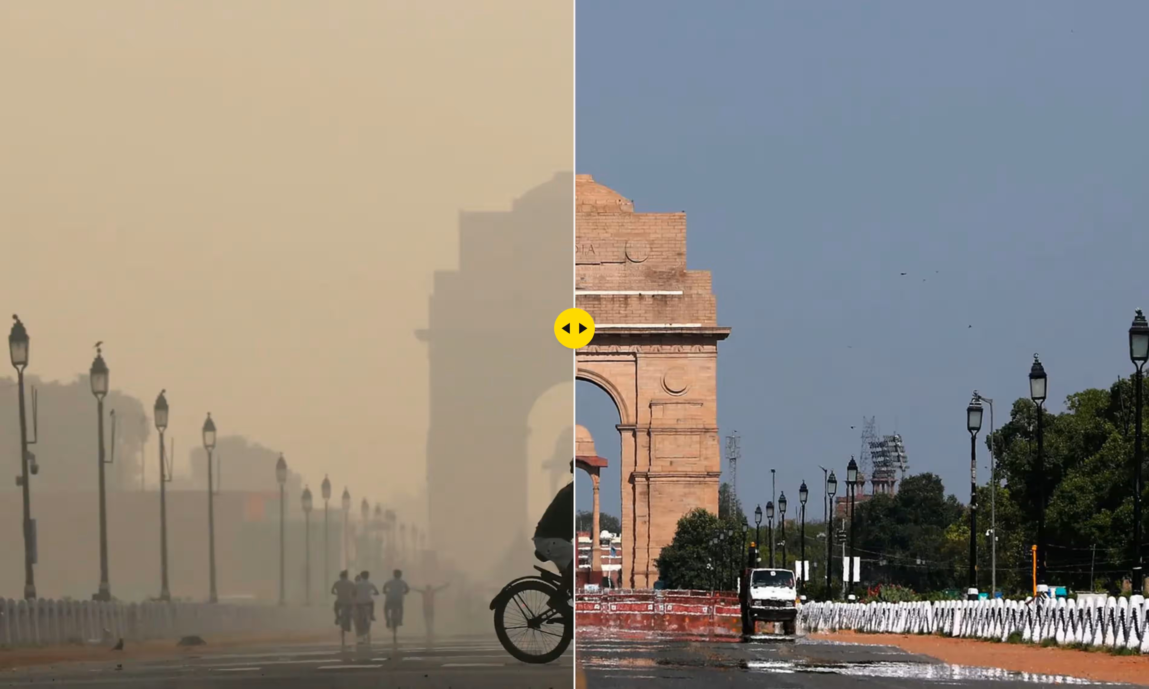
Thank You

