Slide 1
%de_overlap HOWTO
Roy Pardee
VIG Mid-Year Meeting 2017
Boston MA

Slide 2
What is it?
A utility macro that:
Collapses any overlapping periods in your enrollment data.
Reconciles any conflicting information on said overlaps.
Collapses any contiguous periods of enrollment.
Removes any duplicated records.
Credit: Mike Rhoads SUGI 29 paper Starts and Stops: Processing Episode Data With Beginning and Ending Dates
Notes:
If there were four horsemen of the enrollment datapocalypse, these would be them.
That paper can be had at http://www2.sas.com/proceedings/sugi29/260-29.pdf

Slide 3
Useful For
Cleaning your enrollment data.
Combining enrollment information coming from disparate sources.
Insureds + Patients
Coverages + Benefits
Passing QA checks!
Notes:
In the last round of QA, overlapping periods was part of a 3-way tie for most-failed check.

Slide 4
Why The Fuss?
Raise visibility.
Very simple / straightforward to use if you’ve only ever got the stock VDW variables in enrollment.
But if you’ve got off-spec vars you want to keep, you’ve got to do some significant editing.
So it’s distributed as downloadable/editable code.
Notes:
Pinpoint URL to the code: https://www.hcsrn.org/share/page/site/VDW/document-details?nodeRef=workspace://SpacesStore/148acf2a-b6ac-4009-b306-8ed20182868a

Slide 5
Quick Basic Demo
The easy cases:
Single file with overlaps.
Two files w/some shared people (and overlaps).
Multiple files with duplicates.
All with only stock enroll variables.
Notes:
Cut to C:\Users\pardre1\Documents\vdw\Enrollment\supporting_files\demo_de_overlap.sas

Slide 6
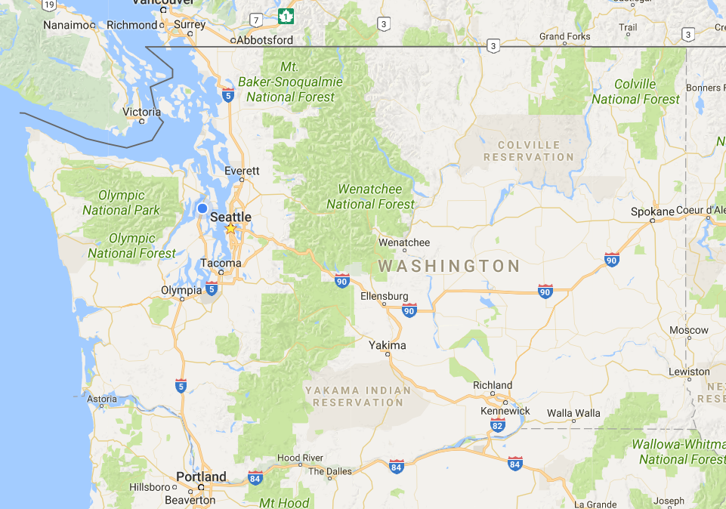
The Cascade Mountains
cascade_side
E = East
W = West
U = Unknown
Notes:
Geographically, these mountains cut the state lengthwise in 1/3rd 2/3rds chunks.
Business-wise, they divide areas of denser population & more complete services (many clinics, including specialty care west of the mtns) and less dense/less complete services (fewer locations, no specialty) on the east side. Many of our EWA locations were acquired in a merger with an organization (confusingly) called Group Health Northwest.
Researchers at KPWA often want to focus just on people in the West part of the state. So it’s a variable we have in our enrollment.

Slide 7
How %de_overlap Works
Generates a set of all possible status change dates (starts/stops) for each person, given their specific data.
Not every day, or every month—just one record per person per start and one per stop.
Joins the result to the input dataset, and takes max() values of each variable.
So you’ve got to work out how you want disparate values reconciled.
For quantitative vars it’s likely easy—plain max() (or min()).
For qualitatives, you’ve got to figure out which values you want to favor.
Notes:
So it’s much more efficient than you might expect it to be.
This is broad-strokes here. To really understand how the code works, do read that SUGI paper. And the code.
It can be tough to decide which qualitative values should trump which others, but it’s necessary if you want to use this approach.

Slide 8
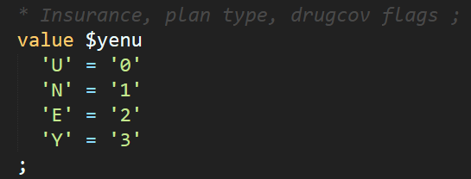
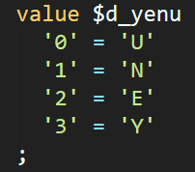
Qualitative MAXing
Use formats to translate alphas into numerics, and then back again.
For example:
Notes:
The basic format turns the values into numbers.
Higher values are favored over lower ones. So here—Ys plus any other value will come out to Ys.
The un-do format goes backwards.
The statement at bottom is how these formats + SQLs max() function combine to resolve any discrepancies that come up.

Slide 9
Steps to Add a Variable
Create formats if necessary:
Value -> number
Number -> value
Add the put(max(put())) statement to the ‘penultimate’ SELECT (~line 158-190).
Add the variable to the by-list in the &outset data step.
Any place but last!
Notes:
Let’s try it for our cascade_side variable!

Slide 10
Questions?
Thank You!

