Slide 1
Mining Millions of Reviews: A Technique to Rank Products Based on Importance of Reviews
Kunpeng Zhang, Yu Cheng, Wei-keng Liao, Alok Choudhary
Dept. of Electrical Engineering and Computer Science
Center for Ultra-Scale Computing and Security
Northwestern University
kzh980@eecs.northwestern.edu
yucheng2015@u.northwestern.edu
wkliao@eecs.northwestern.edu
choudhar@eecs.northwestern.edu
The 13th International Conference on Electronic Commerce
Liverpool, UK, August 2011
Notes:
1

Slide 2




Customer Reviews
More consumers are shopping online than ever before
Online retailers allow consumers to add reviews of products purchased
Customer reviews are more unbiased, honest than product descriptions provided by sellers
Notes:
2

Slide 3
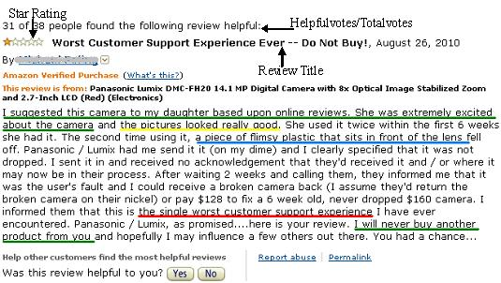

Slide 4
System Architecture
Our ranking system assumes that the ranking score is determined by the review contents, relevance of a review to the product quality, helpful votes and total votes from posterior customers, and posting date and durability of reviews
Preprocessing (Sentence
Splitting)
-------------------
Sentence Filter
-------------------
Sentiment Identification
-------------------
Score Calculation
P1, s1
P2, s2
…
Pm, sm
P1, P2, …, Pm
R1, R2, …, Rn
Notes:
4

Slide 5

Filtering Mechanism
A relevant sentence is either a overall or feature-based comment on a product.
Support Vector Machine[Vapnik,1995]
Brand-level: Nikon, Canon,…
Product-level: product features, product names, keywords(shipping, customer service)
Source-level: Amazon.com, retailer, seller…
Notes:
5

Slide 6
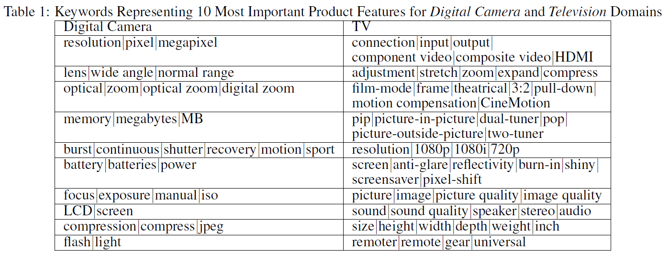
Feature Keywords
Example: features from consumer reports
Notes:
6

Slide 7
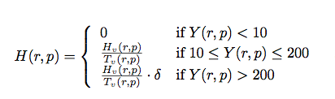
Review Weight Factors
1. Helpful/Total Votes Assign higher weights to the reviews with more votes.
Notes:
7

Slide 8
Review Weight Factors (Cont’d)
2. Age of Review and Durability Reviews posted more recently receive higher weights in assessing their importance.
Without adding weights to the newer reviews, they would contribute less to the ranking score, as they are “young” and likely receive less votes.
The number of reviews for a product released earlier is likely higher than the product released recently. In order to balance the contributions to the ranking scores among the similar products and minimize the effects from large volumes gaps, we reduce the importance of older reviews and increase the weight for newer reviews.
Notes:
8

Slide 9
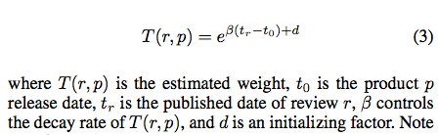
Review Weight Factors (Cont’d)
Notes:
9

Slide 10
Sentiment Identification
Use the keyword strategy
{MPQA[1] + our own words → 1974 positive words + 4605 negative words + 42 negation words}
Accuracy: ~80%
Positive Sentence(PS)
This camera has great picture quality and conveniently priced.
Negative Sentence(NS)
The picture quality of this camera is really bad.
I don’t like it.
[1].http://www.cs.pitt.edu/mpqa
Notes:
10

Slide 11
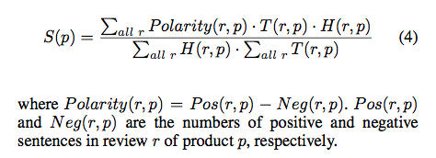
Scoring Strategy
Overall Score Function:
Notes:
11

Slide 12
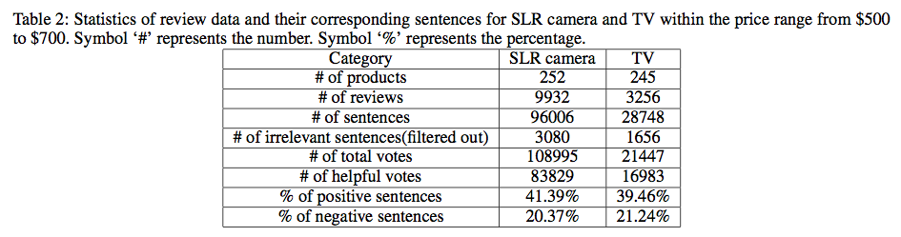
Experiments
Data
Digital camera and TV ($500-$700)

Slide 13
Experiments (Cont’d)
Star Rating is not reliable
Each reviewer has a different grading standard.
The average star rating score for a product with very few reviews is not statistically significant. For example, 94 out of 191 TVs in the price range of $800 to $1000 contain only 1 review.
As observed on Amazon.com, a large number of products share the same star rating scores, rendering such a rating system meaningless.

Slide 14

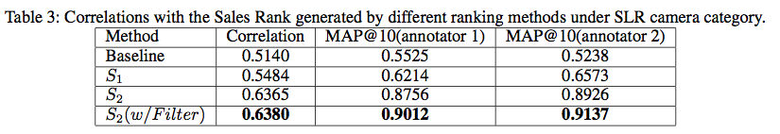
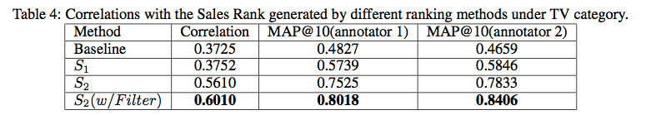
Experiment Results
Evaluation (Salesrank)
The Spearman correlation function
MAP(Mean Average Precision)

Slide 15
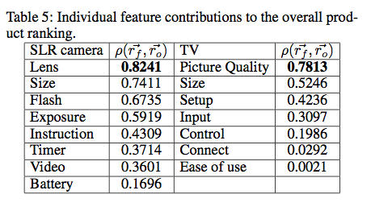
Experiment Results (Cont’d)
Effects of Individual Features

Slide 16
Related Work
Sentiment analysis [B. Liu, 2010; B. Pang, 2002]
Extracting product features [M. Hu, 2004; A. Popescu, 2005]
Review summarization [M. Hu, 2004, 2006]

Slide 17
Summary
Scalable technique to mine millions of online customer reviews to rank products
Preprocessing
(Sentence
Splitting)
-------------------
Sentence Filter
-------------------
Sentiment Identification
-------------------
Score Calculation
P1, s1
P2, s2
…
Pm, sm
P1, P2, …, Pm
R1, R2, …, Rn
Notes:
17

Slide 18
Thank You
Dept. of Electrical Engineering and Computer Science
Center for Ultra-Scale Computing and Security
Northwestern University
The 13th International Conference on Electronic Commerce
Liverpool, UK, August 2011
Notes:
18

