Slide 1



Empirical Analysis of Implicit Brand Networks on Social Media
Authors: Kunpeng Zhang, Sid Bhattacharya, SudhaRam
September 2, 2014

Slide 2

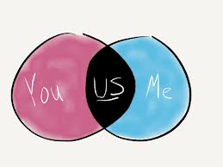




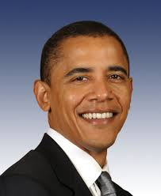

Introduction – three parties
User-generated content about social brands on social media platforms
Textual: comments, posts, tweets, etc.
Actions: becoming fan, following, like, share, etc.
Networks
Explicit: user friendship, user following, etc.
Implicit: brand-brand, and others.
Social media platforms
Social brands
Social users

Slide 3
Research questions
User generated social content and user interactions on social media are employed to construct implicit brand-brand networks;
Research Question I: What is the structure of a brand-brand network?
Research Question II: What is the relationship between an influential brand the number of fans for the brand?
Research Question III: What is the relationship between an influential brand and sentiment of social users/fans?

Slide 4
Related work
Consumer-brand interactions
K. de Valck, G. H. van Bruggen, and B. Wierenga. Virtual communities: A marketing perspective. Decis. Support Syst., 47(3):185–203, June 2009.
A. M. Turri, K. H. Smith, and E. Kemp. Developing Affective Brand Commitment Through Social Media. Journal of Electronic Commerce Research, 14(3):201–214, 2013.
Information diffusion over consumer networks
S. Hill, F. Provost, and C. Volinsky. Network-based marketing: Identifying likely adopters via consumer networks. Statistical Science, 22(2):256–275, 2006.
R. Iyengar, C. Van den Bulte, and T. W. Valente. Opinion leadership and social contagion in new product diffusion. Marketing Science, 30(2):195–212, Mar. 2011.
S. Nam, P. Manchanda, and P. K. Chintagunta. The effect of signal quality and contiguous word of mouth on customer acquisition for a video-on-demand service. Marketing Science, 29(4):690–700, 2010.
Network studies
M. J. Newman. A measure of betweenness centrality based on random walks. Social Networks, 27(1):39 – 54, 2005.

Slide 5


Why study implicit brand-brand networks?
Explicit networks ignore interactions among users and brands
Useful for Identifying influential brands
Facilitating targeted online advertising

Slide 6
Overall framework
1. Data collection
2. Data cleansing
4.1 Network measures
4.2 Influential brand identification
4.3 Textual sentiment identification
3. Brand-brand network extraction
Research question I
Research question II
Research question III

Slide 7
Data collection
Facebook data (Graph API)
For each brand, download posts, comments, likes, and public user profile information
Time frame: 01/01/2009 – 01/01/2013
Approximately 2 TB
Description and statistics of raw dataset
Number of downloaded brands | 13,806
Number of unique users | 286,862,823
Number of unique brand countries | 122
Number of unique brand categories defined by Facebook | 172

Slide 8
Data cleansing
Remove brands for which most posts and comments are non-English;
Simple spam user removal

Slide 9
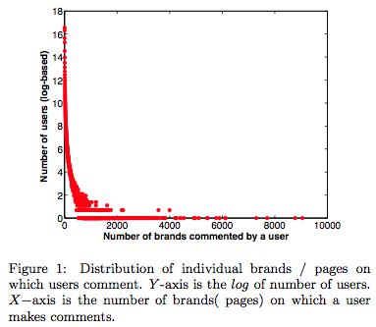
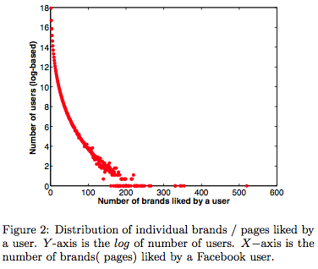
Spam user removal
Users connecting to an extremely large number of brands are likely to be spam users or bots.
Users tend to
Comment on 4,5 brands on average
Like 7,8 brands on average
Users making many duplicate comments containing URL links

Slide 10
Dataset after Cleansing
Description and statistics before and after data cleansing. Cleaned dataset containing top 2,000 brands.
After cleaning |  | After selecting top brands
Number of brands | 7,580 | 2,000
Number of unique users | 97,699,832 | 16,306,977
Number of comments | 2, 327, 635, 302 | 470, 742, 158
Number of positive comments | 651, 231, 870 | 179, 009, 470
Number of negative comments | 234, 571, 177 | 60, 613, 968
Number of brand categories | 150 | 118
Number of posts | 13, 206, 402 | 3, 793, 941

Slide 11
Brand-brand network
Weighted and undirected brand-brand network (B)
A node is a brand
A link between two brands is created if the same user commented on or liked posts made by both brands
Network generation using Hadoop (MapReduce algorithm)

Slide 12
Network normalization (B →B_{n})
A comparison across brands requires normalization of link weights.
Global maximum weight based technique will lose global network semantics such as the distribution of connection strength among links of a brand relative to the size of a brand: Connection (b₁,b₃) vs. connection (b₁,b₂), (100%) of b₃ users connected to b₁;only 10% of b₂ users interested in b₁.

Slide 13
Network normalization (B →B_{n})
Two step normalization strategy:
Step I: normalize each individual link between two brands b_{i}, b_{j} by setting
Step II: normalize all by setting , where f_{i} and f_{j} are number of fans for brand i and brand j, respectively.

Slide 14
Network measures
Property | Network B_{n}
Number of nodes | 2,000
Number of links | 965,605
Average weighted degree | 0.662
Network density | 0.483
Network diameter | 4
Average clustering coefficient | 0.785
Average weighted clustering coefficient | 0.882
Average path length | 1.503

Slide 15
Network Measures: Centrality
Degree centrality
measures the connectivity of a node
Closeness centrality
Measures how far a node is from the rest of nodes
Betweeness centrality
A node acts as a bridge connecting two communities
Eigenvector centrality
Measures the influence of a node

Slide 16
Influential brand identification
Eigenvector centrality

Slide 17
Influential brands
Top 10 influential brands
Rank | Brand name | Category
1 | Barack Obama | Politician
2 | CNN | Media news publishing
3 | Starbucks | Food beverages
4 | Coca-cola | Food beverages
5 | Victoria’s secret | Clothing
6 | True blood | TV show
7 | Dexter | TV show
8 | Tack bell | Food beverages
9 | Lady Gaga | Musician band
10 | Pepsi | Food beverages

Slide 18
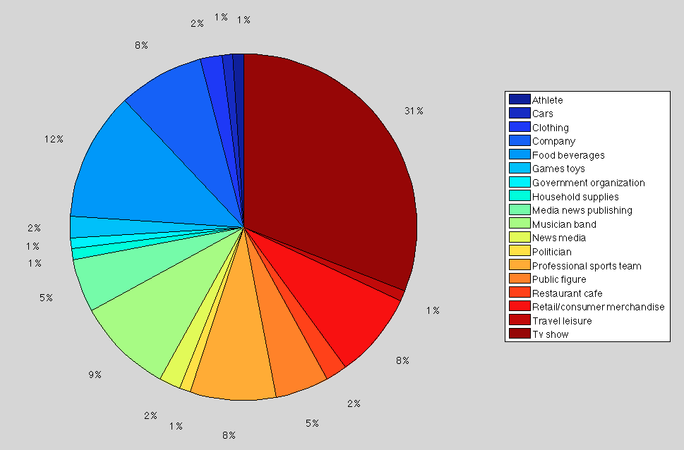
Influential brand identification
Category distribution of top 100 influential brands

Slide 19
Further Analysis: brand-brand network
Sentiment identification (random forest machine learning on features using 3 components)
Sentiment classified as: Positive, negative, neutral
Sentiment of a brand
Relationships using Spearman Rank Correlation:
Sentiment of a brand VS. eigenvector centrality of a brand
Size of a brand VS. eigenvector centrality of a brand

Slide 20
Results and Implications
Sentiment vs. eigenvector centrality | Size vs. eigenvector centrality
-0.282 | 0.676
Size of brand has high positive correlation (.676) with its influence: Big brand likely to influence other brands in the network.
The influence/importance of a brand within the network has a low but negative correlation (-0.282) with its sentiment.
Implication: negative comments on brands are likely to propagate much faster and get more attention than positive comments.

Slide 21
Conclusion and Future Work
Implicit Brand-Brand network using social interactions and its structure
Scalable (MapReduce) algorithms for large scale network construction and analysis
Understanding Relationship between size/influence, sentiment/influence
Targeted Online marketing/advertising
Spread of sentiment and brand communities
Evolution of network over time/location: Dynamic network analysis

Slide 22
Questions?
Thank you

