Slide 1

Project Simulation (SoftPAC)
Aakanksha Panwar
Harsh Jain
Himanshi Agho
Kumar Shivam
Nehal Ahuja
Rajat Pancholi
Rajesh Bhardwaj
By
Group 1
TSL694 Batch

Slide 2
Project Description
SoftPAC – User friendly Banking Software
Banking functions specially designed for farmers.
Transactions according to RBI guidelines
Farmers pay no interest
User can change generic data.

Slide 3
Project Objectives
To construct test scenarios followed by test cases.
To construct a hybrid automation framework for SoftPac.
To make the framework as flexible as possible.
To integrate the test cases with the framework.

Slide 4
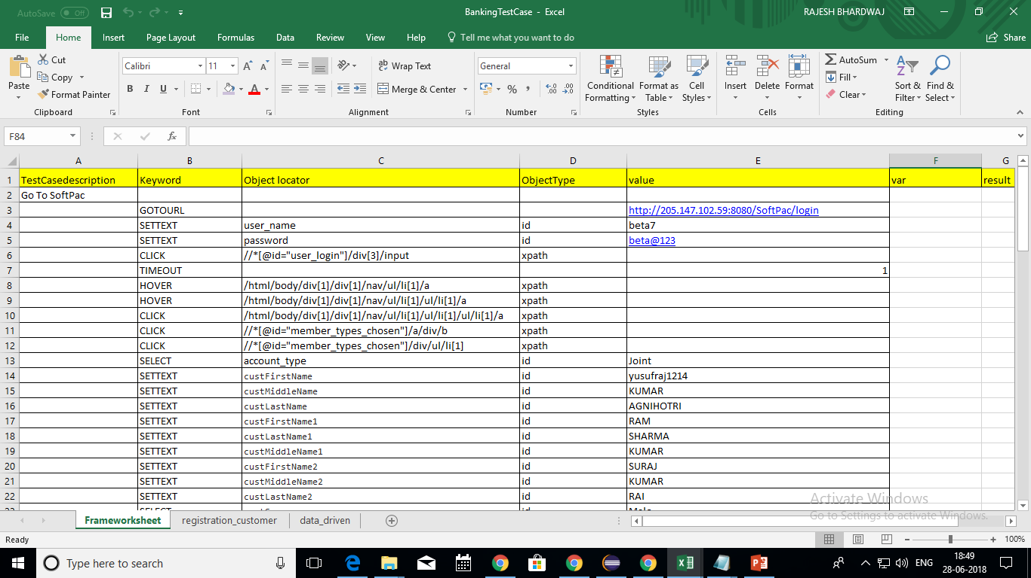
Using Keyword Driven Framework

Slide 5
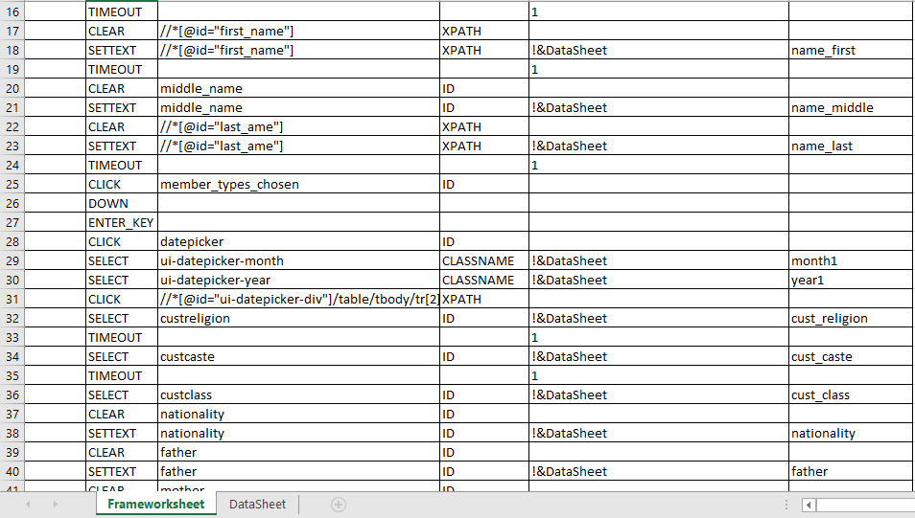
Using Hybrid Framework

Slide 6
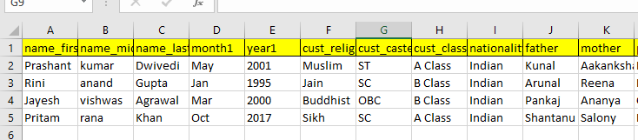
Data Sheet

Slide 7
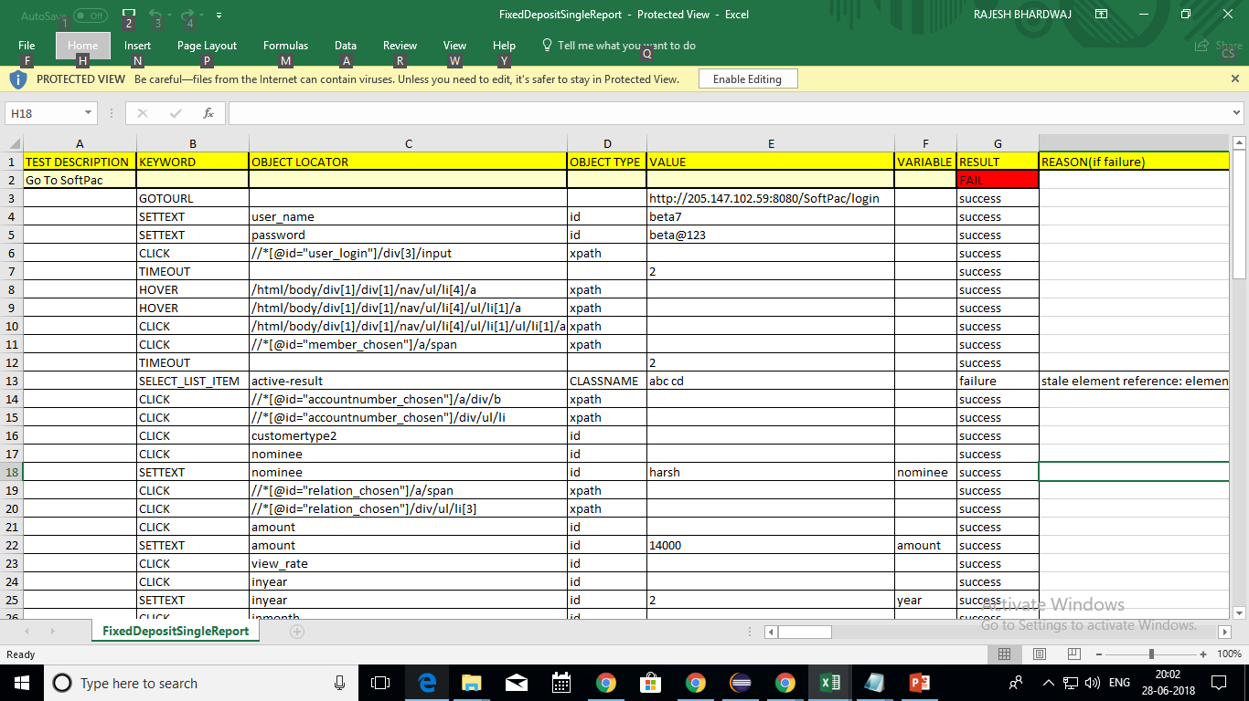
Test Results

Slide 8
EXECUTION

Slide 9
Defects
1. Fixed deposit
view age proof (of senior citizen)
2. Close fixed deposit -> confirm-> reloads
On selecting a value from dropdown

Slide 10
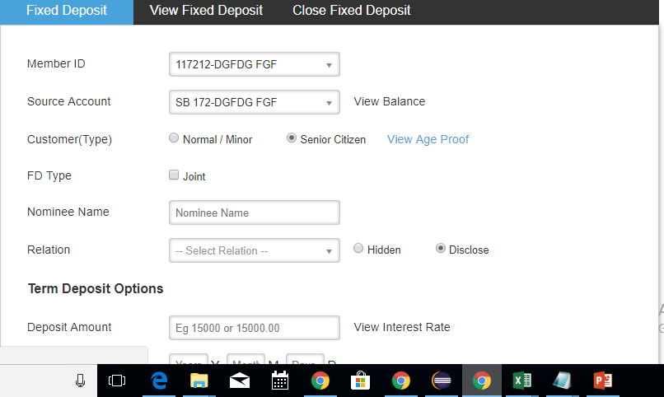
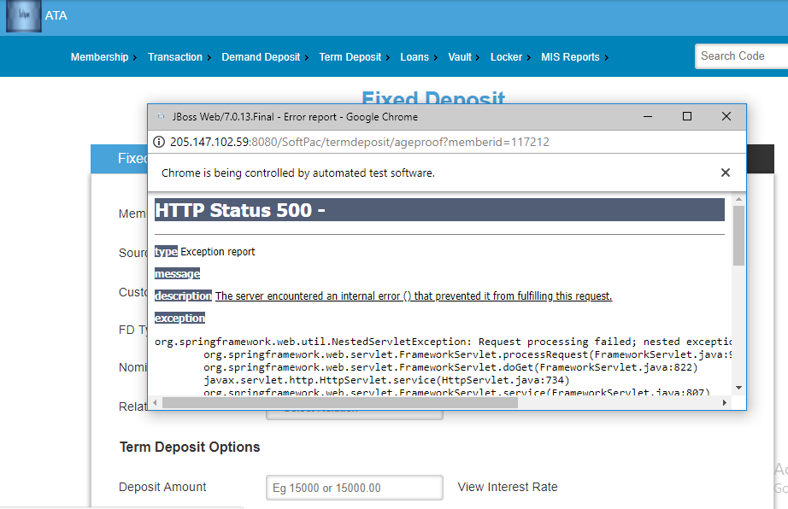
fixed deposit
view age proof (of senior citizen)

Slide 11
Challenges
1. Null pointer exception
Debugger helps a lot
Formatting the excel file
Rows/cells deletions
File requested by output stream should not be running anywhere else.
2. ChromeDriver exception
Having an internet connection with decent speed
Older versions of ChromeDriver does not support some methods of selenium.

Slide 12
Thank You

