Slide 1
Sandip Kumar
R&D Software Engineer 2

Slide 2
About me
Software Developer with 6+ Years of Experience
Passionate about creating innovative products that simplify everyday life.
Background: Born and raised in Buxar, Bihar.
Education: Bachelor’s degree in Computer Science from Birla Institute of Technology, Mesra.
Professional Journey:
  Began IT career as a Software Engineer at Onmobile Global.
  Currently serving as a Member of Technical Staff 2 at VMware, contributing to the CloudHealth team.
Hobbies: Enjoys playing indoor and outdoor games.

Slide 3
Problem statement
Design and implement a competitor to Stack Overflow Website.
Home Page: Display top questions for easy access.
User Profiles: Users can create and manage their profiles.
Post Questions: Users can post questions and add relevant tags.
Answer Questions:
Users can post answers to questions.
Responses can include rich media content (photos/videos).
Commenting: Users can respond to existing answers.
Voting System: Users can vote on questions and answers to indicate usefulness.
Tag Search and Browsing: Search and browse questions using tags.
Text Search: Search for questions and answers based on text input.

Slide 4
Assumptions
Multiple Answers per Question: A question can have several answers.
Comments on Answers: Each answer can have multiple comments.
Authentication Access: Authentication is required for users to access the APIs.
Top Questions Filtering: Questions can be filtered based on votes.
Single Persona: The system is designed with one user persona in mind.
Voting System:
Votes can either be UPVOTE or DOWNVOTE.
In-Memory Caching: Utilized to optimize performance and data retrieval.

Slide 5
Tech Stacks
1. Java
2. Spring Boot / Spring Security
3. MySQL
4. Elasticsearch
5. S3 Storage
6. Kafka

Slide 6
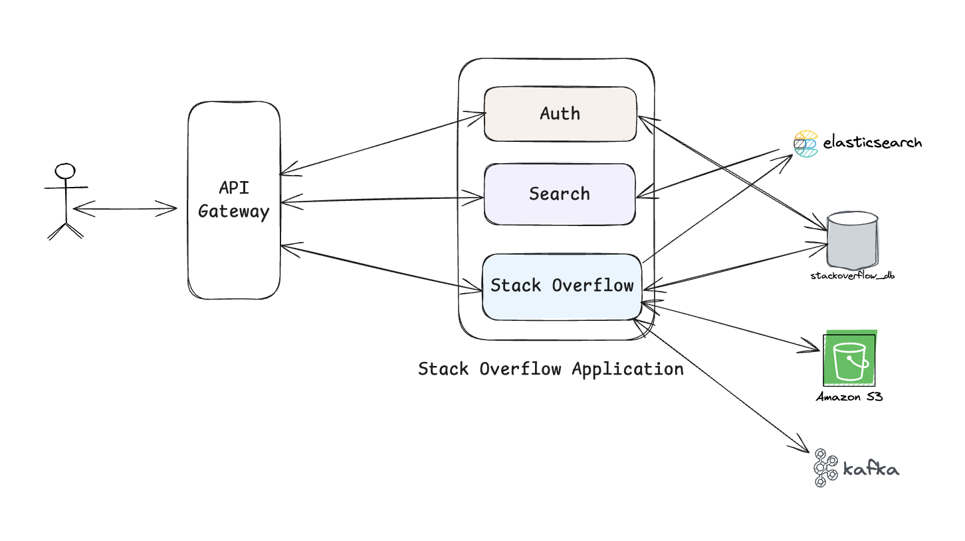
HLD

Slide 7
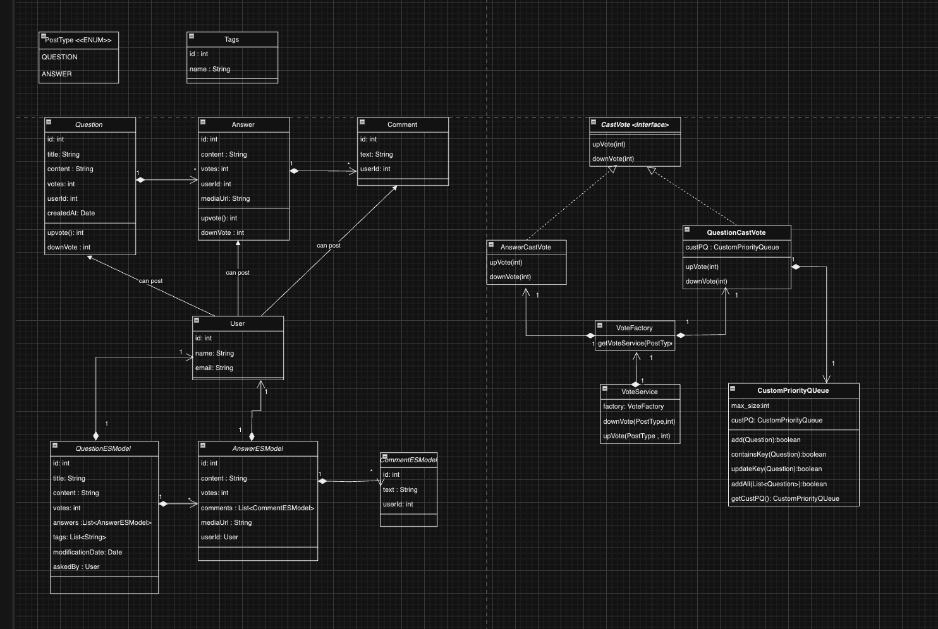
Class Diagram

Slide 8
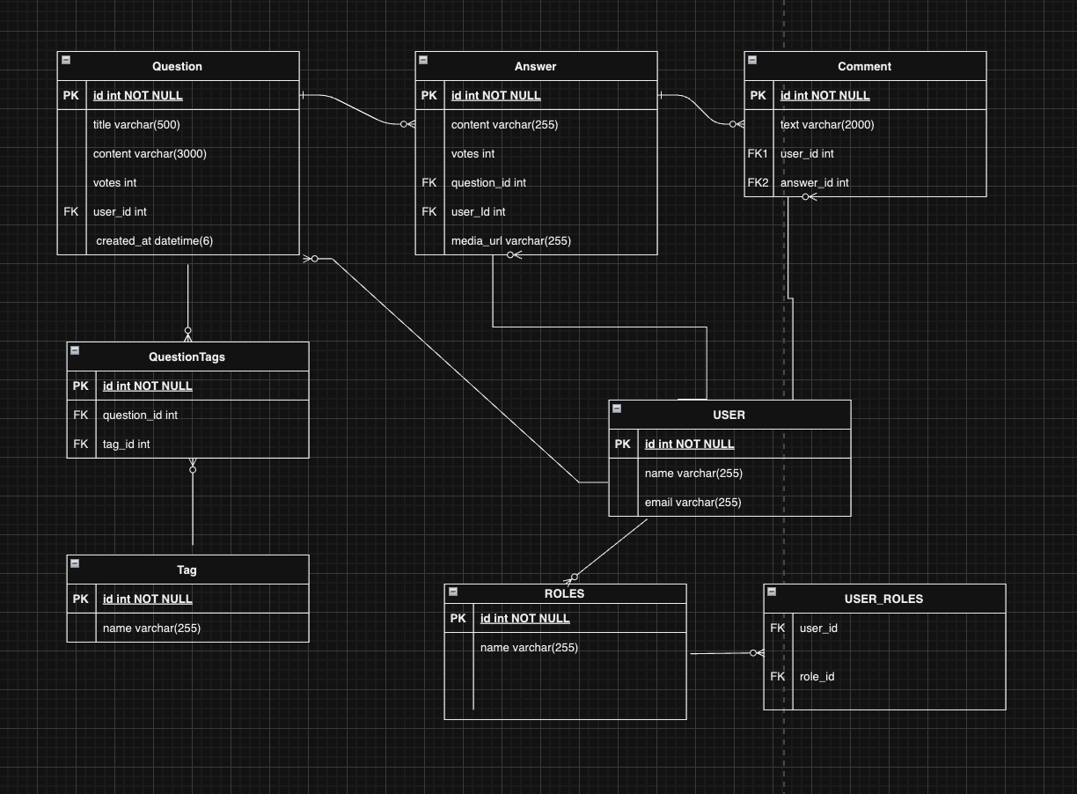
ER Diagram

Slide 9
Future Scope
Notification System: Notify users about activity on their questions, answers, or comments.
Redis Cache: Replace in-memory caching with Redis for enhanced scalability and performance.
Advanced Filtering: Implement various filters for fetching top questions.
Recommendation System: Display personalized top questions based on user preferences and behavior.
Payment Service Integration: Enable a payment service for managing bounties on questions.
Analytics Dashboard: Provide admins with detailed insights into user activity, trending tags, and popular content.
AI-Powered Question Suggestions: Use AI to suggest similar questions while users are typing to reduce duplicates.

Slide 10
Thank You

